Slide 1
GPU kernel verification
why correctness and timing are harder than they look
Building and validating a Triton kernel evaluation harness: AutoKernel bench.py and a KernelBench bridge, on Modal L4 / H100
Use case: a Qwen2.5-Coder-7B-Instruct GRPO kernel agent whose reward is the harness
Artifacts: results/ (every rollout, numbers.json, v3/), code in modal_app/ · torch 2.6.0, Triton 3.2.0, AutoKernel 78435821cc3d
Modal re-run, Sept 2026 · 1
Notes:
This talk is about kernel verification. I built and debugged an evaluation harness for Triton kernels: the thing that decides whether a generated kernel is correct and how fast it is. The use case that forced me to take it seriously was an RL study, Qwen/Qwen2.5-Coder-7B-Instruct trained with GRPO, where the harness is the reward. Everything is re-run on Modal with torch 2.6.0 and Triton 3.2.0; every number on the slides is read from results/ at build time.

Slide 2
The verifier paid 2.9× for 0% speed and broken numerics
two dtype casts flipped FAIL → PASS; the speed was the starter's fusion, and rows with RMS > 4.0 now come back as zeros
rmsnorm: every code line that changed vs the starter
What actually happened
- x = tl.load(…).to(tl.float32)
+ x = tl.load(…).to(tl.float16)
- w = tl.load(…).to(tl.float32)
+ w = tl.load(…).to(tl.float16)
Speed was already there: the 2.9× over eager PyTorch is the starter's; the casts moved latency −0.4%.
Numerics broke: Σx² now runs in fp16 and overflows; at N=4096, RMS ≈ 4 zeroes 133/256 rows (fp32 starter: 0).
Why the verifier paid: its reference squares in float16 and overflows identically, so the correct fp32 starter FAILs; and speed is scored vs PyTorch, not vs the starter.
 | starter | model's kernel
full bench (L4) | FAIL: 4/5 stages | PASS: 5/5 stages
failing stage | numerical stability | –
logged speedup | 2.904× (quick mode) | 2.926× (full) = reward
remeasured, cold L2 | 287.7 µs | 286.7 µs
eager PyTorch | 833.5 µs
zero rows, RMS ≈ 4 | 0/256 | 133/256
This talk: the harness that surfaced this, what else it got wrong, and how I would verify and time kernels so a PASS and a speedup mean something.
Modal re-run, Sept 2026 · 2
grpo_v2 step 9, code c45bd6a226e2 · stage1_baselines.jsonl · results/v3/rmsnorm_remeasure.json
Notes:
Here is the hook. The fastest correct kernel in the project is an RMSNorm the verifier scored at 2.926x over PyTorch on L4. It differs from the starter in exactly two casts, float32 to float16 on the loads. The starter already ran at 2.904x in quick mode, but it fails the full bench on numerical stability; the model's version passes all five stages and so it gets the reward. Remeasured on L4 with a cold L2 and 200 repetitions, the starter takes 287.7 microseconds and the model's kernel 286.7, against 833.5 for eager PyTorch. The casts are worth +0.4%, which is noise. And at N=4096, inputs with row RMS around 4 make the model's kernel return zeros in 133 of 256 rows, where the starter returns none. So what changed is correctness, not speed, and in the wrong direction: the reference computes x squared in fp16 and overflows on the adversarial inputs, and the fp16 kernel overflows identically, so it matches. Two verifier lessons. A reference with the kernel's own precision bug can't tell a better kernel from a matching bug. And a reward measured against PyTorch, rather than against the starter or the previous turn, credits an edit with speed it didn't create.

Slide 3
The harness: model output → reward
every box below gave a wrong answer at least once
Parse
Correctness
Timing
Cache
Reward
code block → kernel.py
→
5 stages: smoke, shape sweep, stability, determinism, edge sizes
→
do_bench, float16 4096×4096, vs eager PyTorch
→
sha256(gpu, mode, kernel, code)
→
log2 speedup if PASS, else 0
failure found: worker passed --kernel-type and parsed results.tsv; bench.py takes --kernel and prints to stdout
failure found: --quick skips stability; both-NaN/Inf outputs accepted (bench.py:838)
failure found: one shape, one dtype, PyTorch-only baseline; H100 spec lookup reports 113% of peak BW
failure found: 201/271 best-PASS records in low-variance groups were cache replays
failure found: a slow PASS scored below a crash (14/22 passing episodes)
KernelBench bridge (second harness, held-out eval): starter keeps super(Model, self) → every starter crashes; weights never seeded → all 35 conv problems fail even for an identical model; CPU get_inputs() timed inside the 30 s trial → 9 flaky timeouts. Only 55/100 Level 1 problems are harness-valid.
Modal re-run, Sept 2026 · 3
modal_app/bench_modal.py · results/autokernel_src/bench.py · CLAUDE.md findings
Notes:
This is the request-to-result path. The model's code block becomes kernel.py; bench.py runs five correctness stages; if they pass it times the kernel against eager PyTorch with do_bench; the result is cached by a hash of GPU, mode, kernel type and code; and the reward is computed from it. Each box had a real defect. Parsing: the original worker used a flag bench.py doesn't have and read a file it never writes, so no reward could be parsed at all. Correctness: quick mode skips stability, and the stability check accepts any output with NaN or Inf if the reference has them too. Timing: one shape, one dtype, and PyTorch is the only baseline; on H100 the spec lookup gave 113% of peak bandwidth, which is impossible. Cache: in the low-variance groups, 201 of 271 best-PASS timings were replays. Reward: a correct but slightly slower kernel scored below a crash. The KernelBench bridge was worse: every starter crashed, 35 conv problems could never pass, and only 55 of 100 were usable.

Slide 4
RMSNorm, line by line
y = x / sqrt(mean(x²) + ε) · w, one program per row
model's kernel (verbatim; amber = where precision is decided)
Mapping
row = tl.program_id(0)
offs = tl.arange(0, BLOCK_SIZE)
mask = offs < N
x = tl.load(X_ptr + row*stride_xm + offs*stride_xn,
mask=mask, other=0.0).to(tl.float16)
sq_mean = tl.sum(x * x, axis=0) / N
rms = tl.sqrt(sq_mean + eps)
x_norm = x / rms
w = tl.load(W_ptr + offs, mask=mask, other=0.0).to(tl.float16)
out = x_norm * w
tl.store(OUT_ptr + row*stride_om + offs*stride_on, out, mask=mask)
# launch
BLOCK_SIZE = triton.next_power_of_2(N)
rmsnorm_kernel[(M,)](x, weight, out, M, N, …, BLOCK_SIZE=BLOCK_SIZE)
grid = (M,): one program owns a whole row; the reduction is one in-register tl.sum
BLOCK = next_pow2(N): N=4096 → 4096 lanes; N=768 → 1024, 25% masked off
tail: masked lanes load 0.0, so the sum is exact; it divides by N, not BLOCK
compiled (L4, N=4096): 4 warps, 54→48 regs, 0 spills, 8 vector loads either way
PTX: fp32 mul/fma 64→32, f16 ops 96→136: the math moved to fp16, the memory ops did not
Contract bench.py checks
dtypes float16, bfloat16 only; sizes 1024×768, 4096×1024, 4096×4096, 2048×4096 + 2 edge sizes
tolerance: fp16 atol = rtol = 0.01; bf16 atol 0.1, rtol 0.05
Modal re-run, Sept 2026 · 4
presentation/v2/best_kernel.py · bench.py rmsnorm config · remeasure compile_info
Notes:
The kernel is the textbook one-row-per-program RMSNorm. Each program loads a full row into registers, BLOCK_SIZE is the next power of two of N, masked lanes load zero so the sum of squares is exact, and it divides by N. At the timed size N is 4096, so each program holds 4096 elements; at the small size 768 rounds up to 1024 and 25% of lanes are wasted. From the compiled code: 4 warps, 48 registers and no spills, and the same 8 vectorised global loads as the starter. The fp32 multiply count halves and fp16 ops go up: the casts moved arithmetic into fp16 and left memory traffic alone. The amber lines are where precision is decided: the two load casts and the sum of x*x. In the starter both casts are to float32, so x*x, the reduction, the divide and the weight multiply run in fp32 and only the store narrows back. bench.py tests fp16 and bf16 only, with fp16 tolerance 0.01 and a much looser bf16 tolerance of 0.1 absolute.

Slide 5
What the two casts change numerically
fp32 accumulation vs fp16: the model's kernel forms x*x and sums it in fp16
step (fp16 input) | PyTorch reference | starter | model's kernel
load x, w | fp16 | fp32 | fp16
x · x | fp16 (x ** 2) | fp32 | fp16
Σ over N | mean: fp32 accum. | fp32 | fp16 (tl.sum: no widening)
÷ rms, · w | fp16 | fp32 | fp16
store | fp16 | fp32 → fp16 | fp16
bf16 input | bf16 | fp32 | bf16 → fp16: range narrows
Why the stability stage flips
mixed_scale: every float input × 1000 or × 0.001, small size, first dtype (float16)
reference: x**2 → inf → rms = inf → output 0 (finite, so "clean")
starter (fp32): correct values ≫ 0 → exceeds 10× tol → FAIL
model (fp16): overflows the same way → 0 = 0 → PASS
near_max (× 60000): both inf → accepted by the both-NaN/Inf rule
|x| > 255.9
RMS > 4.0
RMS > 9.2
Prediction to test: the remeasure replays stage 3 and checks every kernel against an fp64 truth: next slide.
x·x overflows fp16 (max 65504)
fp16 Σx² overflows at N=4096
…at N=768 (stability size)
randn rows have RMS ≈ 1, so the sweep passes; activations with outlier channels need not. Worst sweep error is 1.25e-01 for both kernels (bf16).
Modal re-run, Sept 2026 · 5
bench.py stage 3 · reference.rmsnorm_ref · Triton 3.2.0 tl.sum
Notes:
Here is the dtype flow for an fp16 input. The PyTorch reference materialises x ** 2 as an fp16 tensor; its mean accumulates in fp32, but by then the squares have already overflowed. The starter upcasts on load, so everything is fp32 until the store. The model's kernel stays in fp16 throughout, including x*x and the tl.sum, which in Triton 3.2.0 does not widen floating inputs. That matters at modest magnitudes: x*x overflows fp16 once |x| exceeds 255.9, and an fp16 sum of 4096 squares overflows once the row RMS exceeds about 4.0. Random-normal test rows have RMS near 1, so the shape sweep never sees it. On bf16 inputs the cast to fp16 narrows the range. The stability stage multiplies all inputs by 1000 or 0.001. The fp16 reference overflows to an infinite RMS and outputs zeros; the correct fp32 starter disagrees with those zeros and fails; the fp16 kernel overflows the same way and passes. That is a prediction from reading the code, and the next slide tests it.

Slide 6
Measured vs fp64 truth: the oracle is the bug
the stability stage rejects every correct kernel and accepts the overflowing one
Stage 3 replayed: mixed_scale, float16, 1024×768 (L4)
First input scale that fails vs fp64 truth
kernel | harness verdict | zero rows | max |err| vs fp64
starter (fp32) | FAIL | 0/1024 | 3.96
model's kernel (fp16) | PASS | 1024/1024 | 14767
hand-written fp32-acc | FAIL | 0/1024 | 3.96
torch.compile | FAIL | 0/1024 | 3.96
harness reference | – | 1024/1024 | 14767
N | predicted RMS* | model fp16 | model bf16 | eager fp16
768 | 9.2 | 10 | 10 | 100
4096 | 4.0 | 4 | 4 | 100
8192 | 2.8 | 4 | 4 | 100
16384 | 2.0 | 2 | 2 | 100
inputs = scale × randn, so row RMS ≈ scale. * fp16 Σx² overflow threshold sqrt(65504/N), computed here. The model's kernel breaks exactly where fp16 accumulation predicts; eager PyTorch holds until x² itself overflows.
the reference zeroes all 1024 rows; the model's kernel matches it exactly, so it PASSes with the reference's error
near_max: every kernel PASSes via "both NaN/Inf" (365,191 non-finite reference outputs, never compared)
an fp32-accumulating kernel and torch.compile both FAIL: correctness here means agreeing with an overflowing reference
outside the harness: at N=4096, scale 4, the model's kernel zeroes 133/256 rows; fp32 kernels and eager zero none
Fix the oracle, not the kernel: an fp64 / upcast truth reference and exact NaN/Inf masks would flip both verdicts.
Modal re-run, Sept 2026 · 6
results/v3/rmsnorm_remeasure.json: stability_replica, numerics_first_failing_scale_vs_truth
Notes:
The remeasure replays stage 3 exactly and also compares every output with an fp64 truth. On mixed_scale the harness reference zeroes all 1024 rows and is off from the truth by 14767. The starter, a hand-written fp32-accumulating kernel and torch.compile all agree with the truth to within 3.96, and all three FAIL. The model's fp16 kernel reproduces the reference's zeros and PASSes. On the right, the input scale at which each kernel first fails against the truth with the harness tolerance. The model's kernel fails at scale 4 for N=4096, right where the fp16 accumulation threshold of 4.0 predicts; eager PyTorch holds out to 100, where x squared itself overflows. So the verifier is rewarding a kernel that is less accurate than PyTorch by more than an order of magnitude in input range. The fix belongs in the oracle.

Slide 7
Memory traffic: same bytes, same speed
RMSNorm is bandwidth-bound: read x, read w, write y
shape (fp16) | bytes (MB) | floor @ L4 peak | starter | model's kernel | eager PyTorch | model GB/s | % of peak
1024×768 | 3.1 | 10.5 µs | 16.4 µs | 16.4 µs | 37.9 µs | 192 | 64%
4096×1024 | 16.8 | 55.9 µs | 72.7 µs | 72.7 µs | 130.0 µs | 231 | 77%
2048×4096 | 33.6 | 111.9 µs | 143.4 µs | 142.3 µs | 250.9 µs | 236 | 79%
4096×4096 (timed) | 67.1 | 223.7 µs | 287.7 µs | 286.7 µs | 833.5 µs | 234 | 78%
16384×8192 | 536.9 | 1789.6 µs | 2306.0 µs | 2305.0 µs | 7864.8 µs | 233 | 78%
L4, cold L2, median of 200 reps. bytes = (2·M·N + N)·2 B (bench.py bytes_fn), floor at 300 GB/s: both computed here from the shape. For fp16 input the casts change no load or store width.
234 GB/s
254 GB/s
6 kernels
≤ 1.28×
model's kernel at 4096², cold L2: 78% of 300 (starter 233)
warm L2: x is 32 MiB, L2 is 48 MB, so warm beats "peak" on small shapes
eager PyTorch (pow, mean, add, sqrt, div, mul) moves 3.5× the bytes: ≈7·M·N vs 2·M·N
headroom to the 224 µs bandwidth floor; torch.compile is 285.7 µs
Where 2.9× comes from: fusion. Eager runs each op as a separate kernel and re-reads the row; one fused pass moves the minimum bytes. The starter already had it; the casts added nothing.
Modal re-run, Sept 2026 · 7
results/v3/rmsnorm_remeasure.json (gpus.L4.table, primary_rows, eager_cuda_kernels) · bench.py
Notes:
RMSNorm does about 1.5 flops per byte, so it is bandwidth-bound. Minimum traffic is read x, read w, write y: 67.1 MB at the timed shape, which at L4's 300 GB/s gives a floor of 224 microseconds. Cold-L2 medians: starter 287.7, model 286.7, eager 833.5 microseconds. The model's kernel runs at 234 GB/s, 78% of peak, so there is at most 1.28x left, and torch.compile lands at the same 285.7. Warm L2 matters: the timed x is 32 MiB against a 48 MB L2, so warm runs reach 254 GB/s, and on the small shapes warm numbers exceed DRAM peak. Eager PyTorch launches 6 kernels, pow, mean, add, sqrt, div, mul, which is the whole 2.9x. For fp16 inputs the casts change nothing that is loaded or stored, so the bytes and the speed are the same.

Slide 8
How the 2.9× was measured
and what it looks like measured properly
 | logged: starter 2.904× | logged: model 2.926× | remeasure (both)
bench mode | quick (stability skipped) | full (5 stages) | no gate; fp64 checked apart
observations | 3 runs: 2.885–2.917× | 1 (this code hash) | 200 reps per kernel/shape
cache | fresh | fresh | none
L2 | flushed (do_bench) | flushed (do_bench) | warm and cold, reported apart
baseline | eager PyTorch | eager PyTorch | eager, torch.compile, starter
model ÷ starter | – | – | 1.004× cold · 1.004× warm
What do_bench actually does
warmup=25, rep=100 are ms budgets, not counts (Triton 3.2.0)
returns the mean by default; bench.py's docstring says median
zeroes a 256 MB buffer before each call: cold L2 only
its ratio agrees with the cold median: model 2.951× vs starter 2.956×
quick and full time the same do_bench call on the same input; full only adds stages 3–5
the timer was fine; the attribution was not
Geomean over all 28 shape×dtype configs, model ÷ starter: 0.999× cold, 0.990× warm. On H100: 0.999× cold. Cold-L2 CV at 4096²: 0.8%.
All 13 RMSNorm PASS turns in the project: 2.858–2.926×; the base model already had 2.900× before any training. Re-running bench.py full: model PASS at 2.967x, starter FAIL but prints 2.933x.
Modal re-run, Sept 2026 · 8
bench.py _do_bench · Triton testing.do_bench (source-read) · rmsnorm_remeasure.json headline, harness_runs
Notes:
The two logged numbers were measured differently. The starter's 2.904x is quick mode over three runs, because in full mode it fails and gets no reward. The model's 2.926x is one full-mode observation of that exact code hash. The remeasure times both 200 times per shape, warm and cold, with eager and torch.compile baselines and no correctness gate. Model over starter is 1.004 cold and 1.004 warm at the timed shape, and the geomean over all shapes is 0.999. On H100 it is 0.999. The casts bought nothing. Every RMSNorm pass in the project sits between 2.858 and 2.926x, and the base model had 2.900x before training. On the timer: in Triton 3.2.0 do_bench's arguments are millisecond budgets, it returns the mean, and it flushes L2 by zeroing a 256 MB buffer each call. Its ratio agrees with the careful cold-L2 median, so the timer was fine. The problem was attribution: comparing only against PyTorch.

Slide 9
Harness findings I: AutoKernel bench.py
correctness and timing defects, each found by re-running end to end
--kernel-type / results.tsv
FIXED
worker passed a flag bench.py lacks (it is --kernel) and parsed a file it never writes; metrics are on stdout (bench_modal.parse_stdout)
--quick
AVOIDED
skips stability, determinism, edges: 5/9 starters pass quick vs 3/9 full on H100; flash_attention and rmsnorm pass quick, fail full
both NaN/Inf → PASS
REMAINS
stability accepts NaN/Inf output whenever the reference has any; masks never compared (bench.py:838)
low-precision reference
REMAINS
reference computes in the input dtype (x ** 2 in fp16); correct fp32 kernels FAIL, the overflowing one PASSes
narrow stability coverage
REMAINS
one size (small), one dtype (float16), tolerance × 10
GPU spec lookup
IDENTIFIED
"NVIDIA H100 80GB HBM3" misses "H100 SXM", falls back to 2039 GB/s: rmsnorm reports 113% of peak; vs 3352 GB/s it is 68%
Modal re-run, Sept 2026 · 9
results/autokernel_src/bench.py · stage1_baselines.jsonl · CLAUDE.md
Notes:
These are the AutoKernel-side findings. The first two would have made the whole RL study meaningless: with the original worker no reward parsed at all, and a quick-mode reward would have paid kernels that fail numerical stability, since flash_attention and rmsnorm pass quick but fail full. Three remain in the harness as shipped: the both-NaN rule, the low-precision reference, and stability coverage of one size and one dtype with tolerances relaxed 10 times. Together they are exactly what let the fp16 RMSNorm pass. The last one is a reporting bug: Modal's H100 reports as "NVIDIA H100 80GB HBM3", the substring lookup misses "H100 SXM" and falls back to 2039 GB/s, so rmsnorm shows 113% of peak. Against 3352 GB/s it is about 68%. It doesn't affect speedup, but any roofline claim from those logs is wrong.

Slide 10
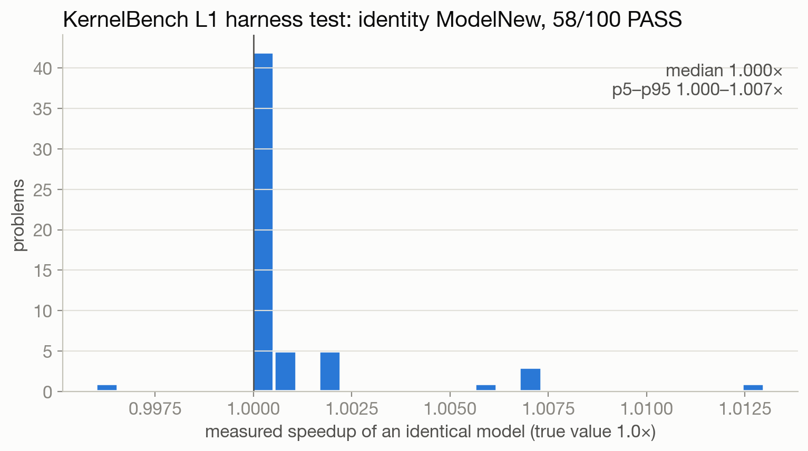
Harness findings II: the KernelBench bridge
an identity model must PASS at 1.0×; most problems could not
55/100
1.000×
Level 1 problems harness-valid
identity median (p5–p95 1.000–1.007)
super(Model, self): starter renamed to ModelNew keeps it → every starter crashes; identity test uses class ModelNew(Model): pass
unseeded init: reference and candidate get different weights → all 35 conv problems fail for an identical model
CPU get_inputs() in the 30 s trial: 9 huge-input problems time out intermittently, even at cpu=8, 32 GB
listing N.py and N.json: read 1–50 twice; kept as a repeat test: 41/50 same verdict
Timing is trustworthy where the harness is valid (identity within 1%: 57/100); coverage is not. A KB bench costs 20.9 s p50 vs 6.0 s for AutoKernel on L4.
Modal re-run, Sept 2026 · 10
KernelBench, arXiv 2502.10517 · results/kb_valid_problems.json
Notes:
The KernelBench bridge was my first harness, and the identity test is the cheapest verifier test there is: submit the reference model itself, which must pass at 1.0x. The median identity speedup is 1.000x with p5 to p95 of 1.000 to 1.007, so the timer is fine. Coverage is not: the bridge's starter crashes on super(Model, self), weights are never seeded so all 35 conv problems fail even for an identical model, and CPU input generation is timed inside the 30 second trial so 9 problems time out intermittently. Only 55 of 100 Level 1 problems are usable, and that list is what the held-out eval uses. This is a limitation of the local bridge, not a claim that KernelBench itself is broken.

Slide 11
Timing: what is noise, what is cache
a reward difference inside a group is not automatically timing noise
≤ 1.89%
42/162
27/42
201/271
speedup CV, quick mode, 72 stage1 runs (3 repeats)
GRPO v1 groups with 0 < σ(reward) < 0.02
of those mix PASS and FAIL (not noise)
best-PASS timings replayed from cache
What the low-variance groups really contain
Noise floor, derived: max CV 1.89% ≈ log2(1 + 0.0189) = 0.027 reward units, so the v2 cutoff σ ≤ 0.02 sits just below it. The remeasure's cold-L2 CV at 4096² is 0.8% over 200 reps.
Consequence: std-normalised advantages amplify whatever differs inside a group: ordering bugs and cache/fresh mixes as well as timing. Remeasure fixed code uncached before calling anything noise.
27 mix PASS and FAIL: the floor bug put slow PASSes (log2 s < 0) next to failures at 0
15 are all-PASS; 40/42 contain several distinct best-PASS code hashes, so "same kernel, re-timed" is rarely true
a cached result replays one earlier timing: identical code gets identical reward, new code gets a fresh sample
cache hit rate averaged 43.6% (v1) and 45.8% (v2) of benchmarks
Modal re-run, Sept 2026 · 11
results/v3/v3_numbers.json (lowvar audit of grpo_v1 rollouts) · bench_modal.cache_key
Notes:
Timing noise is the obvious suspect when rewards in a group differ by a hair. The stage1 repeats put quick-mode CV at 1.89% at worst. In GRPO v1, 42 of 162 groups had a reward standard deviation between 0 and 0.02. I audited them from the rollouts: 27 mix PASS and FAIL, which is the floor bug, not noise. Only 15 are all-PASS, and 40 of 42 contain several different best-PASS kernels. And 201 of 271 of those best-PASS timings came from the cache, which replays one earlier measurement per code hash. Inside a group you are often comparing a replayed timing of one kernel with a fresh timing of another. The 0.02 cutoff is just under the quick-mode CV in log units; the careful remeasure shows cold-L2 CV of 0.8%. The fix is to remeasure fixed code uncached, repeatedly, before attributing anything to noise.

Slide 12
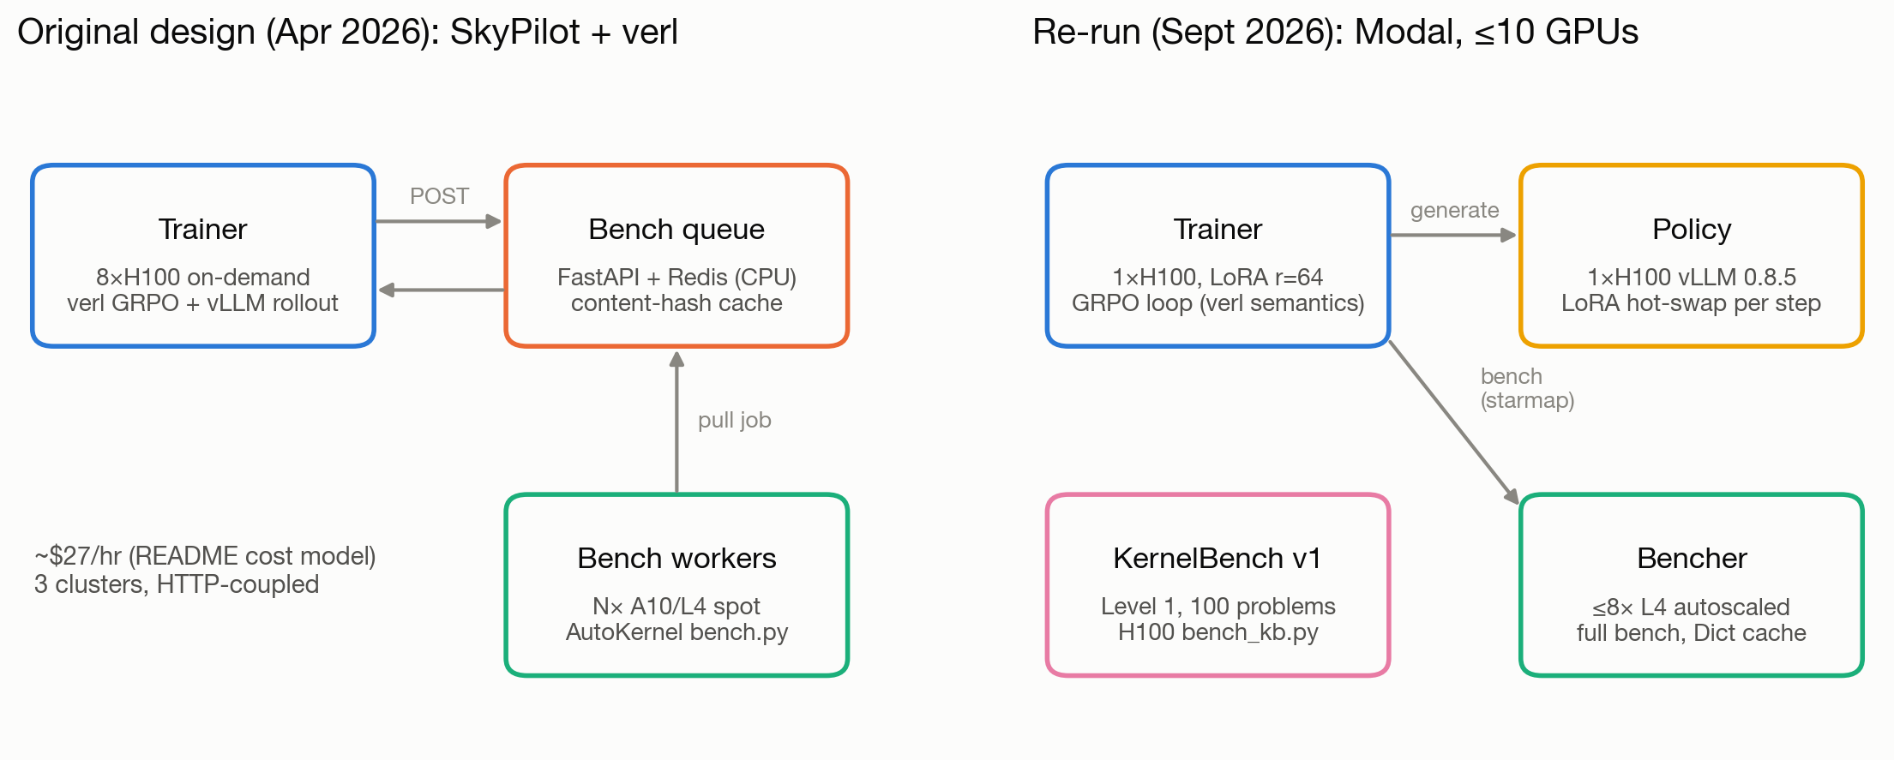
The use case: an RL kernel agent
the harness is the reward, so its defects become the gradient
policy | Qwen2.5-Coder-7B-Instruct + LoRA r=64
tasks | 9 AutoKernel kernel types
episode | ≤ 4 turns: write kernel, get bench feedback
group | 8 episodes/task, 72/step
benchmarks | ≤ 288 per step, ≤ 8 L4 containers
runs | v1 18 steps, v2 10 steps; one each
60.5%
of a v1 step's wall time is benchmarking (generation 32.8%)
The verifier is both the bottleneck and the signal: every defect on the last slides was paid for in wall time and in reward.
Modal re-run, Sept 2026 · 12
modal_app/train_grpo.py, policy.py, bench_modal.py
Notes:
Now the use case. A Qwen/Qwen2.5-Coder-7B-Instruct policy with a rank-64 LoRA writes a Triton kernel for one of 9 AutoKernel tasks, gets bench.py's feedback, and tries again for up to 4 turns. GRPO uses groups of 8, so a step is 72 episodes and up to 288 benchmarks. Benchmarking was 60.5% of a step's wall time and generation 32.8%. So the harness is both the throughput bottleneck and the only source of learning signal.

Slide 13
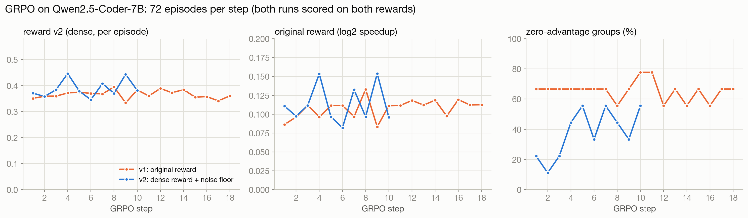
Verification quality set training-signal quality
65% of GRPO groups had zero advantage under the naive reward
65% → 38%
−0.020
zero-advantage groups, v1 → v2 reward
v1 reward for a correct reduce at 0.986× (crash = 0)
78.9%
0/28 → 0/28
v1 (log2 speedup, 0 on fail): all-fail groups tie; slow PASS < crash (14/22 passing episodes scored < 0)
v2 (PASS floor 0.5 + partial credit from bench stages + σ ≤ 0.02 cutoff) adds signal, bundled: effects not isolated
outcome: both runs pass the same 4 kernel types; pass rate 29.2% → 25.0% (v1), 31.5% → 31.9% (v2); one run each
of v1 |A| from σ < 0.02 groups; 27/42 mix PASS/FAIL
KernelBench L1 transfer, base → GRPO v2
The reward could only be as good as the PASS it was gated on, and the speedup it was measured against.
Modal re-run, Sept 2026 · 13
numbers.json grpo · extra_numbers.json dr_grpo_whatif · details in appendix
Notes:
This is the whole RL result on one slide. Under the naive reward, log2 speedup if PASS and zero otherwise, 65.4% of groups had all-equal rewards and so zero advantage: eight failures tie, and a correct reduce at 0.986x scores −0.020, below a crash. Reward v2 floors any PASS at 0.5, gives partial credit from bench.py's own stages and ignores groups with sigma at most 0.02; zero-advantage groups fell to 37.8%. Those changes were bundled, so I can't attribute the drop to one of them. 78.9% of v1's absolute advantage came from low-variance groups, and 27 of 42 of those mix PASS and FAIL, so it is not simply timing noise. Neither run solved a new kernel type, pass rates were flat within noise, and KernelBench transfer was 0 of 28 before and after. The verifier's quality bounded the training signal's quality, which is why my roadmap is about the verifier.

Slide 14
Roadmap: verification before scale
1 Hidden-test verification
2 Deterministic timing
3 Uncached, attributed timing
fp32 / fp64 golden reference; accept if error ≤ k × PyTorch-same-dtype error
compare NaN/Inf masks exactly; drop the both-NaN pass
adversarial magnitude sweep (scale × randn up to the overflow thresholds), every dtype, hidden shapes and strides
mutation tests (no eps, wrong axis, tail mask, fp16 sum) to measure false-accept rate
explicit L2 policy: report warm and cold
fixed clocks, interleaved candidate / baseline, randomized order
n repeats → median + CI, absolute µs and GB/s vs roofline
per-shape table, not one ratio; correct GPU spec lookup
baselines: starter / previous turn and torch.compile, not only eager; reward the Δ an edit made
cache verdicts, never final timings; re-time winners fresh; calibrate noise before any σ cutoff
RMSNorm remeasure done (slides 6–8): the casts were worth +0.4%
Decision rule: scale training only after independent evaluation shows a reproducible gain. Then, on a validated verifier: frozen checkpoints vs a best-of-N search control, and PASS floor, partial credit and normalisation ablated one at a time.
Modal re-run, Sept 2026 · 14
Planned, not measured · Measuring the Checker 2609.22220 · KernelBench-Verified 2607.16241
Notes:
Three things before any more RL. First, hidden-test verification: a truth reference in fp64 or upcast fp32, where a candidate passes if its error is within a small multiple of what PyTorch itself achieves in the same dtype; exact NaN and Inf mask comparison; every dtype, outlier-heavy inputs and hidden shapes; and mutation tests to measure how often the checker accepts a wrong kernel. Second, deterministic timing: an explicit L2 policy with warm and cold reported, fixed clocks, candidate and baseline interleaved in random order, repeated with confidence intervals, in absolute microseconds and GB/s against the roofline, per shape. Third, uncached and attributed timing: time every candidate against the starter or the previous turn and against torch.compile, not only eager PyTorch, so the reward pays for the delta an edit made; the RMSNorm casts got a 2.9x reward for +0.4% speed. The cache may store correctness verdicts but never the timing that becomes a reward or a headline; re-time selected winners fresh, and calibrate full-mode noise before choosing any sigma cutoff. The decision rule: scale training only after independent evaluation shows a reproducible gain. Then the RL questions become answerable: frozen checkpoints against a best-of-N control, and the reward changes ablated one at a time.

Slide 15
Takeaways
2 casts
FAIL → PASS and a 2.9× reward for +0.4% speed: the reference shared the kernel's overflow, and speed was measured against PyTorch, not the starter.
55/100
An identity model is the cheapest harness test; about half of KernelBench L1 failed it locally. Test the verifier before trusting it.
201/271
best-PASS timings were cache replays. Timing claims need uncached, repeated, per-shape measurement with an explicit L2 policy.
65%
zero-advantage groups under the naive reward: verification quality bounded training-signal quality.
All artifacts open: results/ (rollouts, numbers.json, v3/), modal_app/, presentation/v3/.
Modal re-run, Sept 2026 · 15
Notes:
Four takeaways. Two casts flipped a kernel from FAIL to PASS and earned a 2.926x reward, while contributing +0.4% of speed: the reference shared the kernel's overflow, and speed was measured against PyTorch rather than the starter. The verifier needs an independent truth and an attributed baseline. An identity model is the cheapest verifier test, and only 55 of 100 KernelBench problems passed it in the local bridge. 201 of 271 best-PASS timings in the suspicious groups were cache replays; timing claims need fresh, repeated, per-shape measurement with a stated L2 policy. And under the naive reward 65% of GRPO groups carried no gradient: in RL for kernels, the verifier sets the ceiling on the signal.

Slide 16
Appendix: reward v1 vs v2
r_v1: clip(log2 s, −1, 3) if any turn PASSes, else 0
floor bug: reduce PASS at 0.986× → log2 = −0.020, below a failure at 0; 14/22 passing episodes negative
r_v2: PASS: 0.5 + clip(log2 s, 0, 3); else 0.3 · max-turn progress
progress: 0 if smoke fails, else 0.25 + 0.5 · sweep fraction + 0.25 · [stability]
limits: all PASSes ≤ 1× tie at 0.5; weights heuristic; determinism and edges get no credit; cutoff σ ≤ 0.02 added at the same time
episode | r_v1 | r_v2
crash / no code block | 0.00 | 0.00
layernorm: smoke ok, sweep 18/24, stab ok | 0.00 | 0.263
reduce PASS at 0.986× | −0.020 | 0.50
cross_entropy PASS at 2.035× | 1.025 | 1.525
Appendix · Modal re-run, Sept 2026 · 16
src/autokernel-rlvr/agent_loop/reward.py · modal_app/reward_v2.py
Notes:
Reward details for questions. v1 is clipped log2 speedup if any turn passes, else 0, which puts a correct reduce at 0.986x below a crash. v2 floors a pass at 0.5 and gives up to 0.3 partial credit from smoke, sweep and stability. Its limits: every pass at or below 1x ties at 0.5, the weights are heuristic, and the 0.02 cutoff was introduced at the same time.

Slide 17
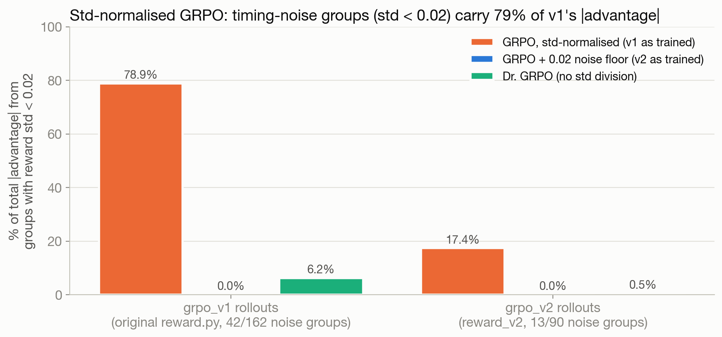
Appendix: ties and advantage mass
tied groups (offline) | G=2 | G=4 | G=8
feedback v2 | 69.3% | 60.4% | 55.6%
feedback v1 | 86.5% | 77.9% | 66.7%
v1 |A| from σ < 0.02 groups: 78.9% std-normalised vs 6.2% no-std replay (offline; |A| mass ≠ gradient mass)
DAPO-style filter drops 65.4% of v1 groups: 24.9/72 episodes left per step
group explorer (layernorm, v1 step 10): all 8 v1 rewards 0; v2 replay separates 3.4/9 groups per step
P(tie) ≥ (1 − p)^G for v1 all-fail groups; bigger G helps slowly
Appendix · Modal re-run, Sept 2026 · 17
Dr. GRPO 2503.20783 · DAPO 2503.14476 · extra_numbers.json
Notes:
Detail behind the RL slide: offline regrouping of base-model samples shows ties fall slowly with group size, and the no-std replay shows how much of the absolute advantage mass sat in low-variance groups. All offline replays, no training runs.

Slide 18
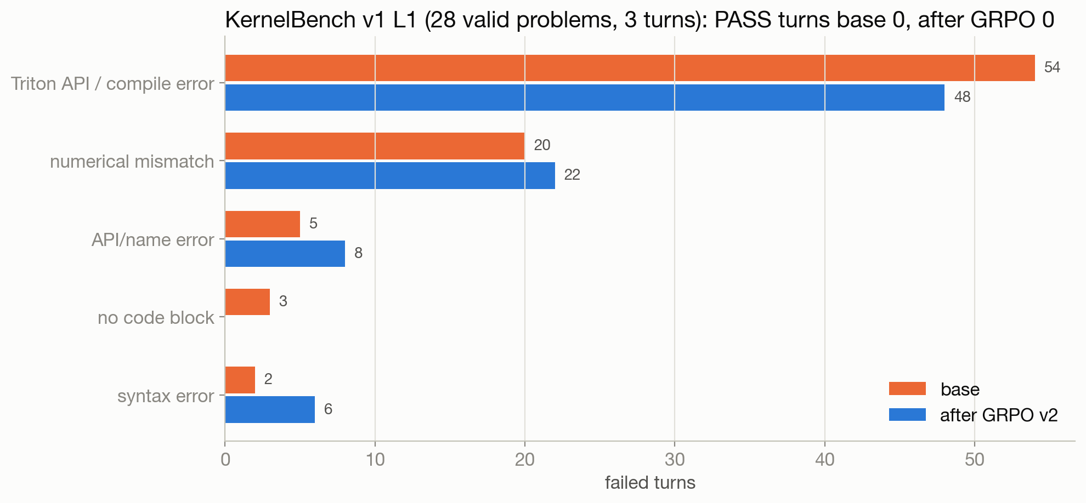
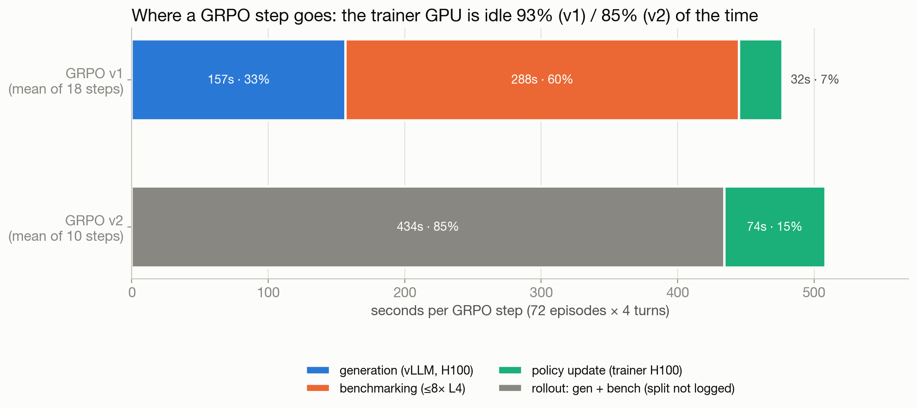
Appendix: transfer and where time goes
KernelBench: 28 valid L1 tasks (every 2nd), 1 sample × 3 turns, H100: PASS turns 0/84 → 0/84; API/compile errors 54 → 48
time (v1): benchmarking 60.5%, generation 32.8%, update 6.7%; free generation bounds a step speedup at 1.49× (Amdahl, derived)
cost estimates: v1 $18.84 (2.38 h), v2 $11.15 (1.41 h), H100 only
Appendix · Modal re-run, Sept 2026 · 18
KernelBench 2502.10517 · extra_numbers.json time_breakdown
Notes:
Transfer was zero before and after, dominated by Triton API and compile errors; the test changes task set, interface and GPU at once, so it is scoped to this protocol. Benchmarking dominated wall time.

Slide 19
Appendix: RMSNorm remeasure, every shape
M×N | fp16 model/starter | bf16 model/starter | fp16 model µs | GB/s
1024×512 | 1.000 | 1.000 | 13.3 | 158
1024×768 | 1.000 | 1.000 | 16.4 | 192
1024×1024 | 1.000 | 1.000 | 22.5 | 186
4096×512 | 1.000 | 1.000 | 37.9 | 221
4096×1024 | 1.000 | 1.000 | 72.7 | 231
1024×4096 | 1.000 | 0.986 | 71.7 | 234
2048×4096 | 1.007 | 1.007 | 142.3 | 236
M×N | fp16 model/starter | bf16 model/starter | fp16 model µs | GB/s
1024×8192 | 1.000 | 0.979 | 142.3 | 236
16384×512 | 0.993 | 1.000 | 145.4 | 231
4096×4096 | 1.004 | 1.004 | 286.7 | 234
16384×1024 | 1.000 | 1.000 | 287.7 | 233
4096×8192 | 0.998 | 0.996 | 575.5 | 233
16384×4096 | 1.000 | 0.999 | 1159.2 | 232
16384×8192 | 1.000 | 0.998 | 2305.0 | 233
L4, cold L2, median of 200 reps. Speed ratio = starter µs ÷ model µs (> 1 means the casts helped). GB/s from analytic bytes computed here. Geomean ratio 1.001 cold.
Appendix · Modal re-run, Sept 2026 · 19
results/v3/rmsnorm_remeasure.json gpus.L4.table (+ .md)
Notes:
Every shape the remeasure covered, fp16 and bf16. The ratio stays at 1 within noise everywhere: the casts are not a speed optimisation at any shape.

Slide 20
Appendix: related work
Area | Work | Relevance
Verifier | KernelBench-Verified (2607.16241) | hidden inputs; realistic baselines and memory
 | Measuring the Checker (2609.22220) | mutation tests measure oracle coverage
Kernels | KernelBench (2502.10517); Kevin-32B | correctness-aware speed; multi-turn feedback
 | AutoTriton (2507.05687); Dr. Kernel (2602.05885) | SFT cold start; turn-level credit and profiling
Methods | Dr. GRPO (2503.20783); DAPO; GRESO | std/length normalisation; zero-variance groups
Scope | different models, tasks, budgets | no cross-paper performance claim
Appendix · Modal re-run, Sept 2026 · 20
arXiv IDs as listed
Notes:
These works motivate the tests; their outcomes are not directly comparable to this nine-task experiment.

