Slide 1
Teaching an LLM to write
faster GPU kernels with RL
AutoKernel-RLVR: multi-turn GRPO with a GPU benchmark as the verifier
KernelBench v1 → AutoKernel kernels → GRPO on Qwen2.5-Coder-7B · re-run on Modal, Sept 2026
Modal re-run, Sept 2026
Notes:
All numbers in this deck come from a fresh re-run on Modal in September 2026. The original April 2026 results were lost with an old disk. Source of truth: results/numbers.json.

Slide 2
The idea: a benchmark is a perfect reward function
1
2
3
4
Propose
Verify
Read
Revise
LLM writes a full Triton kernel.py
bench.py on a real GPU: 5 correctness stages + timing
correctness, speedup, failure lines come back as the next message
up to N turns per episode
Reward per episode r = log2(best speedup vs PyTorch) if any turn PASSes, else 0; clipped to [−1, 3]
No partial credit: a fast but wrong kernel scores 0. GRPO compares 8 episodes of the same task and pushes toward the better ones.
Modal re-run, Sept 2026
Notes:
reward.py is unchanged from the original design. RLVR = reinforcement learning from verifiable rewards.

Slide 3
Project arc
01
02
03
04
KernelBench v1
AutoKernel kernels
GRPO on Qwen-7B
Modal re-run
Started here: 100 Level 1 PyTorch ops, fast_p metric. Became the held-out test set.
9 kernel types with a fixed 5-stage bench.py. Always valid and cheaper per reward, so used for RL.
Multi-turn agent, LoRA, rewards from real GPU benchmarks.
Original results lost; rebuilt on ≤10 Modal GPUs and re-measured everything.
Modal re-run, Sept 2026
Notes:
Tell it chronologically: KernelBench first, then the pivot to AutoKernel for cost, then RL, then the re-run.

Slide 4
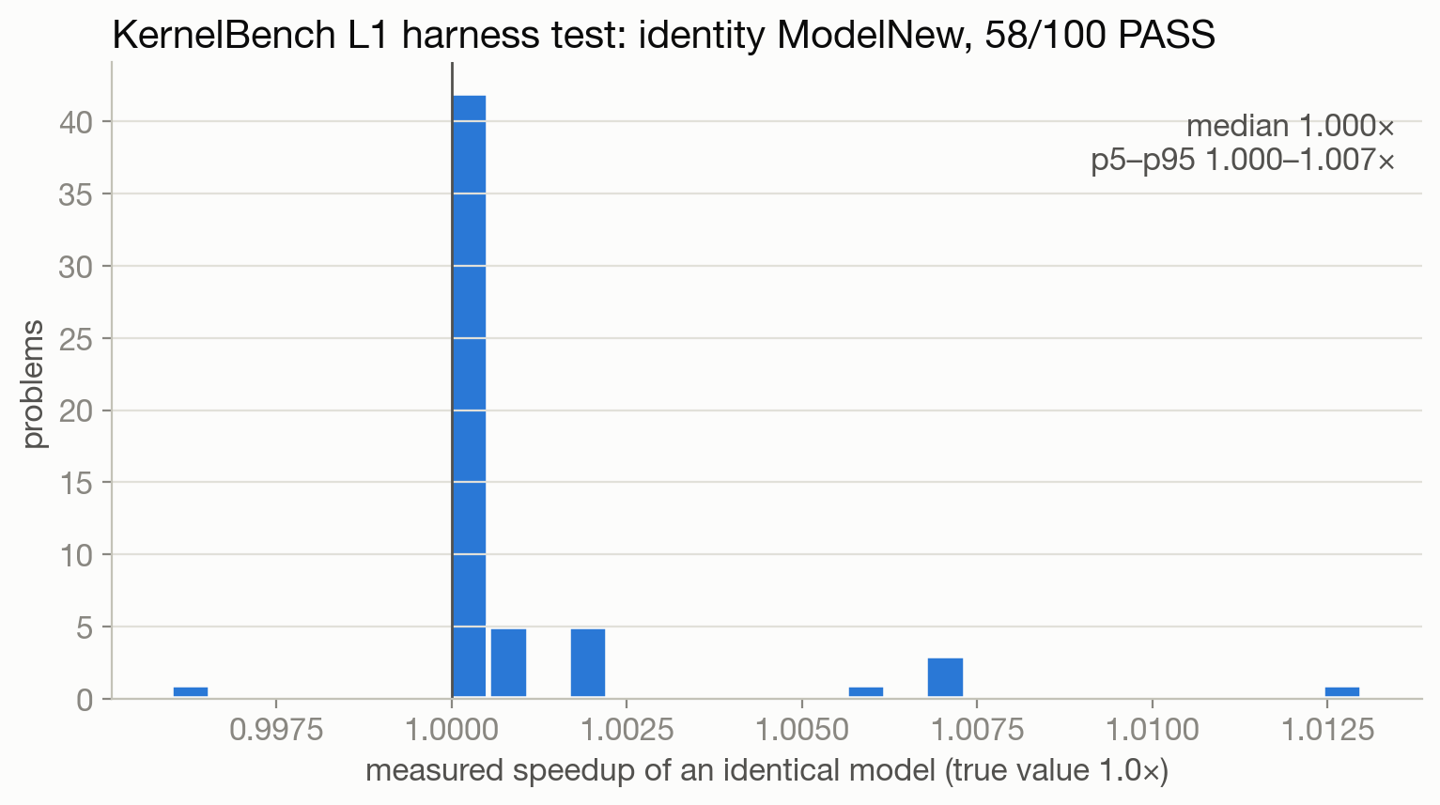
KernelBench v1 on Modal: is the timing trustworthy?
55/100
Level 1 problems that are harness-valid (identity PASSes reliably)
1.000×
median measured speedup of an identical model
35 conv problems fail even as an identical model: weight init isn't seeded
9 huge-input problems time out intermittently (CPU input generation inside a 30 s limit)
Modal re-run, Sept 2026
Notes:
Identity test = the 'answer' is the reference model itself. It must PASS at 1.0x. AutoKernel's own KernelBench starter crashes on all 100 problems (super(Model, self) after the class rename).

Slide 5
Why RL moved to AutoKernel's kernels: validity and cost
55/100
6.0 s
1.89%
KernelBench L1 problems usable as a reward
median AutoKernel bench on L4
max run-to-run noise (CV) of AutoKernel speedup
RL needs thousands of rewards: one GRPO step here is 72 episodes × 4 turns = 288 benchmarks
AutoKernel's bench.py is fixed and 5-stage (smoke, shape sweep incl. fp32, stability, determinism, edge sizes)
KernelBench stays as the held-out evaluation
Modal re-run, Sept 2026
Notes:
Cheaper verifier → more gradient per dollar. L4 bench workers match the original A10/L4 design.

Slide 6
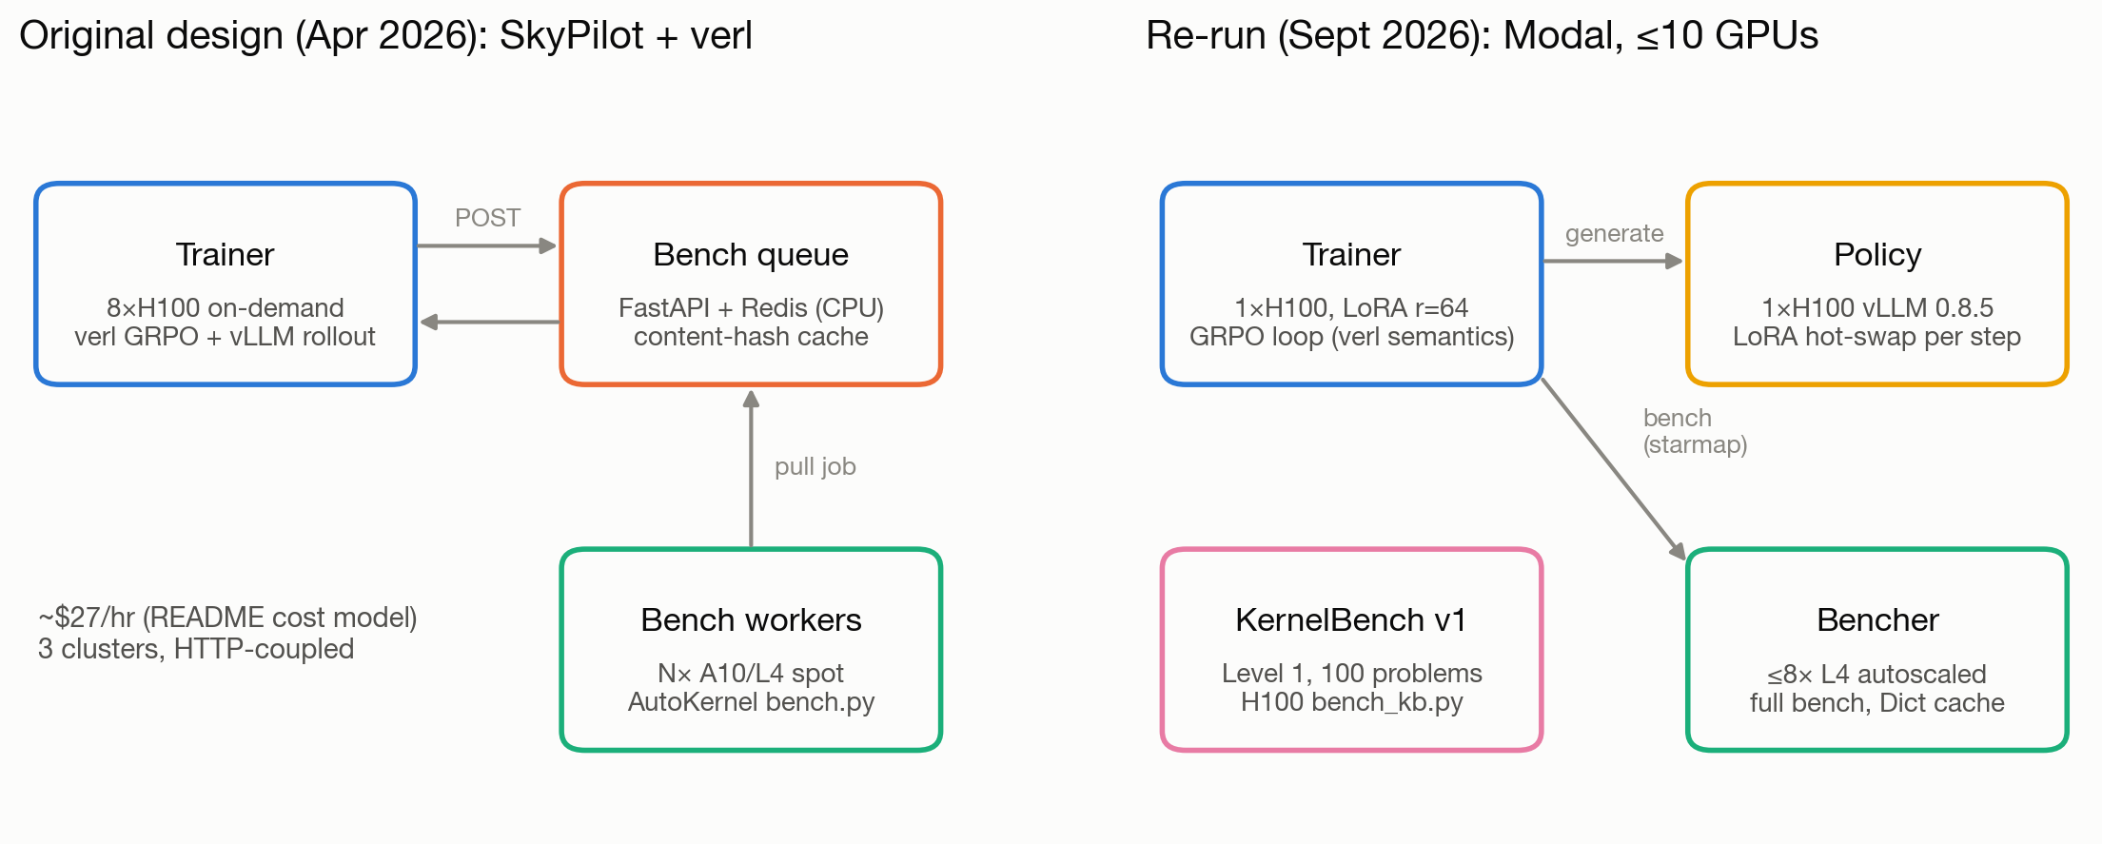
Architecture: original design vs Modal re-run
Modal re-run, Sept 2026
Notes:
Account limit: 10 concurrent GPUs. 1 trainer H100 + 1 vLLM policy H100 + 8 L4 bench containers. Redis queue replaced by modal.Dict content-hash cache; the whole training loop runs inside the trainer container.

Slide 7
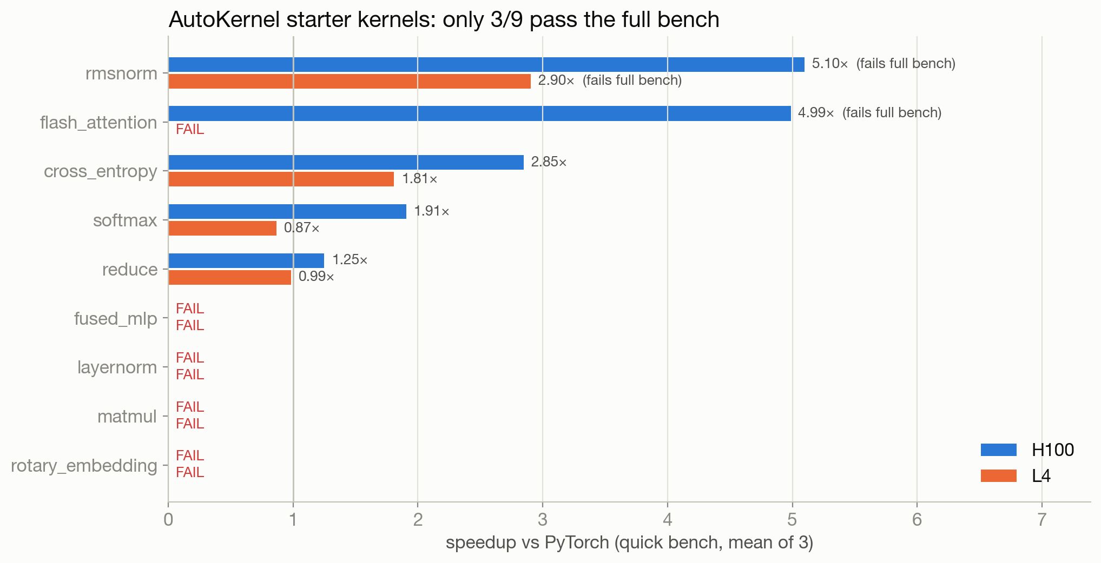
The verifier is strict: most starter kernels fail it
3/9
AutoKernel starter kernels that pass the full bench
quick mode skips numerical stability: flash_attention, rmsnorm pass quick, fail full
→ reward uses the full bench, or the agent learns unsafe kernels
matmul fails because tl.dot uses TF32 on fp32 inputs
Modal re-run, Sept 2026
Notes:
Speedups are GPU-specific: softmax starter is 1.906x on H100 but 0.868x on L4.

Slide 8
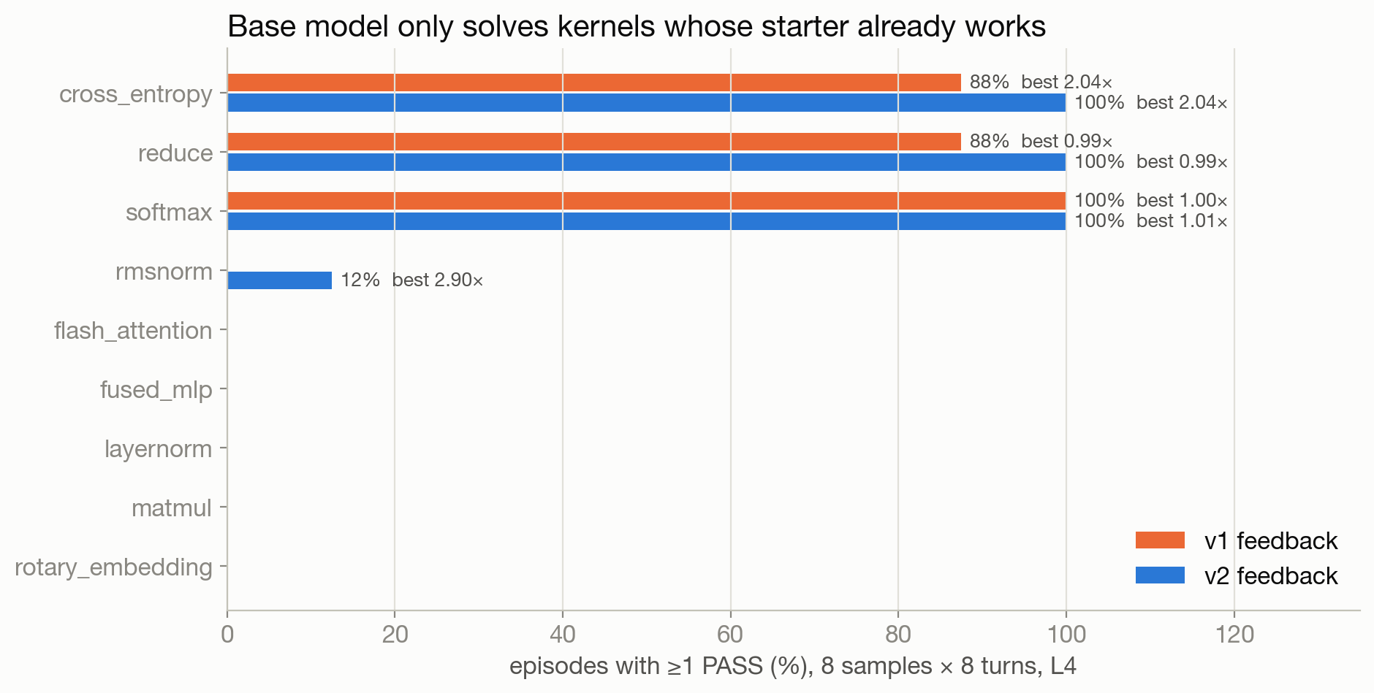
Before RL: the model re-submits what already works
34.7%
episodes with ≥1 PASS (9 kernels × 8 samples × 8 turns)
15.3%
fast_1.0: correct AND faster than PyTorch
61% of turns resubmit code already tried; best speedup 2.9×
Modal re-run, Sept 2026
Notes:
Qwen2.5-Coder-7B-Instruct, temperature 0.8, rewards on L4. Only kernels whose starter already passes get solved, plus rmsnorm once.

Slide 9
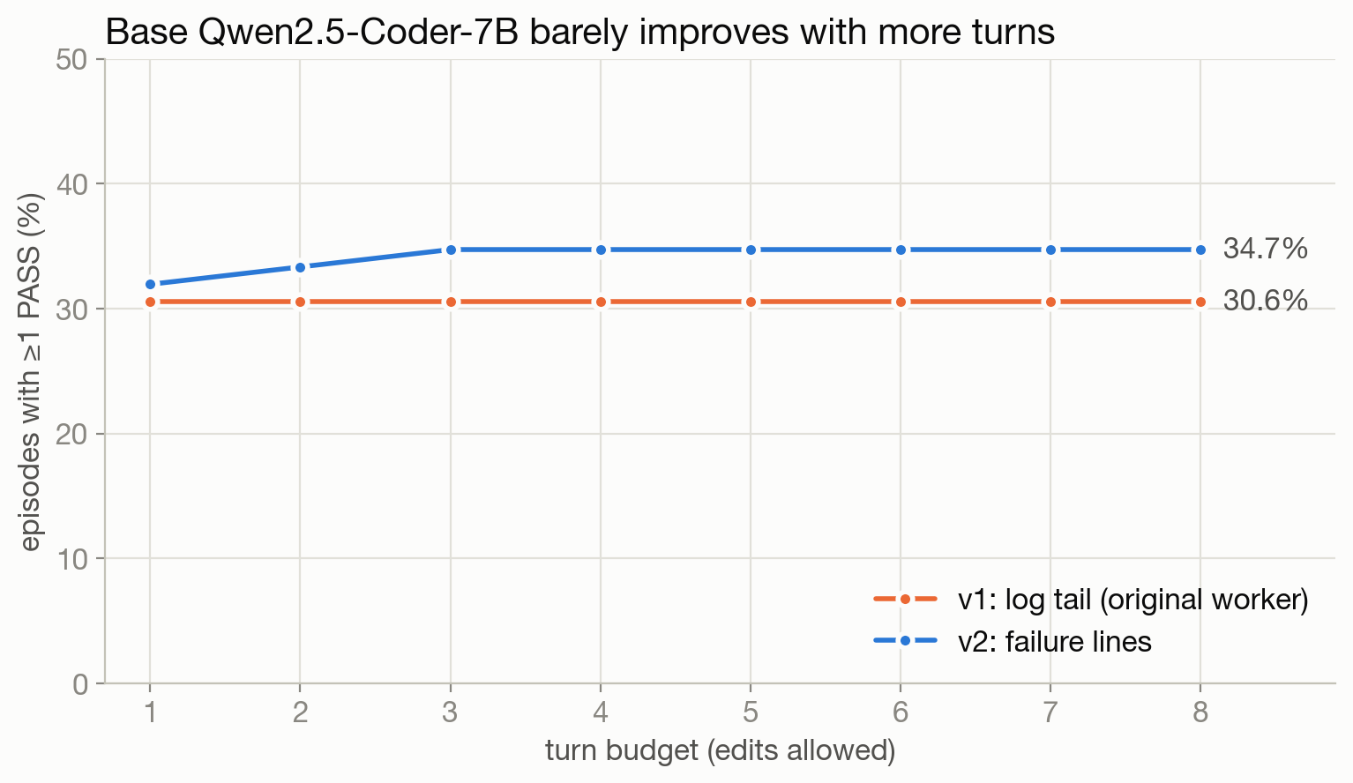
A free win: tell the model *why* its kernel failed
 | v1: log tail | v2: failure lines
episodes with PASS | 30.6% | 34.7%
mean reward | 0.097 | 0.133
PASS turns | 59 | 101
CRASH turns | 128 | 56
kernels solved | 3 | 4
The original worker returned the tail of bench.py's log: only the summary block, never which check failed.
Modal re-run, Sept 2026
Notes:
Same model, same sampling; only the observation text changed. This is the cheapest improvement in the project.

Slide 10
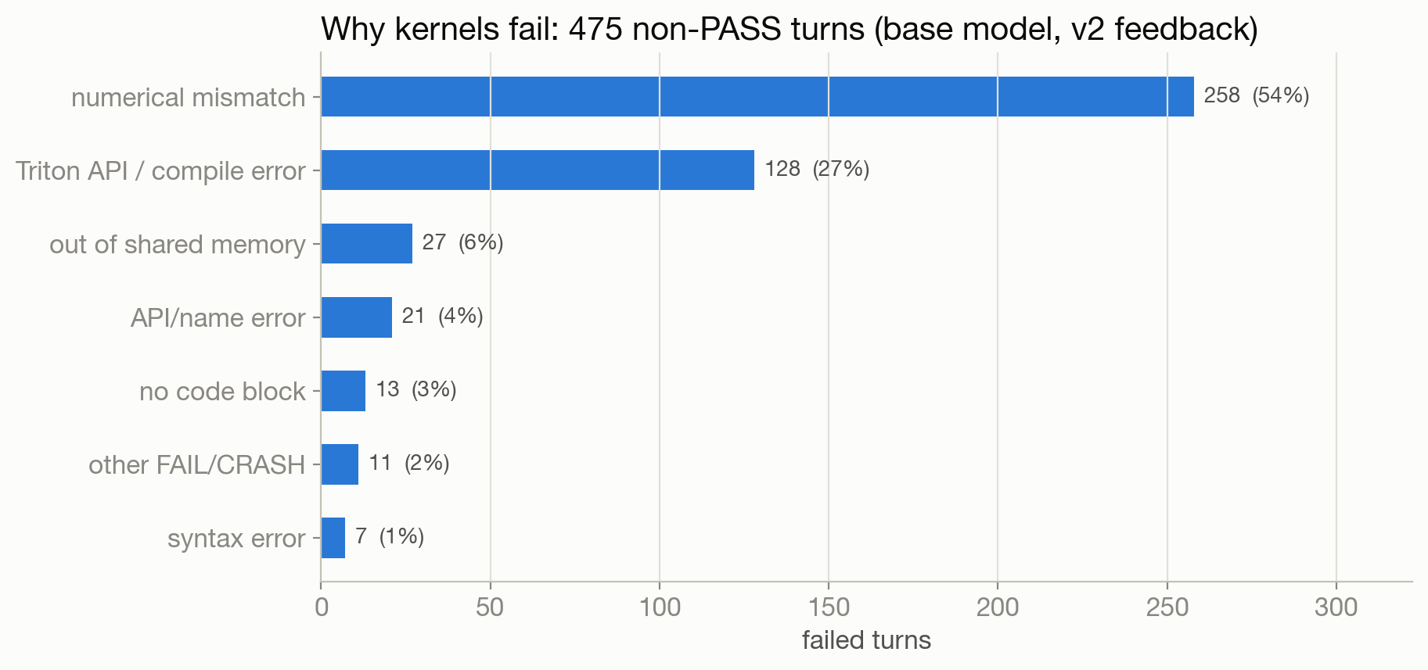
Correctness, not speed, is the bottleneck
numerical mismatch: wrong accumulation dtype, TF32, bad masking on edge sizes
Triton API / compile errors: e.g. tl.math.tanh and tl.EVICT_FALSE don't exist in Triton 3.2
shared-memory overflow: tile sizes chosen for H100, run on L4 (101 KB limit)
Modal re-run, Sept 2026
Notes:
Categories come from the failure lines bench.py prints; see modal_app/analyze.py::failure_taxonomy.

Slide 11
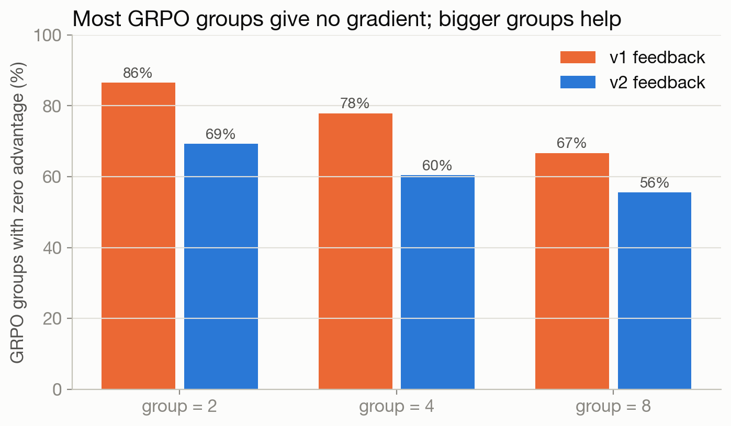
GRPO's hidden cost: most groups give no gradient
60%
of 4-sample groups have identical rewards → advantage 0
group 8 → 56%: chosen for training
LoRA r=64 · lr 1e-5 · 4 turns · T=1.0
token-mean loss, no KL, one on-policy update (verl GRPO semantics)
Modal re-run, Sept 2026
Notes:
Advantage = (r − mean_group)/(std_group + 1e-6). If every sample in a group fails, the group teaches nothing.

Slide 12
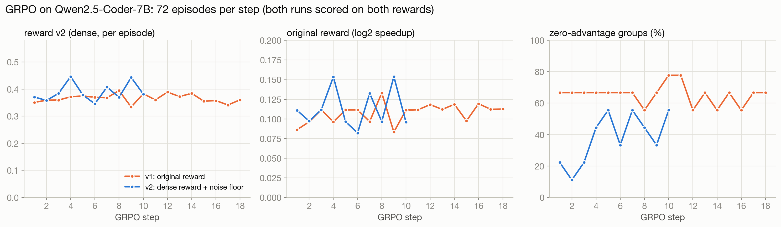
GRPO: dense credit adds signal, not new kernels
0.098 → 0.115
65%
38%
v1 original reward, 18 steps (first vs last 3)
v1 groups with zero gradient
v2 groups with zero gradient (10 steps)
Modal re-run, Sept 2026
Notes:
v1: original log2 reward. 5 of 9 kernels never passed in any episode, so their groups never gave gradient. v2: partial credit for correctness progress (max 0.3), any PASS >= 0.5, and groups with std < 0.02 (timing noise) treated as ties. v2 reward_v2 0.3713 -> 0.3985, pass 31.5% -> 31.9% vs v1 pass 29.2% -> 25.0%. Single seed; reward changes are within step-to-step noise. The robust effect is the zero-gradient fraction.

Slide 13
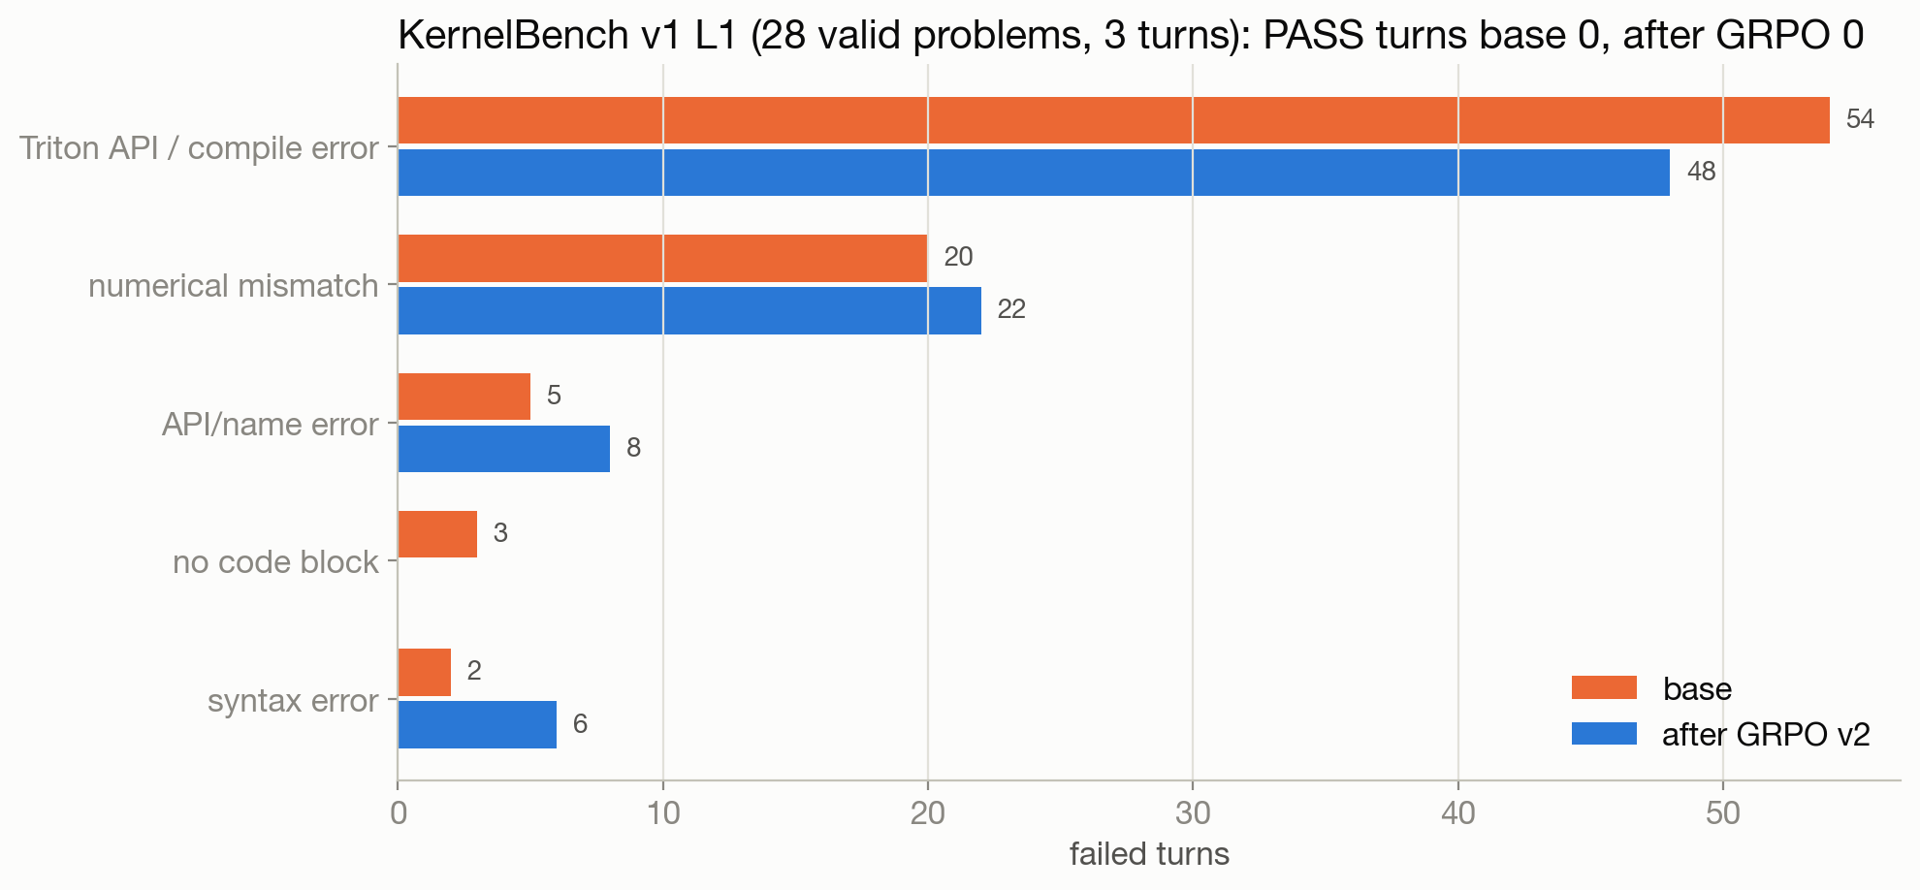
Does it transfer to KernelBench v1? Not yet
0/84
base: PASS turns on valid L1 problems
0/84
after GRPO v2: PASS turns
Most failures are invented or missing Triton APIs; a 7B model needs Triton API grounding before speed.
Modal re-run, Sept 2026
Notes:
Subset = every 2nd harness-valid Level 1 problem (55 valid of 100); 1 sample x 3 turns; H100; bench_kb full protocol.

Slide 14
Re-running exposed five real bugs
--kernel-type
worker passed a flag bench.py doesn't have (it's --kernel)
results.tsv
worker parsed a file bench.py never writes; metrics are on stdout
super(Model)
AutoKernel's KernelBench starter crashes on all 100 problems
no seed
KernelBench mode never seeds weight init: 35 conv problems unpassable
log tail
agent was shown the summary block, not the failing check
Modal re-run, Sept 2026
Notes:
Also: vLLM 0.8.5 breaks with the newest transformers (pin 4.51.3). The AMD MI300X path is design-only: no AMD GPUs on Modal.

Slide 15
Takeaways and next steps
Verifier quality is the product: quick-mode rewards and log-tail feedback both silently hurt
The reward has a floor bug: correct-but-slow (<1×) scores below a crash; use max(0, log2 s) + PASS bonus
GRPO signal is sparse: dense correctness credit cut zero-gradient groups 65% → 38%, but solving new kernels needs more steps or a curriculum
Async rollouts: the trainer H100 idles during benchmarking
Next benchmark: KernelBench Level 2 fusion problems
Modal re-run, Sept 2026
Notes:
30 follow-up questions with numbers: presentation/qa_30.md.

