Slide 1
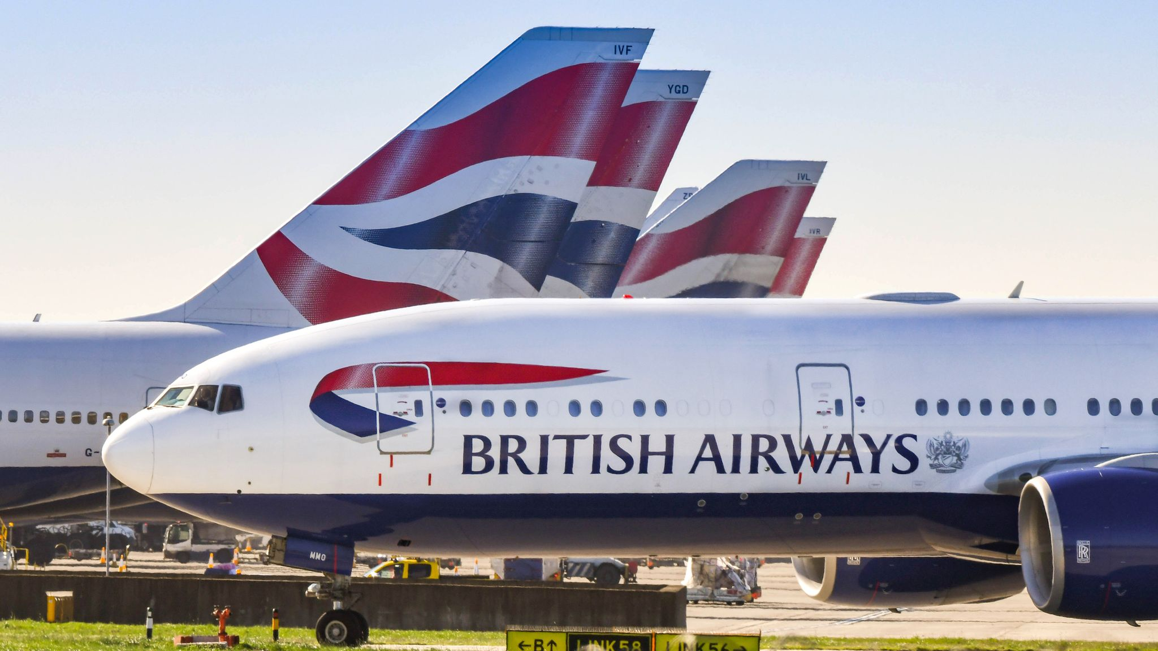

Problem Statement:
Scraping the customer review
data from the customer review website of British Airways and Analyse the review data to get insights.

Slide 2
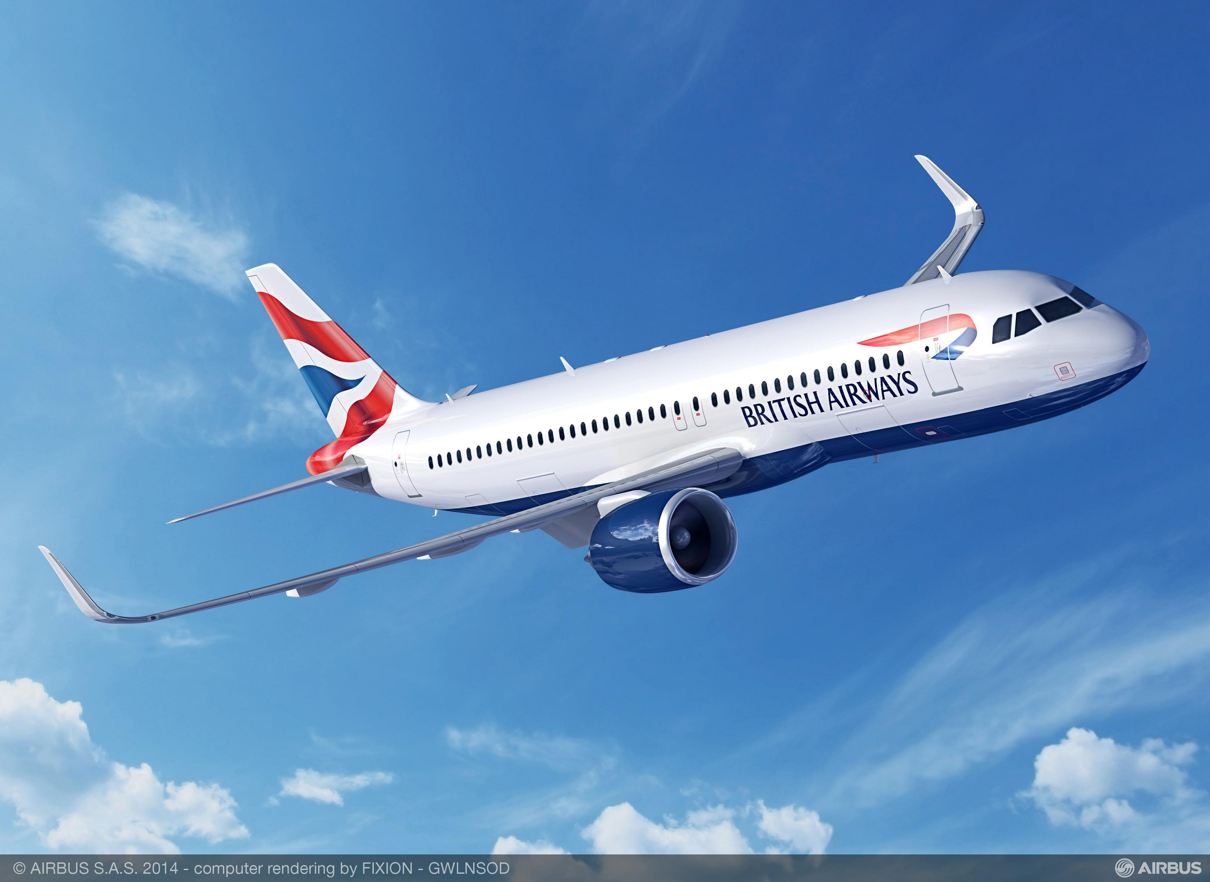
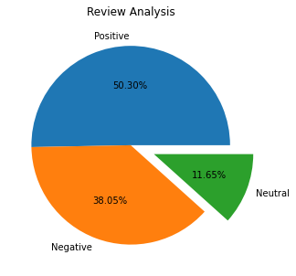
Insights From Customer Review:
Created VADER Model to do sentimental analysis in 2000 review data and derived the result as
Positive Reviews – 1006
Negative Reviews – 761
Neutral Reviews - 233

Slide 3
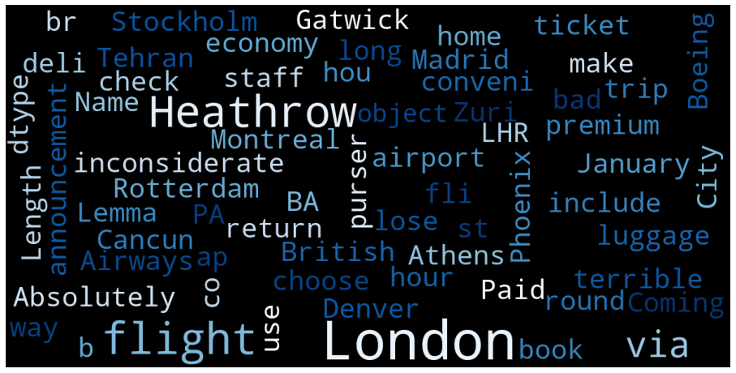
Insights From Customer Review:
Created VADER Model to do sentimental analysis in 2000 review data and derived the result as
Word clouds is used for visualizing unstructured text data and getting insights on trends and patterns.

