Slide 1
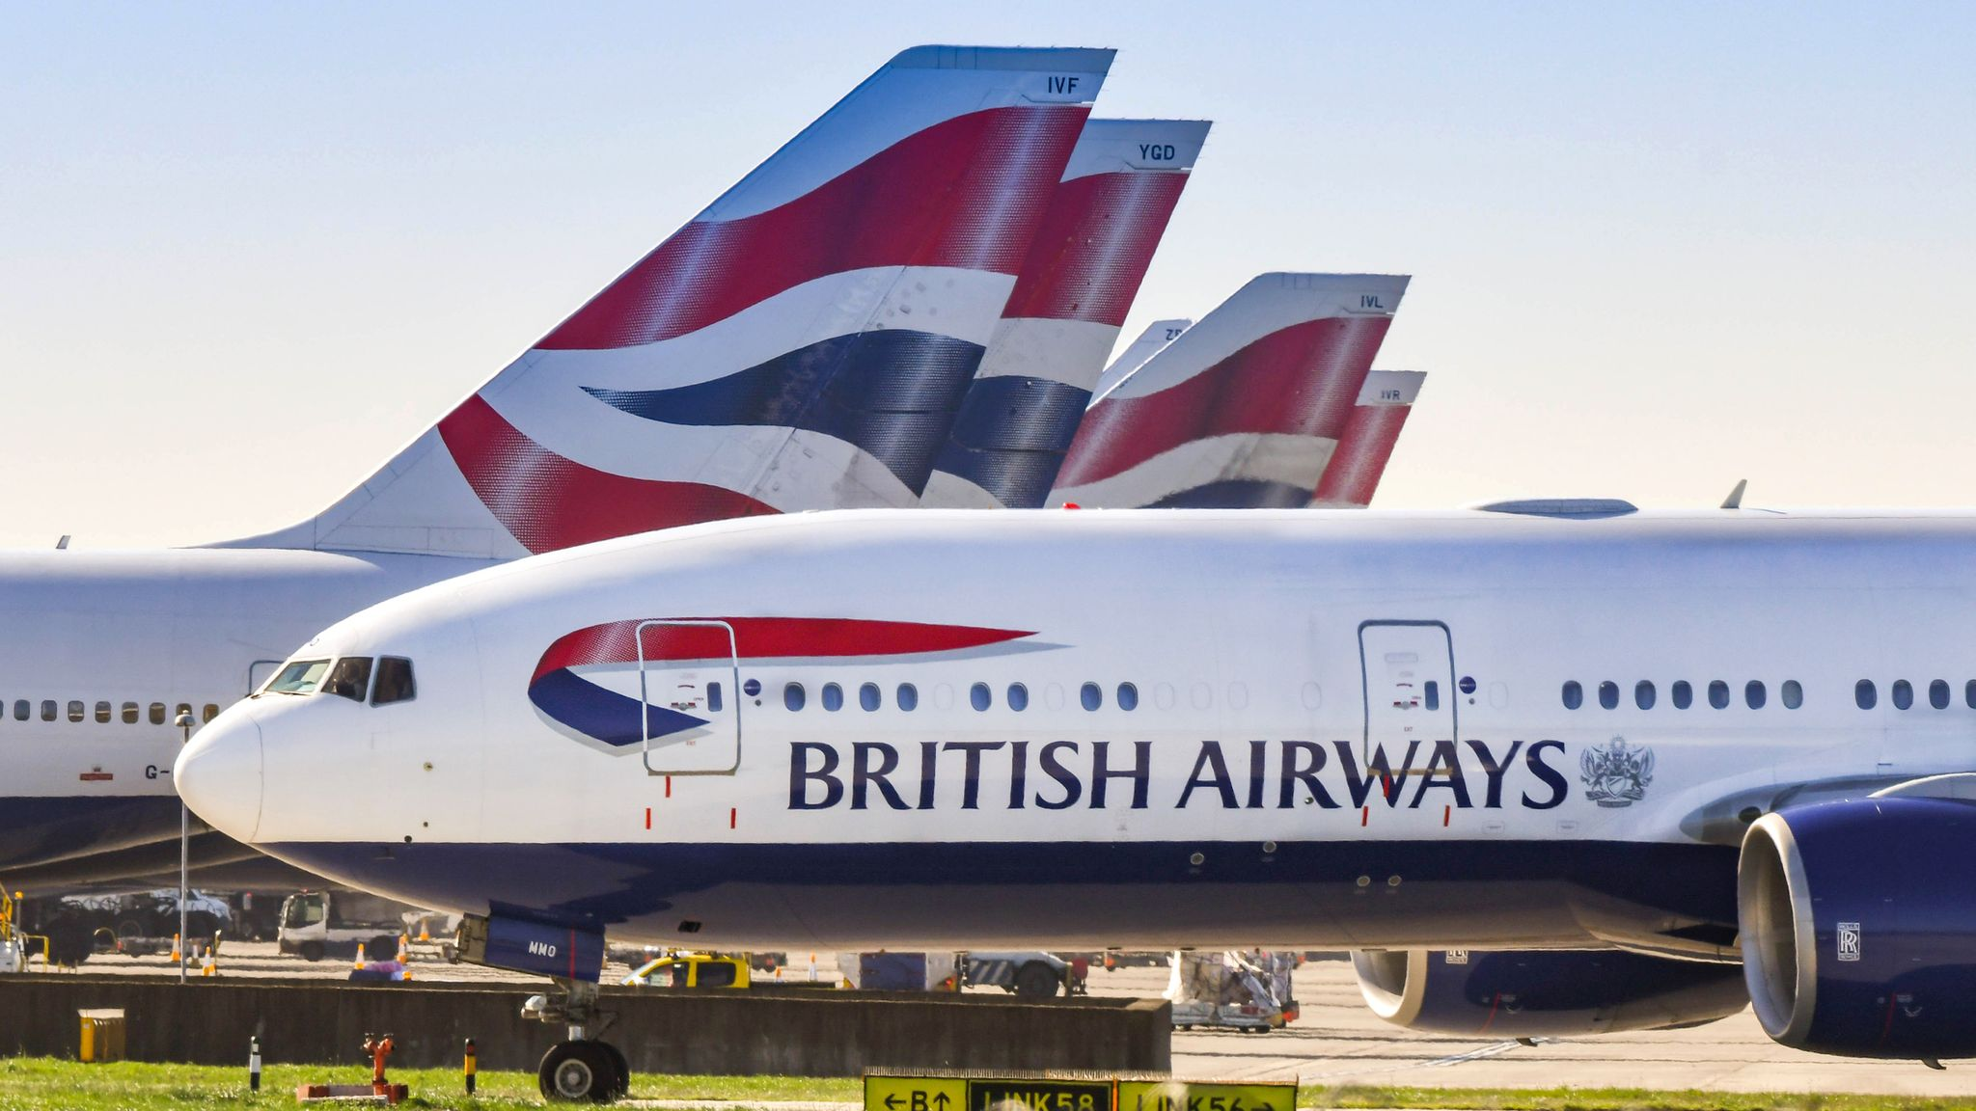

Problem Statement:
Analyse and create the prediction model to predict booking completed or not in customer booking behaviour analyse data and finding the which feature is most impact on dependent variable

Slide 2

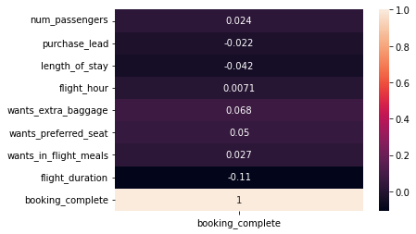
Insights From Customer booking data:
Created RandomForestRegression and XGBoostRegressor with accuracy of 84% and 84.99%
Most impacted feature to dependent feature is:

Slide 3
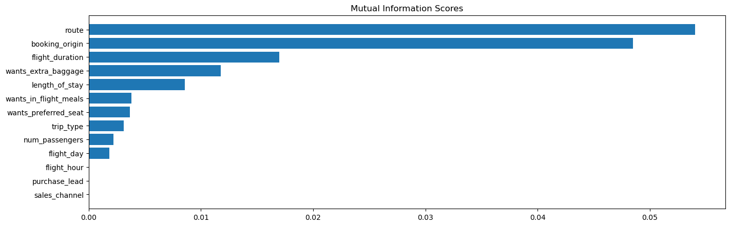
Insights From Customer booking data:
Created RandomForestRegression and XGBoostRegressor with accuracy of 84% and 84.99%
Most impacted feature to dependent feature is:

