Slide 1

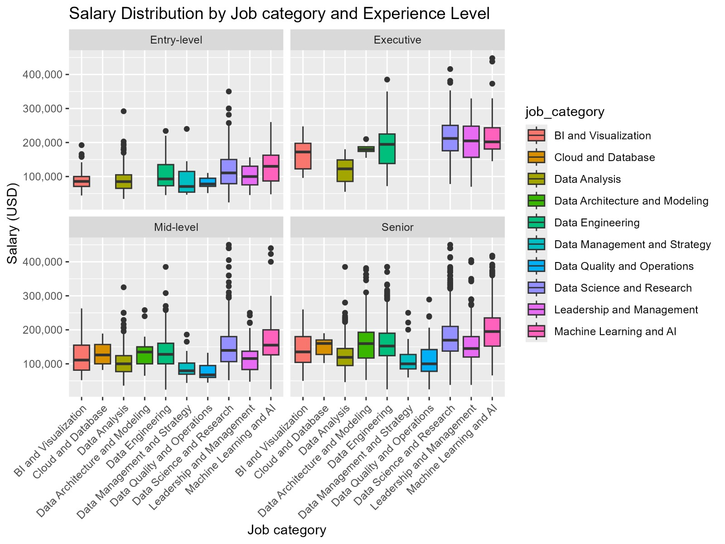
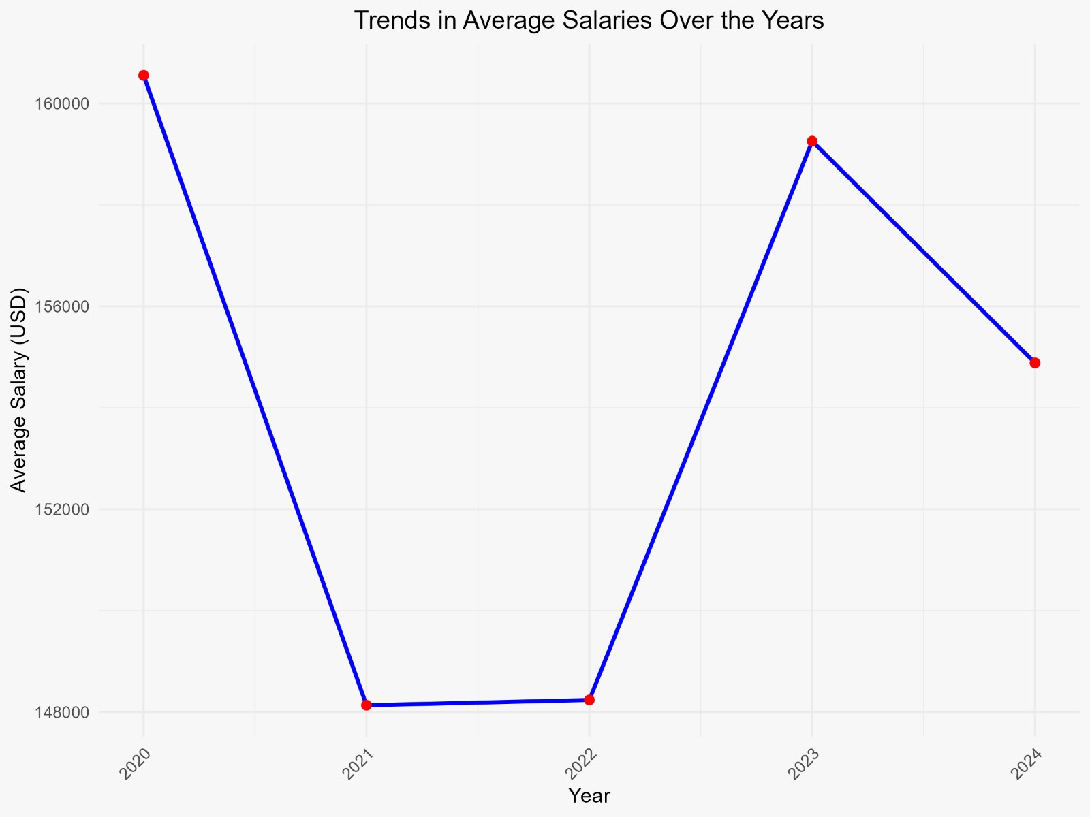
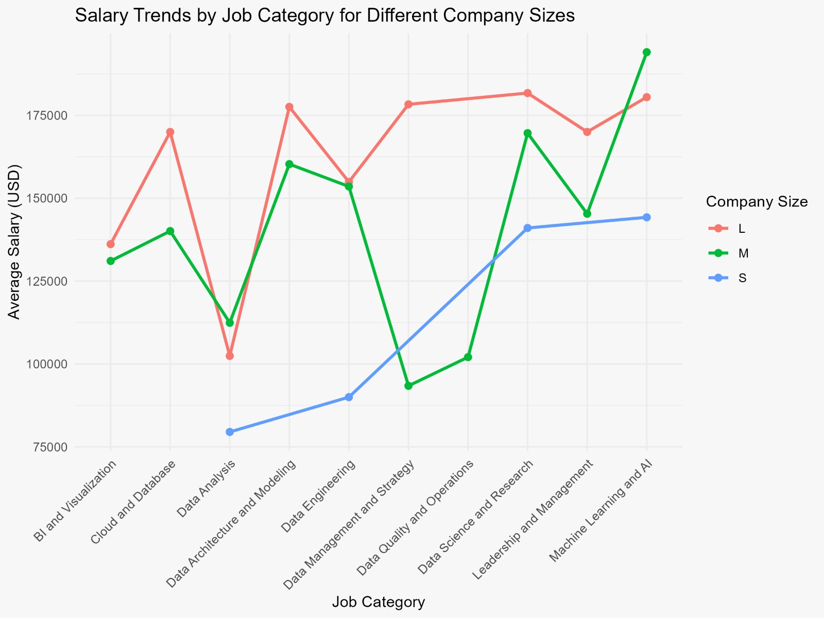
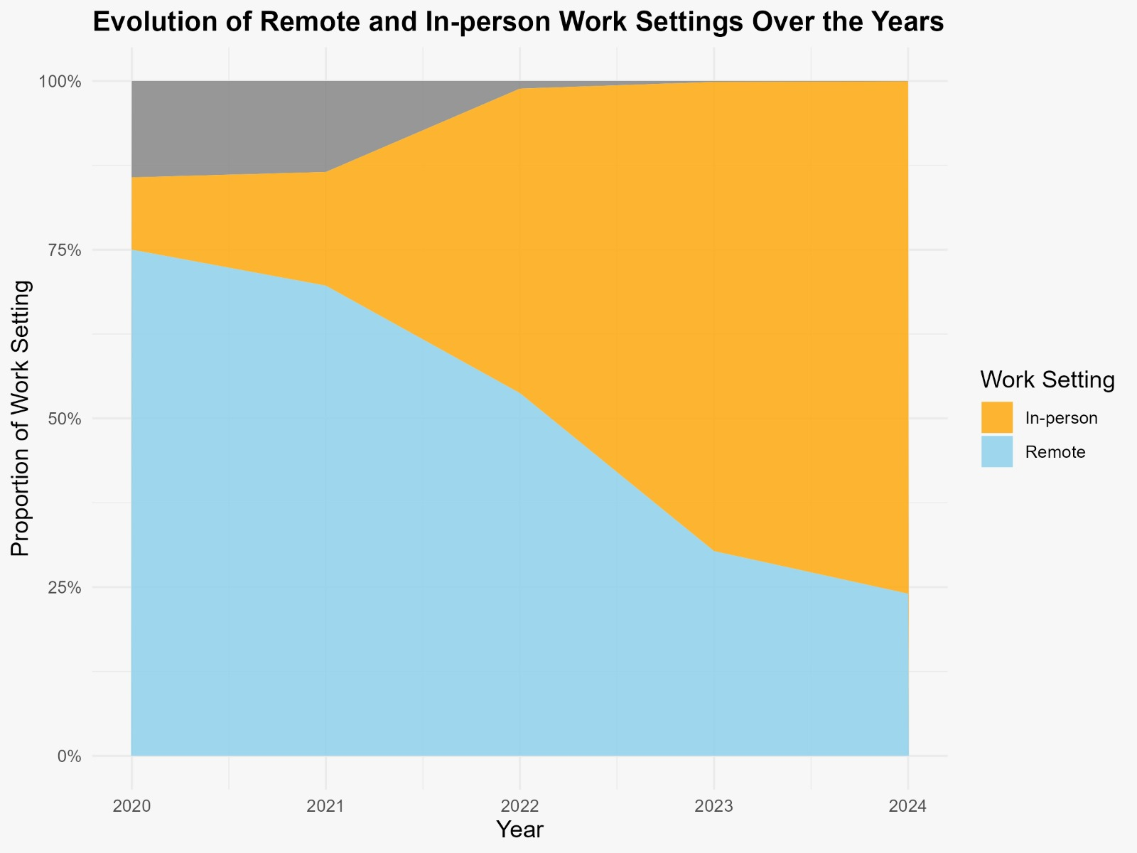
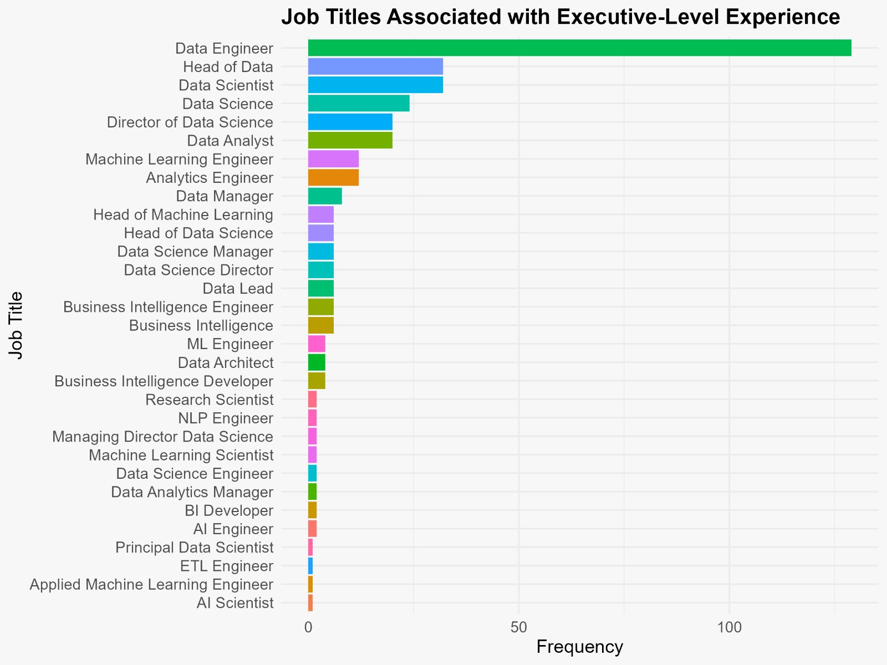
Kaggle: Historical data (2020–2023) sourced from Kaggle's publicly available datasets.
Web Scraping Monster & Indeed: Data for 2024 was collected using web scraping techniques on Indeed, facilitated by Web Scraping Monster.
Student Survey: Additional insights were derived from a student survey conducted by the research team in 2024
DreamJobs - Team 10 Research Project
Mehgashree – Sohan – Ram Teja - Naveen
Under Prof. Anna Leach
Salary distribution by Job category & Experience
Average Salaries Over the Years
The primary goal of this project is to conduct a comprehensive analysis of the U.S. job market, focusing on identifying trends, skills, and career pathways relevant to students graduating from our course. This analysis will provide insights into current job demand, salary expectations, and industry-specific opportunities, ultimately supporting students in making informed career choices.
Salary Trends – By Jobs – By Company size
The above graph illustrates salary distributions across various job categories and experience levels, segmented into four groups: Entry-level, Mid-level, Senior, and Executive. The x-axis represents job categories, such as "Data Engineering," "Data Science and Research," and "Machine Learning and AI," while the y-axis shows salaries in USD. Each boxplot conveys the spread of salaries within a specific job category and experience level, highlighting the median (middle line), interquartile range (the box), and outliers (dots beyond the whiskers). The job categories are color-coded for clarity, and the legend provides easy identification of each domain.
Entry-level roles tend to have lower salary ranges, with medians clustering between $100,000 and $150,000 across most categories.
Remote vs In-person Over the Years
Job Titles vs Experience Level
The graph on the Right illustrates the shift in work settings from 2020 to 2024, with a clear focus on the balance between remote and in-person work. Initially, in 2020, in-person work was dominant, but as the pandemic took hold, there was a sharp increase in remote work, peaking around 2021. By 2021, a large proportion of the workforce transitioned to remote settings, reflecting the global response to COVID-19 restrictions. However, starting in 2022, the graph indicates a gradual return to in-person work, as companies began to reopen offices and adapt to new hybrid work models.
The Graph on left visualizes the frequency of job titles associated with executive-level experience in a given dataset. The x-axis represents the frequency count, while the y-axis lists various job titles. Prominent roles such as "Data Engineer," "Head of Data," and "Data Scientist" are highlighted at the top with the highest frequencies, indicating that these positions are most commonly linked with executive experience.
References : Historical data (2020–2024) sourced from Kaggle's publicly available datasets. Web Scraping Monster & Indeed: Data for 2024 was collected using web scraping techniques on job posting sites Indeed, facilitated by Web Scraping Monster. Student Survey: Additional insights were derived from a student survey conducted by the research team in 2024

