Slide 1
UNIT-1

Slide 2
Computer Types
A computer is an electronic device that can store, manipulate, and process data according to a set of instructions.
The list of instruction is called Computer Program
Many types of computers exist that differ widely in size, cost, computational power and intended use
Types
Personal Computers
Notebook Computers
Workstations
Enterprise Systems or mainframes and Servers
Supercomputers

Slide 3
Computer Types
Personal computers
Personal Computers is also known as a microcomputer. It is basically a general-purpose computer designed for individual use. It consists of a microprocessor as a central processing unit(CPU), memory, input unit, and output unit. This kind of computer is suitable for personal work such as making an assignment, watching a movie, or at the office for office work, etc.
Notebook Computers
These are compact version of the personal computer with all of the components packaged into a single unit the size of the thin briefcase.
Workstation
It is a high-performance computer system that is basically designed for a single user and has advanced graphics capabilities, large storage capacity, and a powerful central processing unit. A workstation is more capable than a personal computer (PC) but is less advanced than a server

Slide 4
Computer Types
Enterprise systems or mainframe
A mainframe is defined as a large, powerful computer typically used for complex calculations and data processing tasks. It can connect to multiple end clients simultaneously so that several users can access different applications and processes running on the mainframe concurrently without impacting performance or security.
Server
A server is a computer or system that provides resources, data, services, or programs to other computers, known as clients, over a network
Supercomputer
A supercomputer is defined as an extremely powerful computing device that processes data at speeds measured in floating-point operations per second (FLOPS) to perform complex calculations and simulations, usually in the field of research, artificial intelligence, and big data computing.

Slide 5
Questions
Write about applications of Super computer.
List the top companies who manufacturer the Mainframes
How many servers are installed in our dept and name the company of server and give the details of server configuration

Slide 6
Functional Units
A computer in its simplest form comprises five functional units namely input unit, output unit memory unit, arithmetic & logic unit and control unit.

Slide 7
Functional Units
Input Unit:
Computer accepts coded information through input unit. The standard input device is a keyboard. Whenever a key is pressed, keyboard controller sends the code to CPU/Memory.
Memory Unit:
Memory unit stores the program instructions (Code), data and results of computations etc. Memory unit is classified as:
Primary /Main Memory
Secondary /Auxiliary Memory
Primary memory is fast memory that operates at electronic speeds
The memory contains a large number of semiconductor storage cells,each capable o fstoring one bit of information.
The cells are rarely read or written as individual cells but instead are processed in groups of fixed size called words.
To provide access to any word in memory, a distinct address is associated with each word location.
The number of bits in each word is often referred to as the word length of the computer
Typical work length range from 16 to 64 bits.
Memory in which any location can be reached in a short and fixed amount of time after specifying its address is called Random Access memory.
The time required to access one word is called memory access time.
The time is fixed , independent of the location of the word being accessed.
It typically ranges from a few nanoseconds to about 100 ns for modern RAM Units.

Slide 8
Functional Units
Output Unit:
Computer after computation returns the computed results, error messages, etc. via output unit. The standard output device is a video monitor, LCD/TFT monitor. Other output devices are printers,etc
Control Unit:
Control unit co-ordinates activities of all units by issuing control signals.
Control signals issued by control unit govern the data transfers and then appropriate operations take place.
Control unit interprets or decides the operation/action to be performed.

Slide 9
Functional Units
ALU
Any arithmetic or logic operation is initiated by bringing the required operands into the processor where the operation is performed by the ALU.
When the operands are brought into the processor they are stored in high speed storage elements are registers.
Each register can store one word of data.
Access times to register are some what faster than access times to the fastest cache unit in the memory hierarchy

Slide 10
Functional Units
Computer will handle the information for doing tasks.
The information will be categorize into two types
Instructions
These will govern the transfer of information within a computer as well as between the computer and its devices
Specify the arithmetic and logic operations to be performed
The processor fetches the instructions from memory one after another and performs the desired operations.
Data
These are numbers and characters that are used as operands by the instructions.
Information handled by a computer must be encoded in a suitable format.
Most present day hardware employs digital circuits that have only two stable states ON and OFF.
Each number, character and alpha numerics are encoded as a string of binary digits called bits with possible values 1 or 0.

Slide 11
Basic Operational Concepts
The activity of computer is governed by instructions
To perform a task, an appropriate program consisting of a list of instructions is stored in the memory.
Individual instructions are brought from the memory into the processor, which executes the specified operations
Data to be used as operands are also stored in the memory
Ex:Add LOCA, R0
Add the operand at memory location LOCA to the operand in a register R0 in the processor.
Place the sum into register R0.
The original contents of LOCA are preserved.
The original contents of R0 is overwritten.

Slide 12
Basic Operational Concepts
Ex:2
Load LOCA, R1
Add R1, R0
Whose contents will be overwritten?

Slide 13
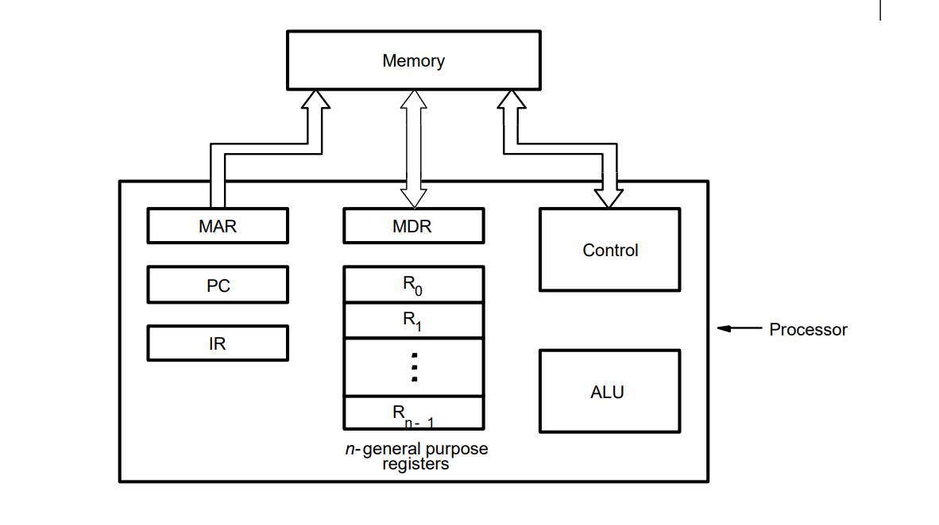
Basic Operational Concepts

Slide 14
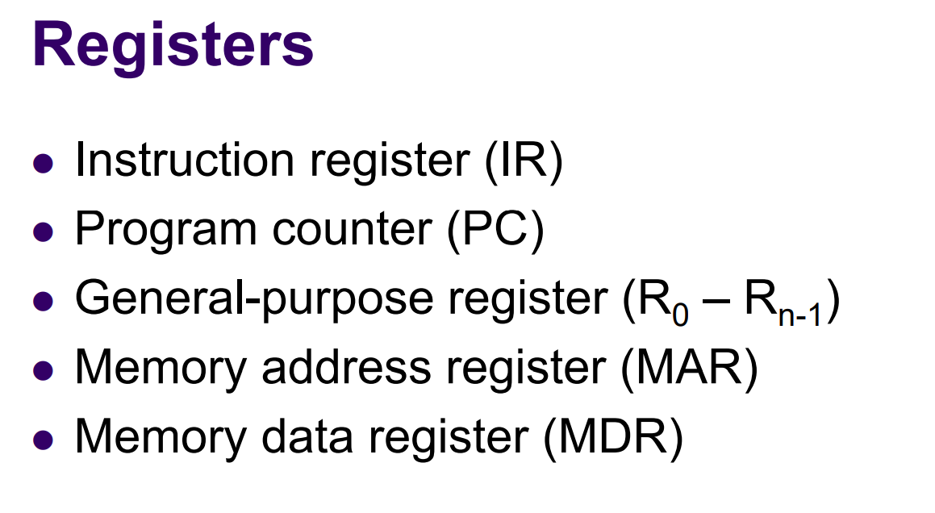
Basic Operational Concepts

Slide 15
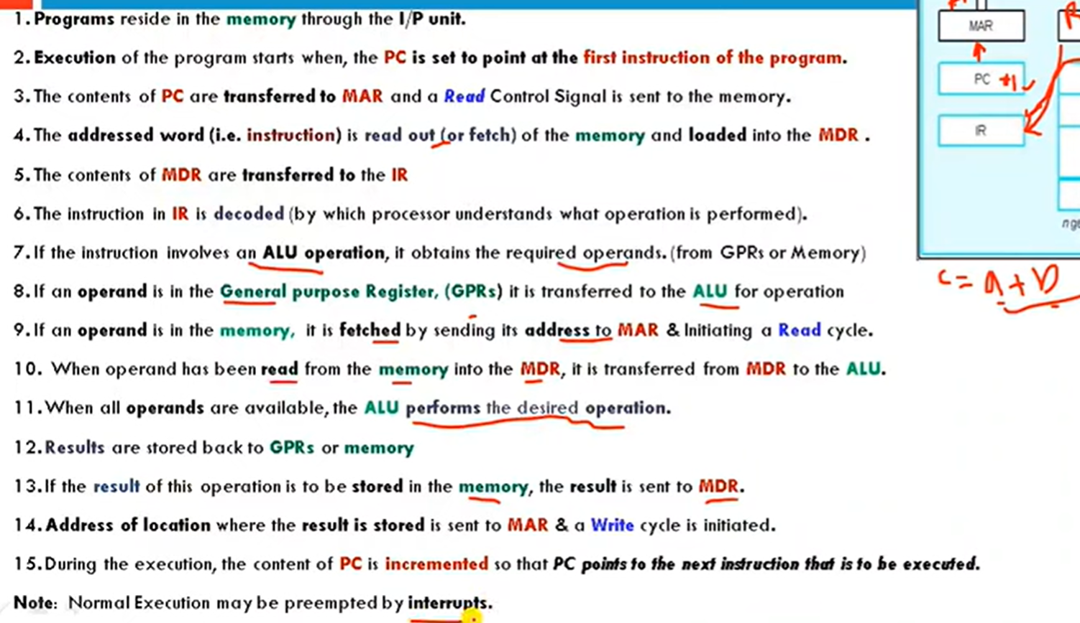
Basic Operational Concepts

Slide 16
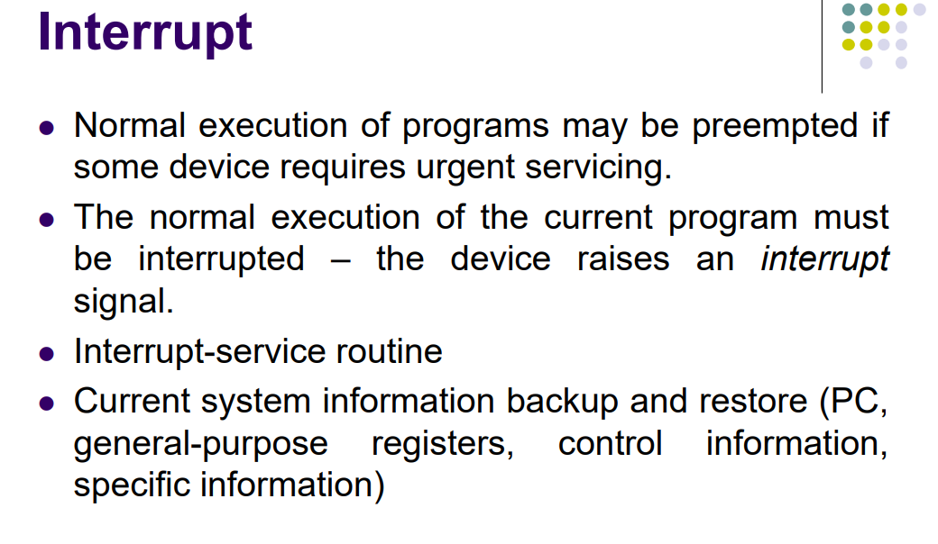
Basic Operational Concepts

Slide 17
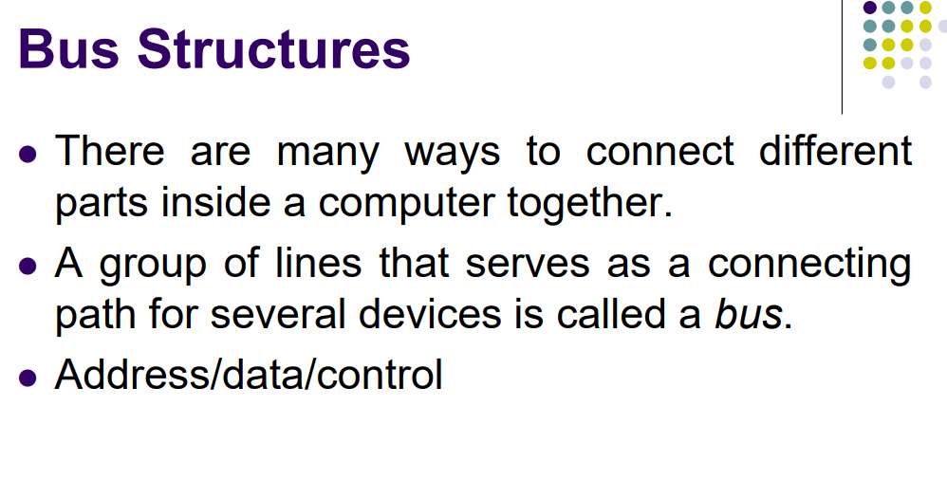

Slide 18
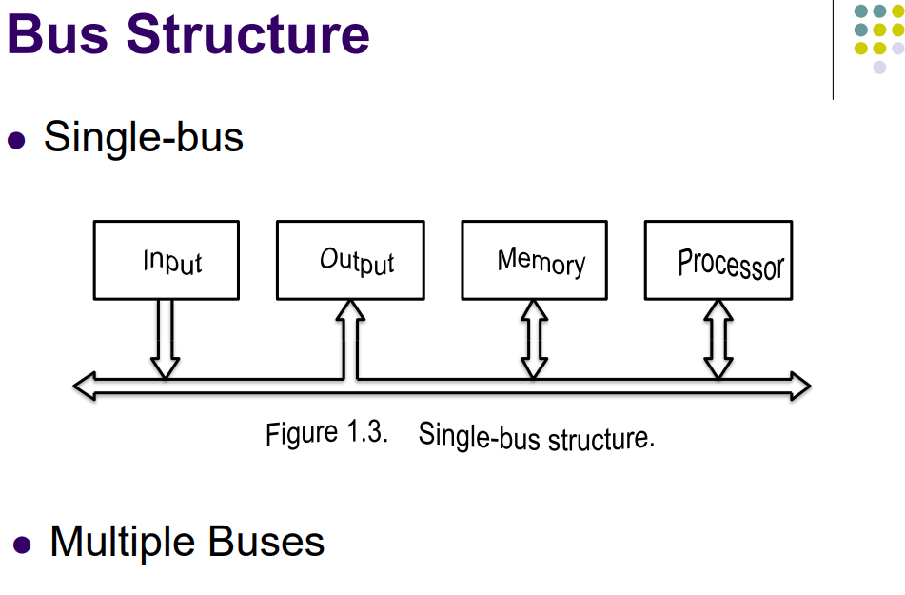

Slide 19
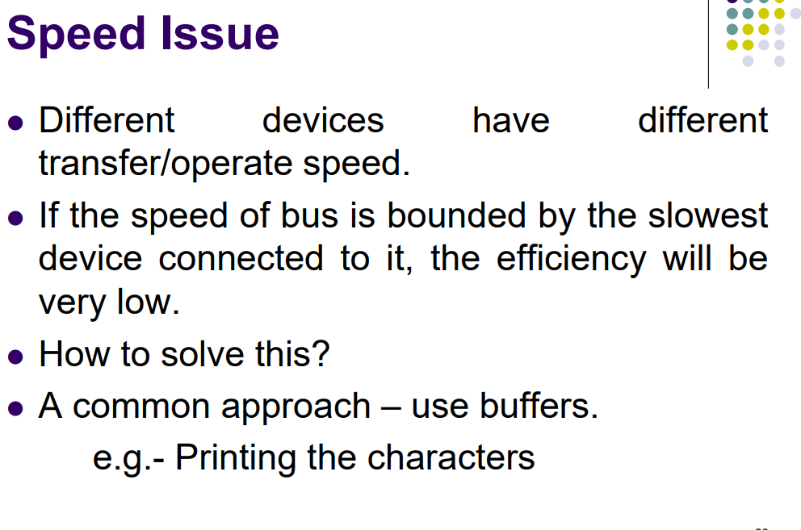
Bus Structures

Slide 20
Software
In order for a user to enter and run an application program, the computer must already contain some system software in its memory
System software is a collection of programs that are executed as needed to perform functions such as
Receiving and interpreting user commands
Running standard application programs such as word processors, etc, or games
Managing the storage and retrieval of files in secondary storage devices
Controlling I/O units to receive input information and produce output results

Slide 21
Software
Translating programs from source form prepared by the user into object form consisting of machine instructions
Linking and running user-written application programs with existing standard library routines, such as numerical computation packages
System software is thus responsible for the coordination of all activities in a computing system
Another important system program that all programmers use is a text editor.
It is used fo entering and editing application programs.
The user of this program interactively executes commands that allow statements of a source program entered with the keyboard.

Slide 22
Operating System
Operating system (OS)
This is a large program, or actually a collection of routines, that is used to control the sharing of and interaction among various computer units as they perform application programs
The OS routines perform the tasks required to assign computer resource to individual application programs
These tasks include assigning memory and magnetic disk space to program and data files, moving data between memory and disk units, and handling I/O operations
In the following, a system with one processor, one disk, and one printer is given to explain the basics of OS
Assume that part of the program’s task involves reading a data file from the disk into the memory, performing some computation on the data, and printing the results

Slide 23
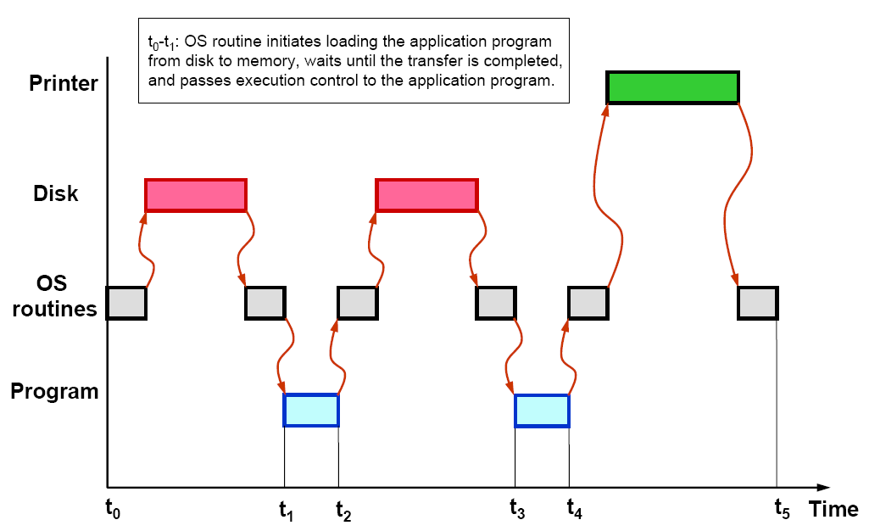
User Program and OS Routine Sharing

Slide 24
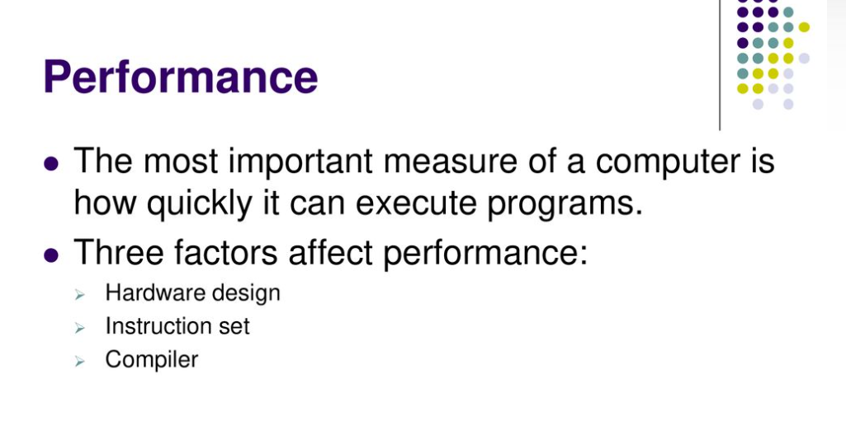

Slide 25
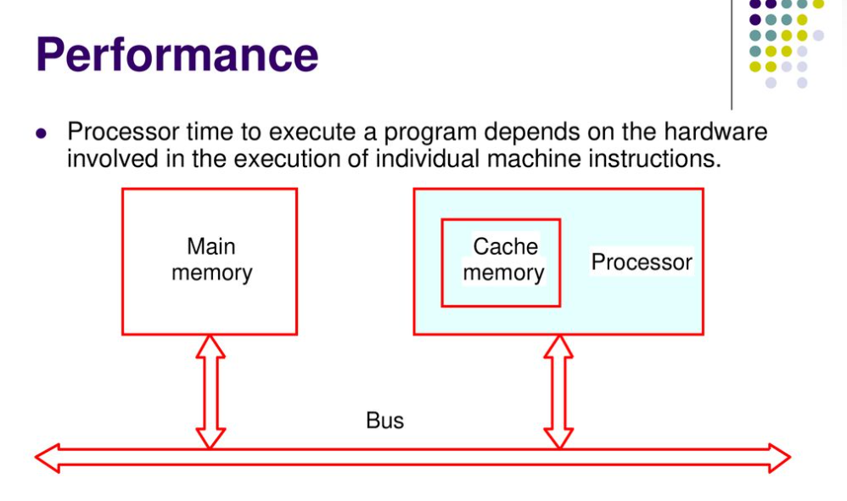

Slide 26
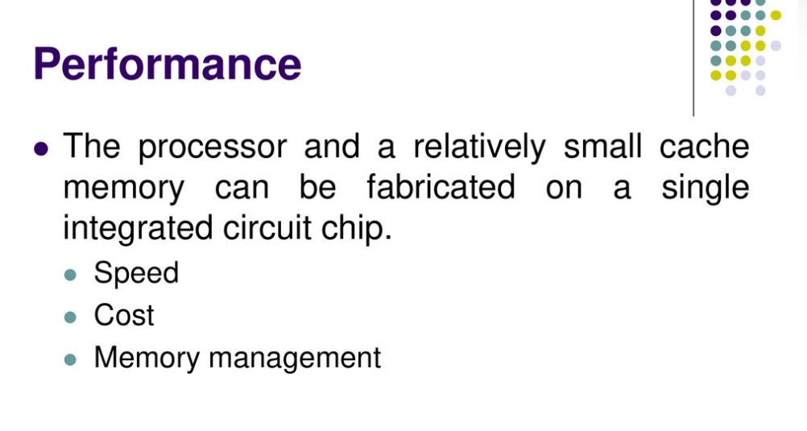

Slide 27
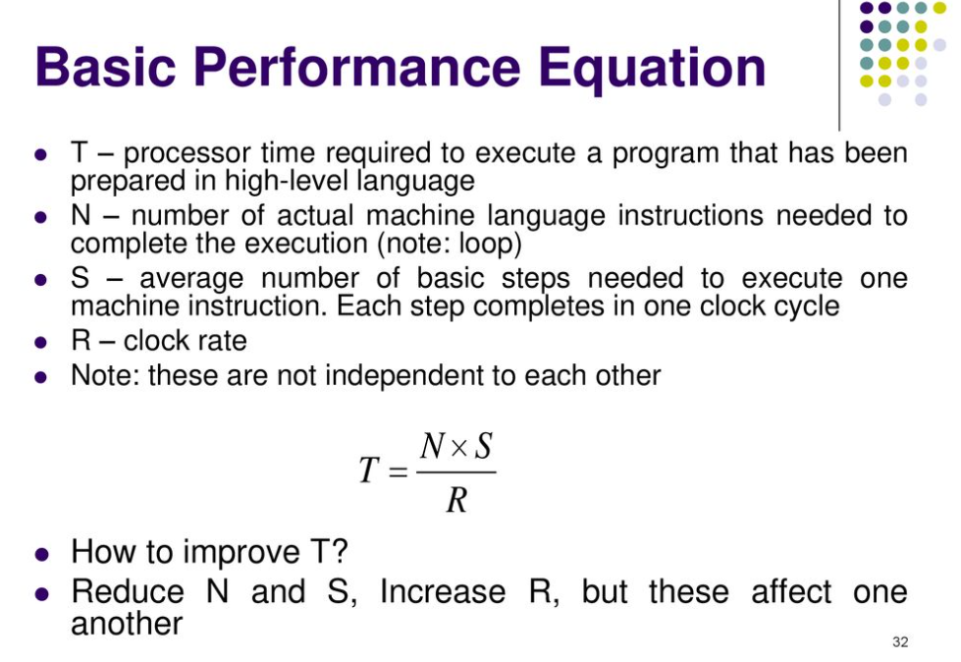
Performance
Clock rate is number of clock cycles per second

Slide 28
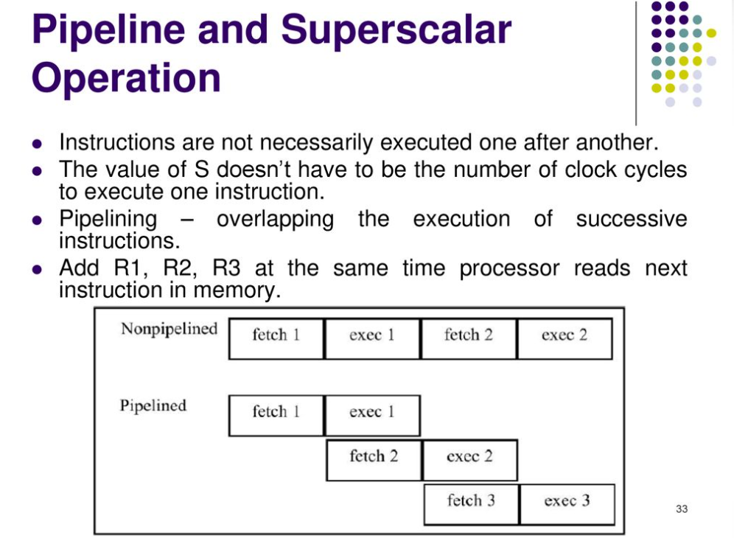
Performance

Slide 29
Performance Improvement
Pipelining and superscalar operation
Pipelining: by overlapping the execution of successive instructions
Superscalar: different instructions are concurrently executed with multiple instruction pipelines. This means that multiple functional units are needed
Clock rate improvement
Improving the integrated-circuit technology makes logic circuits faster, which reduces the time needed to complete a basic step

Slide 30
Performance Improvement
Reducing amount of processing done in one basic step also makes it possible to reduce the clock period, P.
Reduce the number of basic steps to execute
Reduced instruction set computers (RISC) and complex instruction set computers (CISC)

Slide 31
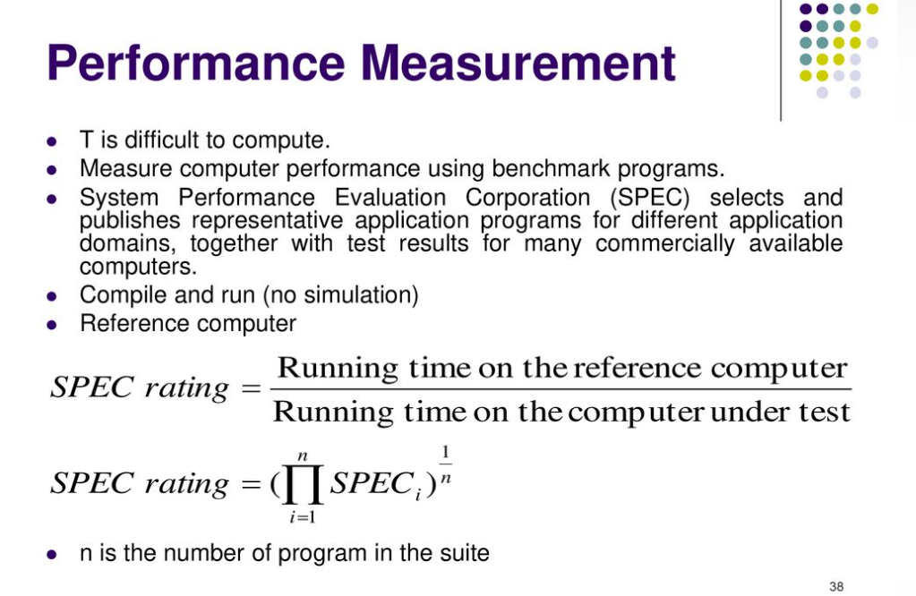
Performance

Slide 32
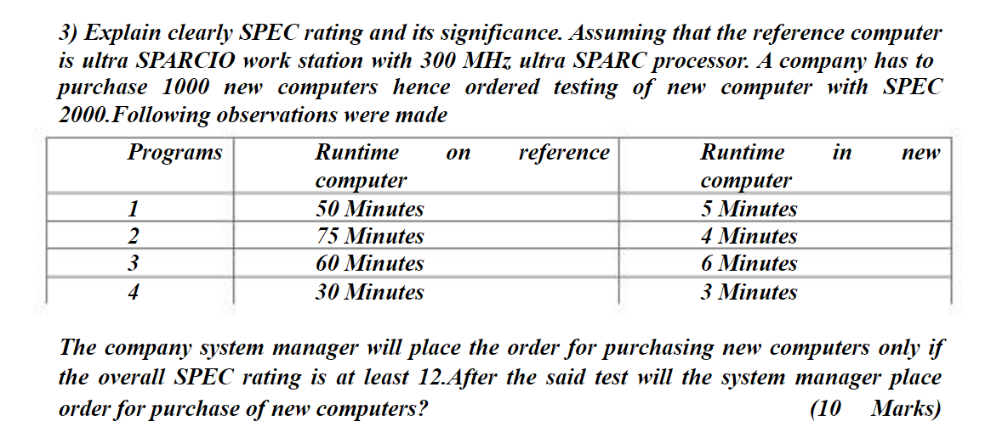

Slide 33
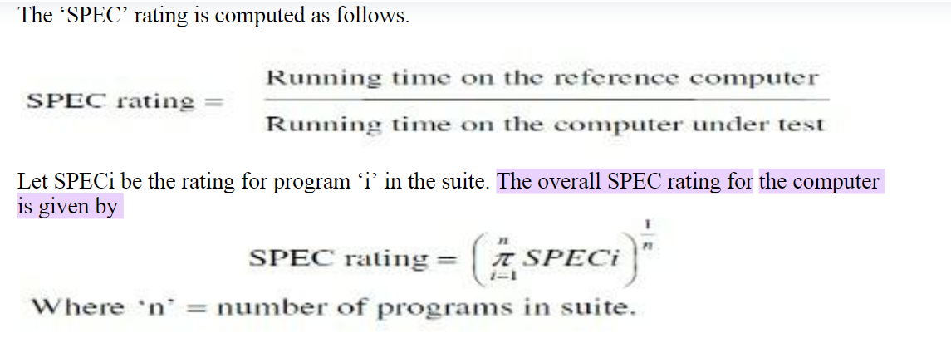

Slide 34
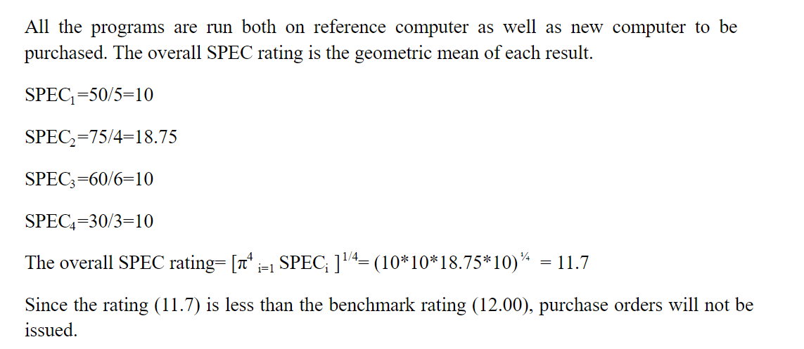

Slide 35
