Slide 1
P.A.R.R.O.T Parallel Asynchronous Robots, Robustly Organizing Trucks
PROJECT MEMBERS:
NABIN KHADKA (HCE076BEI005)
NISHAN GNAWALI (HCE076BEI008)
PRASHANT BASHYAL (HCE076BEI009)
RAMU ACHARYA (HCE076BEI010)

Slide 2
CONTENTS
Introduction
purpose
Objective
Scope and Application
Methodology
Work Completed
Work Remaining
Future Enhancement

Slide 3
INTRODUCTION
Warehouse is used for storing products before they are distributed usually with storage and logistics infrastructure.
Effective warehouse management system is needed to optimize inventory, minimize storage costs, order dispatch, reduce errors and improve efficiency.
Warehouse productivity can be increased using robots by reducing the time taken for pickup/drop; and managing products.
Implementing robotics introduces challenges i.e. coordinating robots to operate efficiently avoiding collisions.
This increase need to design and develop systems that enhance operation efficiency and product management processes.

Slide 4
PURPOSE
To design and develop cost-effective system prototype for a warehouse management.
To implement different methods for integration of cost-effective prototype of the inventory management robots.
To assets the warehouse pickup and drop facilities of items in designated place and improving efficiency.

Slide 5
OBJECTIVE
To design and integrate the prototype robots to pickup and drop pallets in warehouse reducing manual tasks and increasing efficiency.

Slide 6
SCOPE AND APPLICATION
SCOPE
To automate the process of tracking and managing inventory within a warehouse.
Efficiently navigate through warehouses to pick and drop items for order fulfillment resulting in faster and efficient order dispatch.
Sort and consolidate items based on various criteria, such as destination, order, or specific requirements.

Slide 7
SCOPE AND APPLICATION
APPLICATION
In e-commerce, medium and small scale warehouses to assist in order picking, sorting and dropping resulting in improve in order accuracy and delivery speed.
In manufacturing units to automate the movement and management of raw materials, work-in-progress items, and finished goods.
In cold storage where temperature-controlled environments are required & robots can operate without being affected by low temperatures.

Slide 8
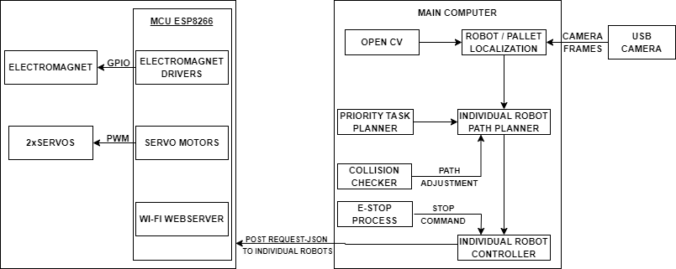
METHODOLOGY
Fig: System model of the project.

Slide 9

1 | 0 | 0 | 0 | 0
0 | 1 | 1 | 1 | 1
1 | 0 | 0 | 0 | 0
1 | 0 | 0 | 0 | 0
1 | 0 | 0 | 0 | 0
(0011000000)₂ = (192)₁₀
Table: Table of ArUco code bit information
Fig: ArUco code sample

Slide 10
ALGORITHM
Start
Load ArUco detector and object detector
Establish connection between Robot and computer system in same network
If camera is connected; get ArUco markers from the corners else goto xv
Discretize the floor into grid
Detect pallet and robots using open cv & Input pallets+goal pair and position of robots
Calculate the distance between Robots and pallets using formula
│ (x₂-x₁ ₎│+│ (y₂-y₁) │

Slide 11
Allocate highest priority pallet to the robot with shortest distance & Plan the path with highest priority robot and loop over all robots
If intersection is present in the path; loop through other path and generate the new path
Send PWM signal to the robots and robot act accordingly
If position of pallet is same as the position of robot; initiate electromagnet
Plan the path of robot from current position to the goal position of pallet
If current position of the robot and goal position is same turn off the electromagnets
End

Slide 12
WORK COMPLETED
Aruco Marker Generation and Recognition: Developed and deployed ArUco markers, allowing robots to detect and recognize specific markers for navigation and coordination.
Object Detection: Achieved the ability for robots to detect objects within their environment, enabling them to interact with their surroundings effectively.
Hardware Setup for Robot: Successfully established the hardware configuration for robot, ensuring its operational readiness.
Camera Calibration: Completed the calibration process for camera enhancing the accuracy in perceiving the environment.
Division of the field in grid: The field was converted into 2D grid

Slide 13
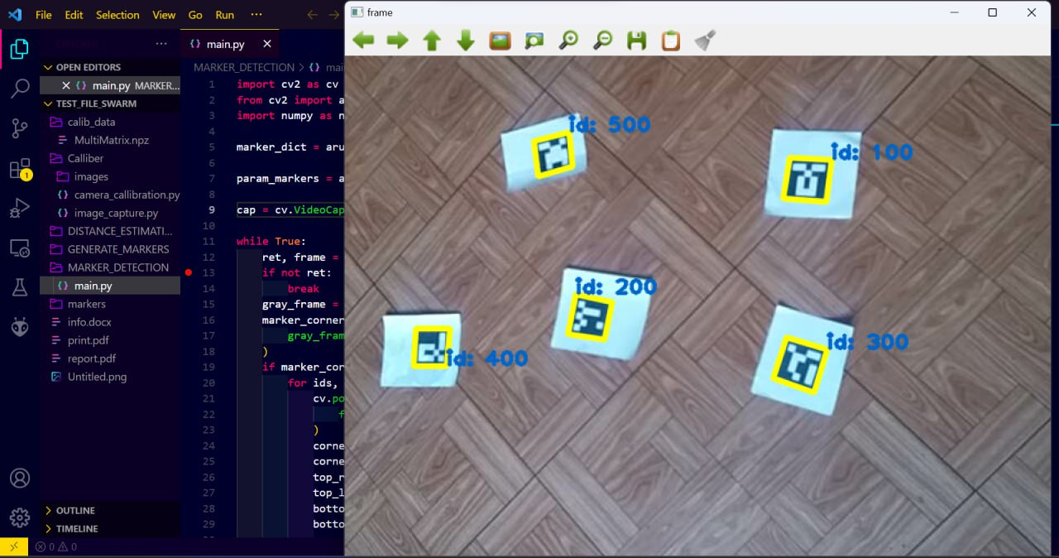

Slide 14
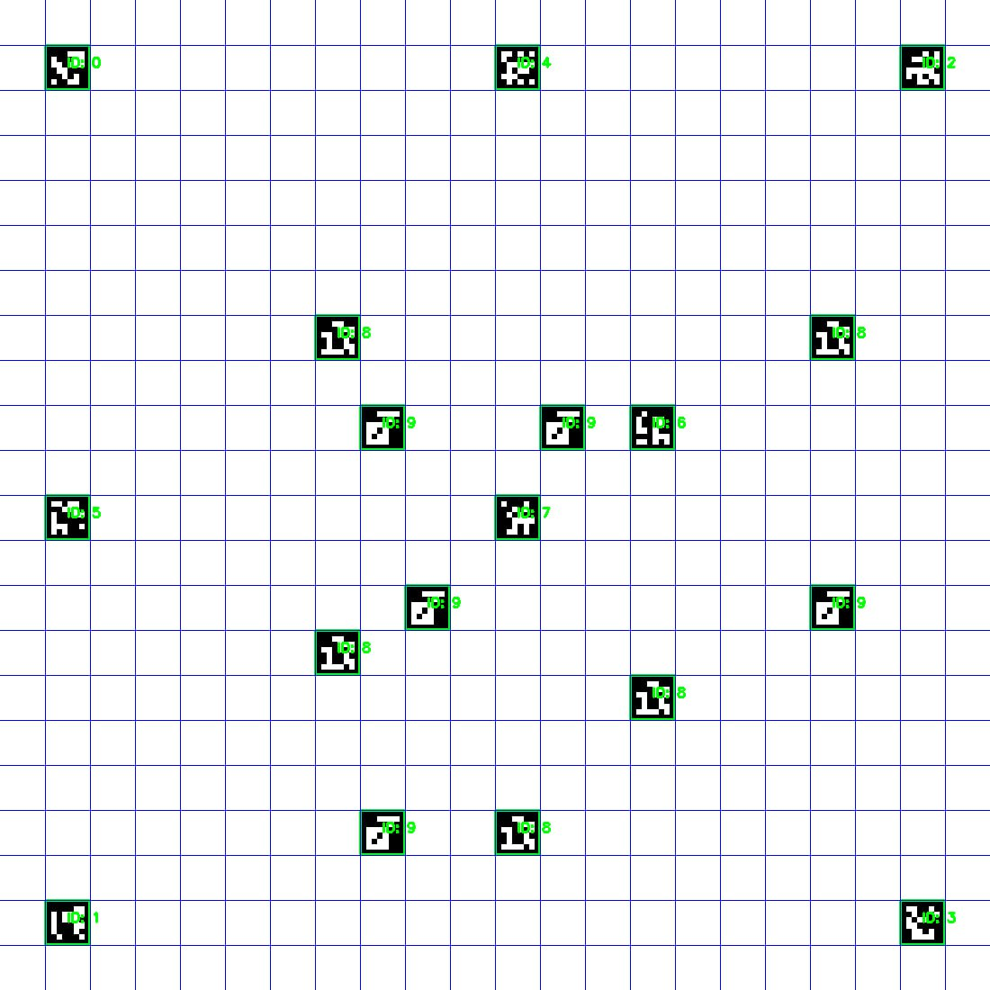
LOCALIZATION

Slide 15
WORK REMAINING
Path Planning and Task Planning Algorithm Implementation
Hardware and Software Integration
Advancement of Robots
Collision checker implementation

Slide 16
FUTURE ENHANCEMENT
Advanced Robotics Integration: Incorporate more advanced robotic technologies, such as machine learning and computer vision, to enhance the robots' ability.
Predictive Maintenance: Implement predictive maintenance systems using sensors and data analytics to anticipate and address potential issues with robots, reducing downtime and ensuring continuous operation.
Cloud-Based Robotics:Utilize cloud computing for centralized control and data storage, allowing for more scalable and flexible robotic systems.
Integration with Warehouse Management Systems (WMS)

Slide 17
CONCLUSION
The project acknowledges how crucial it is for humans and robots to work together smoothly. The project prioritizes a friendly and customizable interface, fostering seamless collaboration between humans and robots in the warehouse for increased versatility and productivity.

