Slide 1

AI AND ML PROJECT

Slide 2
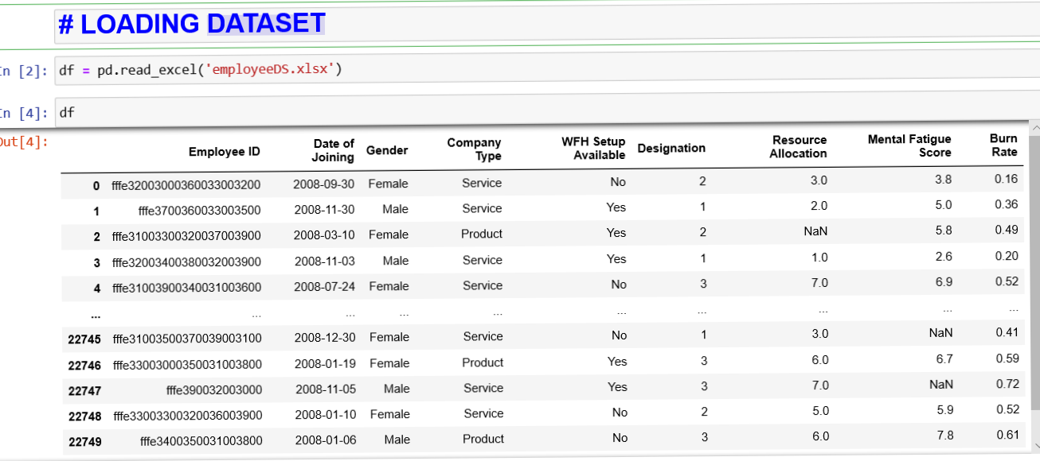
Loading Dataset

Slide 3
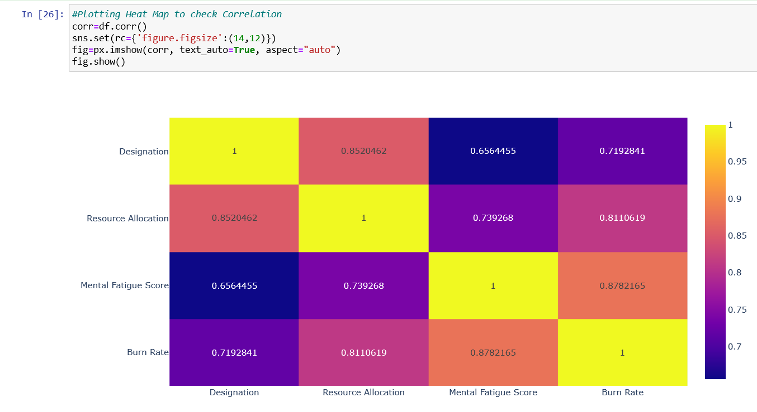
Data Visualization

Slide 4
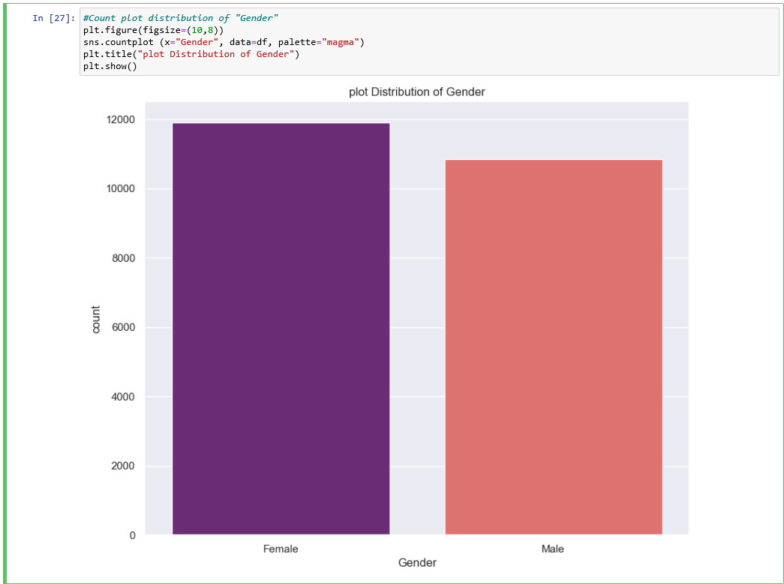
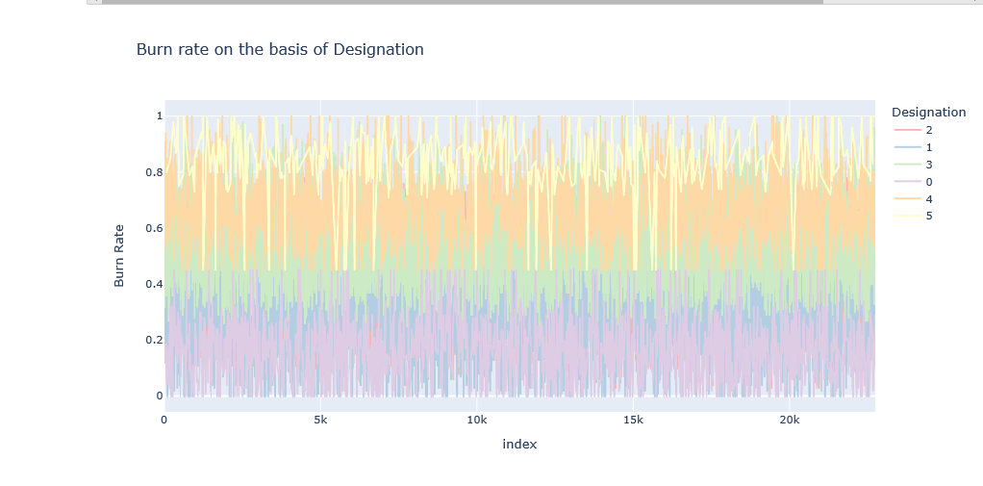

Slide 5
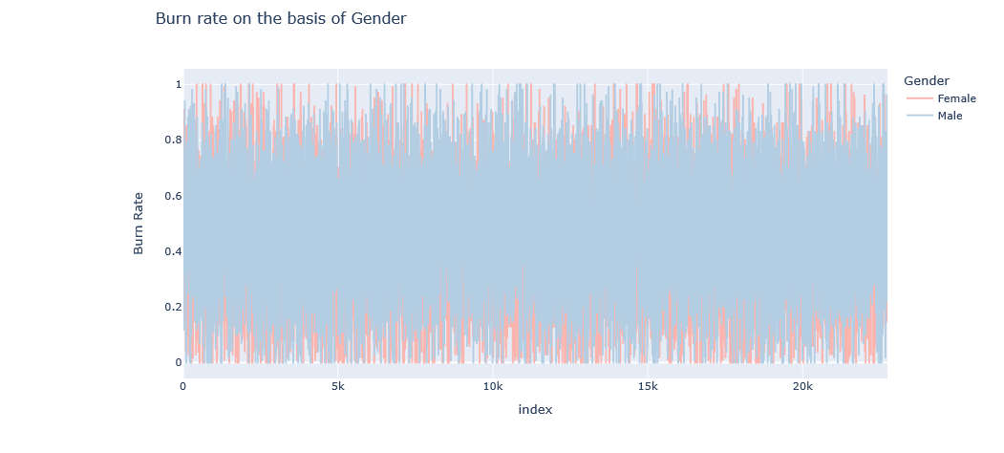
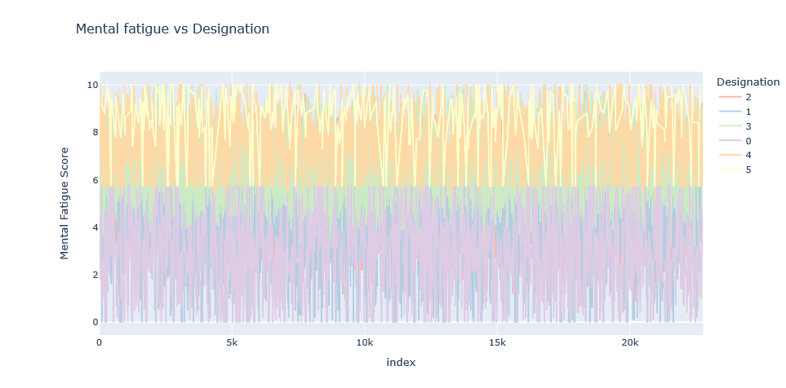

Slide 6
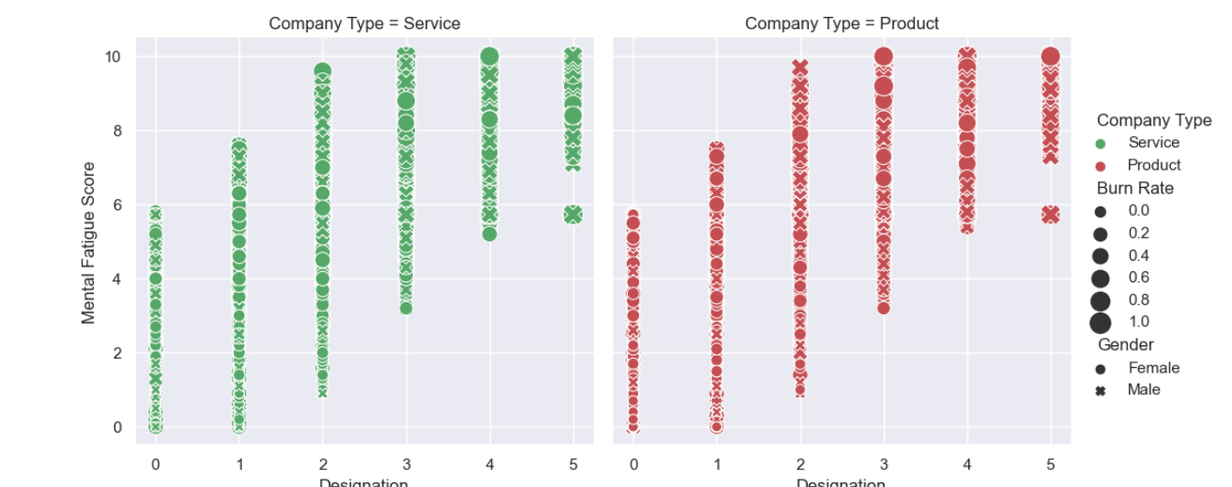

Slide 7
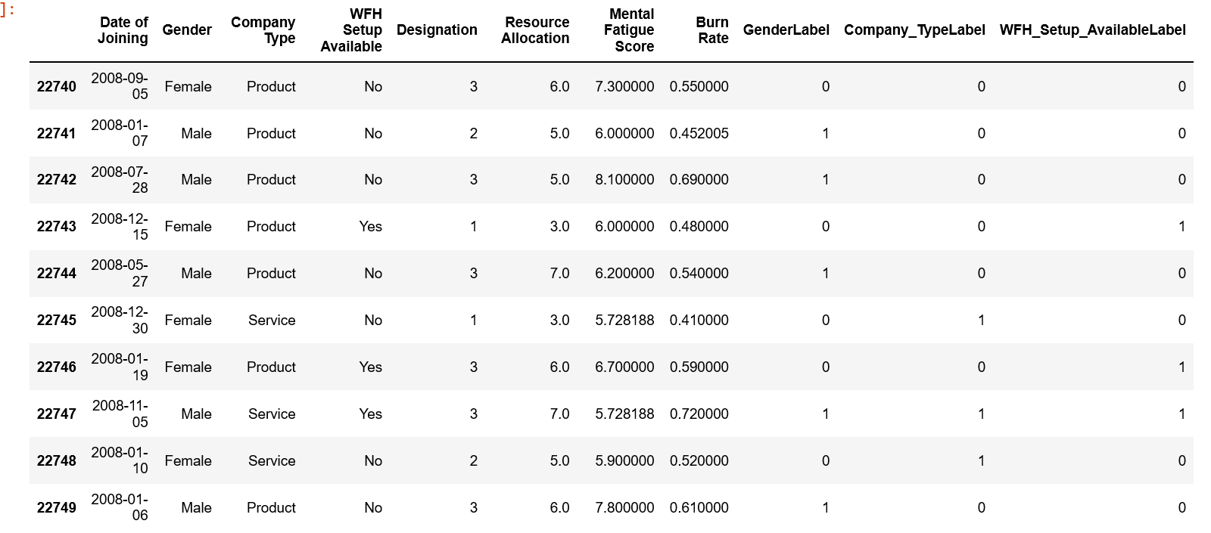
Label Encoding

Slide 8
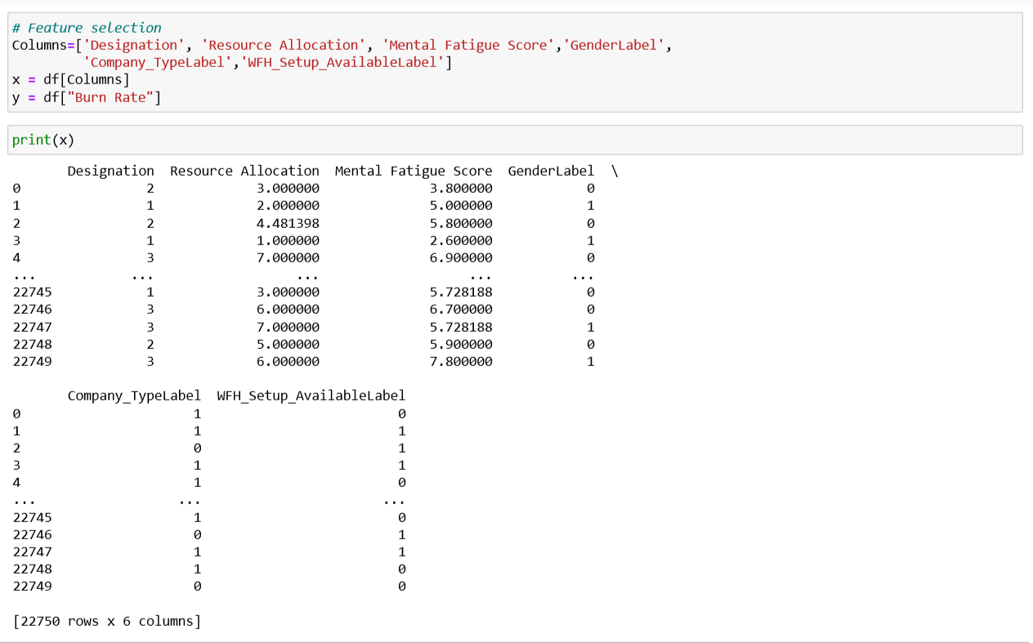
Feature Selection

Slide 9


Slide 10

Implementing Principal Component Analysis (PCA)

Slide 11

Data Splitting

Slide 12
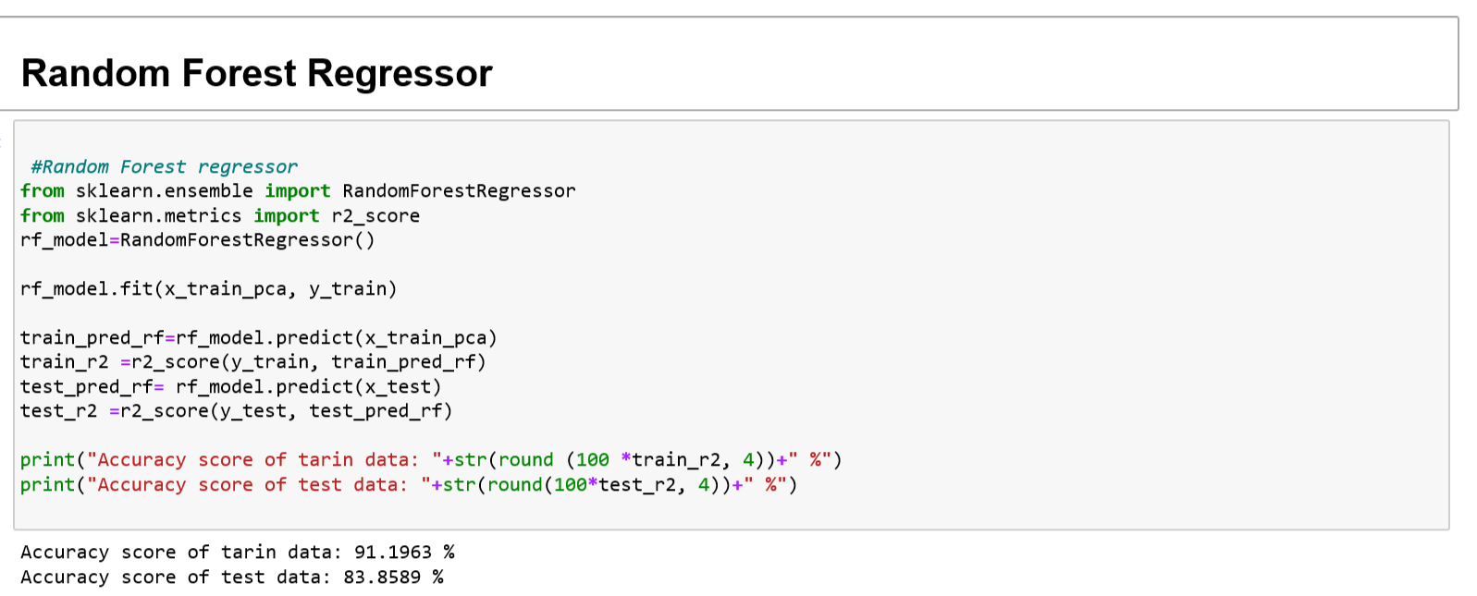
Model Implementation

Slide 13

AdaBoost Regressor

Slide 14


