Slide 1
ABC
Asynchronous Blockchain without Consensus
Ramu Ramasamy

Slide 2
Overview
Consensus
Proof-of-Work & Proof-of-Stake
Double-spending attack
The ABC model
ABC vs BFT Consensus
Assumptions
Components
Transactions
Adversaries
Results
Smart contracts
Related works

Slide 3
Consensus
What do we agree on?
Single chain of blocks containing valid transactions
How do we come to an agreement?
Longest chain rule → Proof-of-Work (PoW)
Complete transaction history

Slide 4
Proof-of-Work & Proof-of-Stake
Proof-of-Work
Complex computation task
Security ∝ Investment on hardware
Miners
Proof-of-Stake
Target → save energy
Minting equipment → less expensive
Validators
The 51% attack → double-spending possible

Slide 5
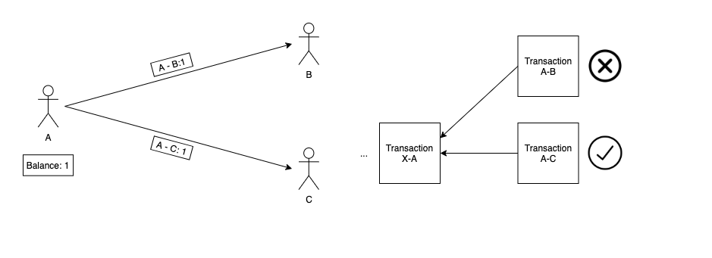
Double-Spending Attack
Spending the same inputs more than once.

Slide 6
The ABC Model
Asynchronous
Permissionless
Final
Simple
Condition
⅔ amount should be held by honest participants
N ≥ 3f + 1
Validators issue acks

Slide 7
ABC vs BFT Consensus
Agreement
Some honest agent accepts → Every honest agent accepts the same
Validity
FIrst transaction observed by every honest agent is same → accept
Termination
BFT | ABC
Every honest agent accept some transaction. | Transaction seen by every honest agents is same → accept

Slide 8
Assumptions
Agents
Honest agents
Adversaries
Adversaries → at most hold ⅓ of the network’s value
Communication → broadcasting messages
Permissionless
Asynchronous → messages are not time-bound
Asymmetric encryption

Slide 9
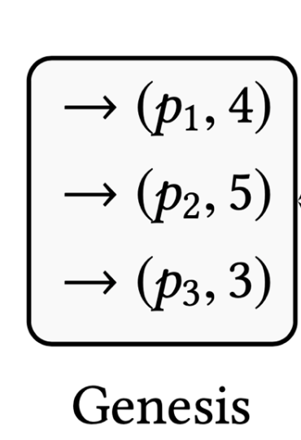
Components
Output → basic unit of transaction
Value
Owner key
Validator key
Genesis → initial distribution of cryptocurrency

Slide 10
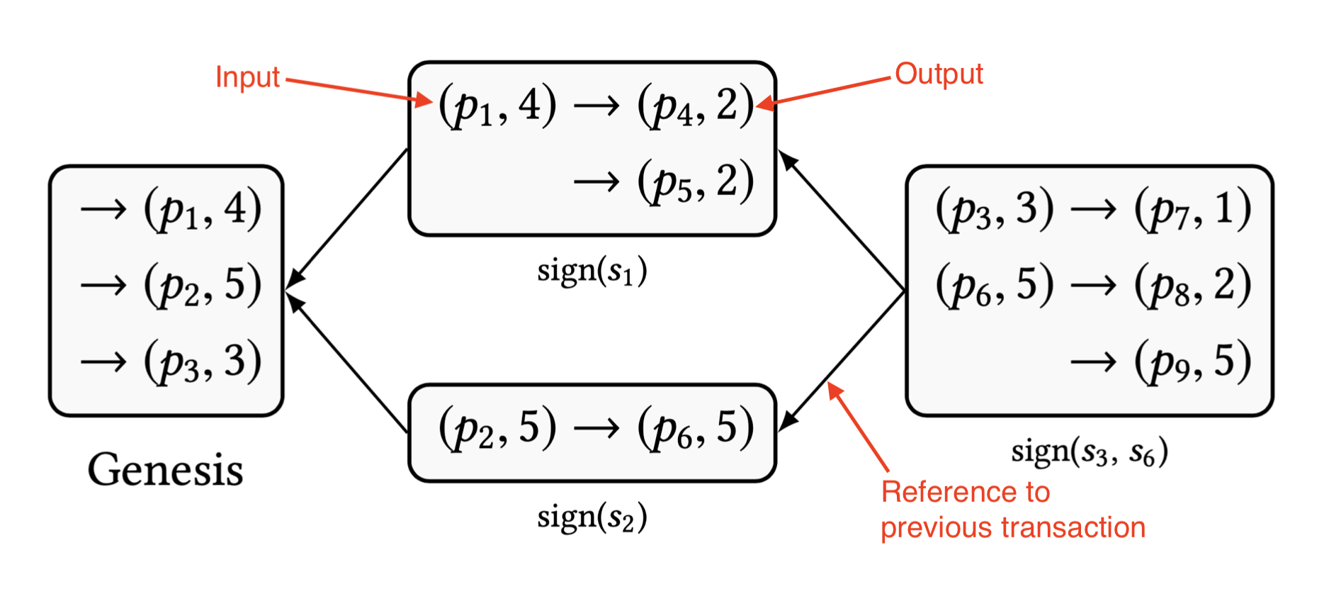
Transactions
Broadcasted as messages
Types
Spending transaction
Reference transaction (acks)
Refers previous transaction
Directed Acyclic Graph (DAG)
Past transactions → past(t)
Dependencies → can be transitive
Conflicts

Slide 11
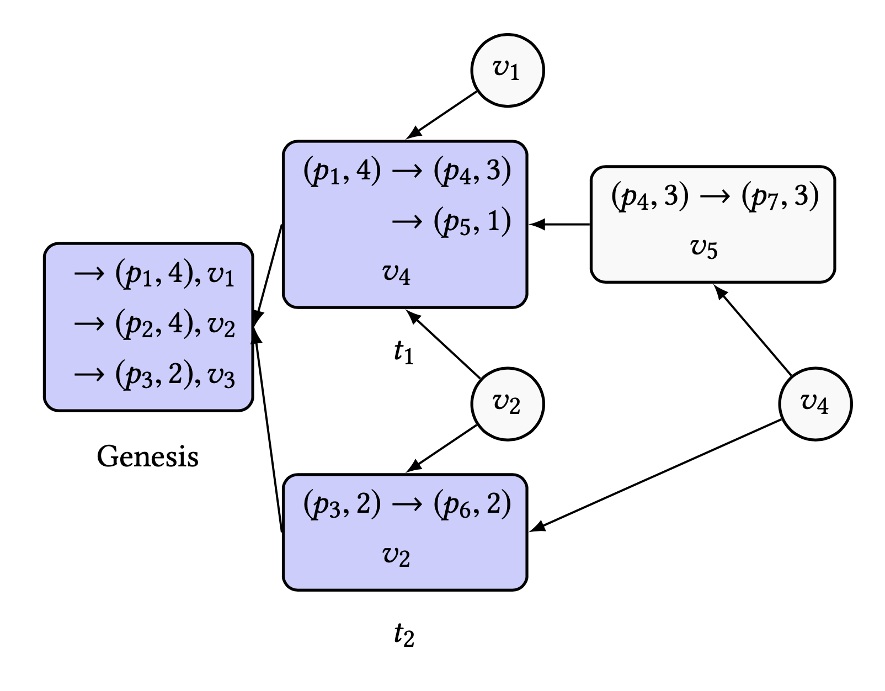
Transactions (Cont.)
Effective ack (C_{t}) → ack contributing to confirmation
Confirmed transactions
Set of effective acks (C_{t})
C_{t1} = {𝑣₁, 𝑣₂}
C_{t} → at least 2f + 1

Slide 12
Adversaries
Cannot control the network
Delay delivery time
Initial inputs of the network → 3f + 1
At least 2f + 1 held by honest agents
Transactions
Adversary → Honest agent
Honest agent → Adversary

Slide 13
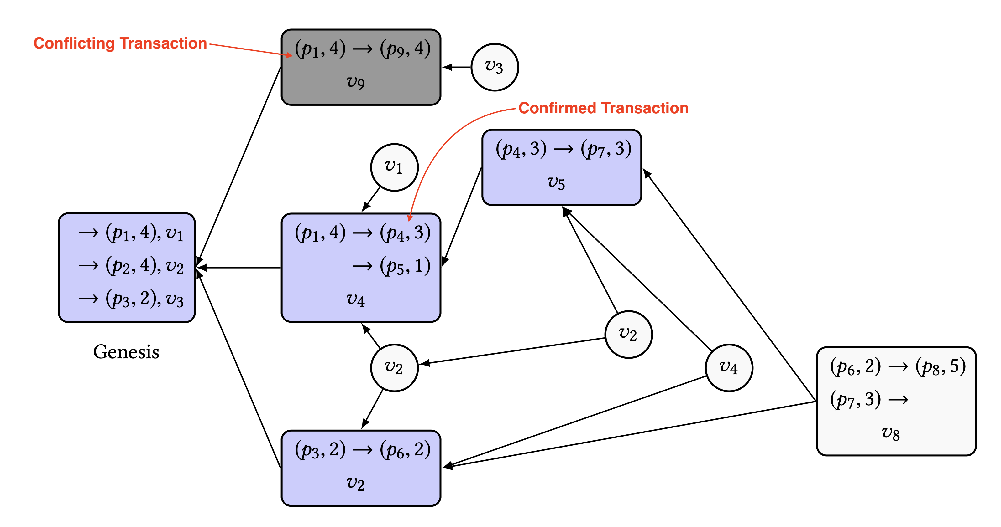
DAG with Double-Spending

Slide 14
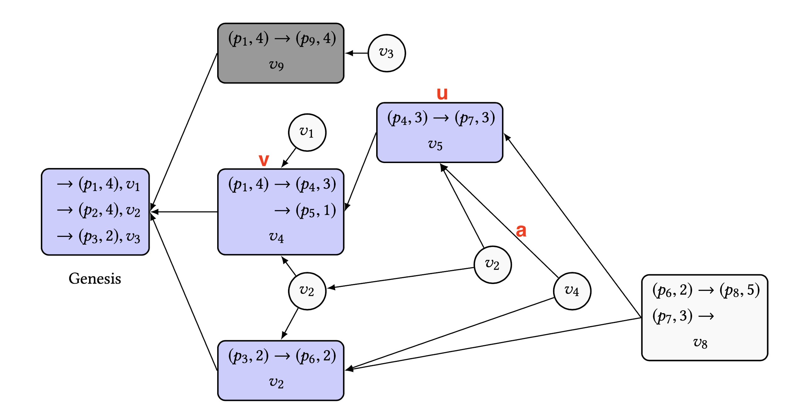
Confirmed transaction u depends on v, v is confirmed
a → effective ack for u
past(a) = {u, v, Genesis}
past(u) = {v, Genesis}
Results
u ∈ past(a)
v ∈ past(u)
v ∈ past(a)

Slide 15
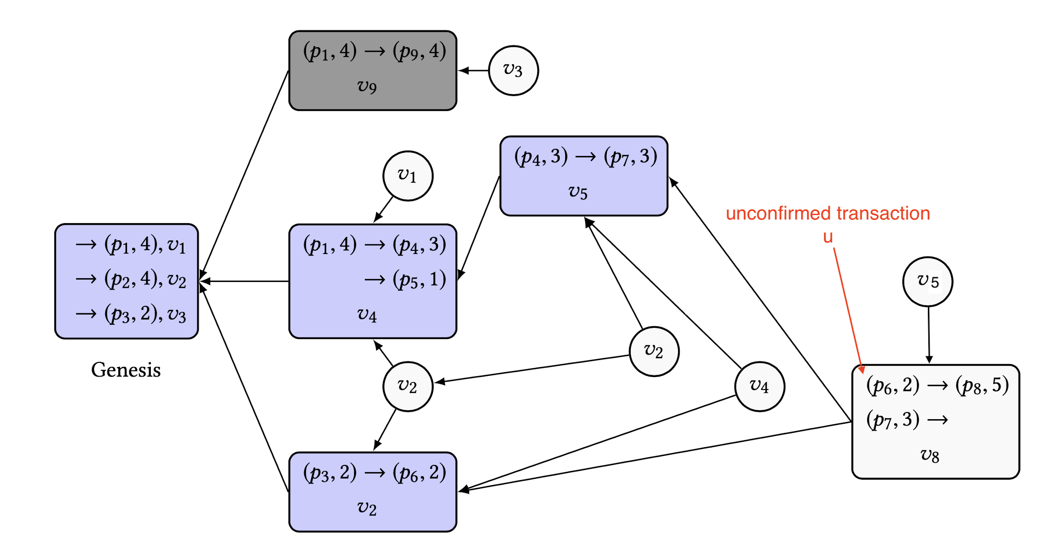
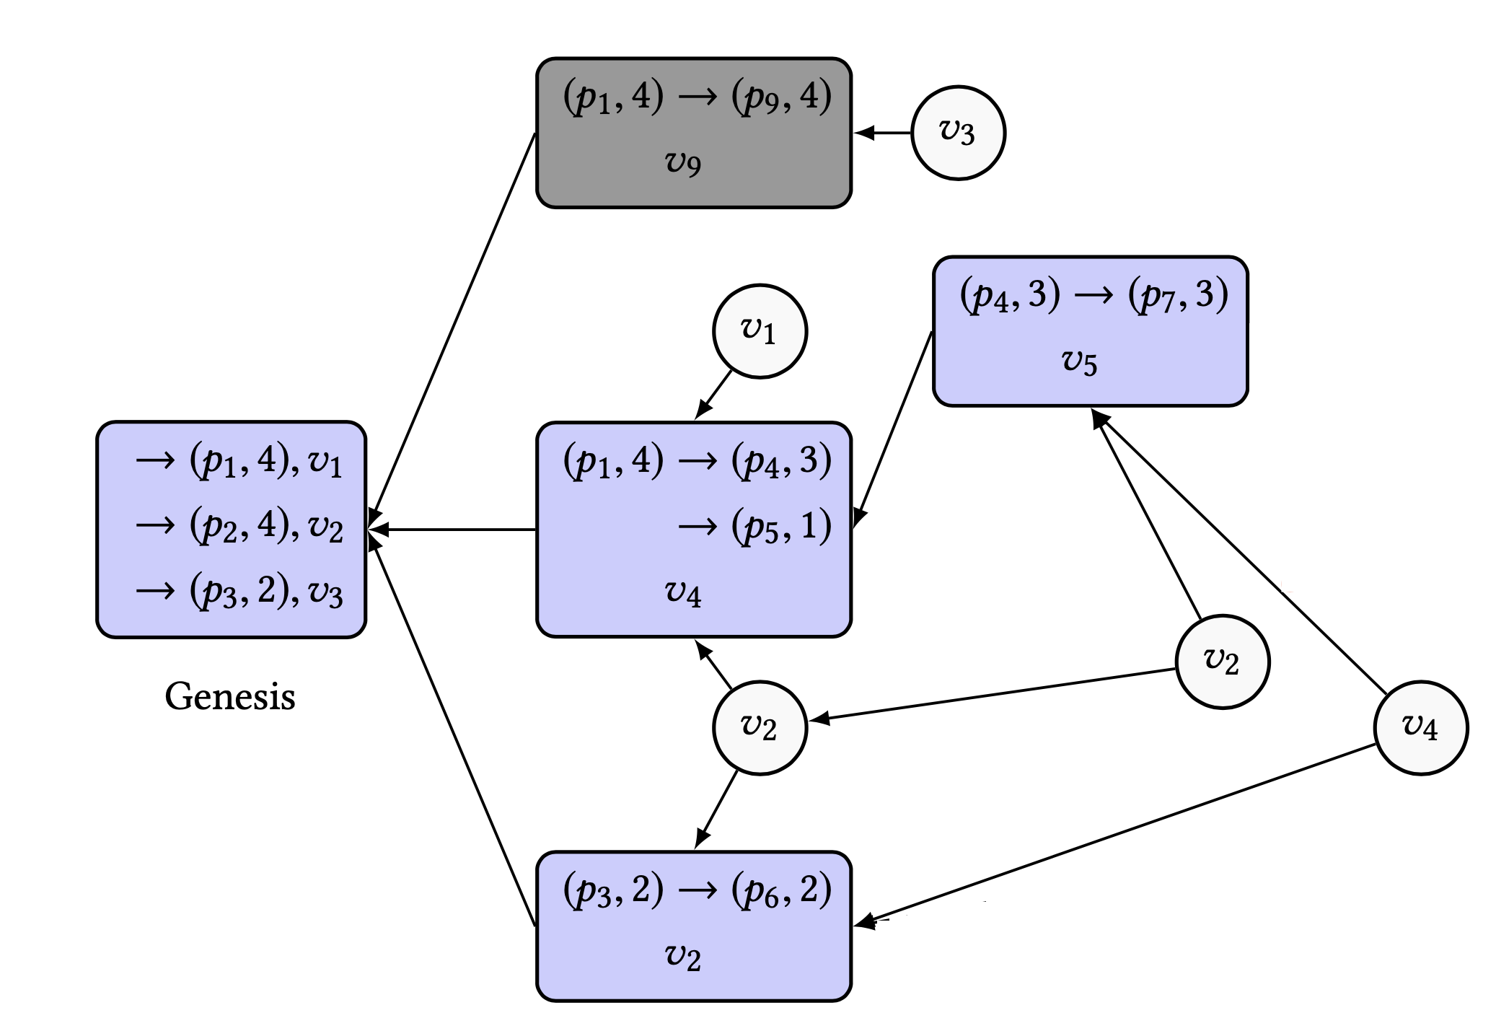
There are no unconfirmed transactions
G
G’

Slide 16

No conflicting transaction can become confirmed
t ∈ past(a1)
t ∈ past(a2)
t ∈ past(a4)
t would have received 2f+1 acks
At least f+1 honest acks
t’ can receive at most 2f acks
Not sufficient for confirmation
t and t’ issued at same time
Either of them gets confirmed
Neither of them are ever confirmed

Slide 17
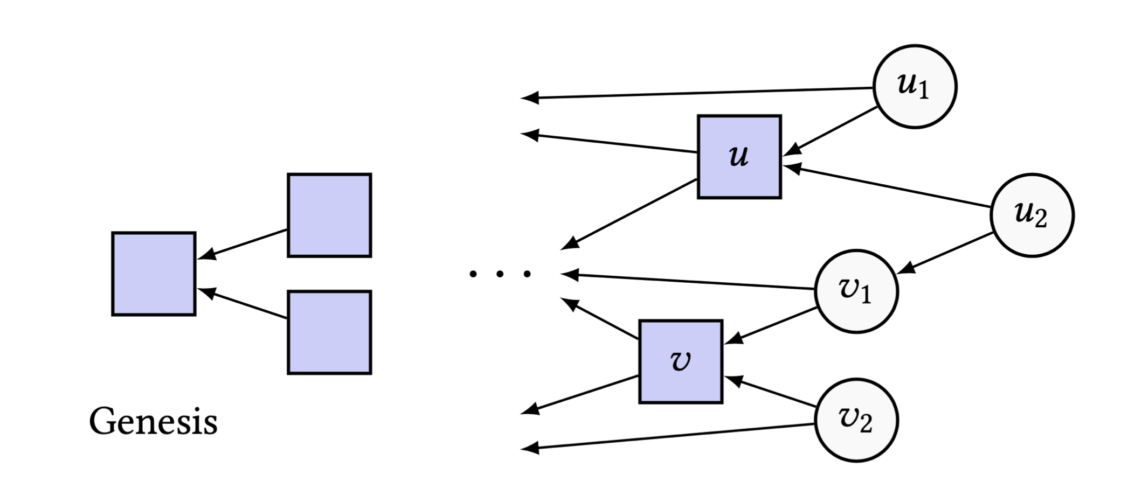
There are no conflicting transactions in a DAG
If transactions u and 𝑣 are confirmed → either u ∈ past(C_{𝑣}) or 𝑣 ∈ past(C_{u})
Here, 𝑣 confirmed before u
C_{u} = {u₁, u₂}
C_{𝑣} = {𝑣₁, 𝑣₂}
past(C_{u}) = {u₁, u₂, u, 𝑣₁, 𝑣, ...}
past(C_{𝑣}) = {𝑣₁, 𝑣₂, 𝑣, ...}
Results
u ∉ past(C_{𝑣})
𝑣 ∈ past(C_{u})

Slide 18
Smart Contracts
Disadvantage
Identified as double-spending
Requires → transaction ordering mechanism

Slide 19
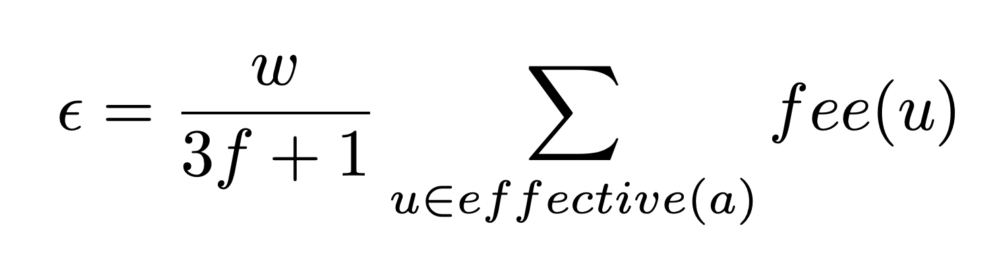
Transaction Fees and Money Creation
Transaction fees
Spamming attacks
acks → no fees
Every validator receives incentive
Money Creation
Multiplying fee with a constant, ɑ > 1

Slide 20
Non-Consensus Financial Transaction Model
Transaction validations → similar to acks
Transaction confirmations → 2f+1 valid signatures
Partial ordering
Life cycle
Proposed
Authorized
Sequence number
Nodes → local set of authorized transactions
Transaction
Sequence number
Authorized input transactions
Most recent transaction by the same owner
Outputs
Signature of owner

Slide 21
Non-Consensus Financial Transaction Model (Cont.)
Validation → proposed transaction + recent transaction
Validity
Structural → authorized inputs / amount / sequence number of recent transaction
Functional → local authorization set of transactions
Structurally valid for one honest node → valid for all other honest nodes
Functional validity → locally authorized transactions
No possibility for double-spending

Slide 22
Consensus Number of a Cryptocurrency
Transaction confirmations → 2f+1 acknowledgements
Atomic snapshot memory
Multiple process → withdraw from the same account
Account order → sequence number
Conflicting transaction (same sequence number) → account blockage

Slide 23
Summary
ABC
Asynchronous
Permissionless
Simple
Ensures finality
Full functionality of a cryptocurrency
Related works

Slide 24
Thank You!

Slide 25
PoW and Nakamoto Consensus
Proof-of-Work (PoW)
Complex computation task
Sybil resistance
Security ∝ Investment on hardware
Miners → maintain the network
Disadvantages of Proof-of-Work
Excessive energy wastage
The 51% attack → double-spending possible
Mining pools

Slide 26
Proof-of-Stake (PoS)
Target → save energy
Validators → maintain the network
Approving fraudulent transaction → loss of stake
Advantages when compared to PoW
Mining equipment
More decentralized
Disadvantage
The 51% attack → double-spending possible
Peercoin

