Slide 1
Local Agent & Datastructure - abccore
„abccore“-Module
By Nico Wördenweber
And
Matthias Pilot

Slide 2
Chapter-Overview
Module-Overview
Interfaces
Datastructure
Example Calls
Changes to the original ABC-protocol
Special-Cases:
Pending Transactions
Orphaned Nodes

Slide 3
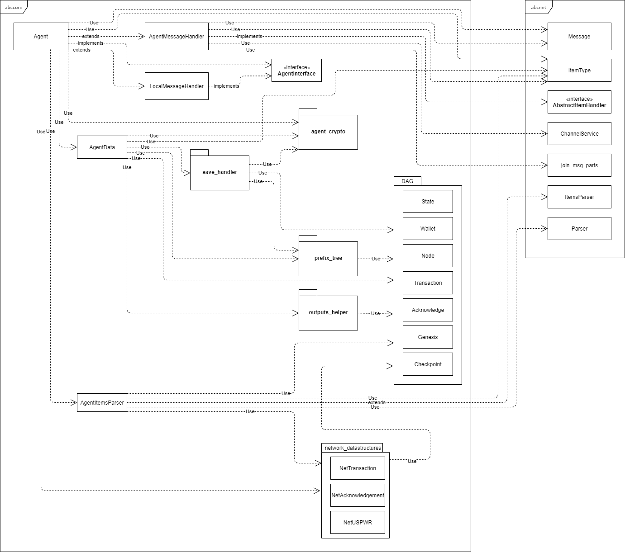


Module-Overview

Slide 6
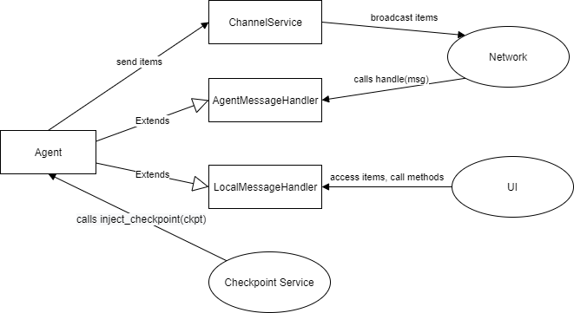
Interfaces

Slide 7
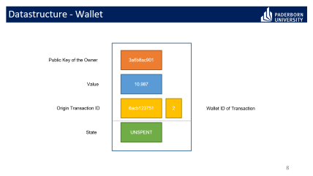
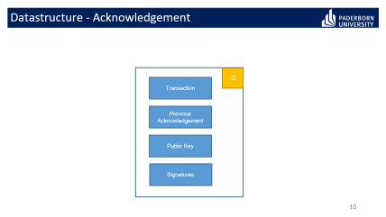
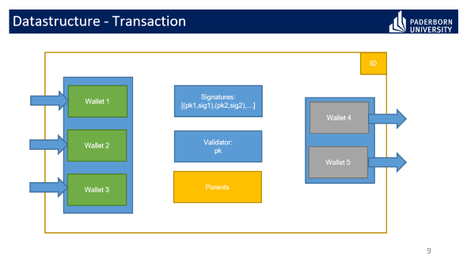
Datastructures

Slide 8
Datastructure - Wallet
3a6b8ac901
Public Key of the Owner
10.987
Value
6acb123751
2
Origin Transaction ID
Wallet ID of Transaction
UNSPENT
State

Slide 9
Datastructure - Transaction
ID
Wallet 1
Signatures:
[(pk1,sig1),(pk2,sig2),…]
Wallet 4
Wallet 2
Validator:
pk
Wallet 5
Wallet 3
Parents

Slide 10
Datastructure - Acknowledgement
ID
Transaction
Previous Acknowledgement
Public Key
Signatures

Slide 11
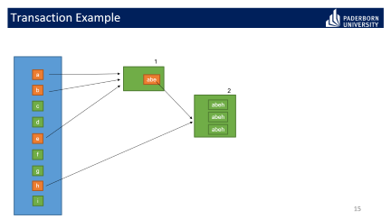
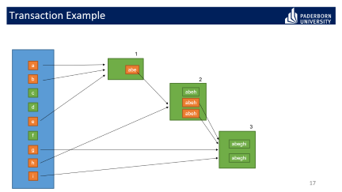
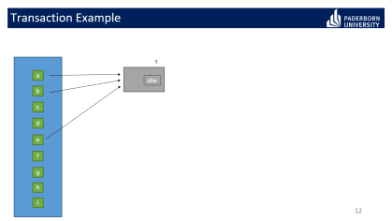
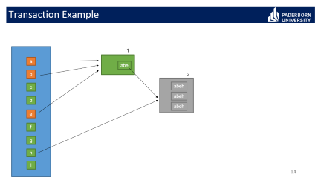
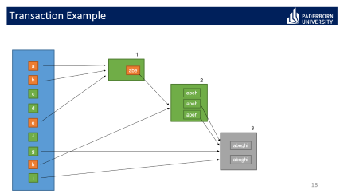
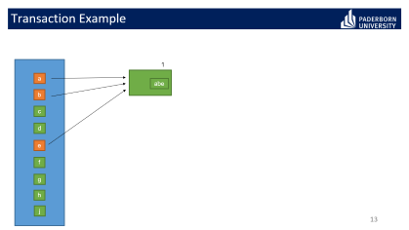
Transaction Example

Slide 12
Transaction Example
1
a
abe
b
c
d
e
f
g
h
i

Slide 13
Transaction Example
1
a
abe
b
c
d
e
f
g
h
j

Slide 14
Transaction Example
1
a
abe
b
2
c
abeh
abeh
d
abeh
e
f
g
h
i

Slide 15
Transaction Example
1
a
abe
b
2
c
abeh
abeh
d
abeh
e
f
g
h
i

Slide 16
Transaction Example
1
a
abe
b
2
c
abeh
abeh
d
abeh
e
3
f
abeghi
g
abeghi
h
i

Slide 17
Transaction Example
1
a
abe
b
2
c
abeh
abeh
d
abeh
e
3
f
abeghi
g
abeghi
h
i

Slide 18
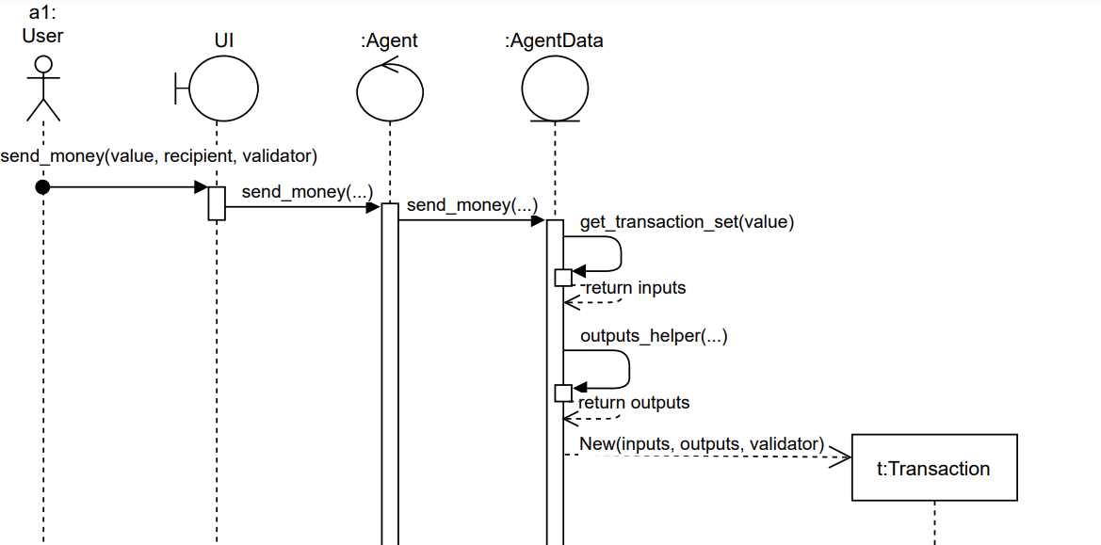
Example Calls – Send Money

Slide 19
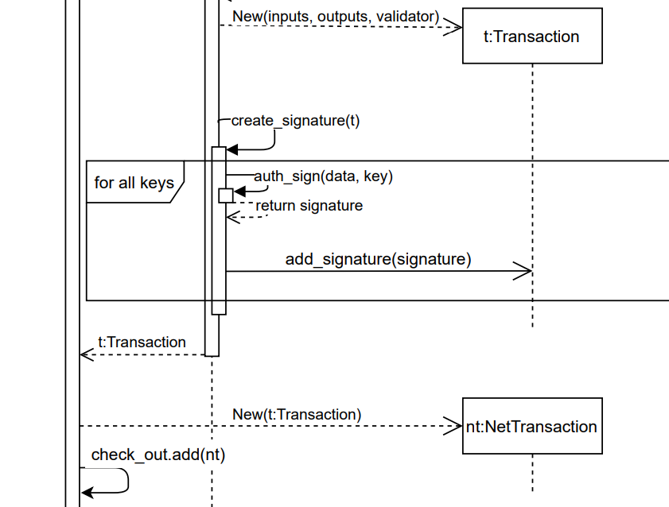
Example Calls – Send Money

Slide 20
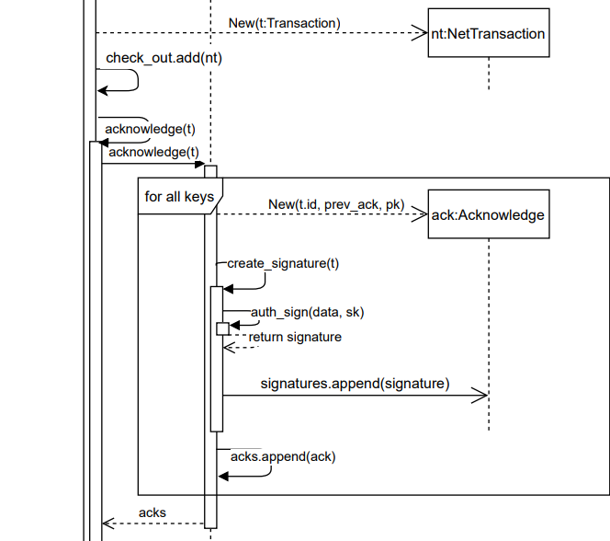
Example Calls – Send Money

Slide 21
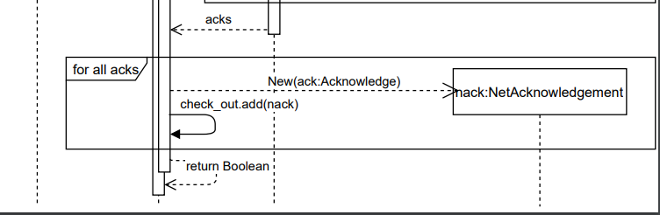
Example Calls – Send Money

Slide 22
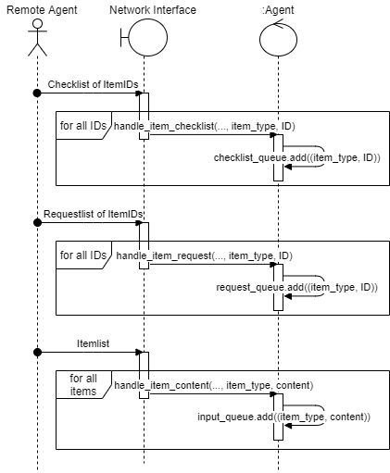
Network Queues

Slide 23
Changes
Incentive gain only within new Checkpoints
Stake Recalculation only within new Checkpoints
→ Reduction of Network Traffic for „negligible“ small values
Checkpoints do not include all unspent Wallets (utxos), only UTXOs from incentives. Transactions for all other UTXOs are further saved until spent.

Slide 24
Special Cases – Pending Transactions
Transactions, which don‘t get confirmed stay in the pending list
Agent will send the Pending Transactions in a checklist after a certain amount of time
Other Agents will
A) Create an Acknowledgement for this Transaction if the Transaction is so far unknown to them
B) Resend all known Acknowledgements for this Transaction

Slide 25
Special Cases – Orphaned Nodes
Nodes (Ack, Txn) which don‘t have any known parents are added to the orphan list
Nodes from the orphan list are repeatedly calling for their parents and request them over the network by ID

Slide 26
Replay Functionality
If an Agents starts his last saved status of the DAG is most probably not up-to-date anymore
After loading the DAG the Agent will ask for the latest Checkpoint
After the Checkpoint has been possibly injected the Agent sends an Unspent-Wallet-Request and all his known UTXOs within it to the Network
Remote Agents will answer with their UTXOs and the Agent can update his own DAG by following the Trace of their parents with help of the Orphan and Pending List

