Slide 1
Checkpoint

Slide 2
Purpose of Checkpoints in ABC
Finalize large size of the transaction DAG w.r.t time
Checkpoint as new genesis
Erasing redundant transaction ledger
Stake distribution
Incentives

Slide 3
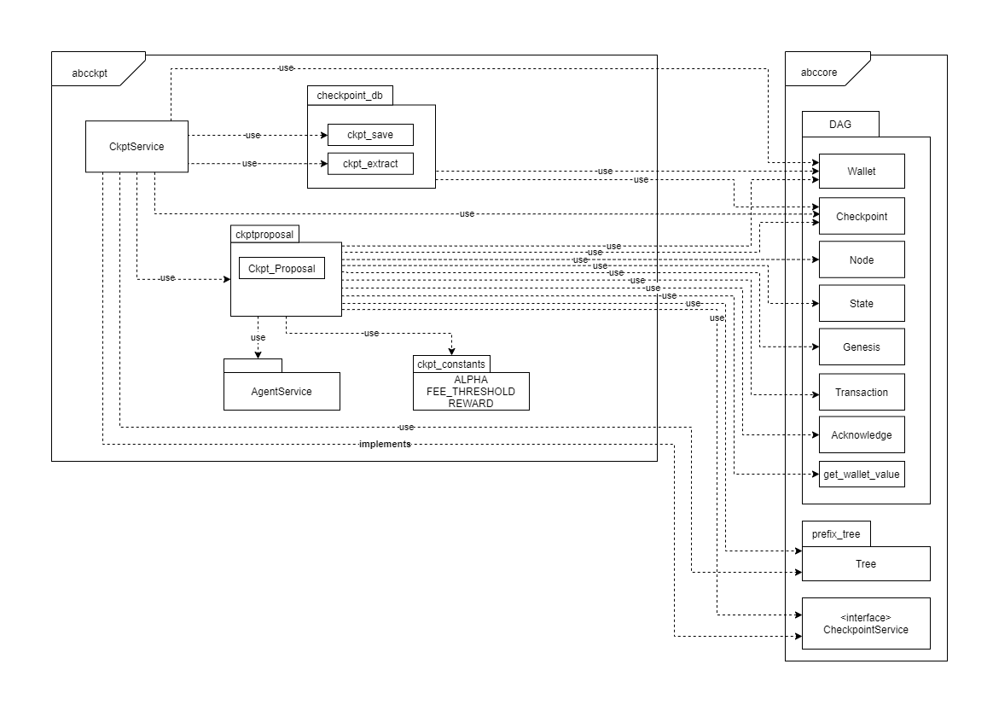
Checkpoint Service

Slide 4
Tackled Issues
Deciding on Checkpoint content
Include transactions?
Transaction processing while Checkpoint creation
Incentive calculation
Stake distribution

Slide 5
How a Checkpoint gets created
By processing local DAG:
Transactions
Acknowledges
Last Checkpoint
Rewards calculation with Acknowledges
Stake calculation with Transactions and Checkpoint: Validator tag
Calculate unspent output list by maintaining set of input-output wallets

Slide 6
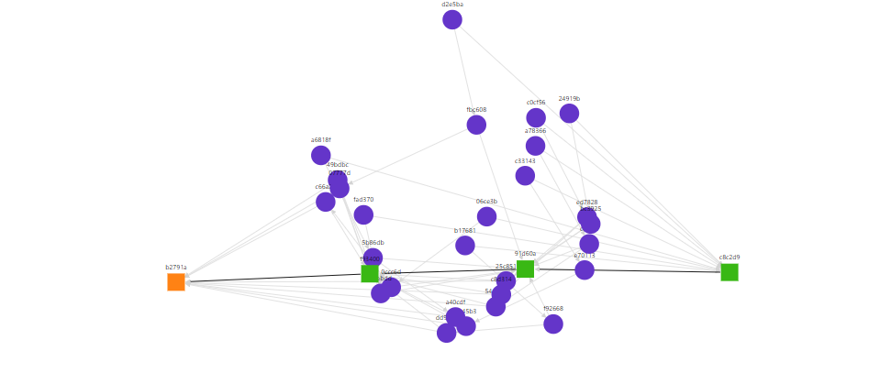
DAG Traversal
Visual representation of DAG

Slide 7
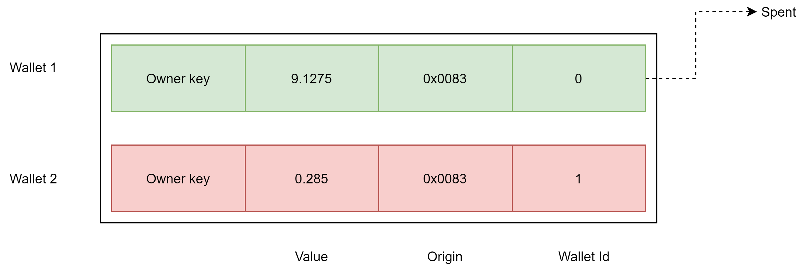
Checkpoint related properties
Transition: Wallets present in checkpoint might be already spent
Wallets are mapped by origin and wallet ID
The new transaction will have exact same wallet which can be traced
If spent during the transition, the new transaction will still be valid
An example of output list of a transaction

Slide 8
Checkpoint attributes
ID
Origin
Height
Unspent Transaction Outputs: UTXOs
Stake list
Fee/Reard list: last wallet of this list contains reward for miner
Miner

Slide 9
3C: Chain Check on Checkpoint
Id
Origin
Height

Slide 10
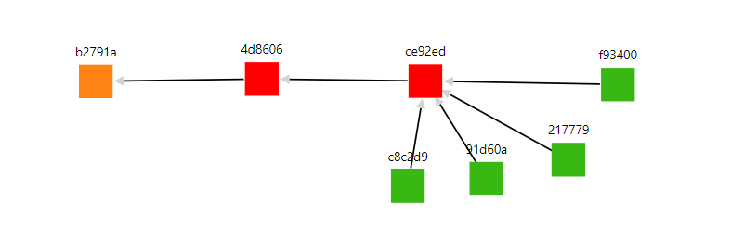
Checkpoint Properties
Transactions which are not fully spent are kept in the DAG
Helps in validating future transaction using the unspent wallets
Once fully spent, transaction will be deleted with upcoming checkpoint
Reduce DAG history
DAG visualization after Checkpoint

Slide 11

Incentive Properties
Origin of the reward Wallets is the Checkpoint
Stake of the rewards belongs to the respective owner
Miner can earn and compensate the Issuer and Receiver
Transaction fees can be earned back as reward for stake delegated
No rewards for Acknowledges if the value is <
Checkpoint is treated as a Transaction

Slide 12
Validator Properties
Agents can freely decide whom to choose as a Validator
The Transaction fees may be earned back by delegating stake of the transaction value "proof of stake pool"
Validators can lure possible agents into their pool by offering the best returns
Validators are financially punished if they are too small.
Computing the rewards to be 0 if the delegated stake is less than threshold
i.e., Forced to collaborate

Slide 13

Money Generation
The transaction pays: fees(x)
Each Validator receives:
The Transaction issuer will always pay fees
Only if the Issuer has stake < 1/3 and 1 < α < 3
Constant reward to the miner
Miner reward in last Wallet of the fee reward list

Slide 14
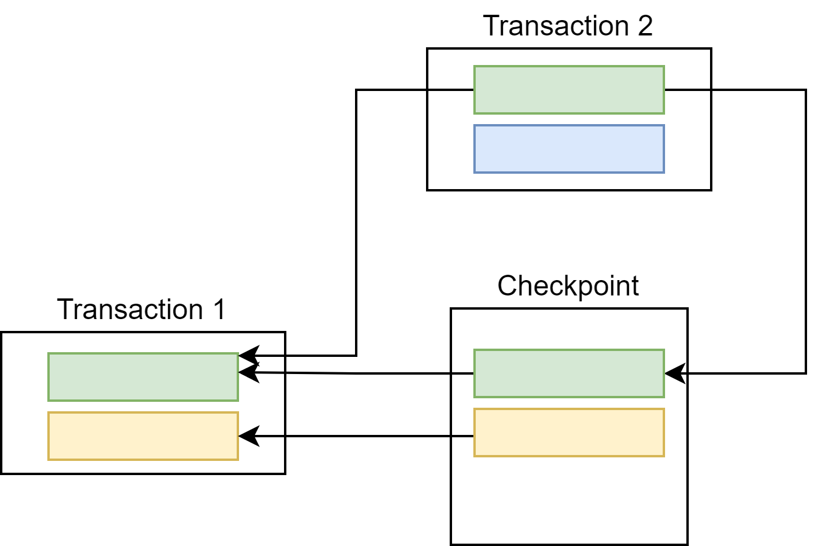
Achievement
Agents joining the system do not need to process the transactions summarized by the checkpoint
No Waiting period or halt while Checkpoint generation
No conflicts even if the wallet present in Checkpoint was spent during the transition.
Checkpoint Transition

Slide 15
Future work
Fees/Coins can be standardized
e.g., 1 Satoshi = 0.00000001 BTC
The protocol can be configured to automatically share the Transaction fees earned by delegated stake with the money holders
More study on incentive and money generation

