Slide 1
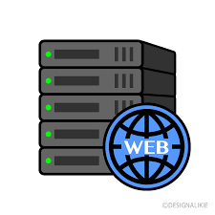

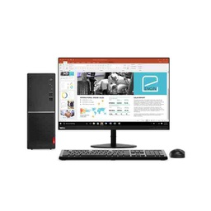
How does Web work?
Client
HTTP Request
HTTP Repense
Web Server
the browser sends an HTTP request to the server asking it to send a copy of the website to the client. This message, and other data sent between the client and the server, are exchanged over the internet connection using TCP/IP..
The server receives the request, and sends the data to the client as a "packet“.
The browser gathers the packets to recompose the entire web site/application and displays it on the screen.

Slide 2
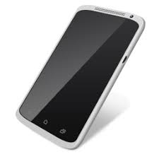

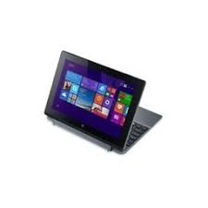



How does Web work?
Domaine Name
HTTP REQUEST
HTTP REPONSE
Web Browser
Client

Slide 3
How does Web work?
HTML Fils
JS Application
Video
Picture…
Request from client
Reponse
DATA BASE
SERVER

Slide 4
What we need to be a web developer?
hardware and software equipment
have the will and the self-confidence
develop basic skills in coding and programming
participate in solid work placements as a beginner developer
obtain the certification(s)
Create the CV

Slide 5
why choosing to lear web developer
Work requested all over the word
Very motivating salary with opportunities to work freelance
There is no routine work
Creative and fun!

