Slide 1
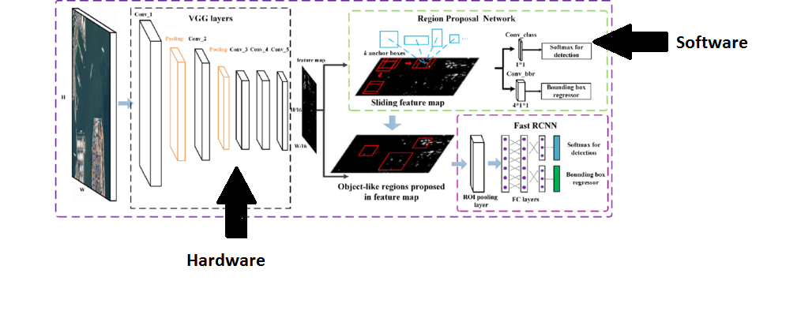
Block Diagram of the project

Slide 2
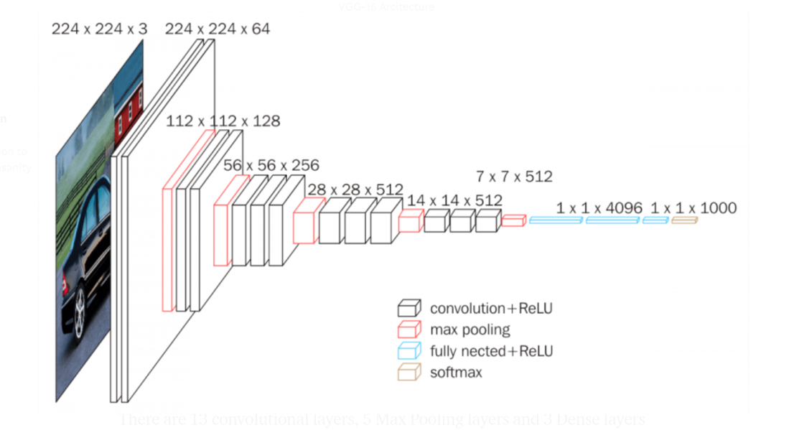
Hardware Implementation
Block diagram of layers of VGG-16
Figure 5

Slide 3
Convolution Layer

Slide 4
Convolution Layer
Inputs: Taking the input RGB image as three dimensional array with (channel * row * column ) and the kernels number , channels and size as four dimension array (kernel number, kernel channel , row , column)
Outputs:The feature maps the number of them is equal to the number of filters and the size is equal to image size –kernel size +1 if no padding is used

Slide 5
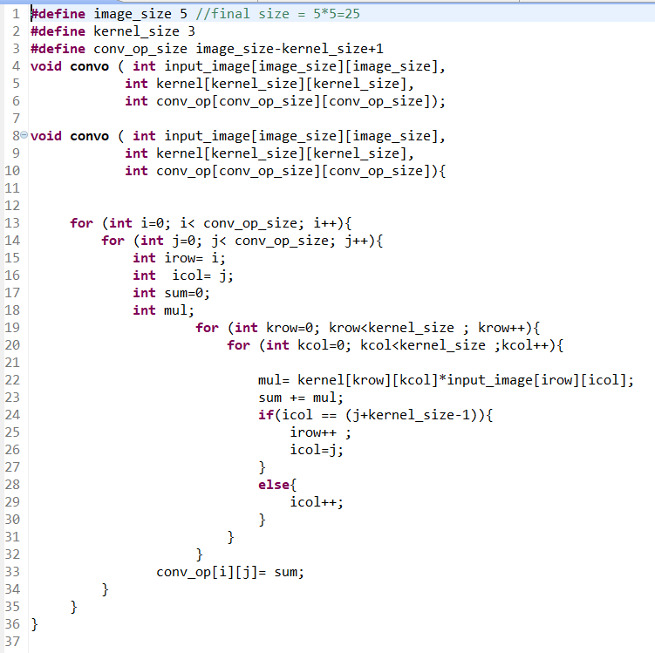
Code implemented

Slide 6
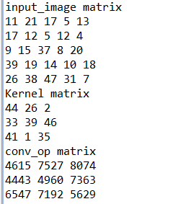
Software Results
Figure 15

Slide 7
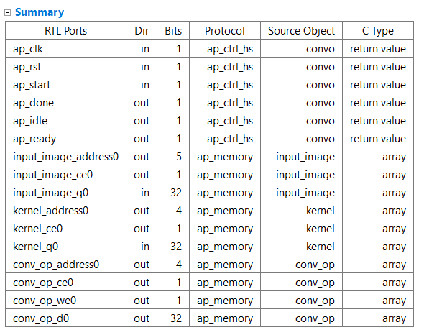
Synthesized code output report

Slide 8
Simulation results
The simulation shows that convolution process is carried out as intend in the c++ code and below output is output of c++ testbench and the output exactly the same. Noting that the we0 (write signal in the output memory (array)is high only when the correct result signals has arrived can be specified by the clock period during project )

Slide 9
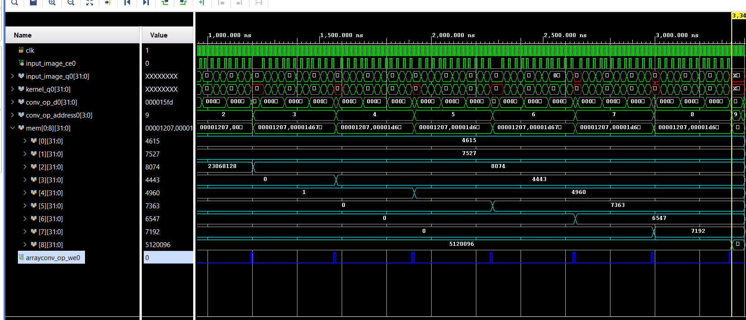

Slide 10
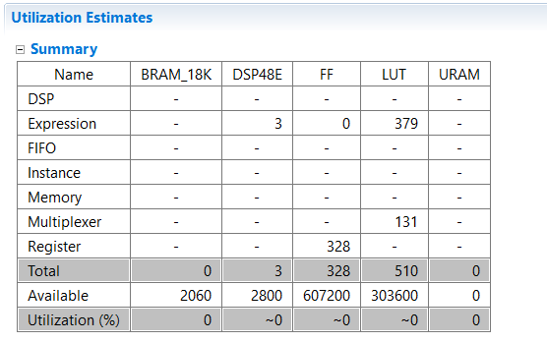
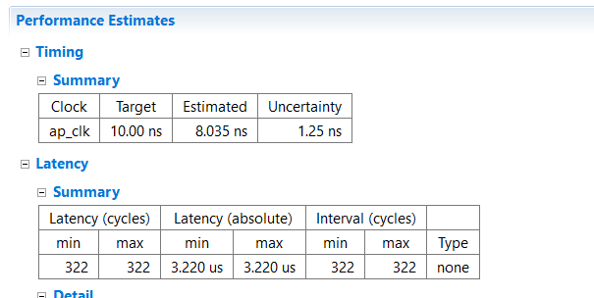
Performance metrics
Clustering

Slide 11
Padding Layer

Slide 12
Padding Layer
Inputs: Input matrix of size 3x3
Outputs: Output matrix of size 5x5 of the 3x3 matrix surrounded by zeros

Slide 13
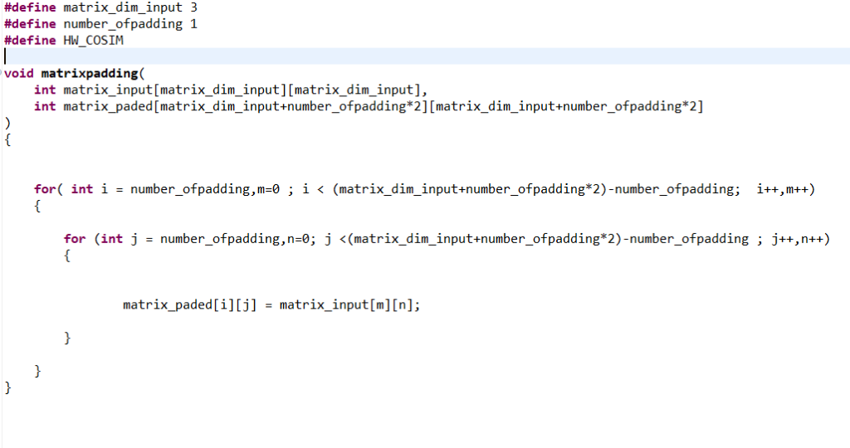
Code implemented

Slide 14
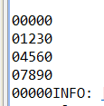
Software Results

Slide 15
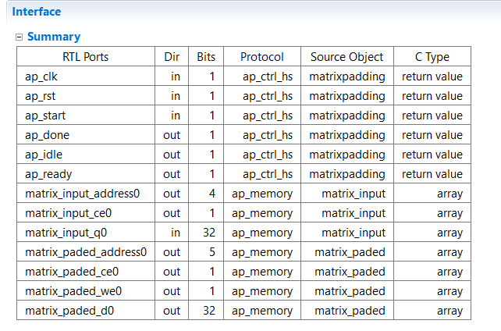
Synthesized code output report

Slide 16
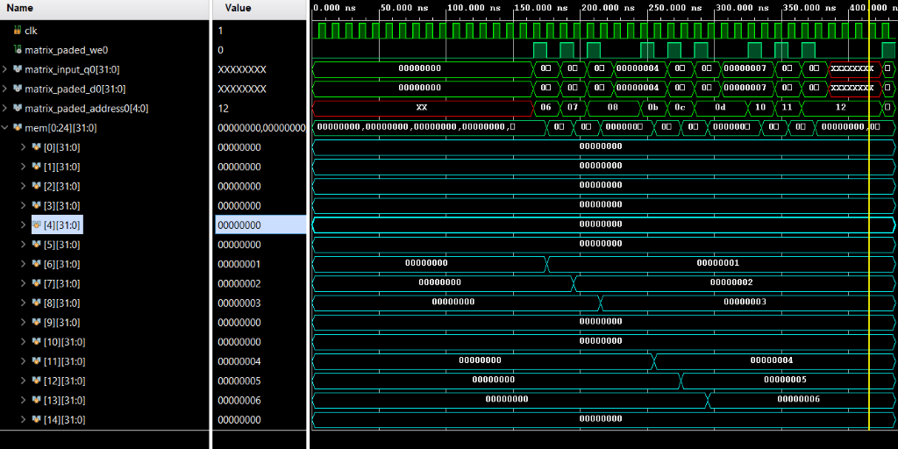
Simulation results

Slide 17
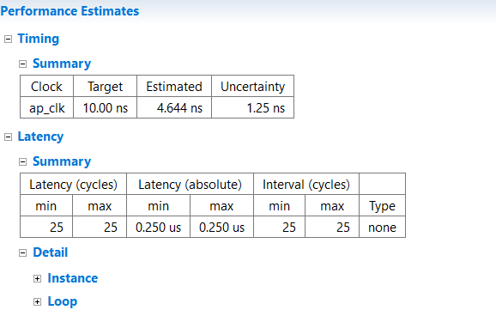
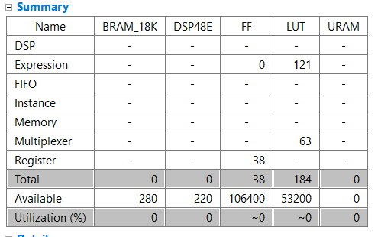
Performance metrics

Slide 18
Max Pooling Layer

Slide 19
Max Pooling Layer
Inputs: Input matrix of 5x5
Outputs: Output matrix of 3x3 but with the maximum numbers only of the input

Slide 20
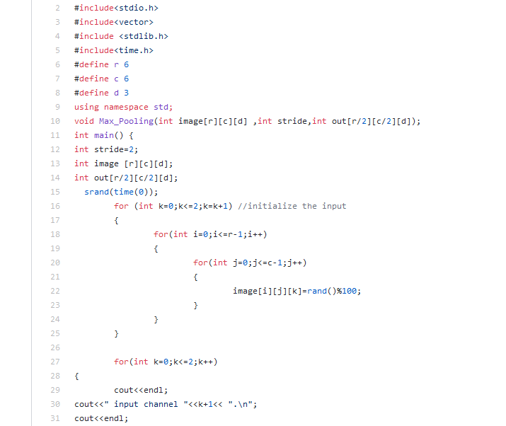
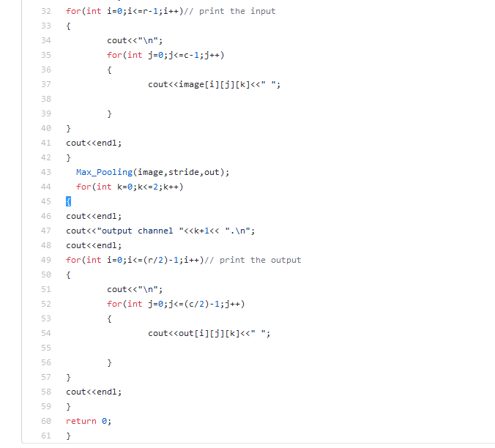
Code Implemented

Slide 21
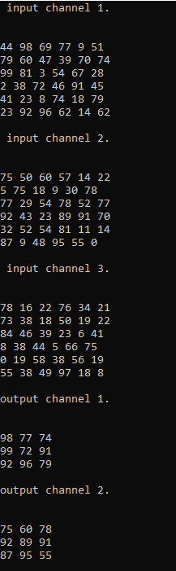
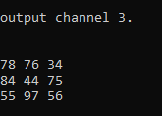
Software Results

Slide 22
Simulation Results

Slide 23
Performance metrics

Slide 24
Integration of padding and convolution

Slide 25
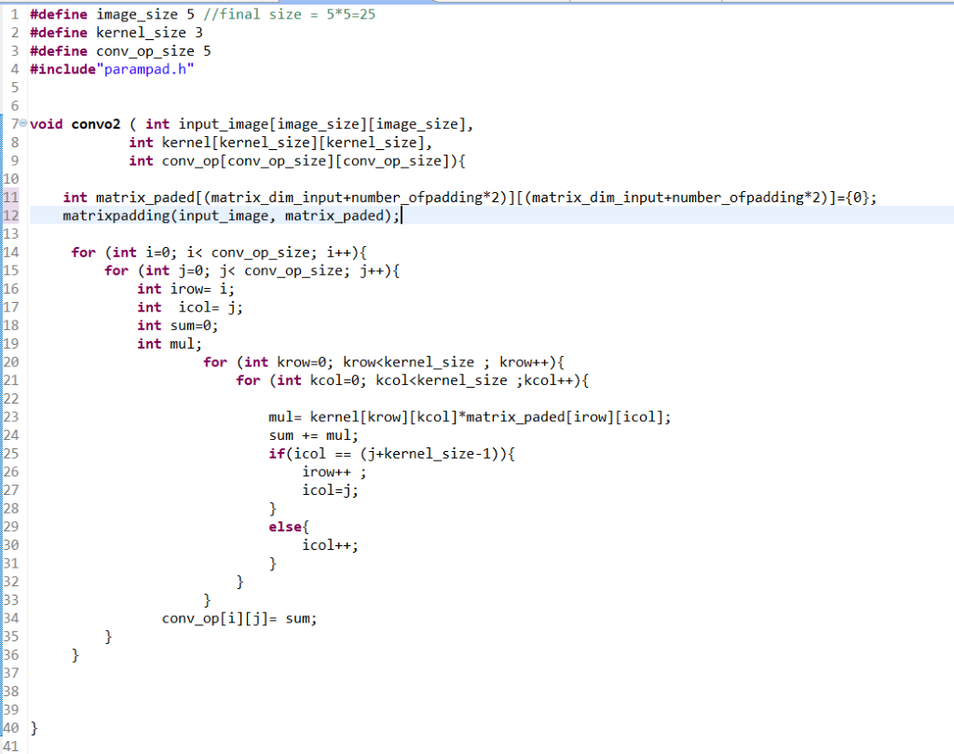
Integration of padding and convolution

Slide 26
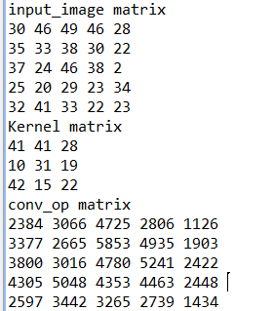
Software Results

Slide 27
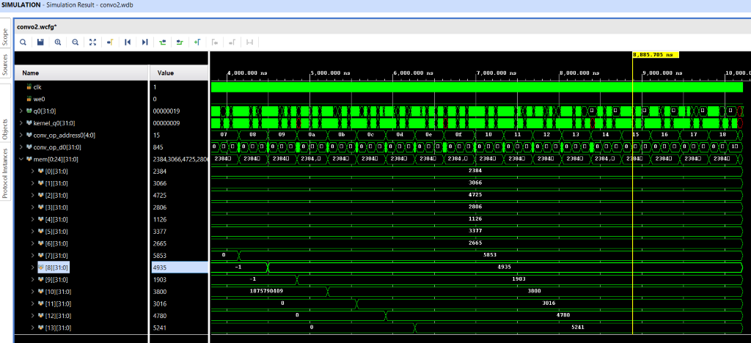
Simulation results

Slide 28
Integration of (Padding-Convolution-Maxpooling)

Slide 29
Integration of (Padding-Convolution-Maxpooling)
Start the function by padding the input image so the feature map after convolution is same size if input image
Then do the convolution with one image RGB ,2 filter with three channels each
Then do max pooling 2*2 which reduce the output feature map size by 2

Slide 30
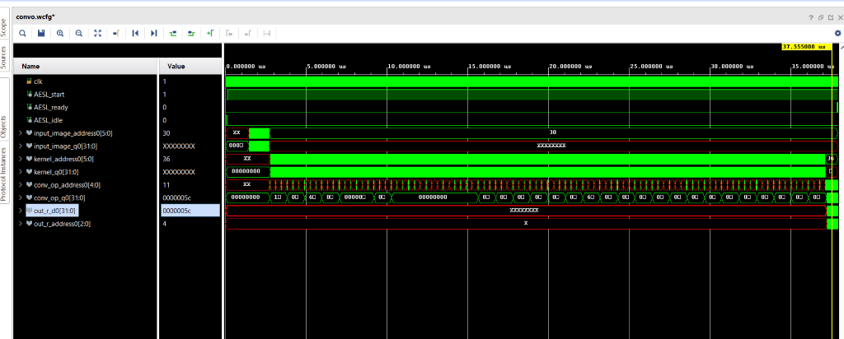
Simulation results

Slide 31
Thank You

Slide 32
Software implementation
Simulated a full Faster-RCNN using the code in the following repo
Hardware-FasterRCNN/Software/tensorflow-object-detection-faster-rcnn/
The steps is attached to the readme file in the github code
https://github.com/Ramy-osama/Hardware-FasterRCNN

Slide 33
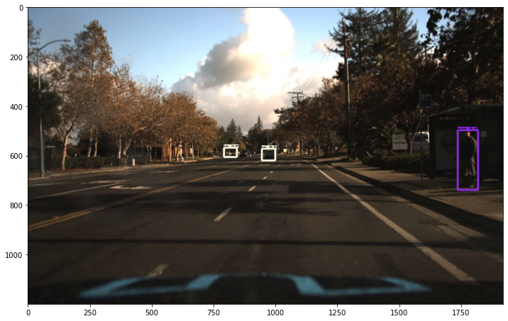
Results

Slide 34
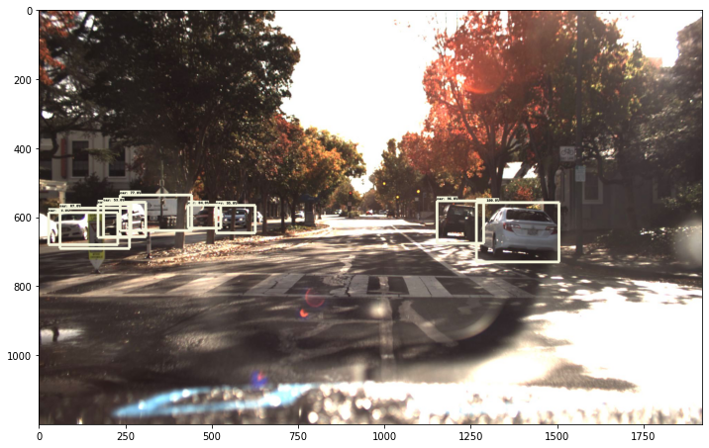
Results

Slide 35
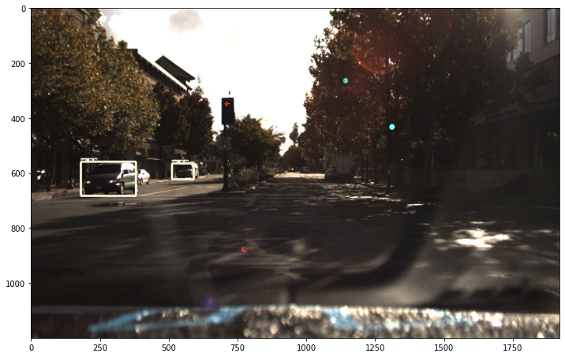
Results

Slide 36
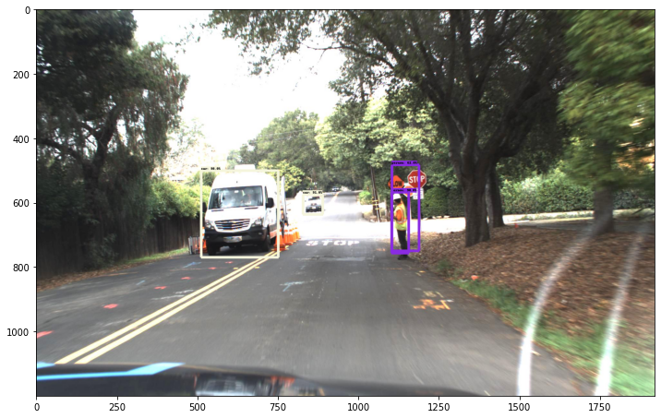
Results

Slide 37
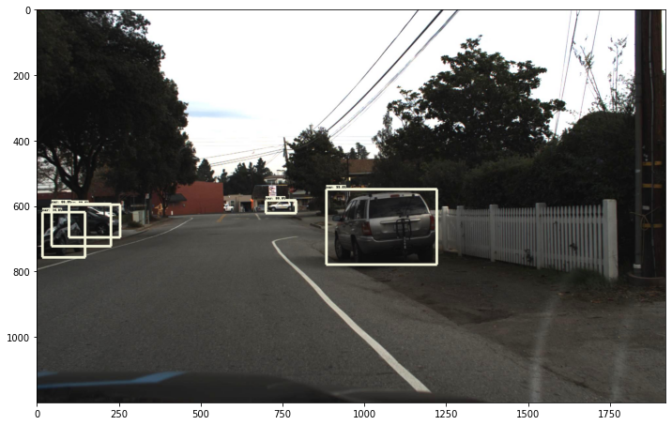
Results

Slide 38
VGG16
created 3 Vgg16 to do get weights we will use in the hardware simulation
1st Vgg I took as a refence from the github code:
https://github.com/Ramy-osama/VGG16-In-Keras

Slide 39
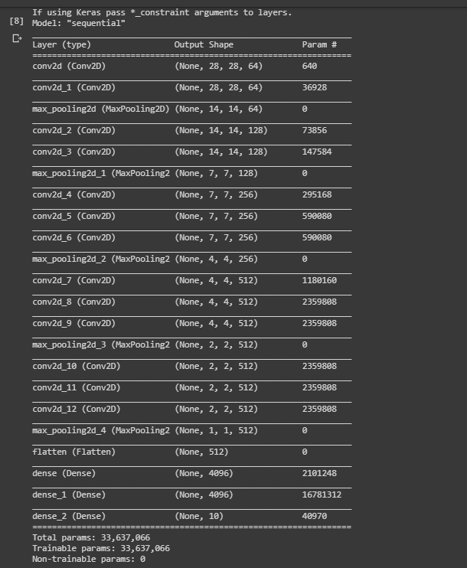
VGG16
Trained VGG16 on the fashion_mnist dataset built in TensorFlow and that was the architecture used

