Slide 1
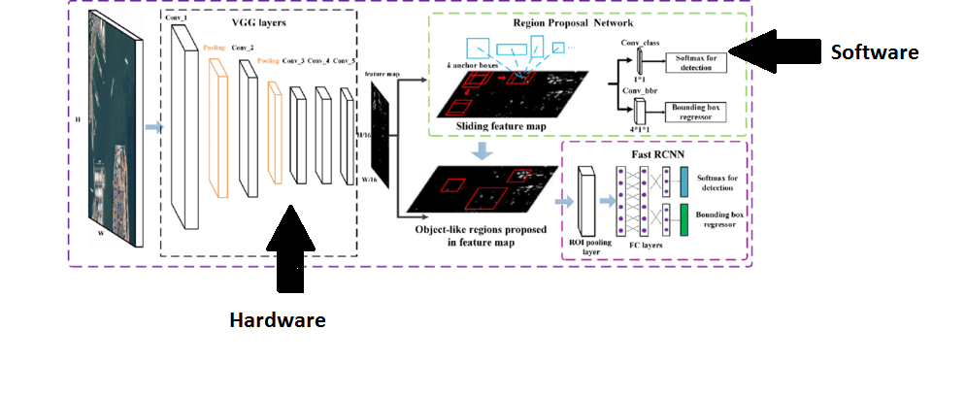
Block Diagram of the project

Slide 2
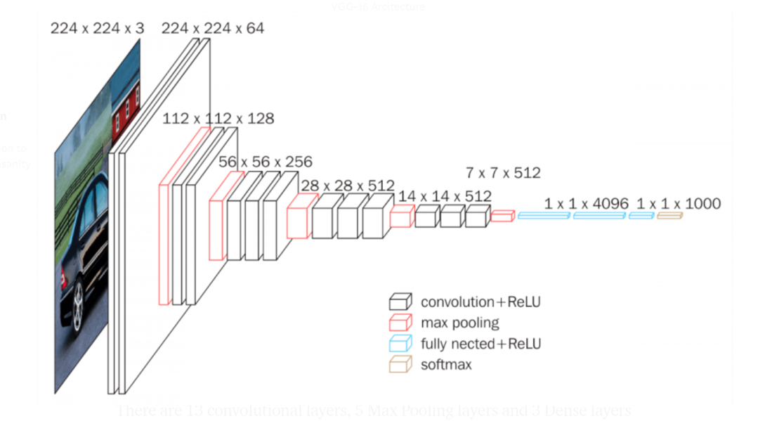
Hardware Implementation
Block diagram of layers of VGG-16
Figure 5

Slide 3
Convolution Layer

Slide 4
Convolution Layer
Inputs: Taking the input RGB image as three dimensional array with (channel * row * column ) and the kernels number , channels and size as four dimension array (kernel number, kernel channel , row , column)
Outputs: The feature maps the number of them is equal to the number of filters and the size is equal to image size –kernel size +1 if no padding is used
GitHub Code: Hardware-FasterRCNN/Hardware/HLS/Convolution

Slide 5
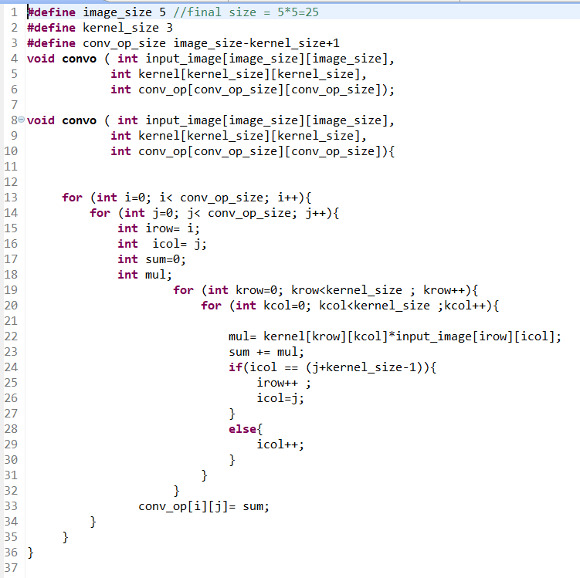
Code implemented

Slide 6
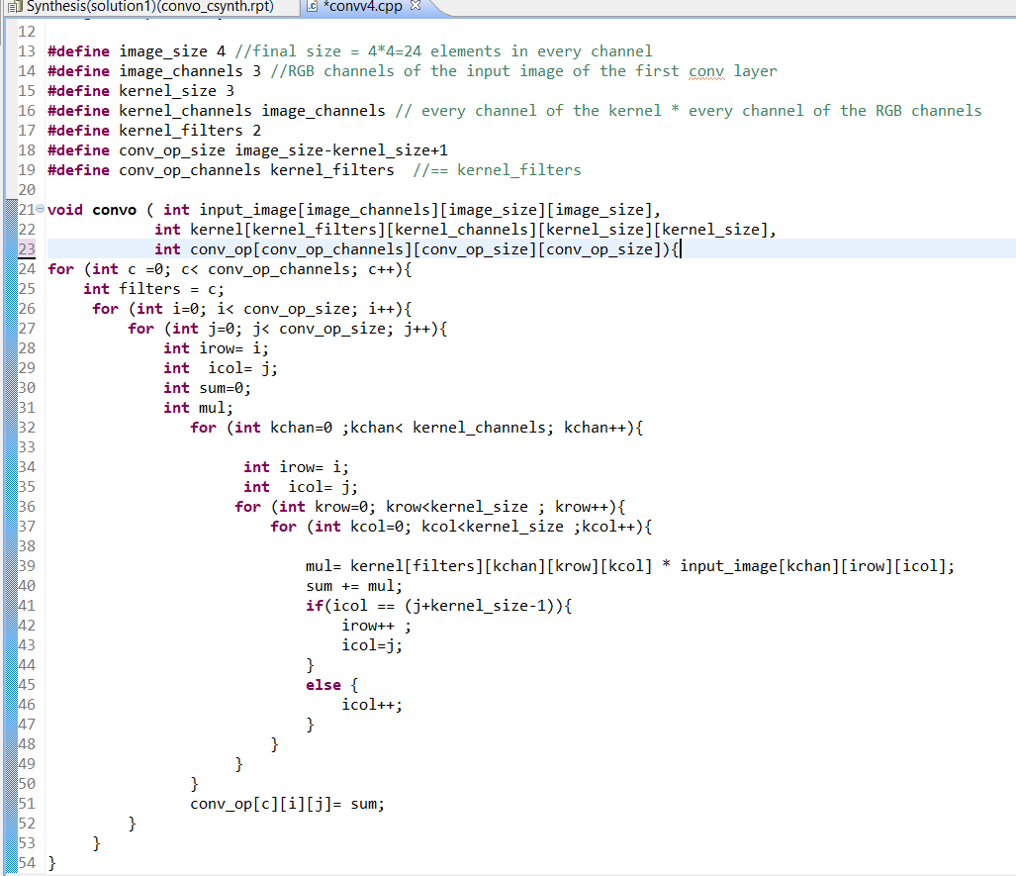
Convolution (RGB Input images and kernel channels)

Slide 7
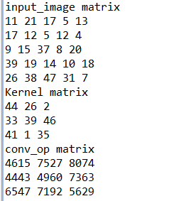
Software Results_v1
Figure 15

Slide 8
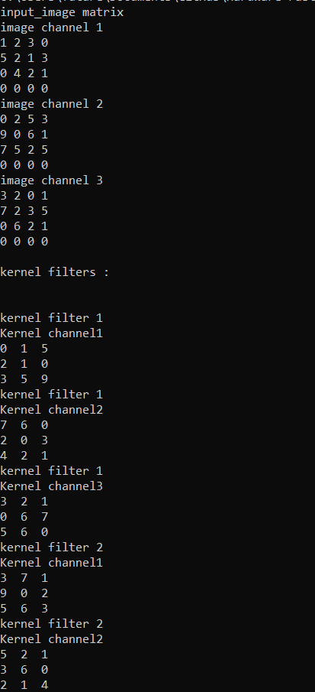
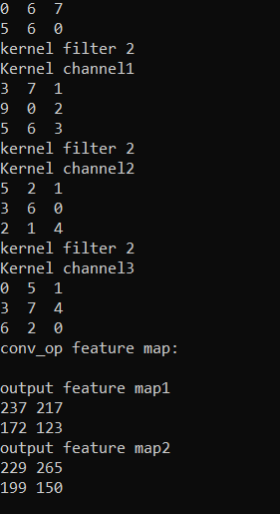
Software Results_v2

Slide 9
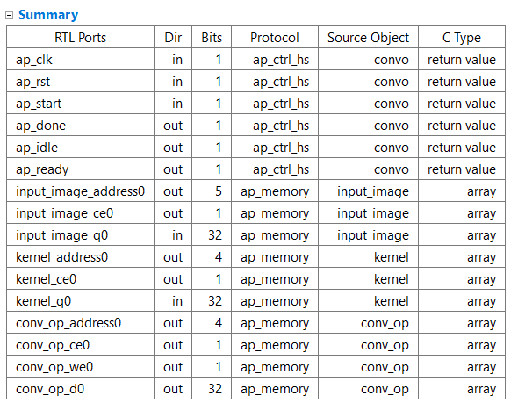
Synthesized code output report

Slide 10
Simulation results
The simulation shows that convolution process is carried out as intend in the c++ code and below output is output of c++ testbench and the output exactly the same. Noting that the we0 (write signal in the output memory (array)is high only when the correct result signals has arrived can be specified by the clock period during project )

Slide 11
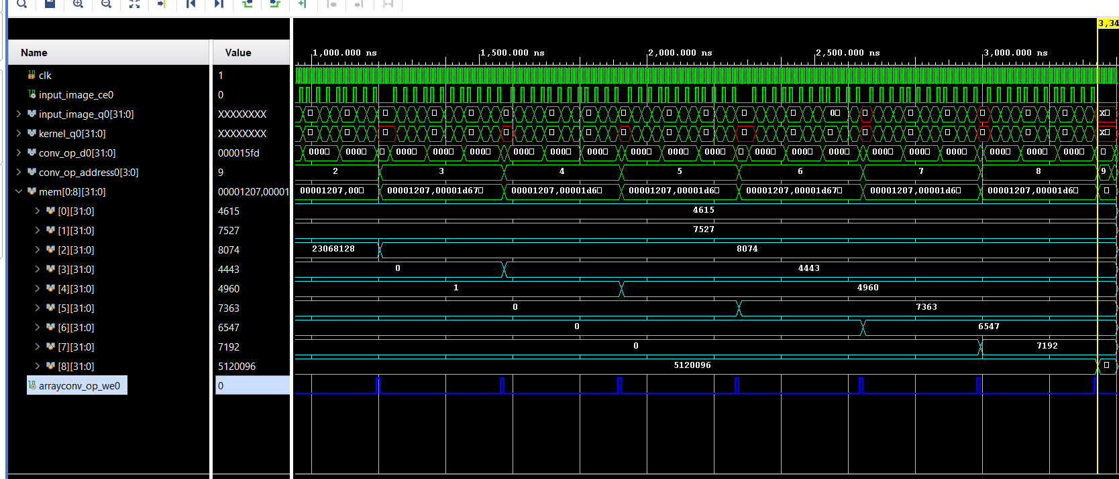

Slide 12
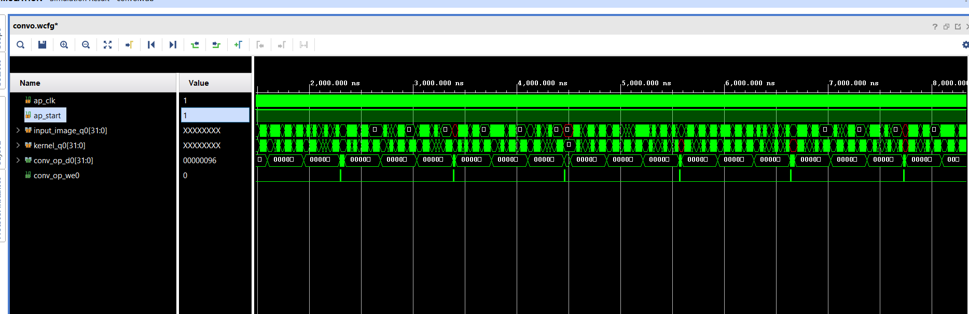
Simulation results (RGB Input images and kernel channels)

Slide 13
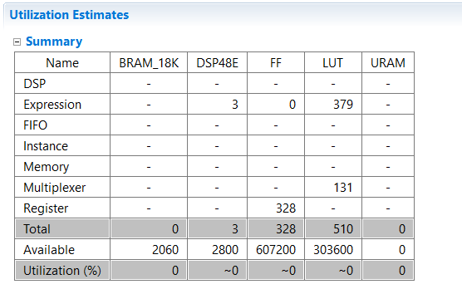
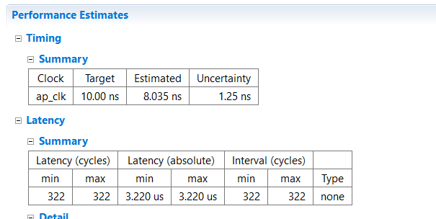
Performance metrics
Clustering

Slide 14
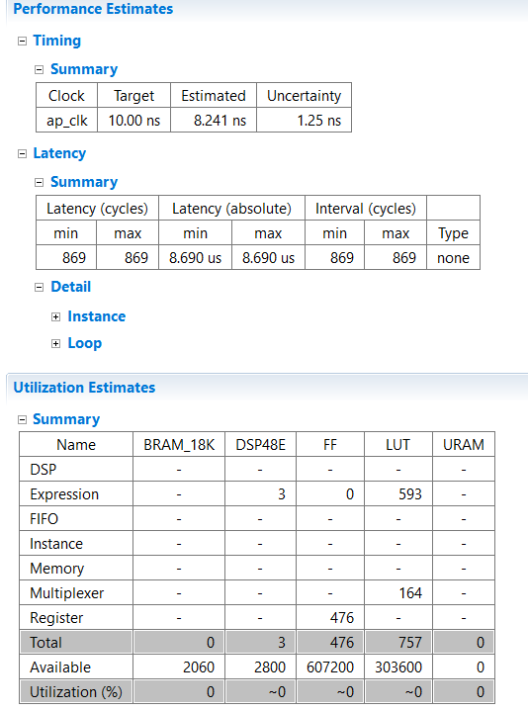
Performance metrics (RGB Input images and kernel channels)

Slide 15
Padding Layer

Slide 16
Padding Layer
Inputs: Input matrix of size NxM
Outputs: Output matrix of size N+2*pad x M+2*pad of the NxM matrix surrounded by zeros
GitHub Code: Hardware-FasterRCNN/Hardware/HLS/Zero_padding/C++ codes

Slide 17
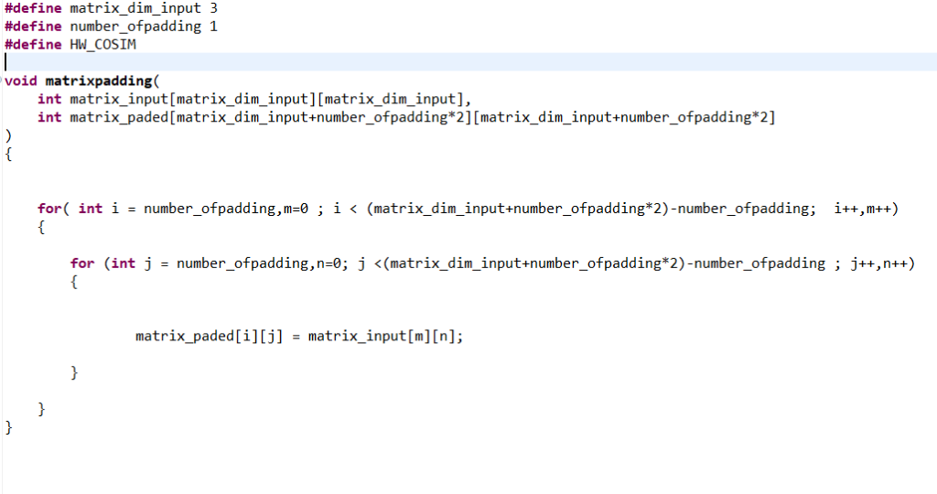
Code implemented

Slide 18
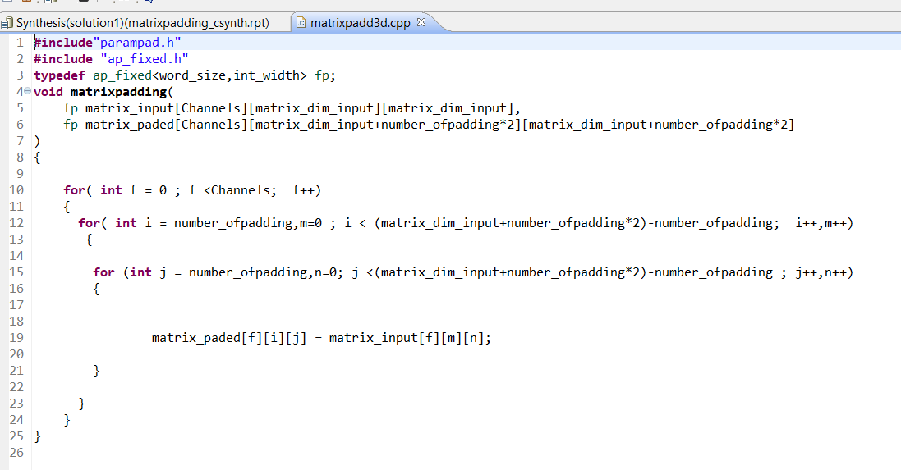
Padding ( padding image with multiple channels )

Slide 19
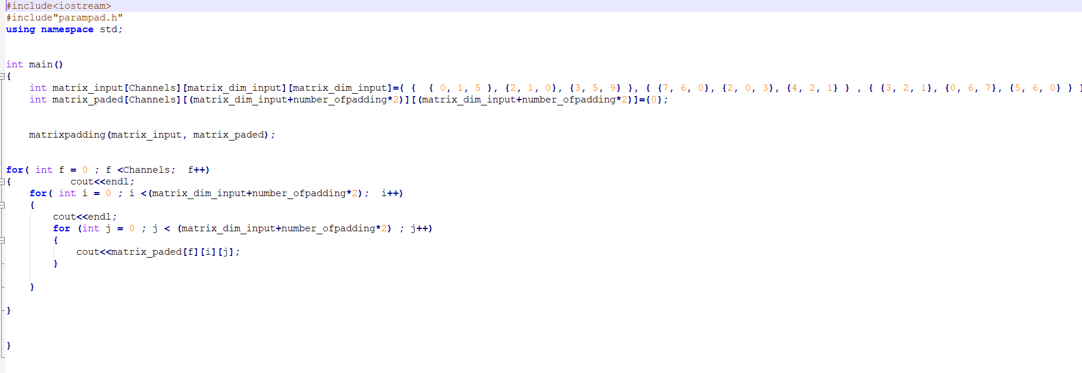
Padding ( padding image with multiple channels )

Slide 20
Software Results
00000
00150
02100
03590
00000
00000
07600
02030
04210
00000
00000
03210
00670
05600
00000

Slide 21
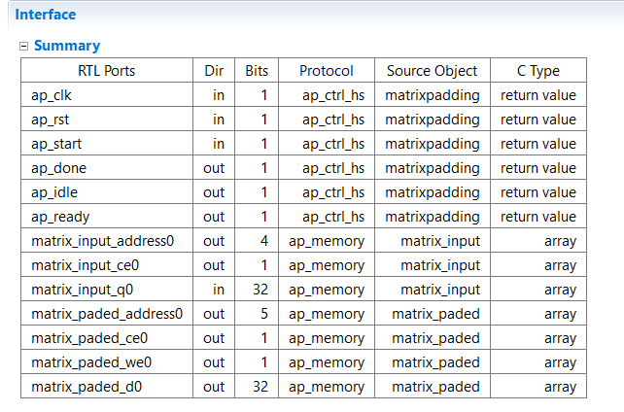
Synthesized code output report

Slide 22
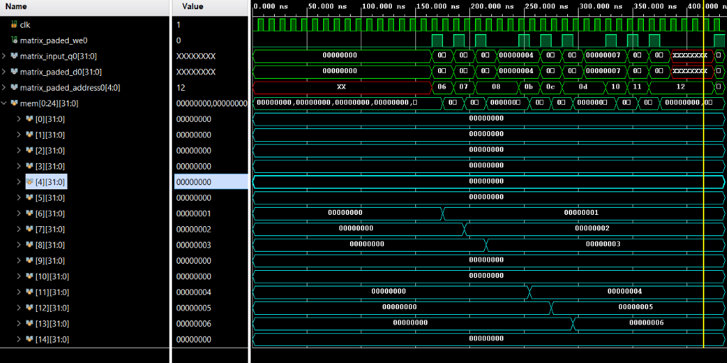
Simulation results

Slide 23
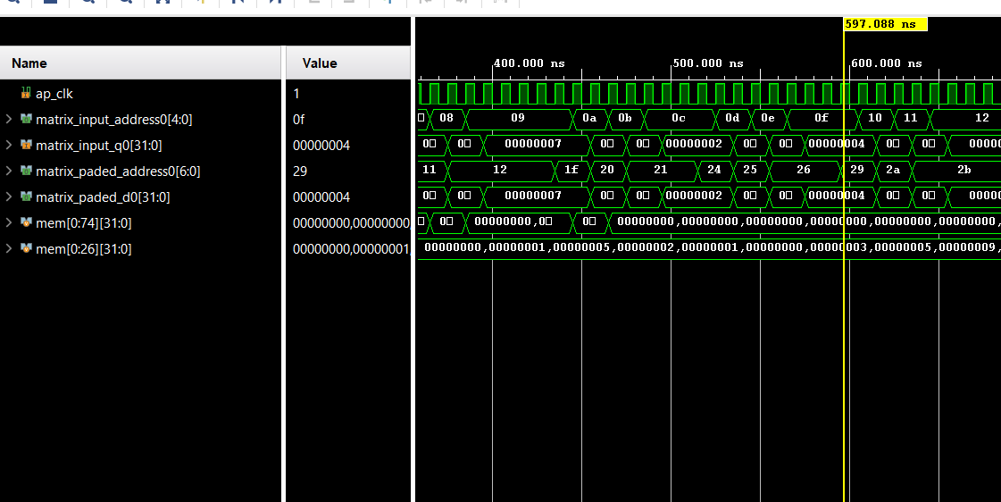
When the input is 3d Matrix (channels * columns*rows)

Slide 24
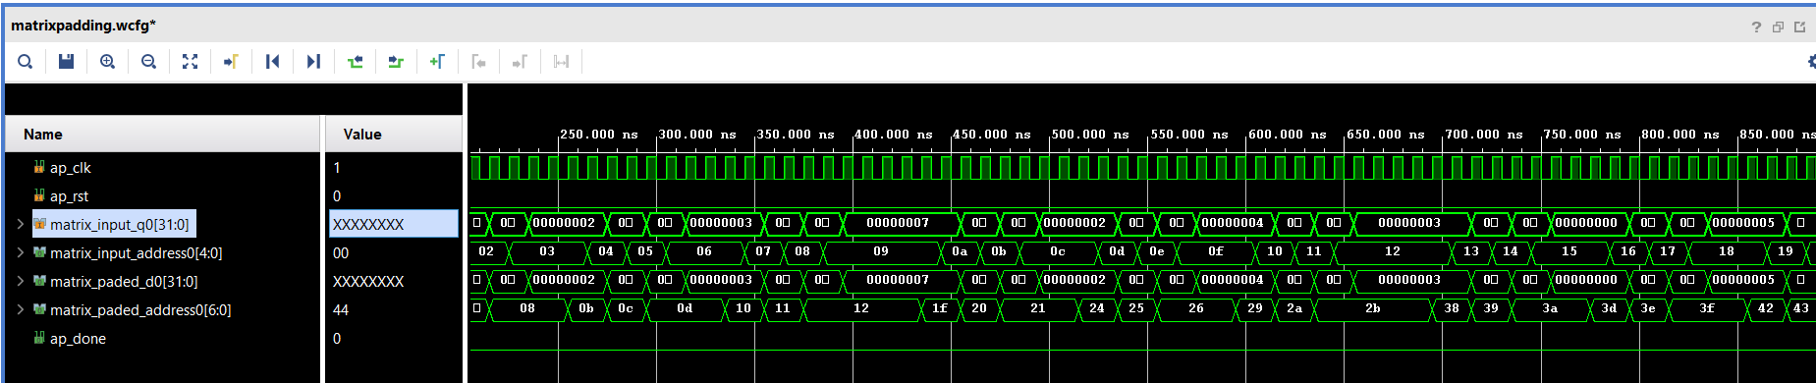
Padding ( padding image with multiple channels )

Slide 25
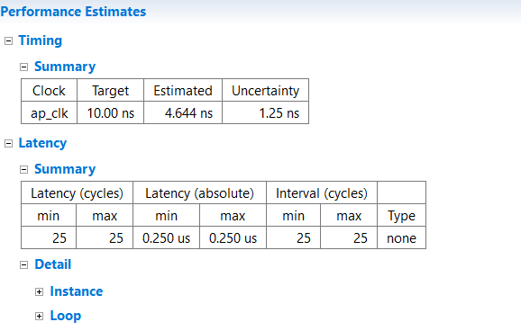
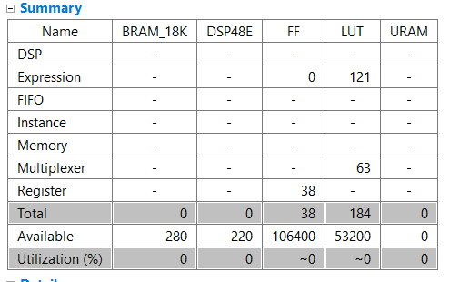
Performance metrics

Slide 26
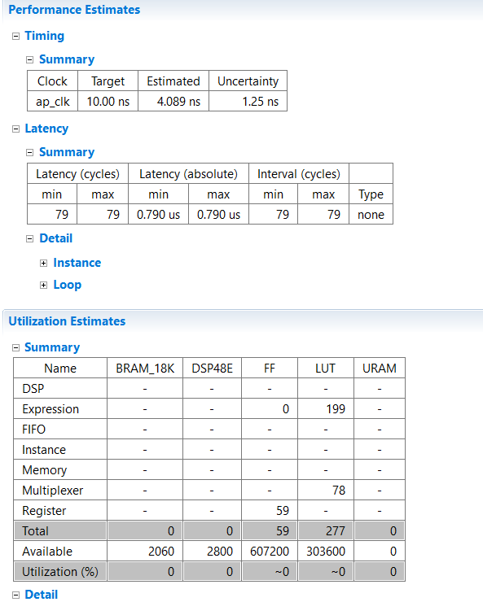
Padding ( padding image with multiple channels )

Slide 27
Max Pooling Layer

Slide 28
Max Pooling Layer
Inputs: Input matrix of NxM
Outputs: Output matrix of N/2 x M/2 but with the maximum numbers only of the input
Github Code: Hardware-FasterRCNN/Hardware/HLS/max_pooling/C++ codes

Slide 29
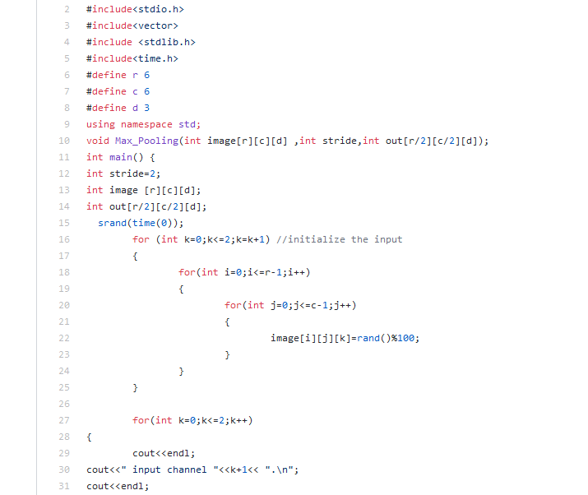
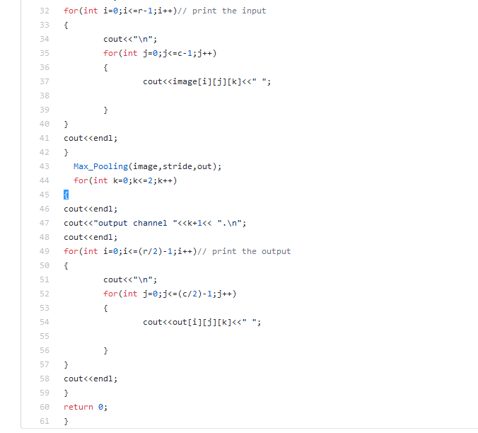
Code Implemented

Slide 30
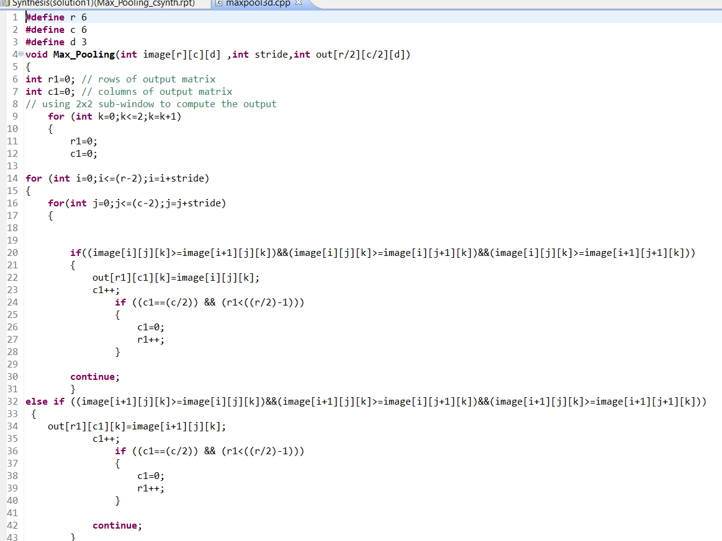
Max pooling (for multiple feature maps )

Slide 31
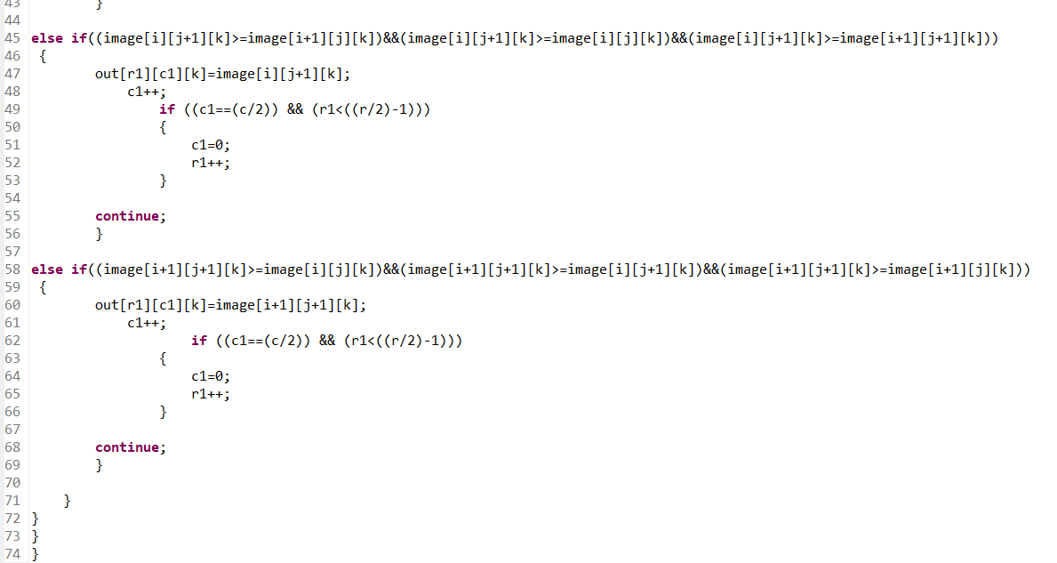

Slide 32
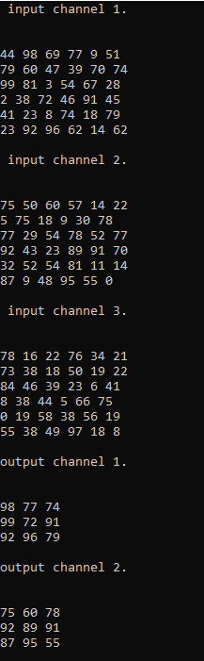
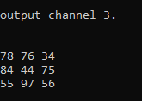
Software Results

Slide 33
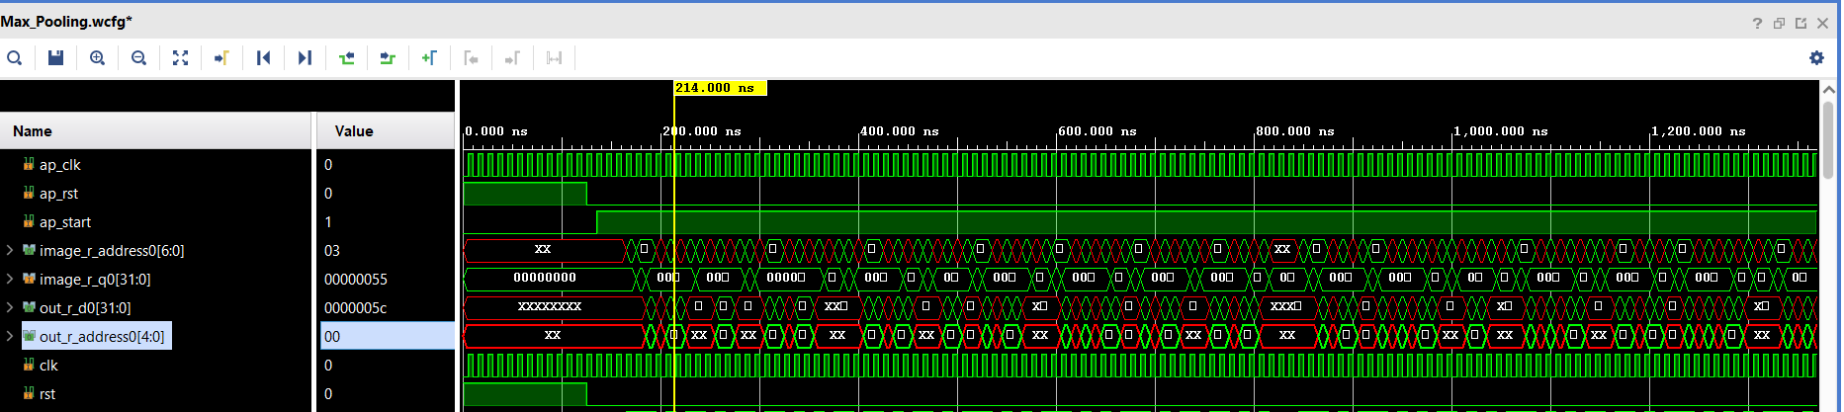
Simulation Results

Slide 34
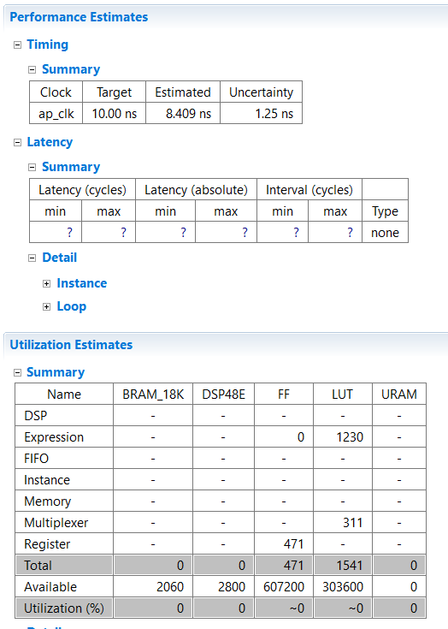
Performance metrics

Slide 35
ReLU

Slide 36
ReLU Layer
Inputs: Input matrix of defined size
Outputs: Output matrix of same defined size but output greater than zero only
GitHub Code: Hardware-FasterRCNN/Hardware/HLS/relu/C++ codes

Slide 37
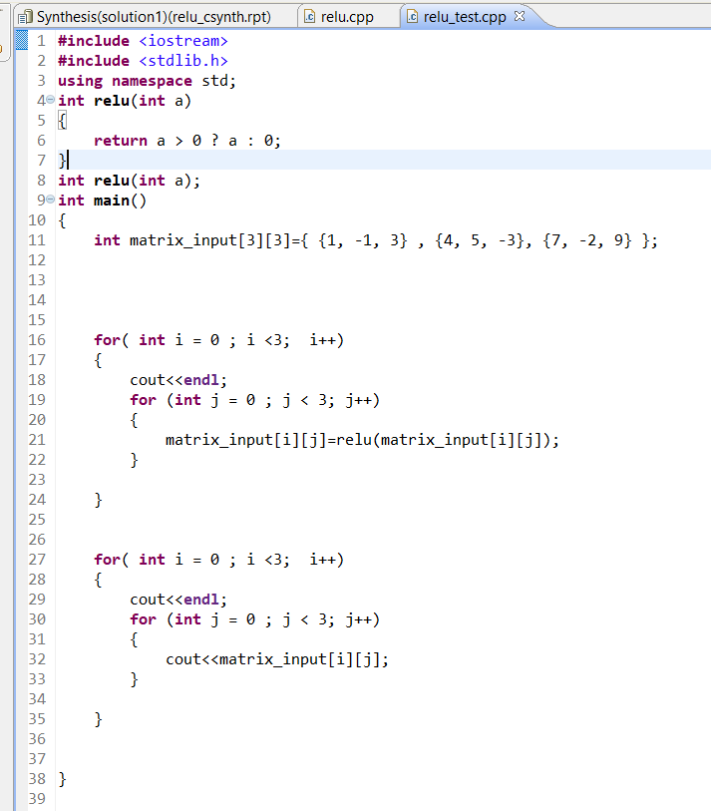
Code Implemented

Slide 38
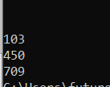
Software Results

Slide 39
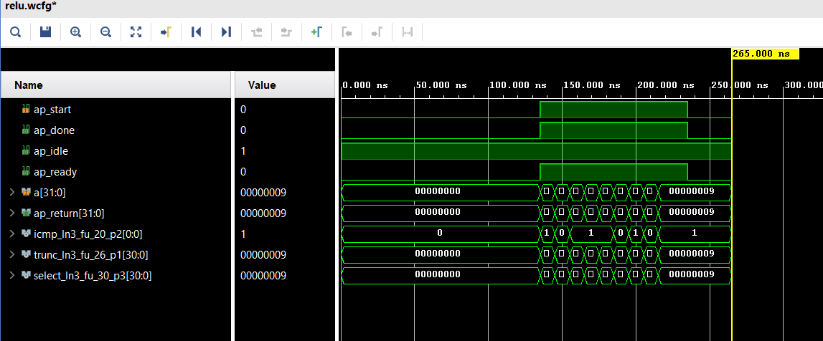
Simulation Results

Slide 40
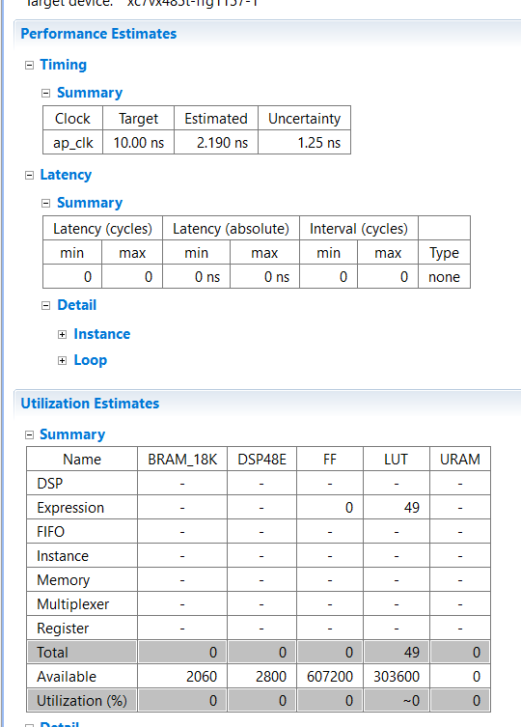
Performance metrics

Slide 41
Integration of padding and convolution

Slide 42
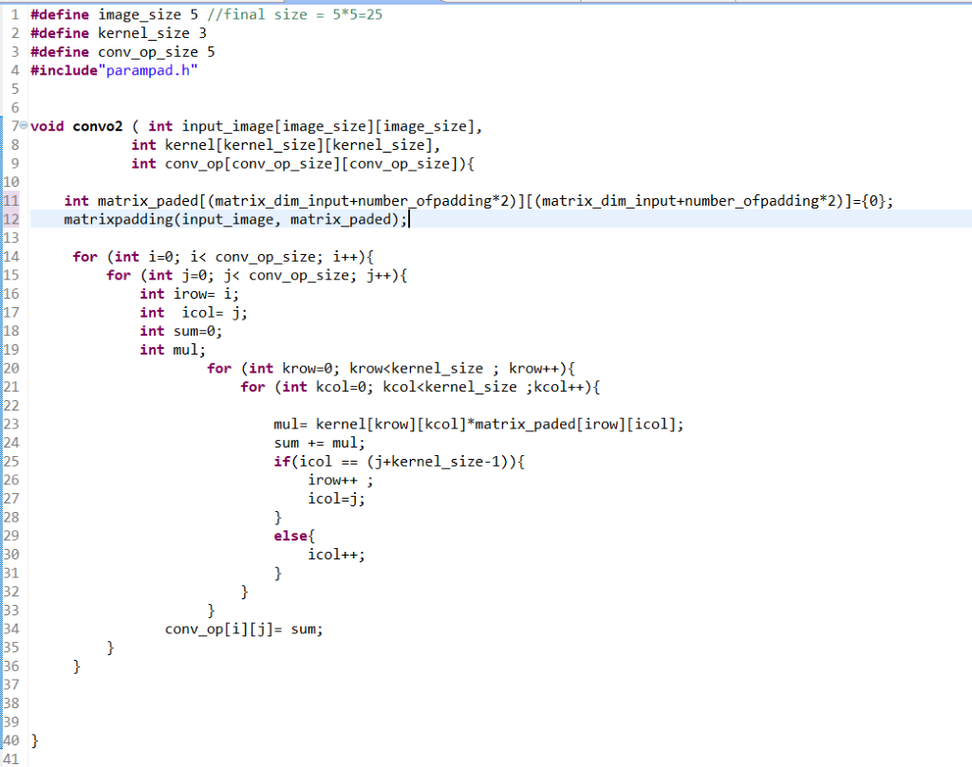
Integration of padding and convolution

Slide 43
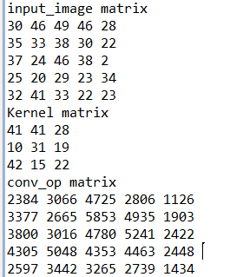
Software Results

Slide 44
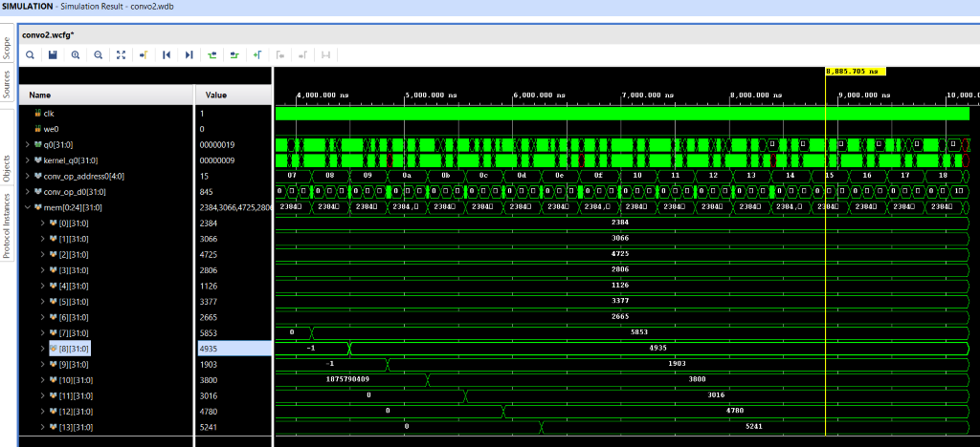
Simulation results

Slide 45
Integration of (Padding-Convolution-Maxpooling)

Slide 46
Integration of (Padding-Convolution-Maxpooling)
Start the function by padding the input image so the feature map after convolution is same size if input image
Then do the convolution with one image RGB ,2 filter with three channels each
Then do max pooling 2*2 which reduce the output feature map size by 2

Slide 47
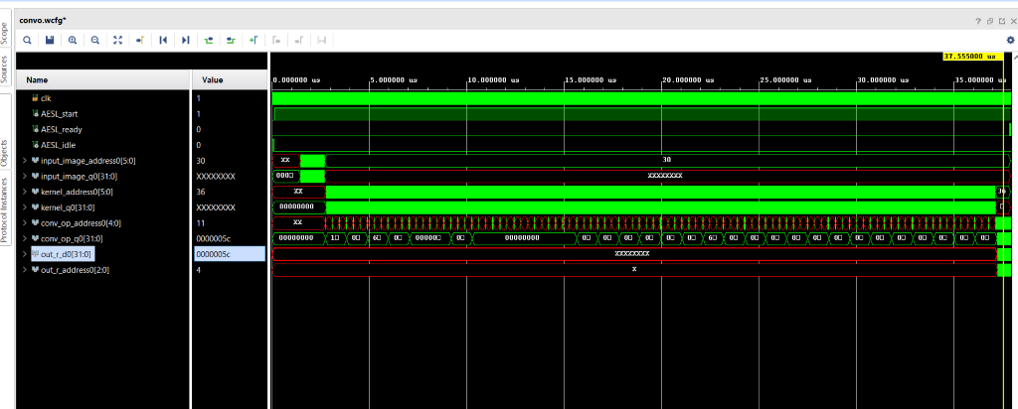
Simulation results

Slide 48
Block Diagram of the project

Slide 49
Software implementation
Simulated a full Faster-RCNN using the code in the following repo
Hardware-FasterRCNN/Software/tensorflow-object-detection-faster-rcnn/
The steps is attached to the readme file in the github code
https://github.com/Ramy-osama/Hardware-FasterRCNN

Slide 50
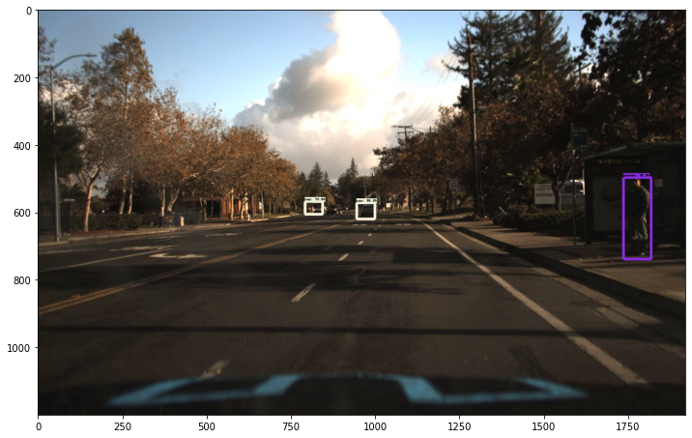
Results

Slide 51
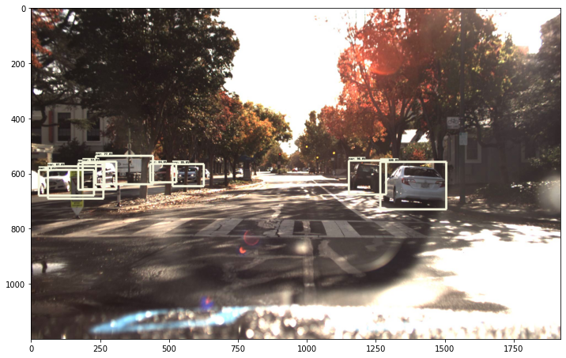
Results

Slide 52
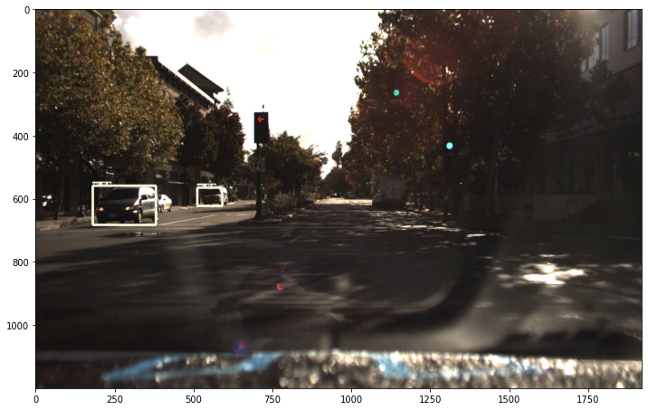
Results

Slide 53
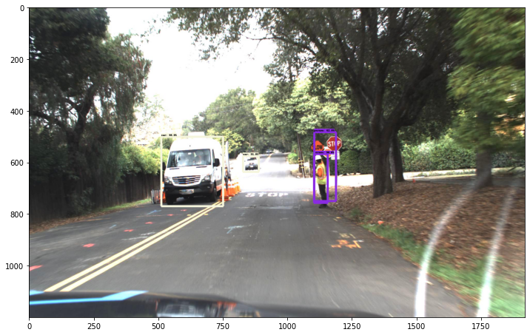
Results

Slide 54
VGG16
created 3 Vgg16 to do get weights we will use in the hardware simulation
1st VGG I took as a refence from the github code:
https://github.com/Ramy-osama/VGG16-In-Keras

Slide 55
VGG16_v1
Trained VGG16 on the fashion_mnist dataset built in TensorFlow

Slide 56
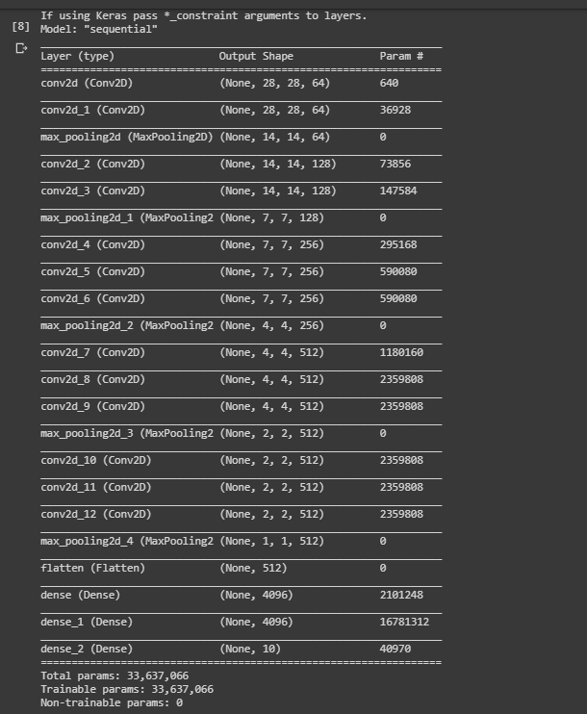
VGG16_v1 architechture

Slide 57
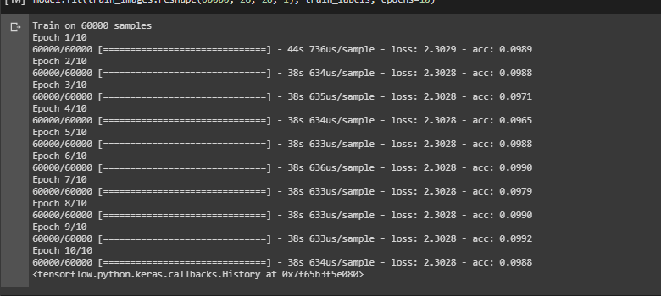
Vgg16_v1 result

Slide 58
Vgg16_V2
Removed some Layers as the size of the images is so small and there are many MaxPool layers That reduces the size of the image which makes it very hard for the network to train

Slide 59
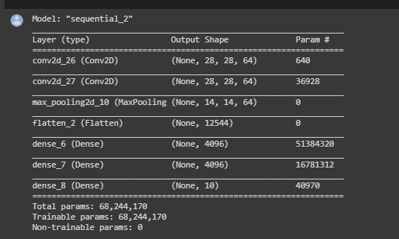
Vgg16_V2 architecture

Slide 60
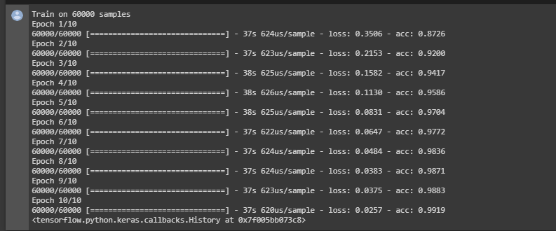
Vgg16_V2 results

Slide 61
Vgg16_V2
The weights were extracted in h5 file format and uploaded on a google drive
https://drive.google.com/drive/u/0/folders/1GQCNm_edwJvQwaAi0zqB5a9IqUj_k90N?fbclid=IwAR30ugLg_A5xYqQ3jtNCu6PBxg48zJwsfVuASQWO_FlbpCma7YFOZ4aPbgw

Slide 62
Future work
Read an image on c++ and apply the convolution layer on it
Use the extracted weights to build our model and use make sure it is working properly by using it in the inference mode
Train vgg16 on an autonomous car dataset which is our interest and extract its weights
Apply the extracted weights to complete Vgg16 architecture and use it in inference mode and make sure it is working properly

Slide 63
Thank You

