Slide 1
SYNTRA

Slide 2


INTRODUCTION
Human readable programming language
Its structure looks like low level programming languages, and its keywords are like high level programming languages (e.g. Python)

Slide 3
KEYWORDS
Concept | Keyword in SYNTRA | Example
Functions | action | action compute() { .. }
Data types | point, distance, name, flag | point x = 10;
Include | use | use core;
Comment | note | note This is a comment.

Slide 4
KEYWORDS
Concept | Keyword in SYNTRA | Example
Output | show | show "Hello!";
Input | get | get username;
For | repeat | repeat (point i = 0; i < 10; i++) { ... }
If | when | when (x > 10) { ... }

Slide 5
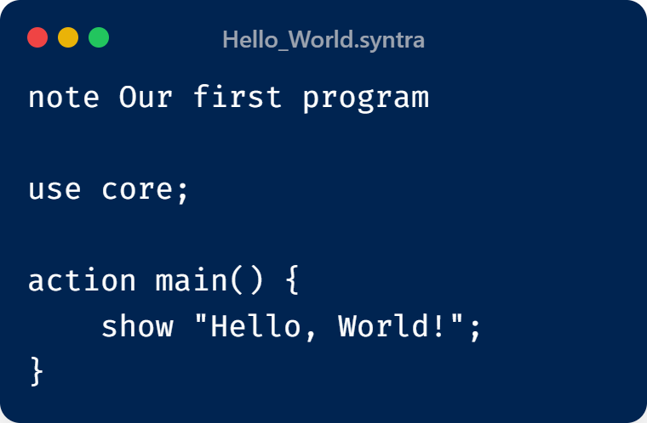
Hello World

Slide 6
Phase 1 - Scanning
Phase 2 - Parsing
Phase 3 - Semantic Analysis

Slide 7
Scanner
Converts raw source code into a list of meaningful Tokens.
Utilizes Regular Expressions (Python re module) to identify patterns.
Each token has type and value

Slide 8

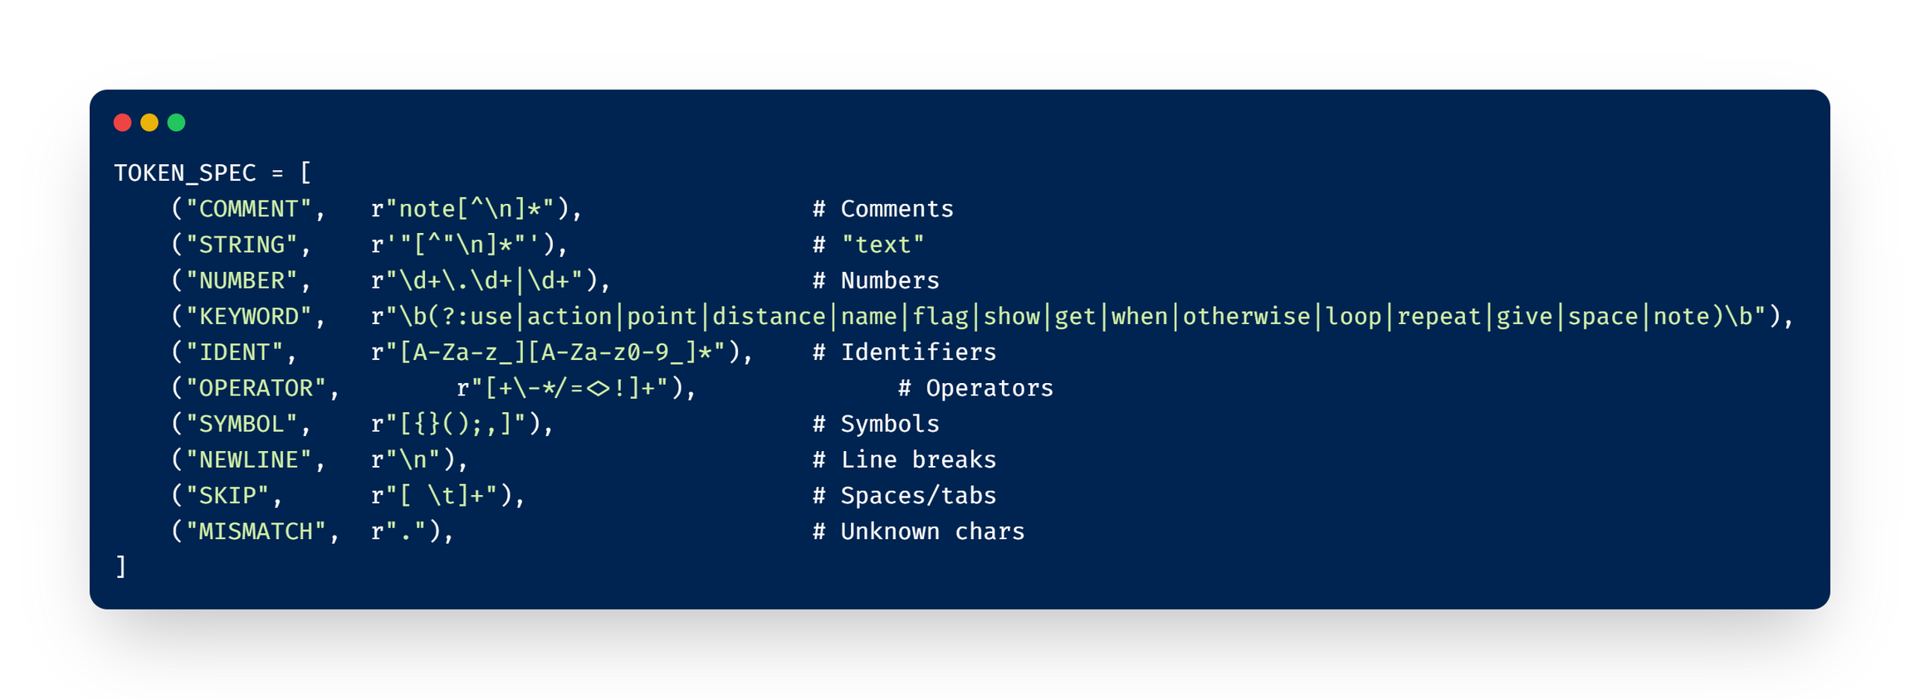
Scanner
Regular Expressions (Regex)
for pattern matching

Slide 9
Parser
Recursive Descent, which is a top-down parsing technique.
The parser accepts a list of tokens from the scanner and generates a Parse Tree that represents the code's hierarchical structure.
It verifies that the code follows the specific grammar rules of our language.
If the structure is invalid, such as a missing semicolon, the system halts and reports the error immediately.

Slide 10
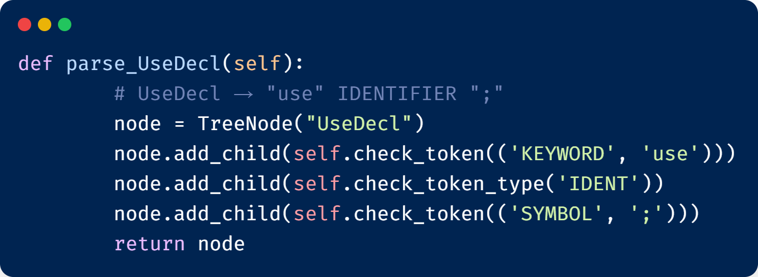
Parser
Parse function
for each rule

Slide 11
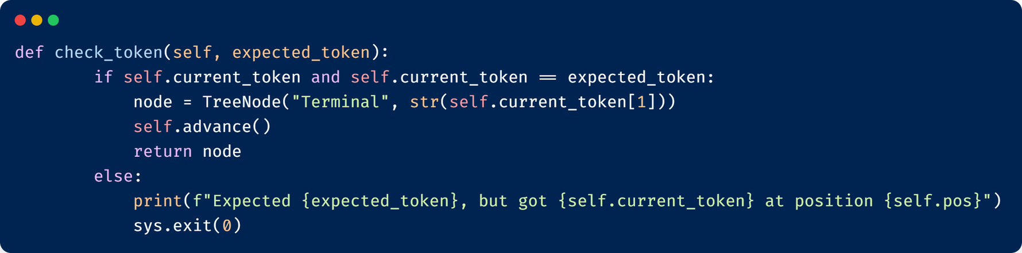
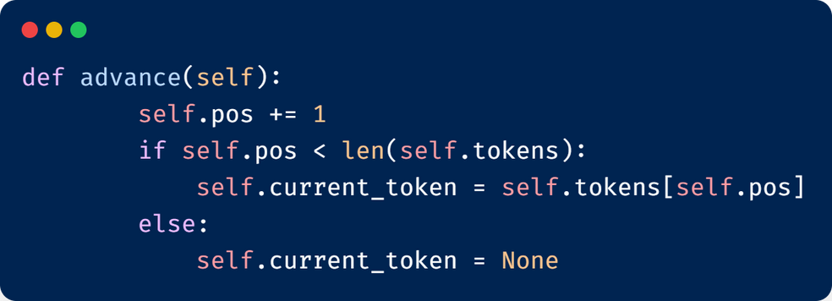
Parser
Checking tokens (used for terminals)
Consume the current token after successful parse

Slide 12
Semantic Analysis
Verifies the meaning and consistency of the code after it has been proven syntactically correct.
Three core parts:
Parse Tree
Symbol Table
Data type check

Slide 13
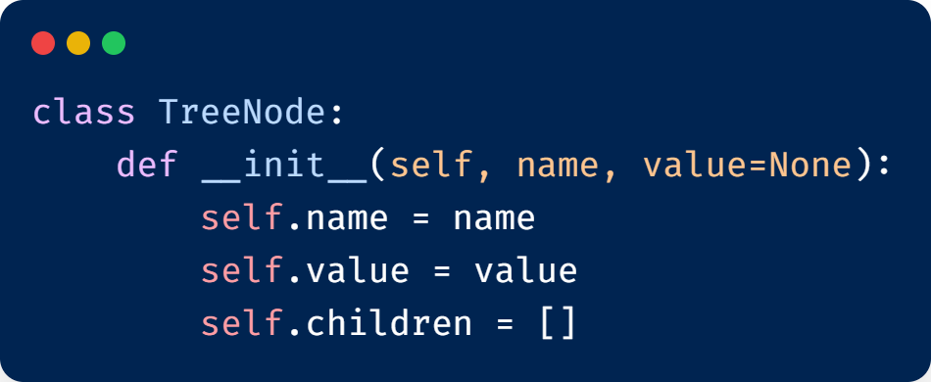
Parse Tree
A new node in the parse tree is created in each parsing function
Each node represents either a rule or a terminal
Each node has name, value and a list of childern nodes

Slide 14
Sybmol Table
A data structure that stores information about identifiers (variables, actions, parameters) declared in the source code.
Implemented as a List (Stack) of Dictionaries.
Each dictionary represents a distinct scope (local or global).
Each entry maps an identifier name (the key) to its associated data (the value).

Slide 15
Sybmol Table
Global Scope: The first dictionary in the list; it persists for the entire program lifecycle.
Local Scopes: New dictionaries are pushed onto the list when entering a function (action) or code block ({...}).
Lookup Rule: When searching for a variable, the table checks the current (inner-most) scope, and then sequentially checks the parent scopes until the global scope is reached.
Error Handling: It prevents redeclaration of a variable within the same scope.

Slide 16
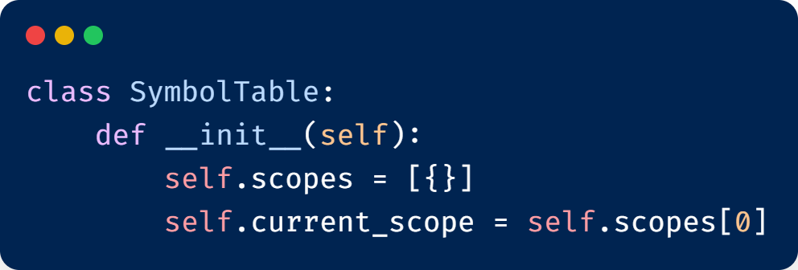
Sybmol Table

Slide 17
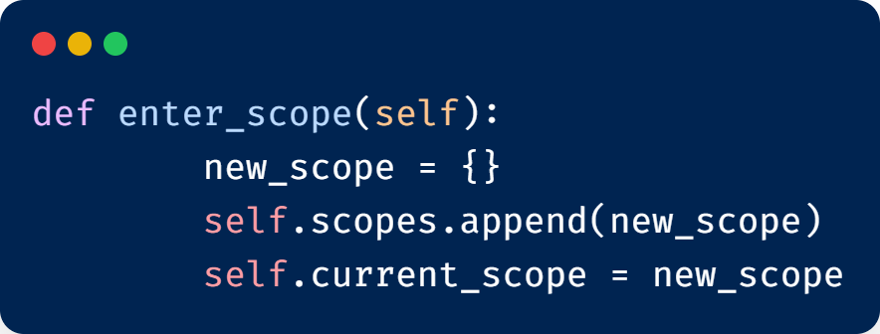
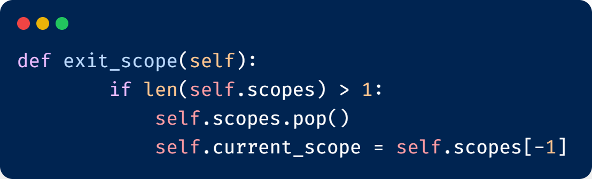
Sybmol Table
Creates a new scope when
entering a new function or block
Removes the scope while leaving

Slide 18
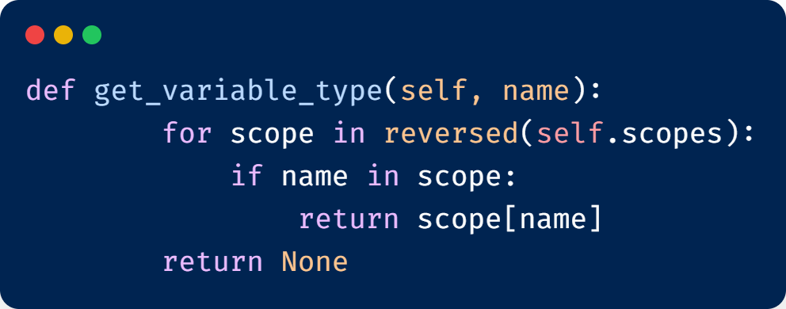
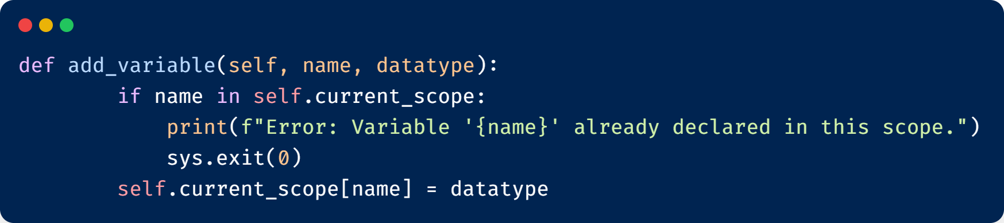
Sybmol Table
Return the type of a variable
(used while datatype check)

Slide 19
Datatype Check
These cases need datatype checking
Variable Declaration
VarDecl → ("point" | "distance" | "name" | "flag") IDENTIFIER "=" Expr ";"
Assignment Statement
AssignStmt → IDENTIFIER "=" Expr ";"

Slide 20
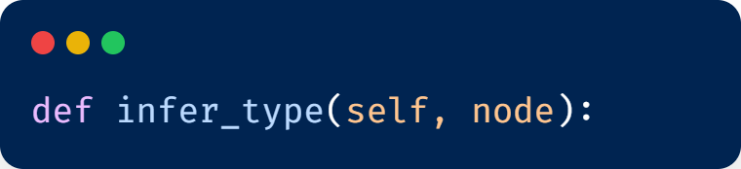
Datatype Check
Outputs the datatype of
that expression node
Takes expression
node as input
Note: Expression can by one term (e.g. a string) or many terms (e.g. 12 + 12.4)

Slide 21
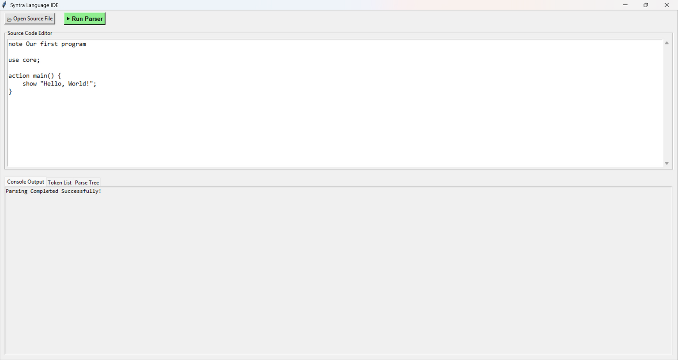
GUI

Slide 22

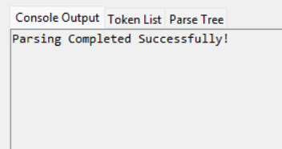

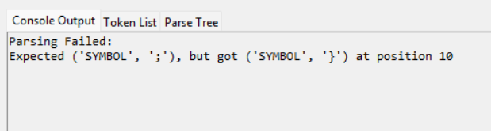
GUI
No errors
Code has errors!

Slide 23
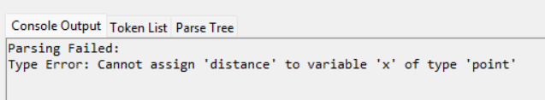
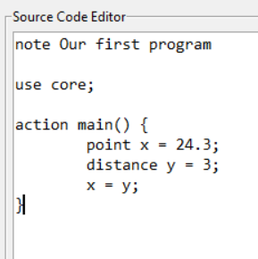
GUI
Datatypes do not match
point ⟶ float
distance ⟶ integer

Slide 24
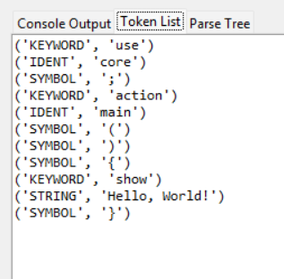

GUI
Token List

Slide 25
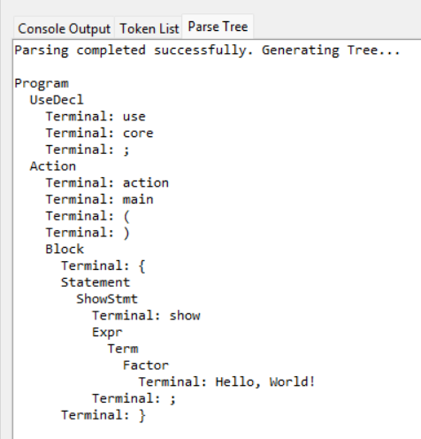
GUI
Parse Tree

