Slide 1
Cloud Project

Slide 2
Agenda
Architecture
Eureka server
Question microservice
Quiz microservice
How to setup the application environment
Deploy the platform

Slide 3
Architecture
Quiz-questions system has 2 main microservices (Quiz, Questions) ,and two another microservices(Eureka-server service and API-gateway service ).
Each service has a docker file and the whole project has a docker compose file for run all images .
Quiz-questions system has a k8s folder contain all Kubernetes files .

Slide 4
Architecture
Quiz-questions system has 2 main microservices (Quiz, Questions) ,and two another microservices(Eureka-server service and API-gateway service ).
Each service has a docker file and the whole project has a docker compose file for run all images .
Quiz-questions system has a k8s folder contain all Kubernetes files .

Slide 5

Eureka Server

Slide 6
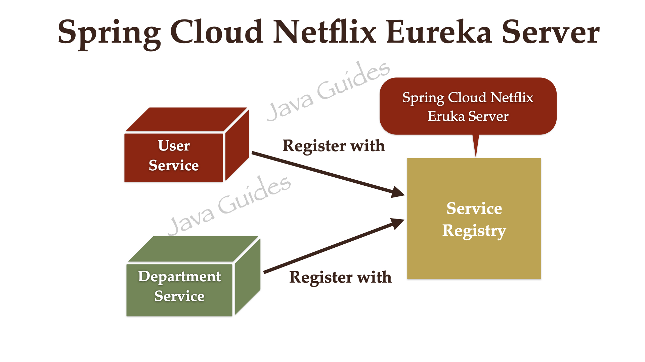





Eureka Server
This microservice act like a server that take a questions from question-service and wait util quiz-service to try to discovery it .

Slide 7
Question Microservice

Slide 8
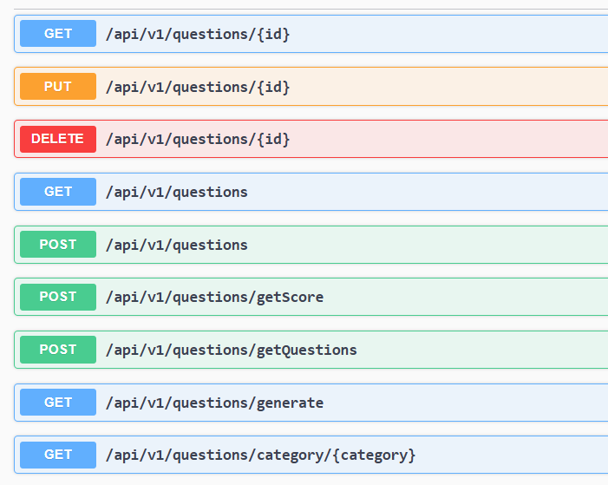
Question Microservice
This microservice can create questions .
Update existing question if you need some changes .
Delete question .
Retrieve a question and all questions
Send data to quiz-service across Eureka server
Data like questions itself and socre

Slide 9
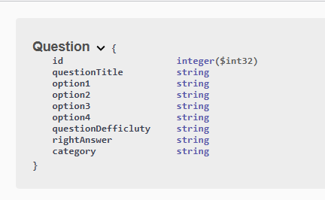
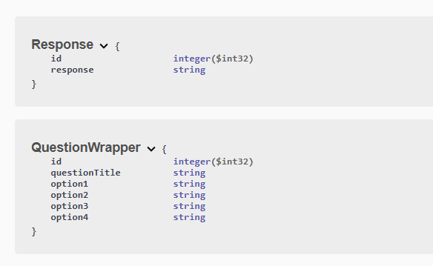
Question Microservice schema

Slide 10
Quiz Microservice

Slide 11
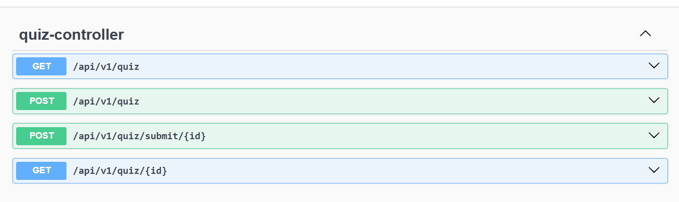
Quiz Microservice endpoints
Quiz-service can make a quiz by talking to questions-service to git questions
Can get all quizzes or just a single quiz.
Can take a response from user and send it to question-service through Eureka server and get the score for the quiz .

Slide 12
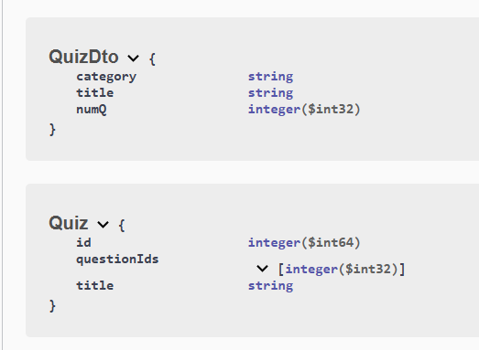
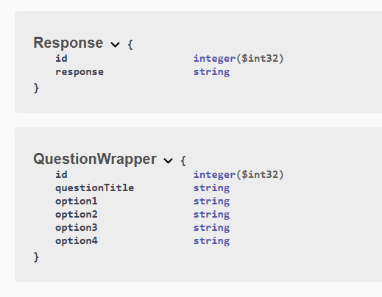
Quiz Microservice schema

Slide 13
API-gateway Microservice

Slide 14
API-gateway Microservice endpoints
API-gateway just help user to access just a single port and through it the quiz-questions system will handle all functions .

Slide 15
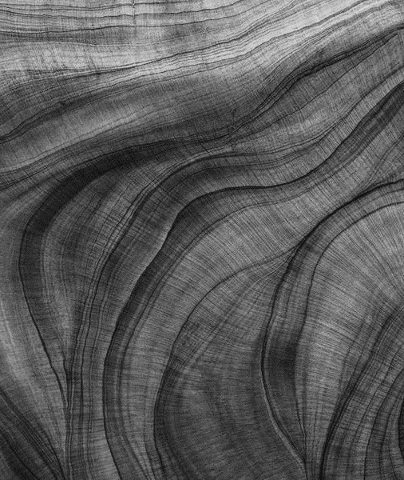
How to setup Environment
Confidence-building strategies

Slide 16
Environment setup
You need to Build every microservice with this command :
mvn clean install
Then you will got the four files.jar that we will use it in each Dockerfile
Use : docker-compose up –build for build the whole application from one file “docker-compose.yml”
Lastly use your endpoints to do all the work :
From create questions and quizess, modify them and delete.

Slide 17
How to deploy the platform

Slide 18
Environment setup
You need to run some commands .
cd path/to/k8s ➔ go to k8s path
kubectl apply -f .
minikube service api-gateway
kubectl get all ➔ for verifying

Slide 19
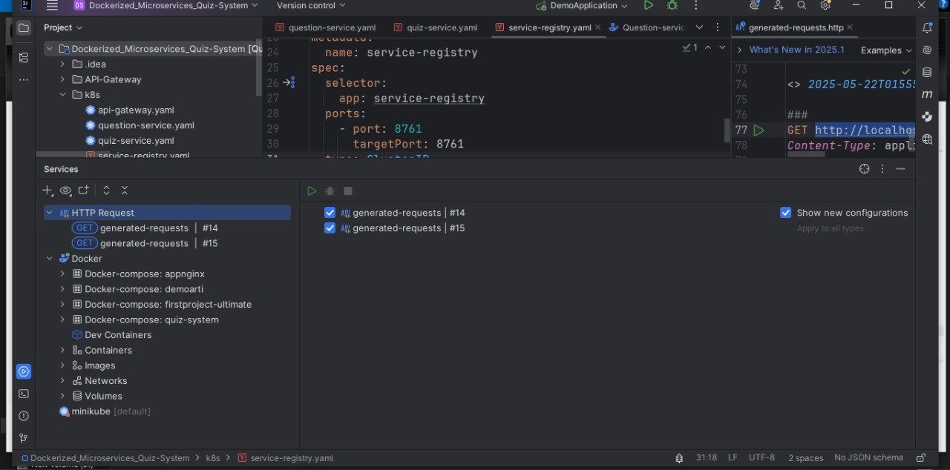
Environment setup

Slide 20
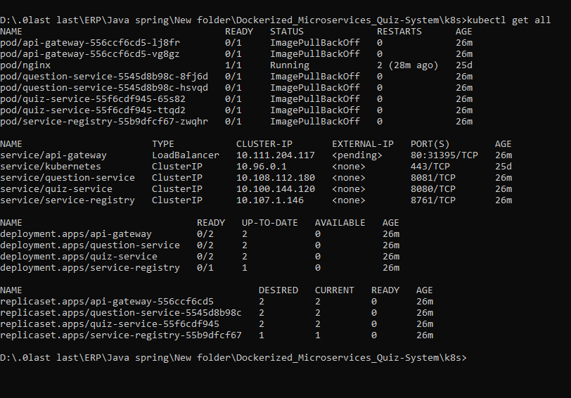
Environment setup

Slide 21
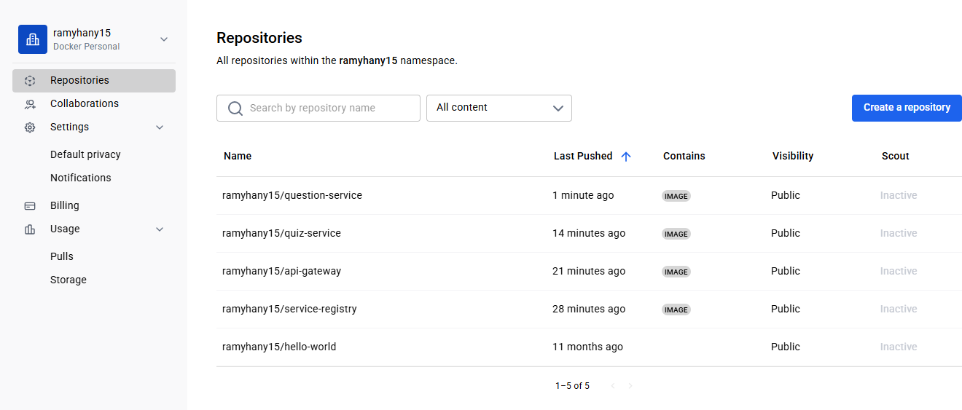
Environment setup

Slide 22
https://github.com/Ramy152002/dockerized_Microservices_Quiz_System/tree/main
You can check the source code from :

Slide 23
Thank you

