Slide 1
Predicting Diabetes Using Machine Learning Techniques
A Data-Driven Approach to Early Diagnosis and Risk Assessment
Presented by:
Ramya

Slide 2
Problem Statement
Diabetes is a growing global health concern.
Early detection can help prevent complications and reduce treatment costs.
Objective: Build a data-driven model to predict diabetes based on patient data.

Slide 3
Tools and Libraries Used
Python
pandas for data manipulation
seaborn and matplotlib for data visualization
sklearn for preprocessing and future model development

Slide 4
Definition of Methodology
The project follows a structured machine learning pipeline including:
Data cleaning
Exploratory Data Analysis (EDA)
Model training
Evaluation
Categorical features were encoded numerically and numeric values normalized.

Slide 5
Dataset Description
Dataset: 'diabetes_prediction_dataset.csv'
Source: Kaggle
Features:
Age, Gender, BMI
Hypertension, Heart Disease
Smoking History, HbA1c Level, Blood Glucose Level
Target: 'diabetes' (1 = diabetic, 0 = non-diabetic)

Slide 6
Data Collection
Data was collected from Kaggle’s open-source health data repository.
Simulated clinical records, cleaned and standardized for educational and research use.
Includes both demographic and clinical indicators.

Slide 7
Data Preprocessing
Handled missing values by dropping incomplete rows.
Encoded 'gender' numerically (Male:0, Female:1, Other:2).
Applied one-hot encoding to 'smoking_history'.
Normalized numerical features using MinMaxScaler.

Slide 8
Exploratory Data Analysis (EDA)
EDA included visualizing and summarizing the dataset:
Distribution of HbA1c and BMI
Relationships with diabetes status
Correlation between features

Slide 9
Visualization Insights
Heatmap revealed strong correlations for key predictors.
HbA1c and blood glucose levels significantly differ between classes.
BMI and age show moderate trends.
Visual patterns validate clinical assumptions.

Slide 10

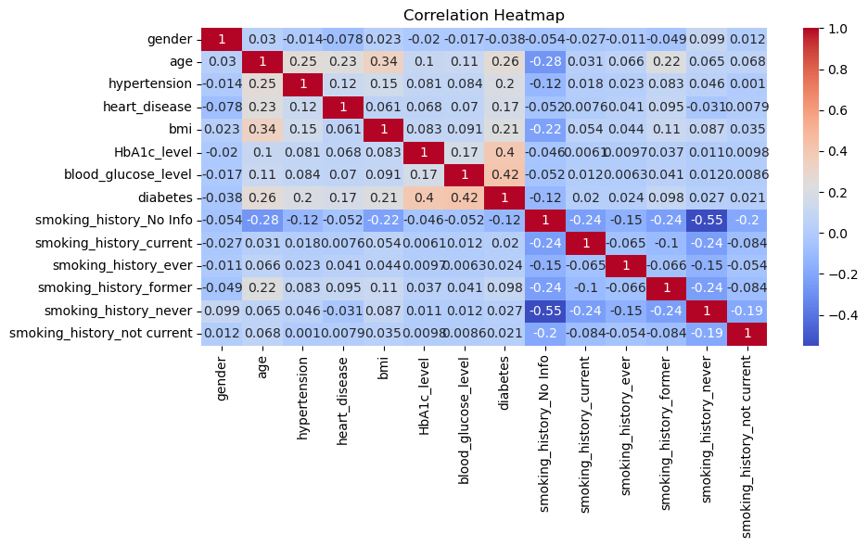
Figure 1: Correlation Heatmap
A heatmap showing correlations among all features.
HbA1c and blood_glucose_level are strongly correlated with diabetes.

Slide 11
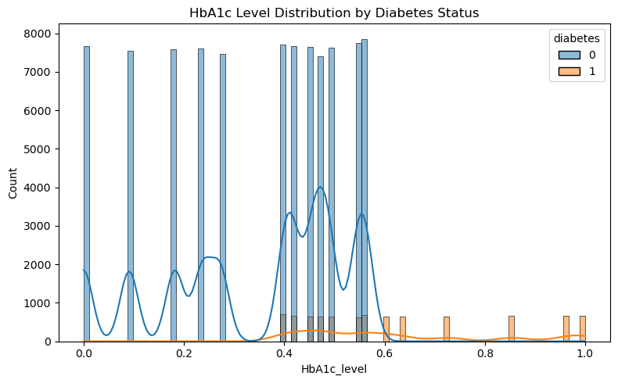
Figure 2: HbA1c Level Distribution by Diabetes Status
A histogram displaying HbA1c level distribution across diabetic and non-diabetic patients.
Diabetic patients tend to have higher HbA1c levels.

Slide 12
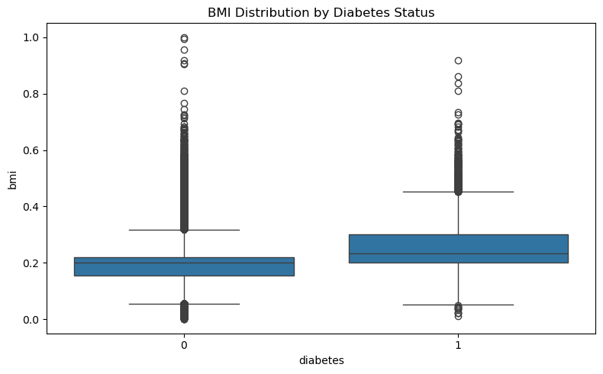
Figure 3: BMI Distribution by Diabetes Status
A boxplot comparing BMI distribution across diabetes classes.
Higher BMI is somewhat associated with diabetes.

Slide 13
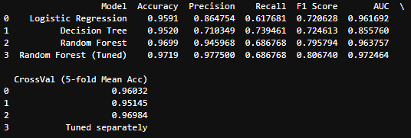
Model Building and Training
Three classification models were trained and tested:
1. Logistic Regression:
Interpretable and fast.
Baseline for performance comparison.
2. Decision Tree Classifier:
Handles nonlinear relationships.
Can be overfit without pruning.
3. Random Forest Classifier:
Ensemble of decision trees.
Best performance among all models.
Robust to overfitting and handles feature importance well.
Models were evaluated using Accuracy, Precision, Recall, F1-Score, and AUC-ROC.

Slide 14
Feature Selection
Selected features based on correlation with the target variable 'diabetes':
High correlation: HbA1c level, blood glucose level
Moderate correlation: BMI, age
Retained all features for model experimentation.

Slide 15
Limitations and Challenges
Dataset is simulated, not actual clinical records.
Possible class imbalance in diabetes distribution.
Feature set does not include lifestyle/dietary factors.
More advanced models yet to be implemented.

Slide 16
Summary of Findings
Dataset cleaned, encoded, and normalized
HbA1c and blood glucose show strong relationships with diabetes
BMI shows moderate correlation
These features align with clinical expectations and are suitable for model training.
Random Forest outperformed others across most metrics.

