Slide 1
Introduction
Facilitator : Ramya Bhargavi Anumula

Slide 2
Query:
get all the actors from a particular movie in a single row

Slide 3
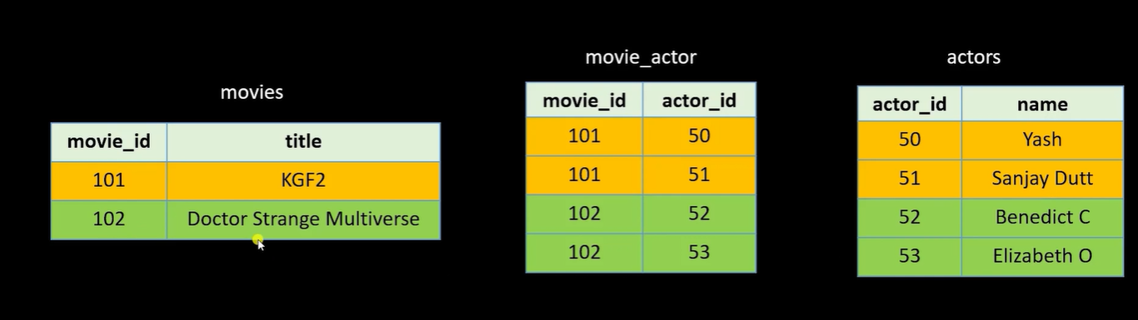

Slide 4
Steps to write query :
step 1:
get all tables info by select statements or we can see ER diagram.
step 2:
then see the what tables and order in which u need to join those tables
Step 3:
After joining get the required cols
check what other things(eg : functions like group_concat ,aggregate functions like count,min,max) we can use on those cols.

Slide 5

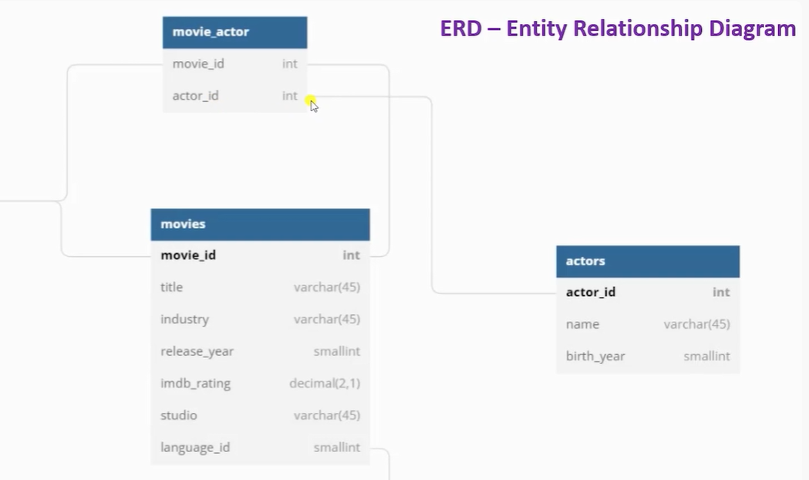


Slide 6
Query 2. get all movies names of a particular actor
actor --- movie

Slide 7
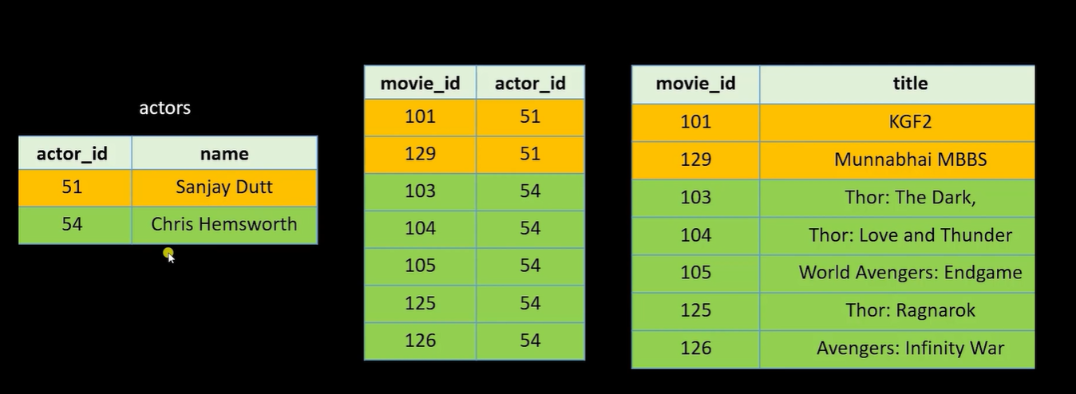

Slide 8
3. get the second actor name who acted In more number of movies
actor --- movie

Slide 9
Q4 : You have two tables, pricing and discounts. Common link between these tables is product_code which can have null value in both the tables. A null product_code record in pricing table is considered a match with discounts table record with NULL product_code value. Which query can perform a correct inner join on all the records including NULL records?

Slide 10
SELECT * from pricing p
JOIN discounts d ON
p.product_code = d.product_code
SELECT * from pricing p JOIN discounts d ON
IFNULL(p.product_code, 1) = IFNULL(d.product_code,1)

