Slide 1
Introduction
Ramya Bhargavi Anumula

Slide 2
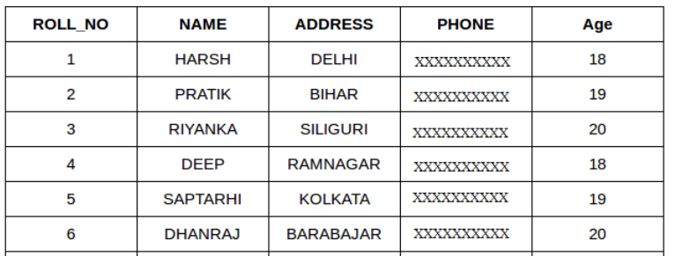
What is SQL?
SQL stands for Structured Query Language
SQL lets you access and manipulate databases
SQL became a standard of the American National Standards Institute (ANSI) in 1986, and of the International Organization for Standardization (ISO) in 1987.
What Can SQL do?
SQL can execute queries against a database
SQL can retrieve data from a database
SQL can insert, update, delete records in a database
SQL can create new databases
Table:
A table is a collection of related data entries and it consists of columns and rows.

Slide 3
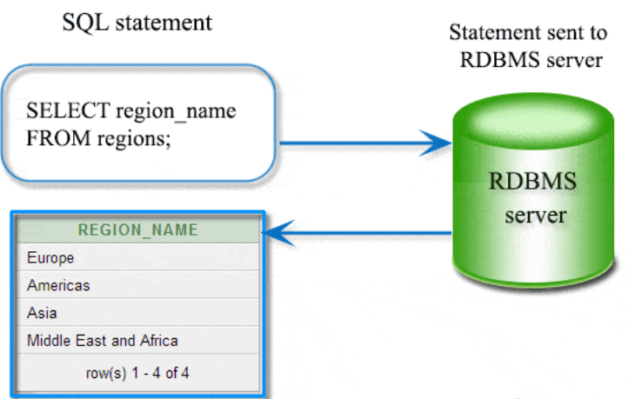
RDBMS
RDBMS stands for Relational Database Management System.
RDBMS is the basis for SQL, and for all modern database systems such as MS SQL Server, IBM DB2, Oracle, MySQL, and Microsoft Access.
The data in RDBMS is stored in database objects called tables.

Slide 4
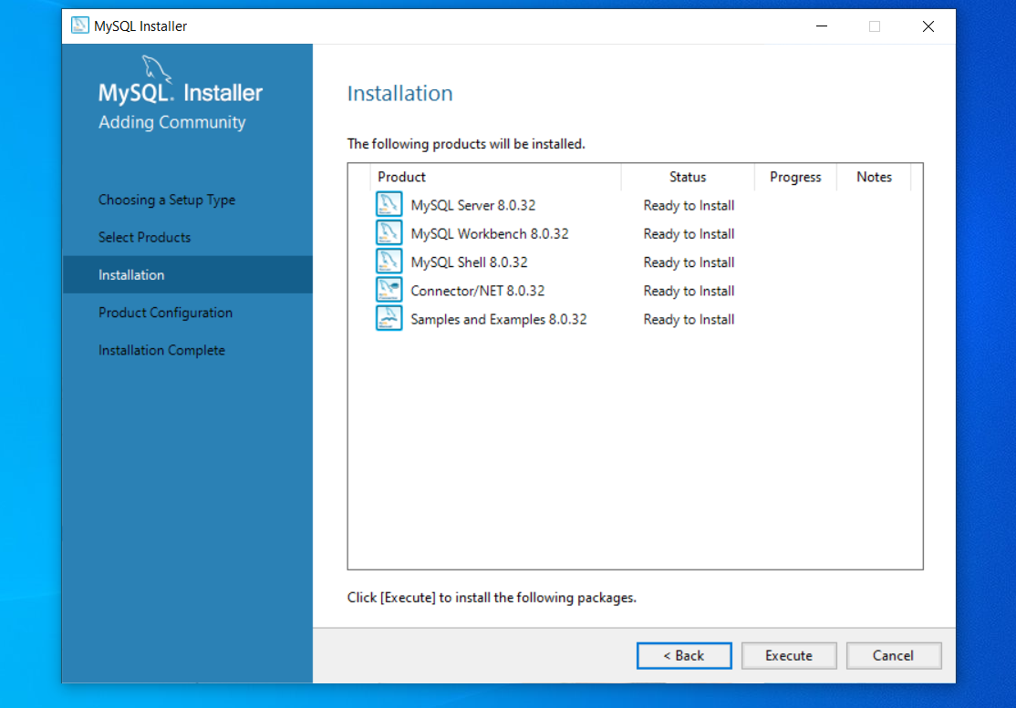
SQL INSTALLATION
Download Mysql windows
Click Run and add only following in installation to complete it fast.

Slide 5
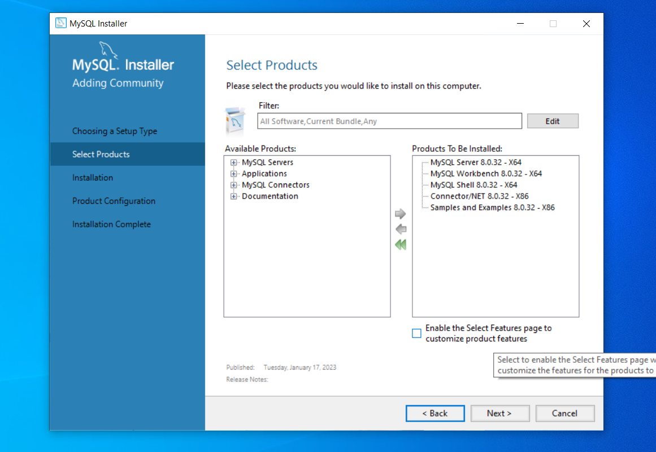

Slide 6
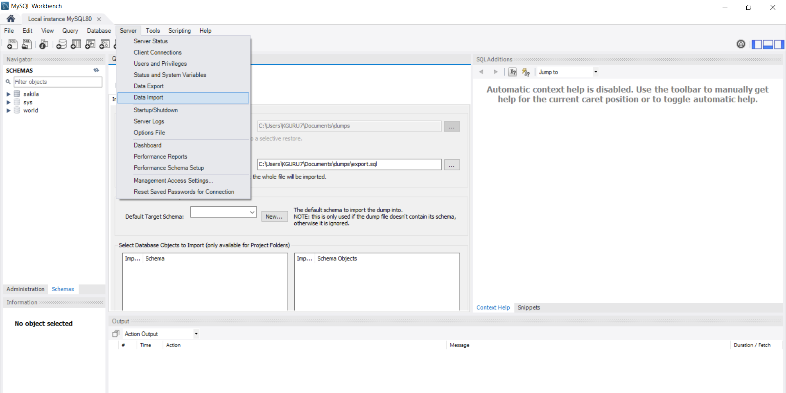

Slide 7
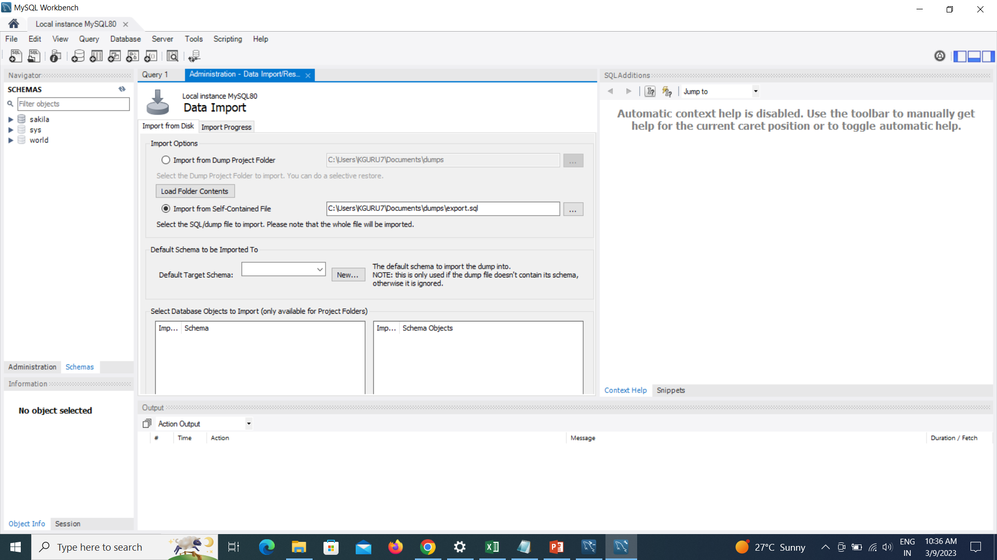

Slide 8
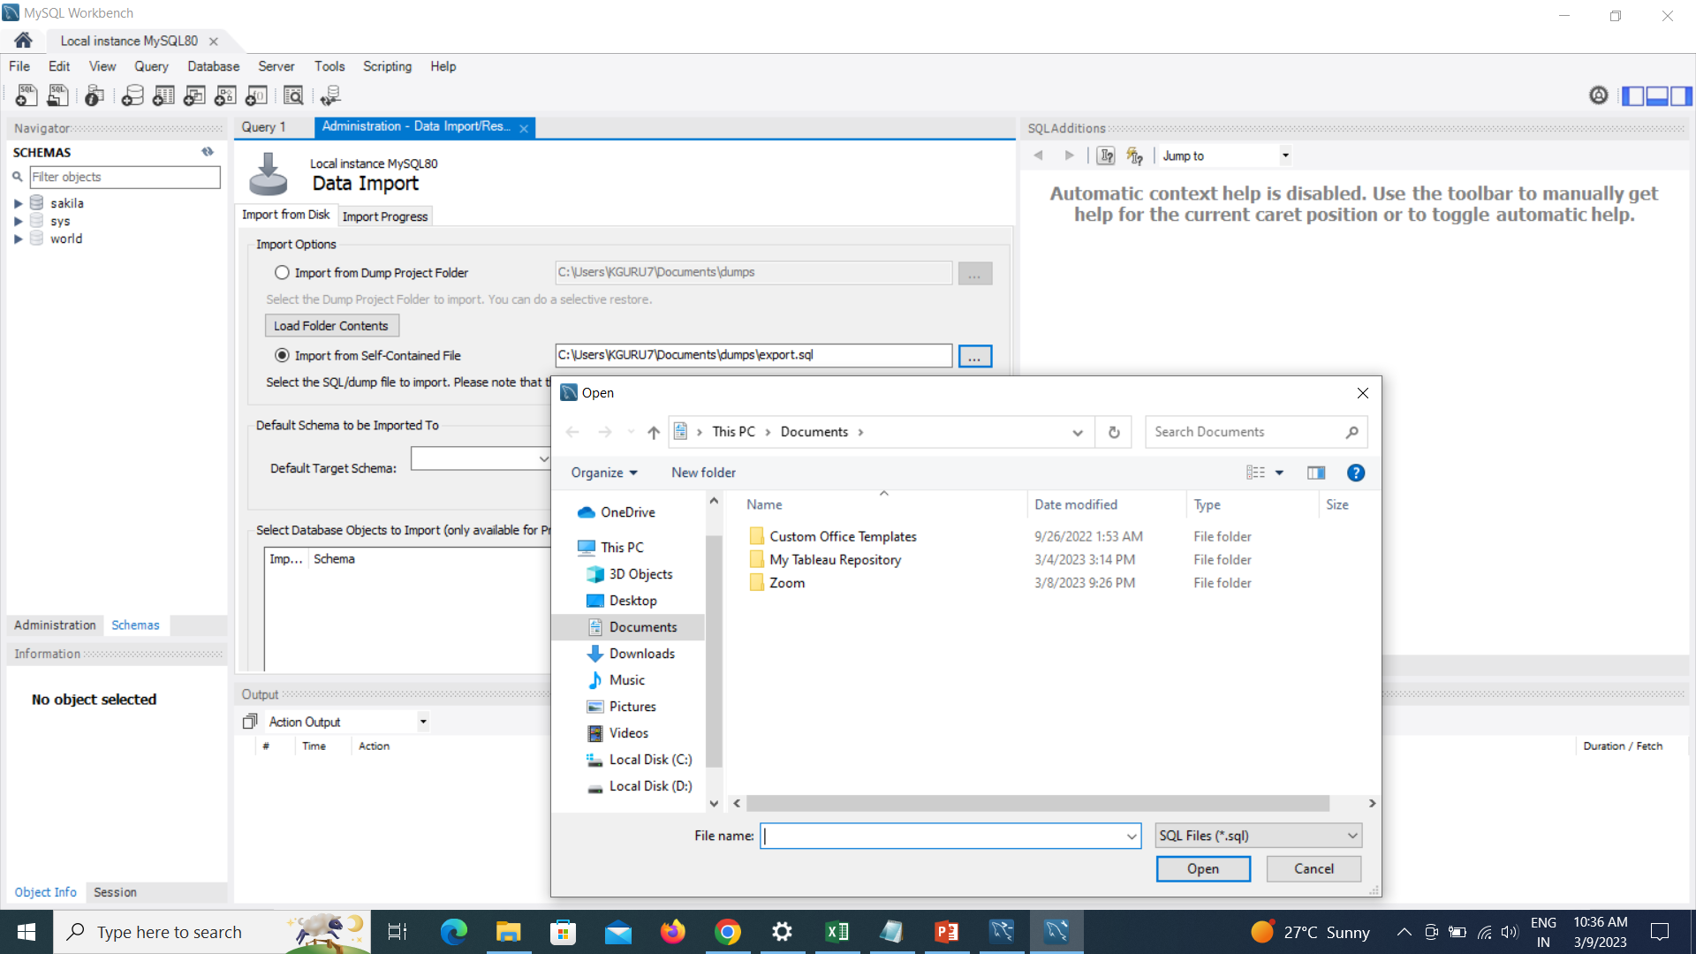
Import Downloaded movies DB

Slide 9
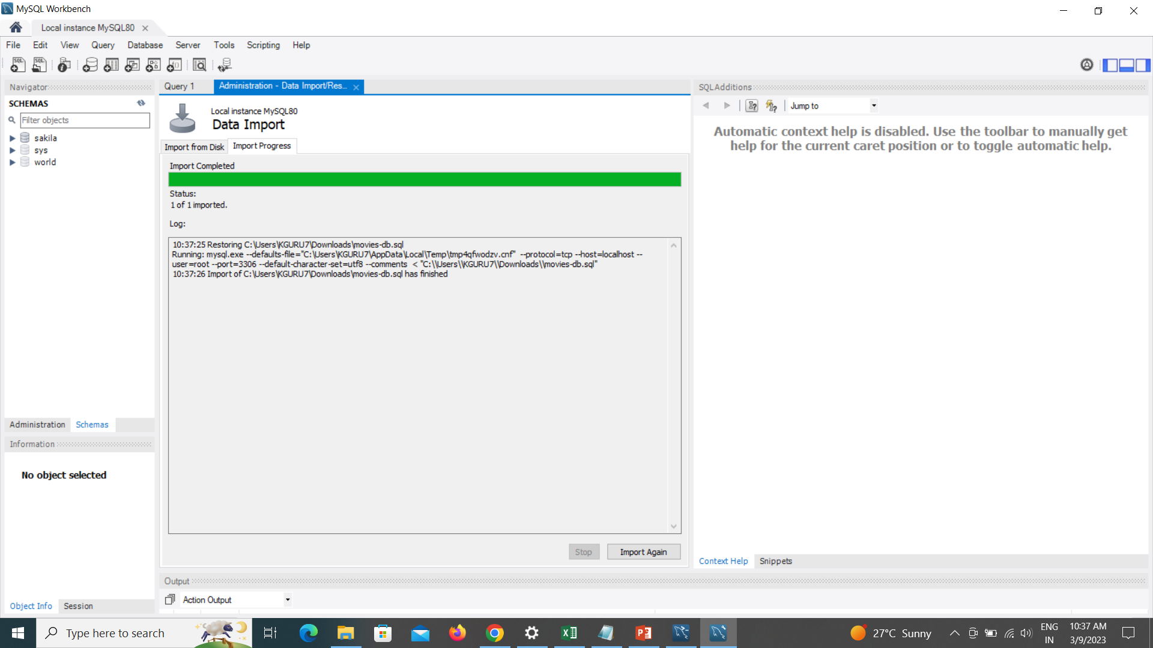

Slide 10
