Slide 1
Introduction

Slide 2
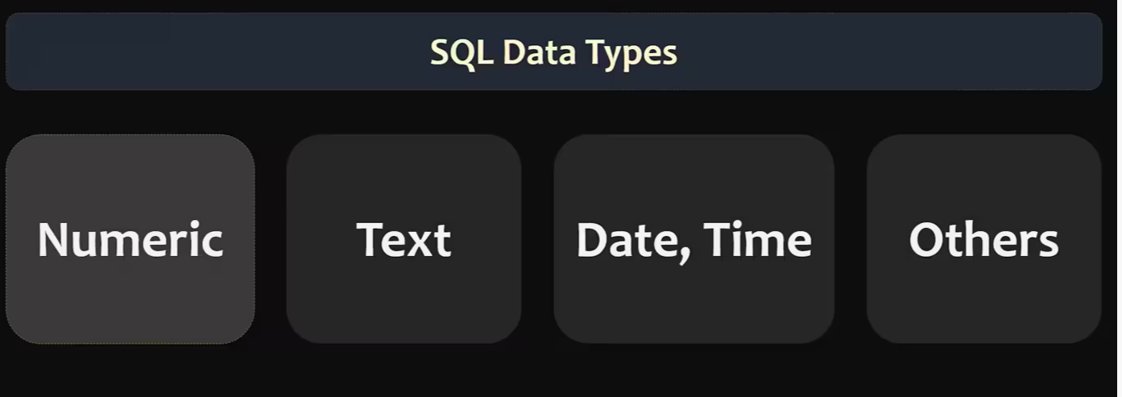
MySQL Data Types
Each column in a database table is required to have a name and a data type.

Slide 3
NUMERIC DATA TYPES

Slide 4
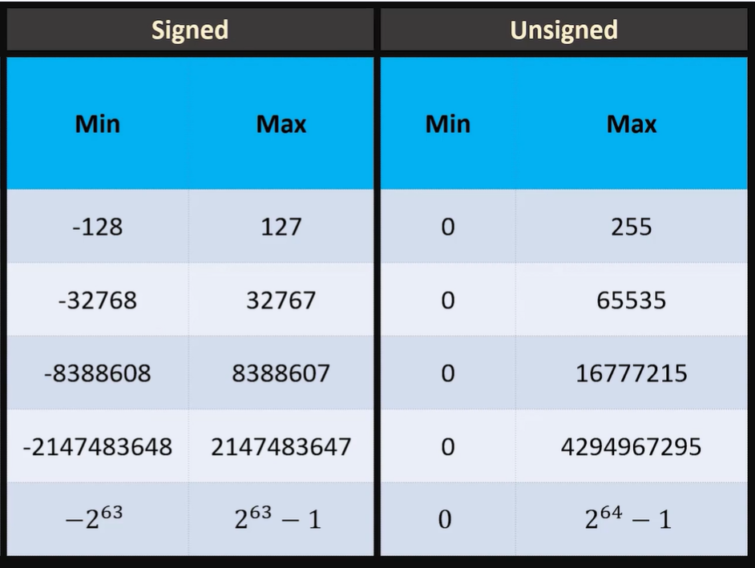
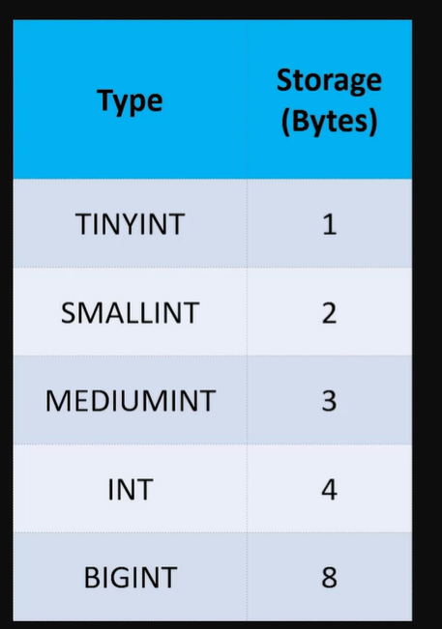

Slide 5
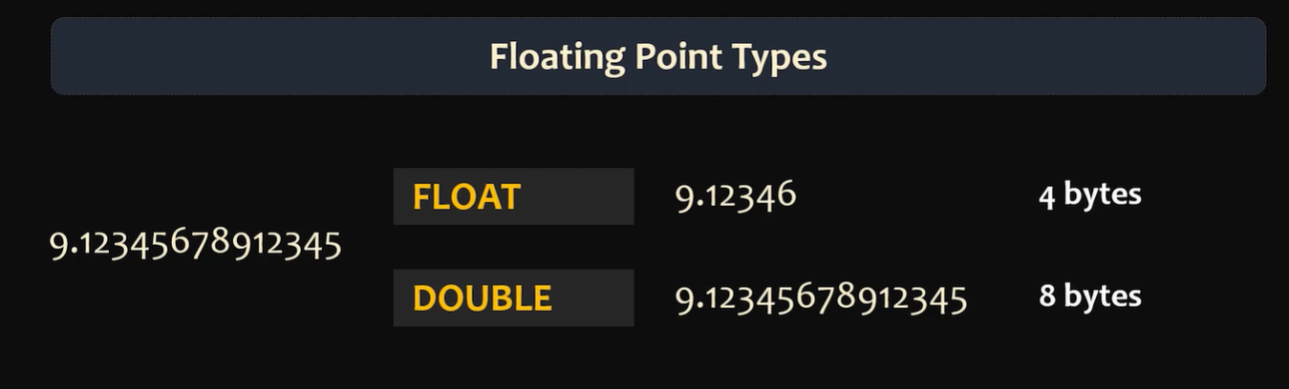


Slide 6
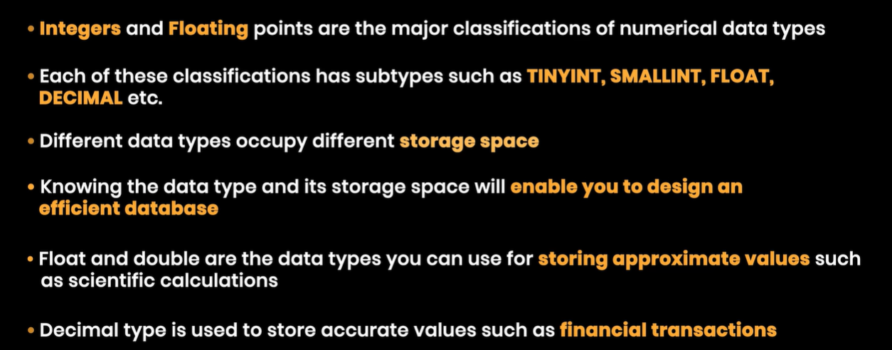

Slide 7
TEXT DATA TYPES

Slide 8

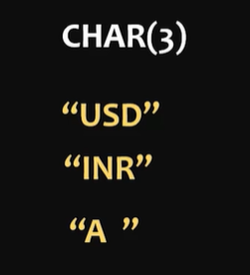

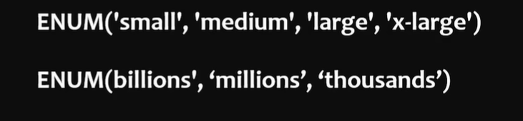
We should give only the fixed length if we are giving less than that spaces are added at end in CHAR(size).
BUT in VARCHAR the length can be varying.
For other data types :
https://dev.mysql.com/doc/refman/8.0/en/data-types.html

Slide 9
DATE DATA TYPES

Slide 10
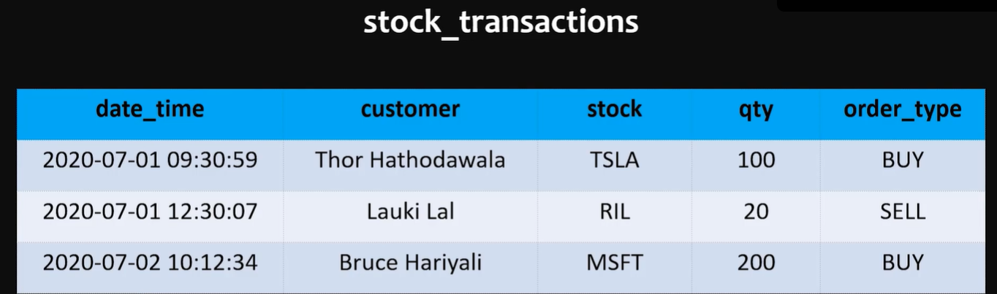


Slide 11
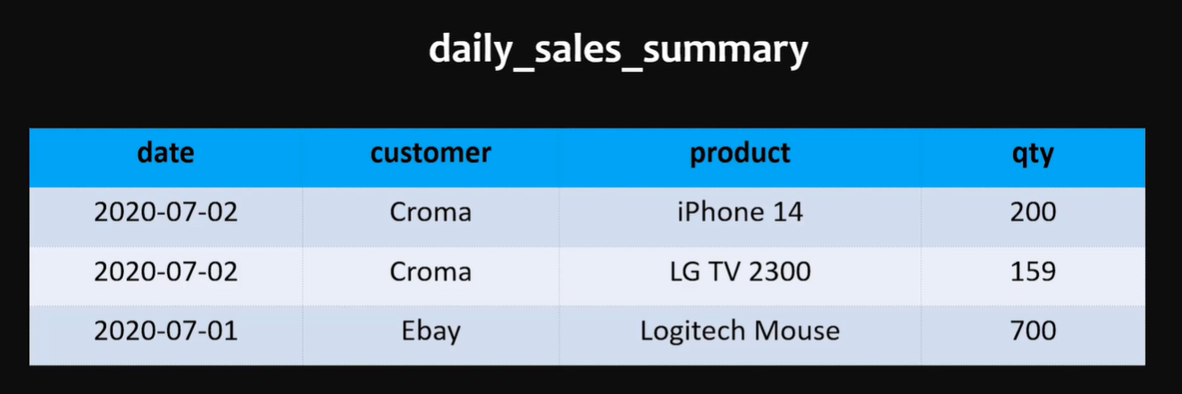


Slide 12
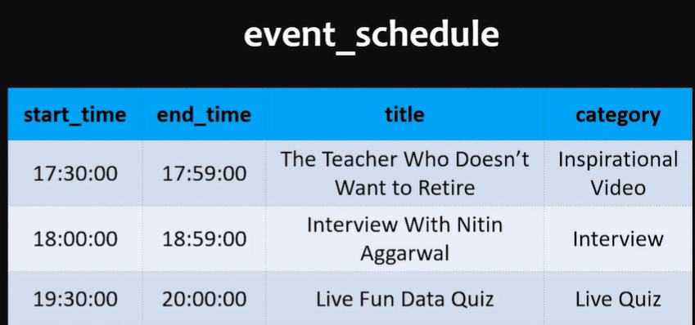


Slide 13
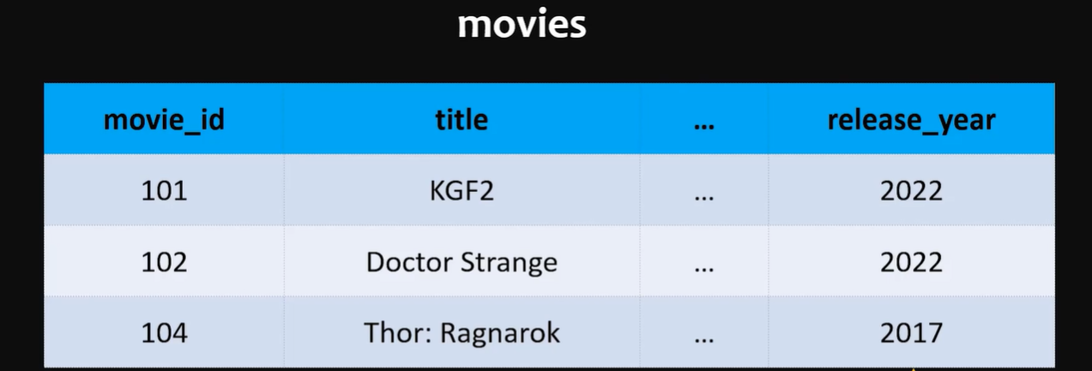
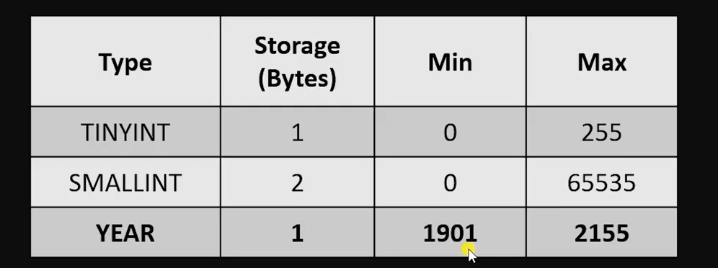


Slide 14
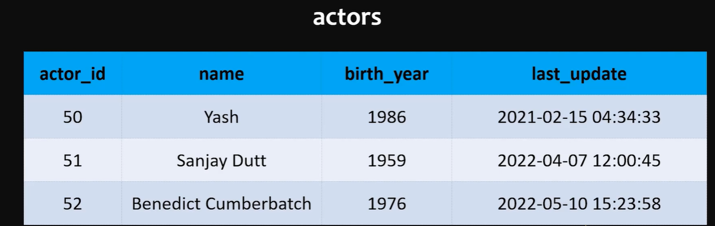
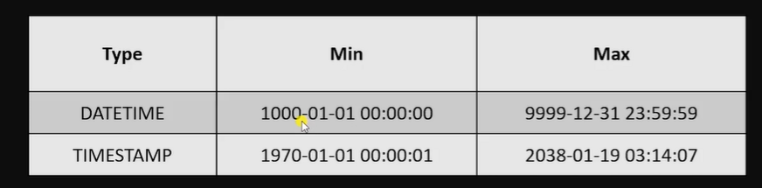


Slide 15
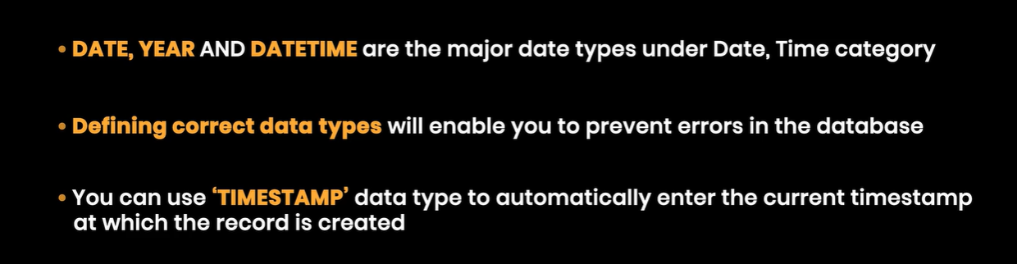

Slide 16
Other DATA TYPES

Slide 17
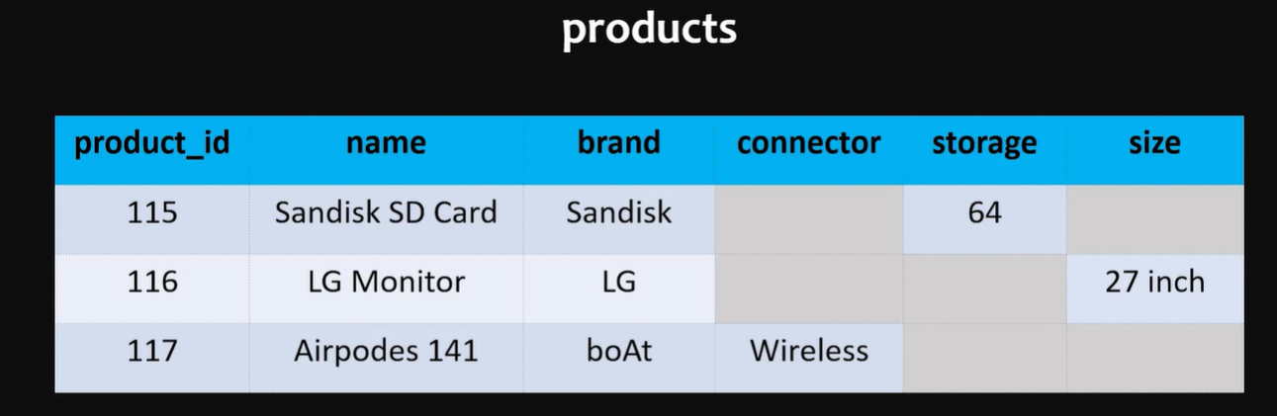
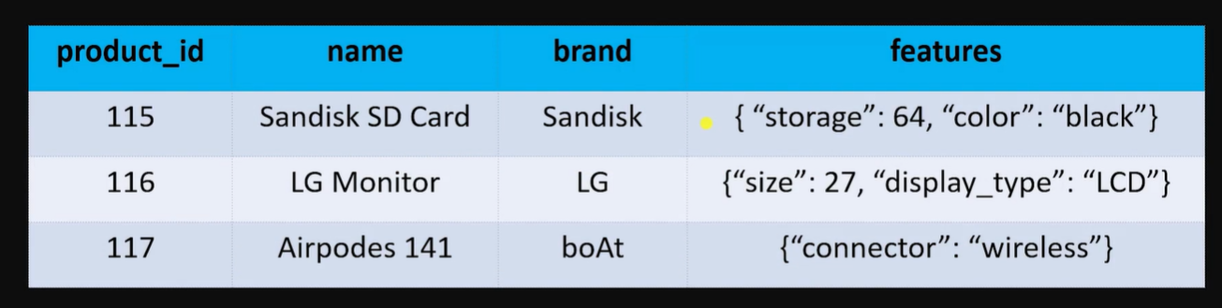

Slide 18
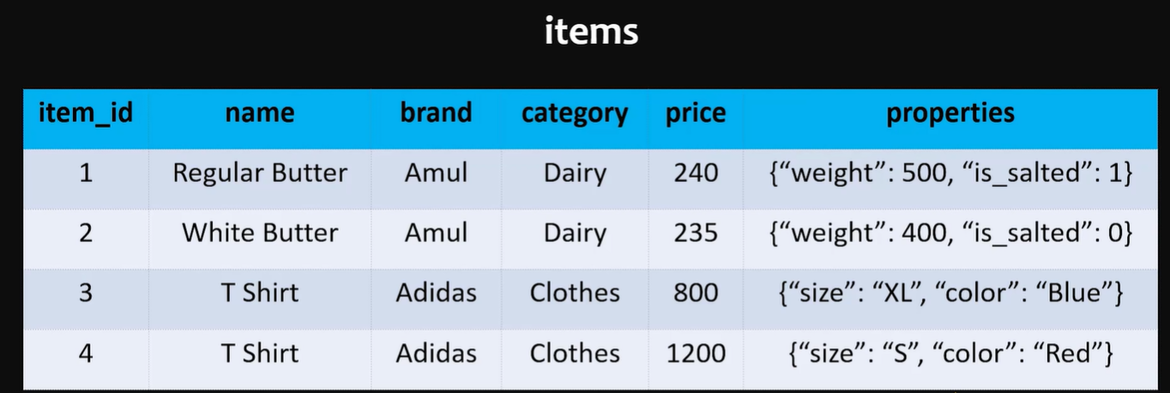


Slide 19
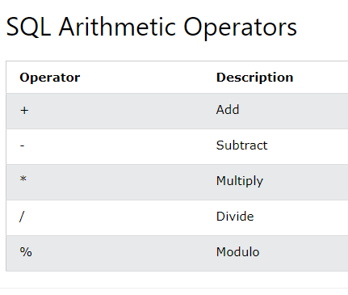
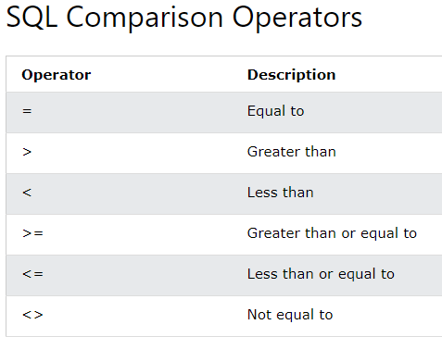
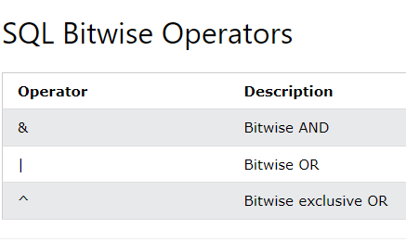
SQL Operators

Slide 20
MySQL Functions
MySQL has many built-in functions.
This reference contains string, numeric, date, and some advanced functions in MySQL.
MySQL String Functions
MySQL Numeric Functions
MySQL Date Functions
MySQL Advanced Functions

Slide 21
SQL Comments
Single Line Comments
Single line comments start with --.
Any text between -- and the end of the line will be ignored (will not be executed).
--SELECT * FROM Customers; SELECT * FROM Products;
Multi-line Comments
Multi-line comments start with /* and end with */.
Any text between /* and */ will be ignored.
/*Select all the columns of all the records in the Customers table:*/ SELECT * FROM Customers;
Examples in MY SQL Workbench

Slide 22
SQL Keywords
This SQL keywords reference contains the reserved words in SQL.
Keyword | Description
ADD | Adds a column in an existing table
ADD CONSTRAINT | Adds a constraint after a table is already created
ALL | Returns true if all of the sub query values meet the condition
ALTER | Adds, deletes, or modifies columns in a table, or changes the data type of a column in a table
ALTER COLUMN | Changes the data type of a column in a table
ALTER TABLE | Adds, deletes, or modifies columns in a table
AND | Only includes rows where both conditions is true
ANY | Returns true if any of the subquery values meet the condition
AS | Renames a column or table with an alias
BETWEEN | Selects values within a given range

