Slide 1
Introduction
Ramya Bhargavi Anumula

Slide 2
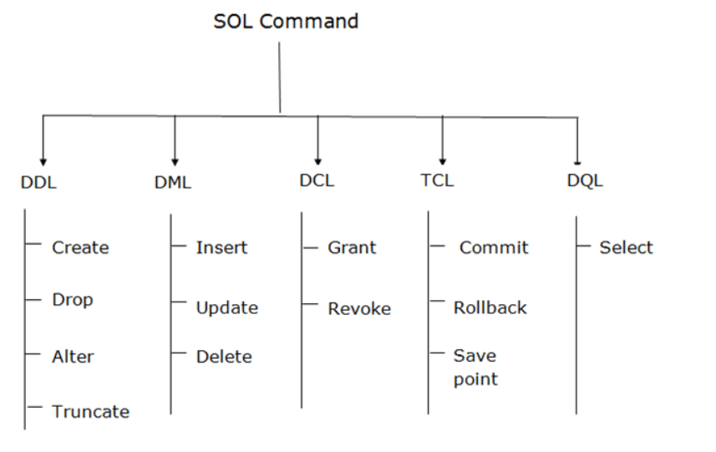

Slide 3
Data Definition Language Commands
Create
This command is used to create the database or its objects (like table, index, function, views, store procedure, and triggers).
Syntax
CREATE table table_name ( Column1 datatype (size), column2 datatype (size), . . columnN datatype(size) );
Alter
ALTER TABLE is used to add, delete/drop or modify columns in the existing table. It is also used to add and drop various constraints on the existing table.
ALTER TABLE – ADD
ADD is used to add columns into the existing table. Sometimes we may require to add additional information, in that case we do not require to create the whole database again, ADD comes to our rescue.
Syntax
ALTER TABLE table_name ADD (Columnname_1 datatype, Columnname_2 datatype, … Columnname_n datatype);

Slide 4
Data Definition Language Commands
ALTER TABLE – DROP
DROP COLUMN is used to drop column in a table. Deleting the unwanted columns from the table.
Syntax:
ALTER TABLE table_name DROP COLUMN column_name;
ALTER TABLE-MODIFY
It is used to modify the existing columns in a table. Multiple columns can also be modified at once. *Syntax may vary slightly in different databases.
Syntax(Oracle,MySQL,MariaDB):
ALTER TABLE table_name MODIFY column_name column_type;
Syntax(SQL Server):
ALTER TABLE table_name ALTER COLUMN column_name column_type;

Slide 5
Data Definition Language Commands
DROP
DROP is used to delete a whole database or just a table. The DROP statement destroys objects like an existing database, table, index, or view.
DROP object object_name
Examples:
DROP TABLE table_name; table_name: Name of the table to be deleted.
DROP DATABASE database_name; database_name: Name of the database to be deleted.
TRUNCATE
statement is a Data Definition Language (DDL) operation that is used to mark the extents of a table for deallocation (empty for reuse).
TRUNCATE TABLE table_name; table_name: Name of the table to be truncated

Slide 6
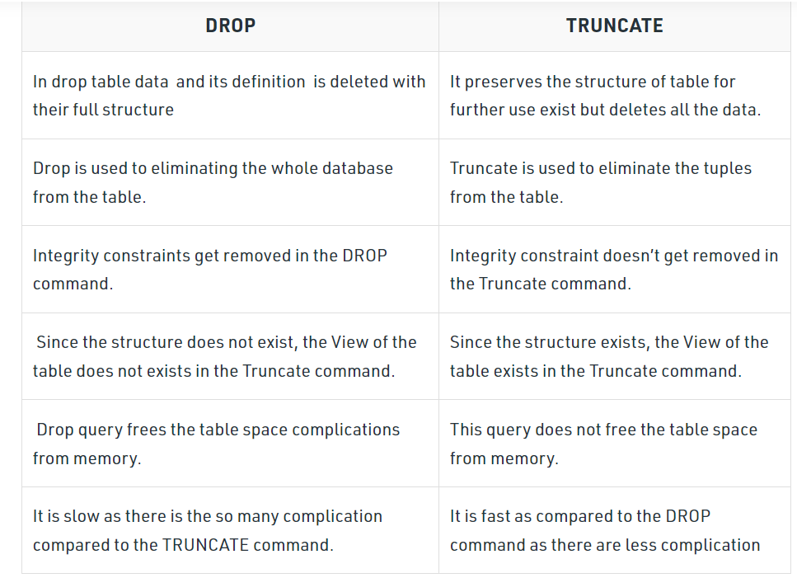
Data Definition Language Commands

Slide 7
Data Manipulation Language commands
INSERT :
The INSERT INTO statement of SQL is used to insert a new row in a table. There are two ways of using INSERT INTO statement for inserting rows:
Only values: First method is to specify only the value of data to be inserted without the column names.
INSERT INTO table_name VALUES (value1, value2, value3,…);
table_name: name of the table. value1, value2,.. : value of first column, second column,… for the new record
Column names and values both: In the second method we will specify both the columns which we want to fill and their corresponding values as shown below:
INSERT INTO table_name (column1, column2, column3,..) VALUES ( value1, value2, value3,..);
table_name: name of the table. column1: name of first column, second column … value1, value2, value3 : value of first column, second column,… for the new record

Slide 8
UPDATE Statement :
The UPDATE statement in SQL is used to update the data of an existing table in database. We can update single columns as well as multiple columns using UPDATE statement as per our requirement.
UPDATE table_name SET column1 = value1, column2 = value2,... WHERE condition;
table_name: name of the table
column1: name of first , second, third column....
value1: new value for first, second, third column....
condition: condition to select the rows for which the values of columns needs to be updated.
DELETE Statement :
DELETE FROM table_name WHERE some_condition;
table_name: name of the table
some_condition: condition to choose particular record.

Slide 9
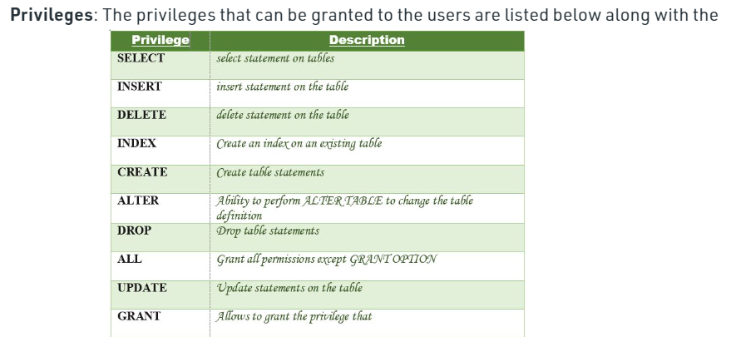
Data Control Language
DCL includes commands such as GRANT and REVOKE which mainly deal with the rights, permissions, and other controls of the database system.
GRANT privileges_names ON object TO user;
Parameters Used:
privileges_name: These are the access rights or privileges granted to the user.
object:It is the name of the database object to which permissions are being granted. In the case of granting privileges on a table, this would be the table name.
user:It is the name of the user to whom the privileges would be granted.

Slide 10
Granting SELECT Privilege to a User in a Table
GRANT SELECT ON Users TO'Amit'@'localhost;
Granting more than one Privilege to a User in a Table:
GRANT SELECT, INSERT, DELETE, UPDATE ON Users TO 'Amit'@'localhost;
Granting a Privilege to all Users in a Table:
GRANT SELECT ON Users TO '*'@'localhost;
Revoking Privileges from a Table
REVOKE privileges ON object FROM user;
Parameters Used:
object: It is the name of the database object from which permissions are being revoked. In the case of revoking privileges from a table, this would be the table name.
user: It is the name of the user from whom the privileges are being revoked.

Slide 11
Transaction Control Language
Transactions group a set of tasks into a single execution unit. Each transaction begins with a specific task and ends when all the tasks in the group successfully complete.
Transactions group a set of tasks into a single execution unit. Each transaction begins with a specific task and ends when all the tasks in the group successfully complete. If any of the tasks fail, the transaction fails. Therefore, a transaction has only two results: success or failure.
Example of a transaction to transfer $150 from account A to account B: 1. read(A) 2. A := A – 150 3. write(A) 4. read(B) 5. B := B + 150 6. write(B)
Incomplete steps result in the failure of the transaction.

Slide 12
BEGIN TRANSACTION: It indicates the start point of an explicit or local transaction.
Syntax:
BEGIN TRANSACTION transaction_name ;
2. SET TRANSACTION: Places a name on a transaction.
Syntax:
SET TRANSACTION [ READ WRITE | READ ONLY ];
3. COMMIT: If everything is in order with all statements within a single transaction, all changes are recorded together in the database is called committed.
The COMMIT command saves all the transactions to the database since the last COMMIT or ROLLBACK command.
Syntax:
COMMIT;
EXAMPLE:
DELETE FROM Student WHERE AGE = 20;
COMMIT;

Slide 13
ROLLBACK:
If any error occurs with any of the SQL grouped statements, all changes need to be aborted. The process of reversing changes is called rollback.
This command can only be used to undo transactions since the last COMMIT command was issued.
Syntax :
ROLLBACK;
EXAMPLE:
DELETE FROM Student WHERE AGE = 20;
ROLLBACK;
SAVEPOINT
creates points within the groups of transactions in which to ROLLBACK.
A SAVEPOINT is a point in a transaction in which you can roll the transaction back to a certain point without rolling back the entire transaction.
SAVEPOINT SAVEPOINT_NAME;
ROLLBACK TO SAVEPOINT_NAME;

Slide 14
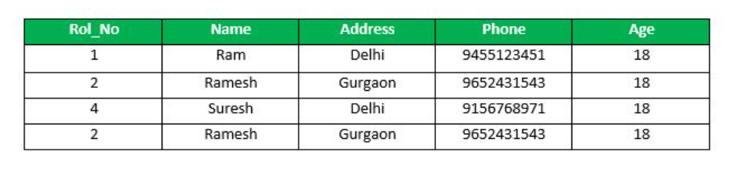
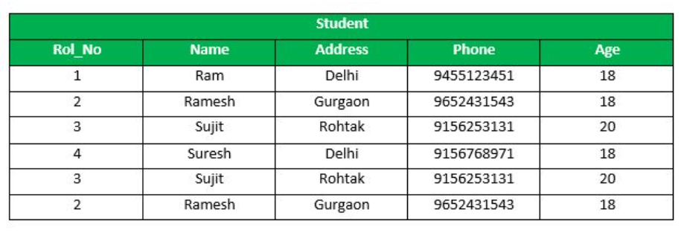
Example :
SAVEPOINT SP1; //Savepoint created.
DELETE FROM Student WHERE AGE = 20; //deleted
SAVEPOINT SP2; //Savepoint created.
ROLLBACK TO SP1; //Rollback completed.

Slide 15
RELEASE SAVEPOINT
This command is used to remove a SAVEPOINT that you have created. Syntax:
RELEASE SAVEPOINT SAVEPOINT_NAME
Once a SAVEPOINT has been released, you can no longer use the ROLLBACK command to undo transactions performed since the last SAVEPOINT.

