Slide 1
Introduction
Ramya Bhargavi Anumula

Slide 2
MySQL Constraints
SQL constraints are used to specify rules for the data in a table.
Constraints are used to limit the type of data that can go into a table. This ensures the accuracy and reliability of the data in the table. If there is any violation between the constraint and the data action, the action is aborted.
Constraints can be specified when the table is created with the CREATE TABLE statement, or after the table is created with the ALTER TABLE statement.
CREATE TABLE table_name ( column1 datatype constraint, column2 datatype constraint, column3 datatype constraint, .... )

Slide 3
MySQL Constraints
The following constraints are commonly used in SQL:
NOT NULL - Ensures that a column cannot have a NULL value
UNIQUE - Ensures that all values in a column are different
PRIMARY KEY - A combination of a NOT NULL and UNIQUE. Uniquely identifies each row in a table.
FOREIGN KEY - Prevents actions that would destroy links between tables
CHECK - Ensures that the values in a column satisfies a specific condition
DEFAULT - Sets a default value for a column if no value is specified
CREATE INDEX - Used to create and retrieve data from the database very quickly

Slide 4
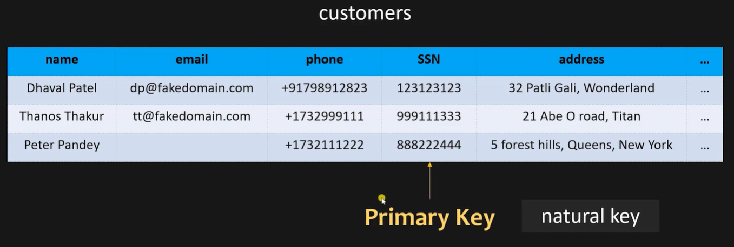
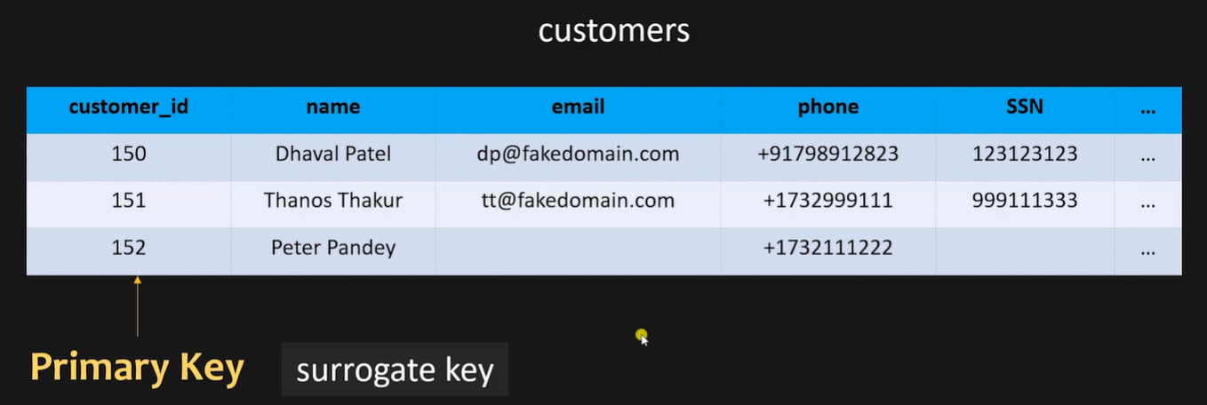
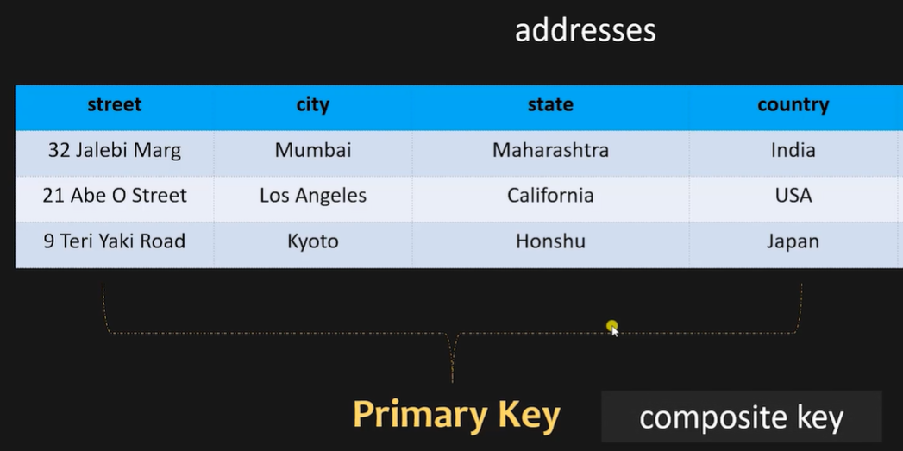
PK - Natural key when COL is part of data set
PK - Surrogate key when COL is artificially created in the data set

Slide 5
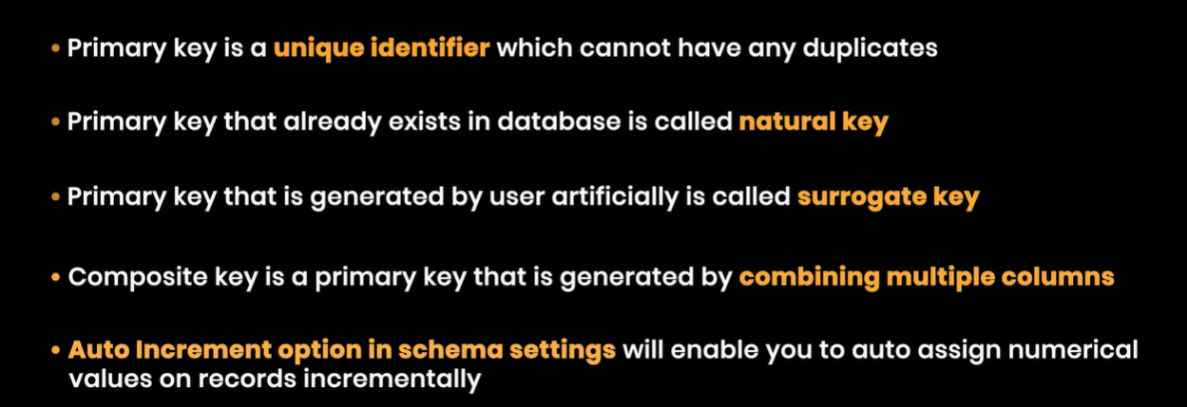

Slide 6
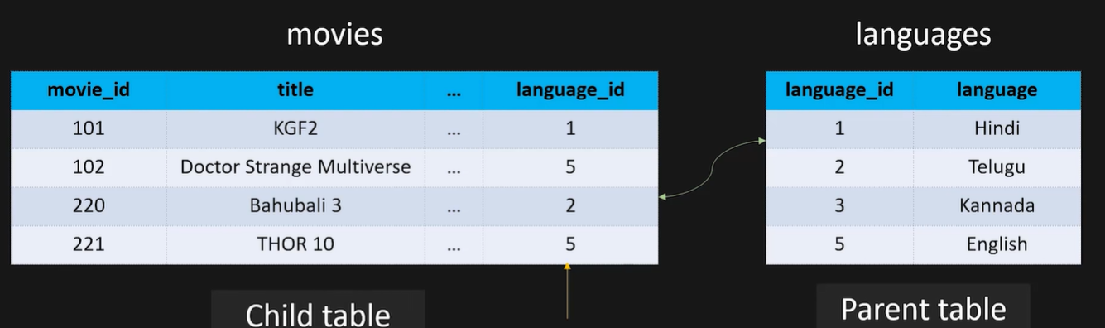


Slide 7
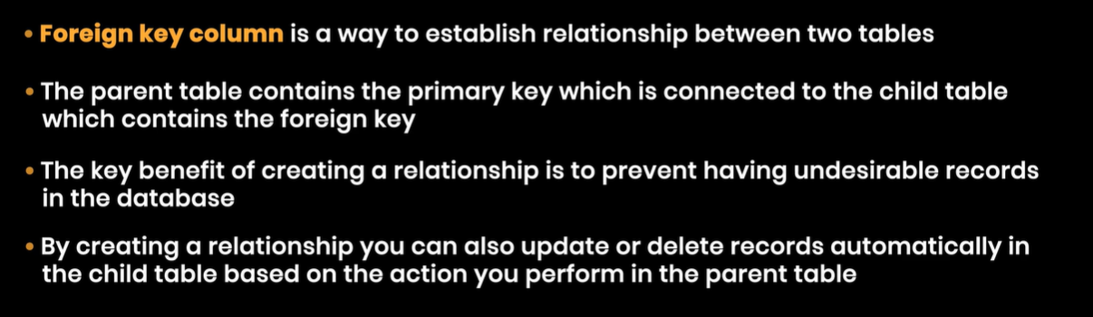

Slide 8
MySQL Constraints
MySQL NOT NULL Constraint
By default, a column can hold NULL values.
The NOT NULL constraint enforces a column to NOT accept NULL values.
NOT NULL on CREATE TABLE
CREATE TABLE Persons ( ID int NOT NULL, LastName varchar(255) NOT NULL, FirstName varchar(255) NOT NULL, Age int );
NOT NULL on ALTER TABLE
ALTER TABLE Persons MODIFY Age int NOT NULL;

Slide 9
MySQL Constraints
MySQL UNIQUE Constraint
The UNIQUE constraint ensures that all values in a column are different.
Both the UNIQUE and PRIMARY KEY constraints provide a guarantee for uniqueness for a column or set of columns.
A PRIMARY KEY constraint automatically has a UNIQUE constraint.
CREATE TABLE Persons ( ID int NOT NULL, LastName varchar(255) NOT NULL, FirstName varchar(255), Age int, UNIQUE (ID) );
UNIQUE Constraint on ALTER TABLE
ALTER TABLE Persons ADD UNIQUE (ID);
ALTER TABLE Persons ADD CONSTRAINT UC_Person UNIQUE (ID,LastName);
ALTER TABLE Persons DROP INDEX UC_Person;

Slide 10
MySQL Constraints
MySQL PRIMARY KEY Constraint
The PRIMARY KEY constraint uniquely identifies each record in a table.
Primary keys must contain UNIQUE values, and cannot contain NULL values.
A table can have only ONE primary key; and in the table, this primary key can consist of single or multiple columns (fields).
CREATE TABLE Persons ( ID int NOT NULL, LastName varchar(255) NOT NULL, FirstName varchar(255), Age int, PRIMARY KEY (ID) );
CREATE TABLE Persons ( ID int NOT NULL, LastName varchar(255) NOT NULL, FirstName varchar(255), Age int, CONSTRAINT PK_Person PRIMARY KEY (ID,LastName) );
Here we have only one primary key with both cols but in previous slide there are two unique keys.

Slide 11
MySQL Constraints
DROP PRIMARY KEY
ALTER TABLE Persons_4
DROP PRIMARY KEY;
# primary key in alter table
ALTER TABLE Persons_4
ADD CONSTRAINT PK_Person PRIMARY KEY (ID,FirstName);
Parameter | PRIMARY KEY | UNIQUE KEY
Basic | Used to serve as a unique identifier for each row in a table. | Uniquely determines a row which isn’t primary key.
NULL value acceptance | Cannot accept NULL values. | Can accepts NULL values.
Number of keys that can be defined in the table | Only one primary key | More than one unique key
Modification | We cannot change or delete values stored in primary keys. | We can change unique key values.

Slide 12
MySQL Constraints
MySQL FOREIGN KEY Constraint
The FOREIGN KEY constraint is used to prevent actions that would destroy links between tables.
A FOREIGN KEY is a field (or collection of fields) in one table, that refers to the PRIMARY KEY in another table.
CREATE TABLE Orders ( OrderID int NOT NULL, OrderNumber int NOT NULL, PersonID int,
PRIMARY KEY (OrderID), FOREIGN KEY (PersonID) REFERENCES Persons(ID));
S.No. | Primary Key | Foreign Key
1 | A primary key generally focuses on the uniqueness of the table. It assures the value in the specific column is unique. | A foreign key is generally used to build a relationship between the two tables.
2 | Table allows only one primary key. | Tables can allow more than one foreign key.
3 | The primary key doesn’t allow null values. | Foreign key accepts multiple null values.
4 | It can identify the record uniquely in the database table. | A foreign key is a field in the table that is the primary key in another table.
5 | In the primary key, the value cannot be removed from the parent table. | In this, the value can be deleted from the child table.
6 | Its restriction can be completely defined on the temporary tables. | Its restriction cannot be defined on the global or local temporary tables.

Slide 13
MySQL Constraints
MySQL CREATE INDEX Statement
Indexes are used to retrieve data from the database more quickly than otherwise. They are just used to speed up searches/queries.
Note: Updating a table with indexes takes more time than updating a table without (because the indexes also need an update). So, only create indexes on columns that will be frequently searched against.
CREATE INDEX index_name ON table_name (column1, column2, ...);
CREATE INDEX idx_lastname ON Persons_4(LastName);
ALTER TABLE table_name DROP INDEX index_name;

Slide 14
MySQL Constraints
MySQL Views
In SQL, a view is a virtual table based on the result-set of an SQL statement.
A view contains rows and columns, just like a real table. The fields in a view are fields from one or more real tables in the database.
You can add SQL statements and functions to a view and present the data as if the data were coming from one single table.
A view is created with the CREATE VIEW statement.
CREATE VIEW view_name AS SELECT column1, column2, ... FROM table_name WHERE condition;
VIEW
View is a logical table. It is a physical object which stores data logically. View just refers to data that is stored in base tables.
A view is a logical entity. It is a SQL statement stored in the database in the system table space. Data for a view is built in a table created by the database engine in the TEMP table space.
INDEX
Indexes are pointers that maps to the physical address of data. So by using indexes data manipulation becomes faster.
An index is a performance-tuning method of allowing faster retrieval of records. An index creates an entry for each value that appears in the indexed columns.

