Slide 1
Introduction
Ramya Bhargavi Anumula

Slide 2
Normalization
A large database defined as a single relation may result in data duplication. This repetition of data may result in:
Making relations very large.
It isn't easy to maintain and update data as it would involve searching many records in relation.
Wastage and poor utilization of disk space and resources.
The likelihood of errors and inconsistencies increases.
So to handle these problems, we should analyze and decompose the relations with redundant data into smaller, simpler, and well-structured relations that are satisfy desirable properties. Normalization is a process of decomposing the relations into relations with fewer attributes.

Slide 3
What is Normalization?
Normalization is the process of organizing the data in the database.
Normalization is used to minimize the redundancy from a relation or set of relations. It is also used to eliminate undesirable characteristics like Insertion, Update, and Deletion Anomalies.
Normalization divides the larger table into smaller and links them using relationships.
The normal form is used to reduce redundancy from the database table.
Why do we need Normalization?
The main reason for normalizing the relations is removing these anomalies. Failure to eliminate anomalies leads to data redundancy and can cause data integrity and other problems as the database grows. Normalization consists of a series of guidelines that helps to guide you in creating a good database structure.

Slide 4
Data modification anomalies can be categorized into three types:
Insertion Anomaly: Insertion Anomaly refers to when one cannot insert a new tuple into a relationship due to lack of data.
Deletion Anomaly: The delete anomaly refers to the situation where the deletion of data results in the unintended loss of some other important data.
Updatation Anomaly: The update anomaly is when an update of a single data value requires multiple rows of data to be updated.

Slide 5
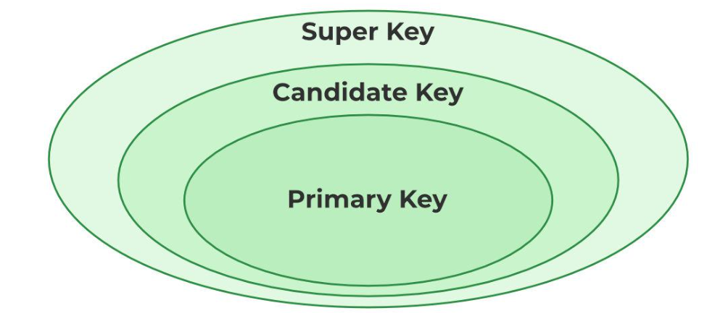

Slide 6
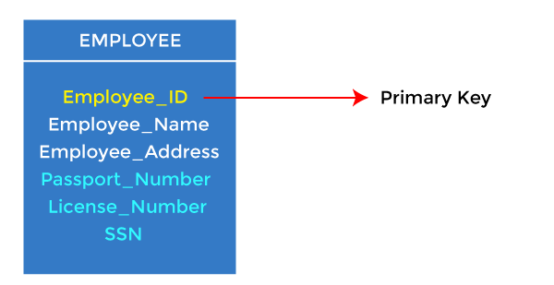
1. Primary key
It is the first key used to identify one and only one instance of an entity uniquely. An entity can contain multiple keys, as we saw in the PERSON table. The key which is most suitable from those lists becomes a primary key.
In the EMPLOYEE table, ID can be the primary key since it is unique for each employee. In the EMPLOYEE table, we can even select License_Number and Passport_Number as primary keys since they are also unique.
For each entity, the primary key selection is based on requirements and developers.

Slide 7
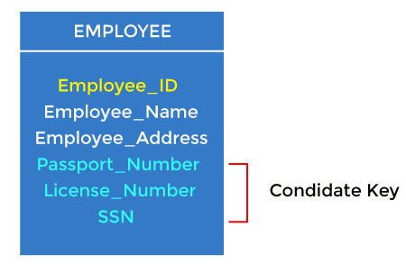
2. Candidate key
A candidate key is an attribute or set of attributes that can uniquely identify a tuple.
Except for the primary key, the remaining attributes are considered a candidate key. The candidate keys are as strong as the primary key.
For example: In the EMPLOYEE table, id is best suited for the primary key. The rest of the attributes, like SSN, Passport_Number, License_Number, etc., are considered a candidate key.

Slide 8
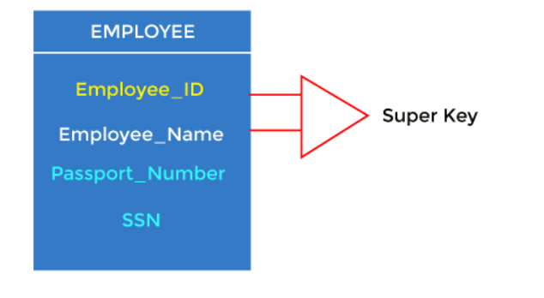
3. Super Key
Super key is an attribute set that can uniquely identify a tuple. A super key is a superset of a candidate key.
For example: In the above EMPLOYEE table, for(EMPLOEE_ID, EMPLOYEE_NAME), the name of two employees can be the same, but their EMPLYEE_ID can't be the same. Hence, this combination can also be a key.
One of the super key can be EMPLOYEE-ID (EMPLOYEE_ID, EMPLOYEE-NAME), etc.

Slide 9
Normalization works through a series of stages called Normal forms. The normal forms apply to individual relations. The relation is said to be in particular normal form if it satisfies constraints.

Slide 10
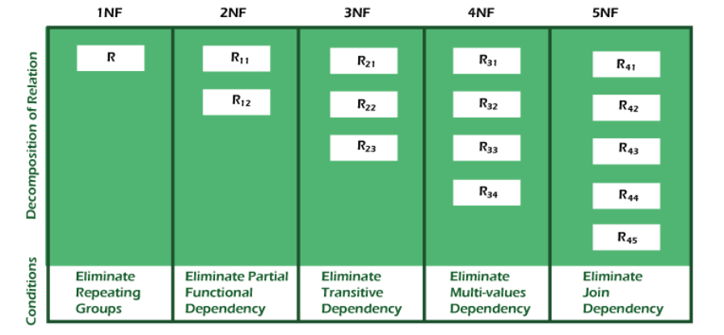

Slide 11
Normal Form | Description
1NF | A relation is in 1NF if it contains an atomic value.
2NF | A relation will be in 2NF if it is in 1NF and all non-key attributes are fully functional dependent on the primary key.
3NF | A relation will be in 3NF if it is in 2NF and no transition dependency exists.
BCNF | A stronger definition of 3NF is known as Boyce Codd's normal form.
4NF | A relation will be in 4NF if it is in Boyce Codd's normal form and has no multi-valued dependency.
5NF | A relation is in 5NF. If it is in 4NF and does not contain any join dependency, joining should be lossless.

Slide 12
Advantages of Normalization
Normalization helps to minimize data redundancy.
Greater overall database organization.
Data consistency within the database.
Much more flexible database design.
Enforces the concept of relational integrity.
Disadvantages of Normalization
You cannot start building the database before knowing what the user needs.
The performance degrades when normalizing the relations to higher normal forms, i.e., 4NF, 5NF.
It is very time-consuming and difficult to normalize relations of a higher degree.
Careless decomposition may lead to a bad database design, leading to serious problems.

Slide 13
First Normal Form (1NF)
A relation will be 1NF if it contains an atomic value.
It states that an attribute of a table cannot hold multiple values. It must hold only single-valued attribute.
First normal form disallows the multi-valued attribute, composite attribute, and their combinations.
Example: Relation EMPLOYEE is not in 1NF because of multi-valued attribute EMP_PHONE.
EMPLOYEE table:
The decomposition of the EMPLOYEE table into 1NF has been shown below:
EMP_ID | EMP_NAME | EMP_PHONE | EMP_STATE
14 | John | 7272826385, 9064738238 | UP
20 | Harry | 8574783832 | Bihar
12 | Sam | 7390372389, 8589830302 | Punjab

Slide 14
EMP_ID | EMP_NAME | EMP_PHONE | EMP_STATE
14 | John | 7272826385 | UP
14 | John | 9064738238 | UP
20 | Harry | 8574783832 | Bihar
12 | Sam | 7390372389 | Punjab
12 | Sam | 8589830302 | Punjab

Slide 15
Second Normal Form (2NF)
In the 2NF, relational must be in 1NF.
In the second normal form, all non-key attributes are fully functional dependent on the primary key
Example: Let's assume, a school can store the data of teachers and the subjects they teach. In a school, a teacher can teach more than one subject.
TEACHER table
In the given table, non-prime attribute TEACHER_AGE is dependent on TEACHER_ID which is a proper subset of a candidate key. But they are not fully functionally dependant. Here it is partial dependency. That's why it violates the rule for 2NF.
To convert the given table into 2NF, we decompose it into two tables:
TEACHER_ID | SUBJECT | TEACHER_AGE
25 | Chemistry | 30
25 | Biology | 30
47 | English | 35
83 | Math | 38
83 | Computer | 38

Slide 16
TEACHER_DETAIL table:
TEACHER_ID | TEACHER_AGE
25 | 30
47 | 35
83 | 38
TEACHER_SUBJECT table:
TEACHER_ID | SUBJECT
25 | Chemistry
25 | Biology
47 | English
83 | Math
83 | Computer

Slide 17
Third Normal Form (3NF)
A relation will be in 3NF if it is in 2NF and not contain any transitive partial dependency.
3NF is used to reduce the data duplication. It is also used to achieve the data integrity.
If there is no transitive dependency for non-prime attributes, then the relation must be in third normal form.
A relation is in third normal form if it holds atleast one of the following conditions for every non-trivial function dependency X → Y.
X is a super key.
Y is a prime attribute, i.e., each element of Y is part of some candidate key.

Slide 18
Example:
EMPLOYEE_DETAIL table:
EMP_ID | EMP_NAME | EMP_ZIP | EMP_STATE | EMP_CITY
222 | Harry | 201010 | UP | Noida
333 | Stephan | 02228 | US | Boston
444 | Lan | 60007 | US | Chicago
555 | Katharine | 06389 | UK | Norwich
666 | John | 462007 | MP | Bhopal

Slide 19
Super key in the table above:
{EMP_ID}, {EMP_ID, EMP_NAME}, {EMP_ID, EMP_NAME, EMP_ZIP}....so on
Candidate key: {EMP_ID}
Non-prime attributes: In the given table, all attributes except EMP_ID are non-prime.
Here, EMP_STATE & EMP_CITY dependent on EMP_ZIP and EMP_ZIP dependent on EMP_ID.
The non-prime attributes (EMP_STATE, EMP_CITY) transitively dependent on super key(EMP_ID). It violates the rule of third normal form.
That's why we need to move the EMP_CITY and EMP_STATE to the new <EMPLOYEE_ZIP> table, with EMP_ZIP as a Primary key.

Slide 20
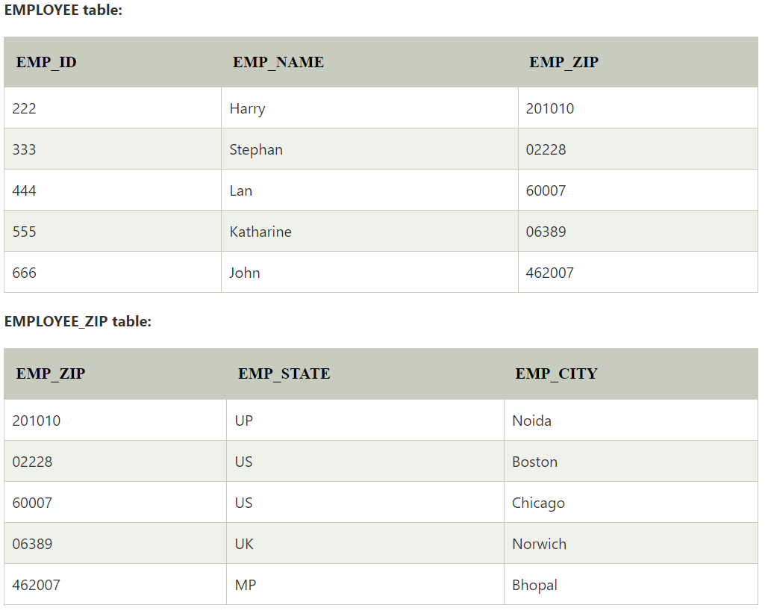

Slide 21
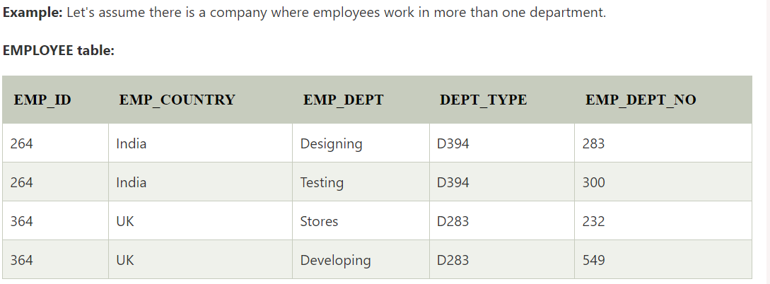
Boyce Codd normal form (BCNF)
BCNF is the advance version of 3NF. It is stricter than 3NF.
A table is in BCNF if every functional dependency X → Y, X is the super key of the table.
For BCNF, the table should be in 3NF, and for every FD, LHS is super key.
Example: Let's assume there is a company where employees work in more than one department.

Slide 22
In the above table Functional dependencies are as follows:
EMP_ID → EMP_COUNTRY
EMP_DEPT → {DEPT_TYPE, EMP_DEPT_NO}
Candidate key: {EMP-ID, EMP-DEPT}
The table is not in BCNF because neither EMP_DEPT nor EMP_ID alone are keys.
To convert the given table into BCNF, we decompose it into three tables:

Slide 23
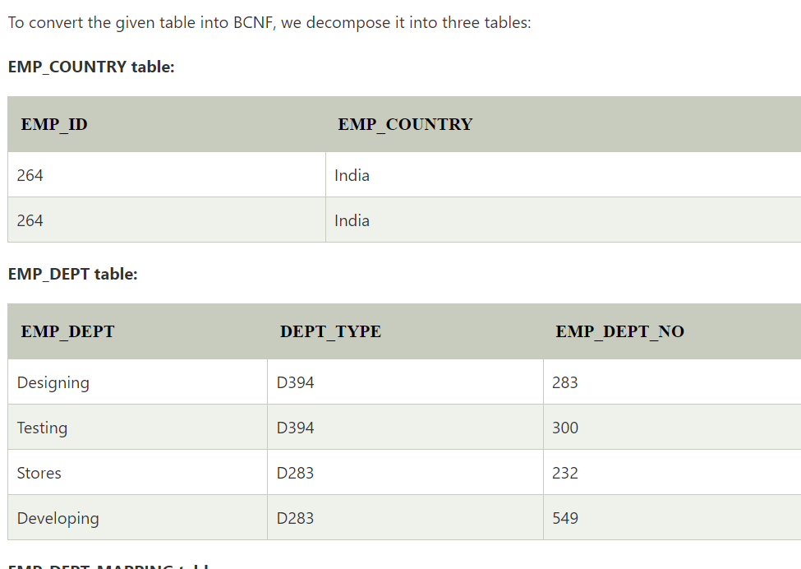

Slide 24
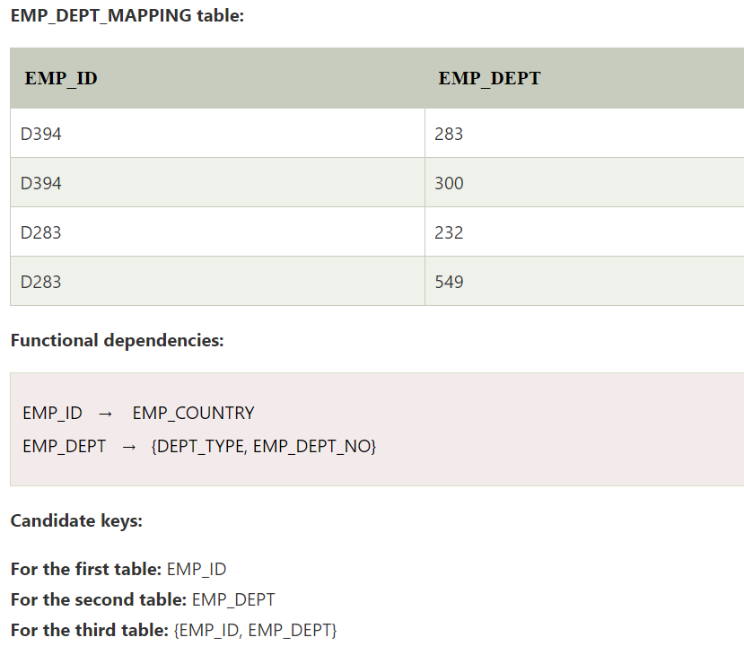

Slide 25
Fourth normal form (4NF)
A relation will be in 4NF if it is in Boyce Codd normal form and has no multi-valued dependency.
For a dependency A → B, if for a single value of A, multiple values of B exists, then the relation will be a multi-valued dependency.
STUDENT
STU_ID | COURSE | HOBBY
21 | Computer | Dancing
21 | Math | Singing
34 | Chemistry | Dancing
74 | Biology | Cricket
59 | Physics | Hockey

Slide 26
The given STUDENT table is in 3NF, but the COURSE and HOBBY are two independent entity. Hence, there is no relationship between COURSE and HOBBY.
In the STUDENT relation, a student with STU_ID, 21 contains two courses, Computer and Math and two hobbies, Dancing and Singing. So there is a Multi-valued dependency on STU_ID, which leads to unnecessary repetition of data.
So to make the above table into 4NF, we can decompose it into two tables:

Slide 27
STUDENT_COURSE
STU_ID | COURSE
21 | Computer
21 | Math
34 | Chemistry
74 | Biology
59 | Physics
STUDENT_HOBBY
STU_ID | HOBBY
21 | Dancing
21 | Singing
34 | Dancing
74 | Cricket
59 | Hockey

Slide 28
Fifth normal form (5NF)
A relation is in 5NF if it is in 4NF and not contains any join dependency and joining should be lossless.
5NF is satisfied when all the tables are broken into as many tables as possible in order to avoid redundancy.
5NF is also known as Project-join normal form (PJ/NF).
SUBJECT | LECTURER | SEMESTER
Computer | Anshika | Semester 1
Computer | John | Semester 1
Math | John | Semester 1
Math | Akash | Semester 2
Chemistry | Praveen | Semester 1

Slide 29
In the above table, John takes both Computer and Math class for Semester 1 but he doesn't take Math class for Semester 2. In this case, combination of all these fields required to identify a valid data.
Suppose we add a new Semester as Semester 3 but do not know about the subject and who will be taking that subject so we leave Lecturer and Subject as NULL. But all three columns together acts as a primary key, so we can't leave other two columns blank.
So to make the above table into 5NF, we can decompose it into three relations P1, P2 & P3:
SEMESTER | SUBJECT
Semester 1 | Computer
Semester 1 | Math
Semester 1 | Chemistry
Semester 2 | Math
SUBJECT | LECTURER
Computer | Anshika
Computer | John
Math | John
Math | Akash
Chemistry | Praveen
SEMSTER | LECTURER
Semester 1 | Anshika
Semester 1 | John
Semester 1 | John
Semester 2 | Akash
Semester 1 | Praveen

