Slide 1
Introduction
Ramya Bhargavi Anumula

Slide 2
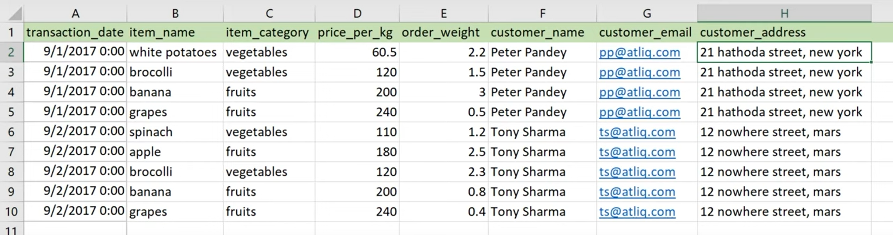
JOINS
WHY WE DO WE NEED MULTIPLE TABLES ???

Slide 3
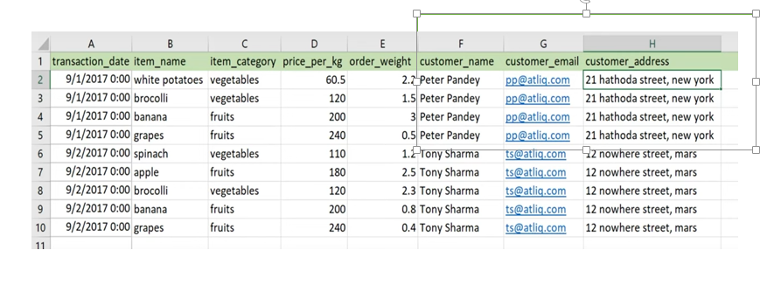
1. To remove redundancy
To avoid more duplicates

Slide 4
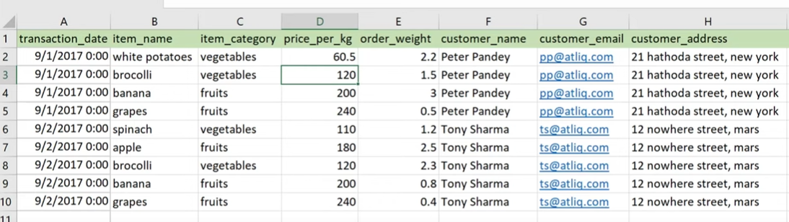
2. Updates are difficult…
Here price per kg is for broccoli lets say in future price of vegetables increased we need to updated all records.

Slide 5
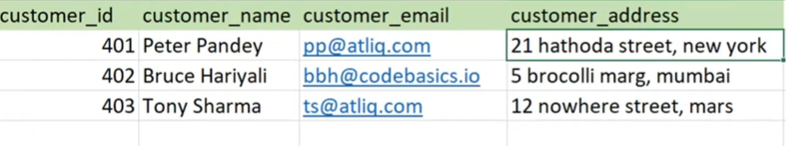
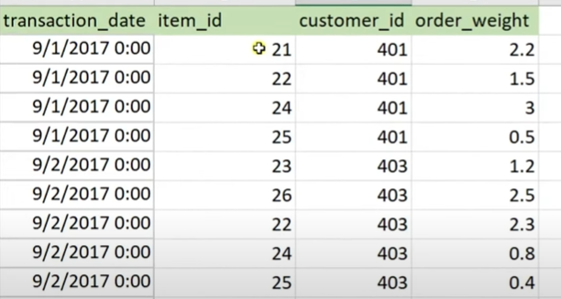
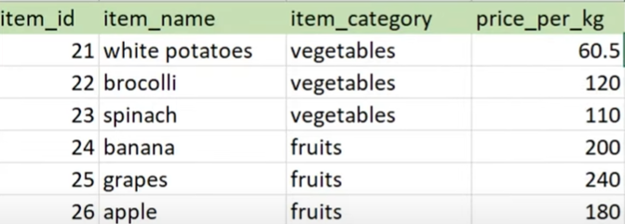
3. Data will be organized properly with multiple tables

Slide 6
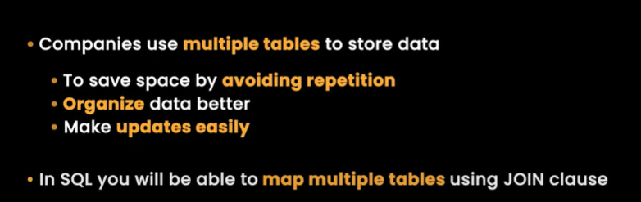
When we use multiple tables we fetch data by using joins.

Slide 7
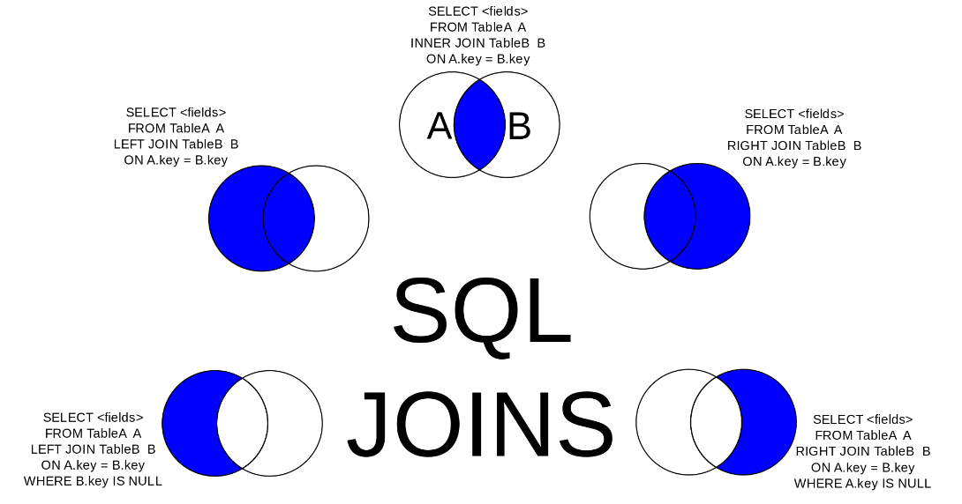
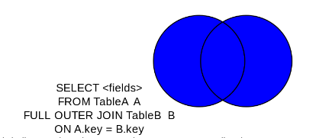
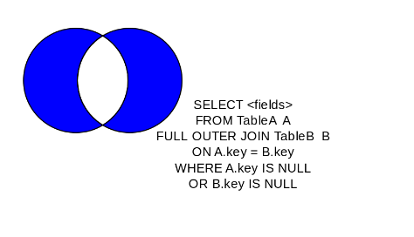

Slide 8
EXAMPLES FROM THE SQL WORKBENCH DDL,DML, DCL SCRIPT FILE

