Slide 1
Python
Ramya Bhargavi Anumula

Slide 2
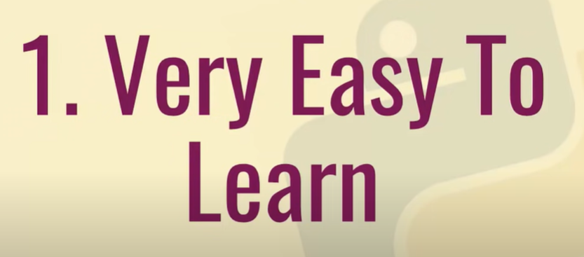

Slide 3
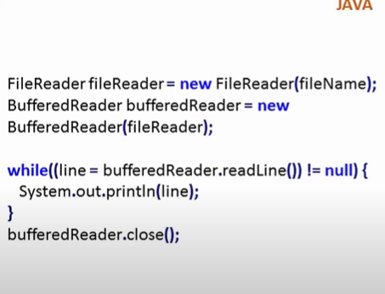
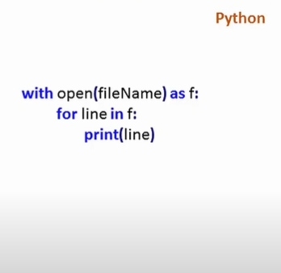

Slide 4
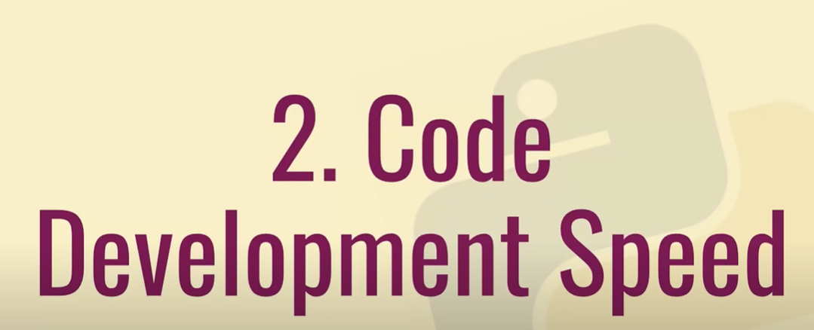

Slide 5
Easy and fast to write.
No compiler, it is interpreted language.
We have so many libraries and modules.

Slide 6
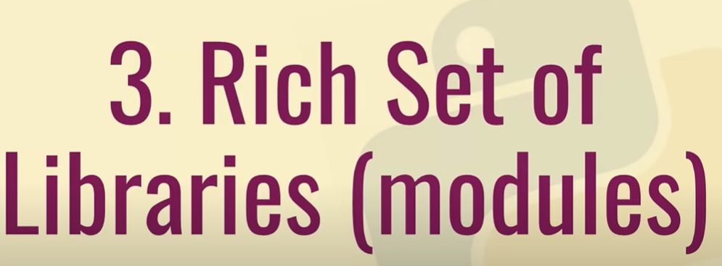

Slide 7
Images – pillow
Scientific calculations – scipy
Numeric calculations – numpy

Slide 8
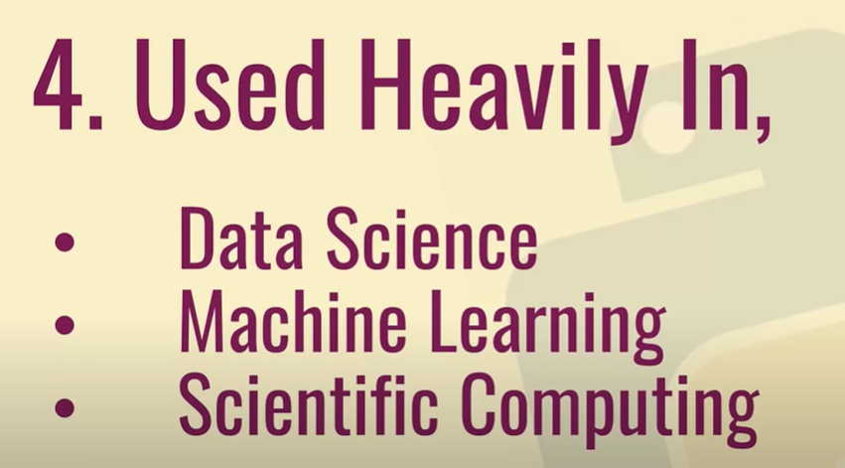

Slide 9


Slide 10

Powered by Python

Slide 11
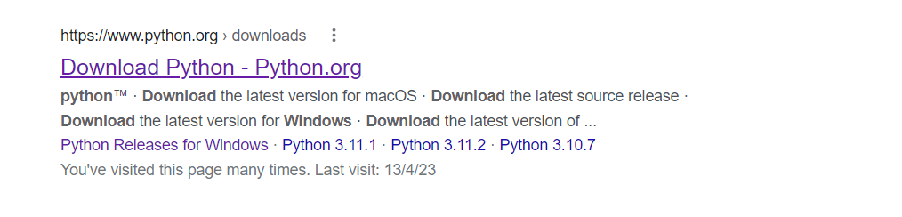
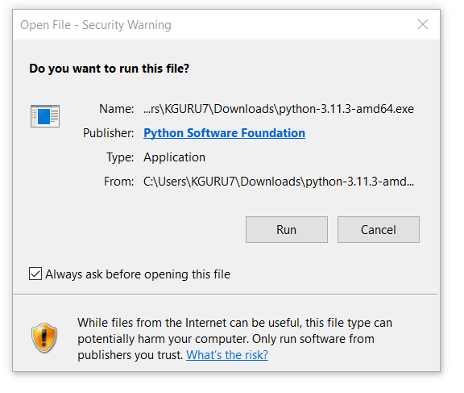
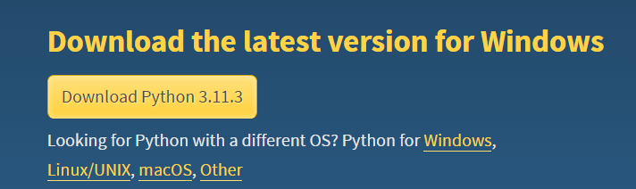
Python Installation
Step 1 — Downloading the Python Installer
Go to the official Python download page for Windows.
Find a stable Python 3 release. This tutorial was tested with Python version 3.10.10.
Click the appropriate link for your system to download the executable file: Windows installer (64-bit) or Windows installer (32-bit).
https://www.digitalocean.com/community/tutorials/install-python-windows-10

Slide 12
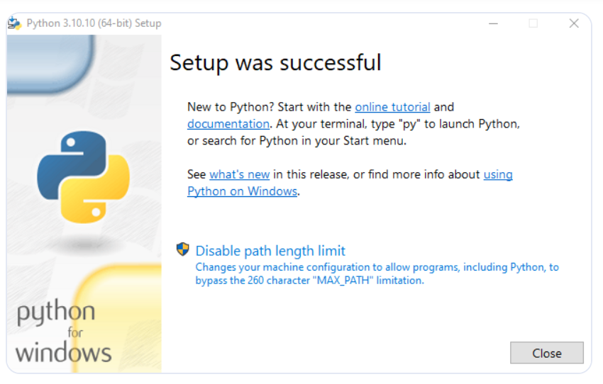

Slide 13
This slide not required
Step 2 — Running the Executable Installer
After the installer is downloaded, double-click the .exe file, for example python-3.10.10-amd64.exe, to run the Python installer.
Select the Install launcher for all users checkbox, which enables all users of the computer to access the Python launcher application.
Select the Add python.exe to PATH checkbox, which enables users to launch Python from the command line.
If you’re just getting started with Python and you want to install it with default features as described in the dialog, then click Install Now.
5.Click Next. The Advanced Options dialog displays
6.Click Install to start the installation.
After the installation is complete, a Setup was successful message displays.

Slide 14
This slide not required
Step 3 — Adding Python to the Environment Variables
1. Go to Start and enter advanced system settings in the search bar.
Click View advanced system settings.
In the System Properties dialog, click the Advanced tab and then click Environment Variables.
Depending on your installation:
If you selected Install for all users during installation, select Path from the list of System Variables and click Edit.
If you didn’t select Install for all users during installation, select Path from the list of User Variables and click Edit.
Click New and enter the Python directory path, then click OK until all the dialogs are closed.
Step 4 — Verify the Python Installation
ing command in the command prompt:
python --version

Slide 15
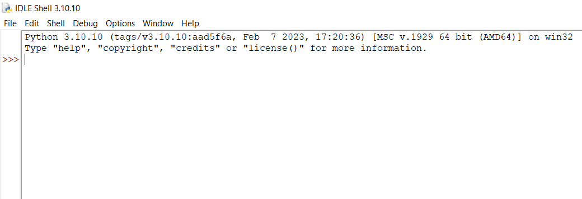
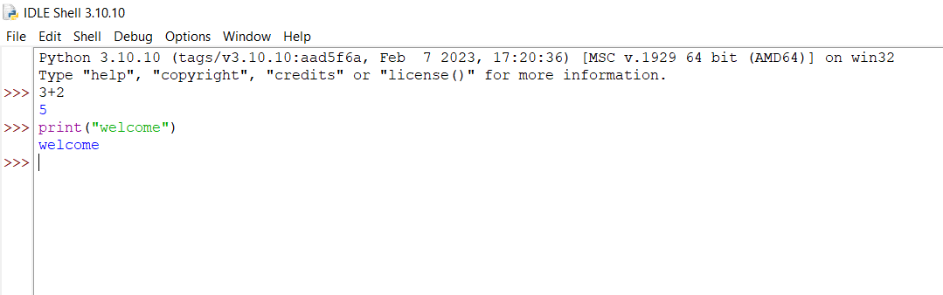
Check Python Installation :
Click IDLE IN SEARCH BAR ..

Slide 16
We can use python notebooks with .ipynb extensions in two different ways
1. Google Colaboratory
2. Install ANACONDA AND JUPYTER NOTEBOOK
https://sparkbyexamples.com/python/install-anaconda-jupyter-notebook/
Anaconda is the most used distribution platform for python & R programming languages in the data science & machine learning community as it simplifies the installation of packages like pandas, NumPy, SciPy, and many more.

Slide 17
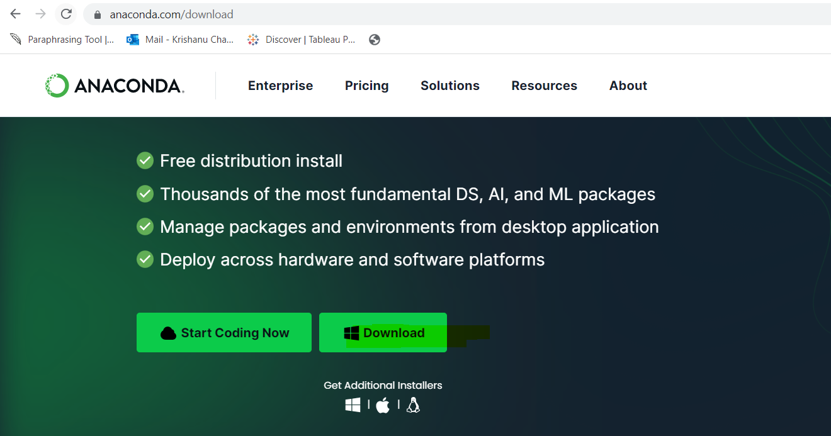
After anaconda got installed check in the search bar jupyter notebook then you will see the application in the system.

