Slide 1



Slide 2
Telangana Tourism Data Analysis
This Data Analysis will answer some of the questions and will also unveil few other interesting facts.
~ RAMYA BHARGAVI ANUMULA

Slide 3



Introduction
Dhaval Patel
Data Entrepreneur (12+ Years), YouTuber, Ex - Bloomberg, NVIDIA
Hemanand Vadivel
Ex- Data Analytics Manager, 8+ Years in Europe, Microsoft Certified, Certified Supply Chain Professional
https://codebasics.io/challenge/codebasics-resume-project-challenge

Slide 4
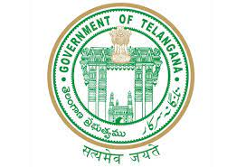
Phases of the Analysis
Ask - What is the problem we are trying to solve?
Prepare - Background of the Data
Process - Data Cleaning and Transformation
Analyze - Checking what is the story that data is telling
Share – Sharing the insights in the form of visuals.
Act – Providing Recommendations.
Notes:
To finish this task I’m imagining myself as a data analyst peter pandey and complete the analysis in a step by step approach.

Slide 5
1. The Ask Phase
To Provide Insights to the Telangana Government Tourism Department by analysing domestic and foreign visitors data from 2016-2019 for all the districts.
To find the patterns in the given data, do additional research, and give data-informed recommendations to the Telangana government which can be used to increase their revenue by improving administrative operations.

Slide 6
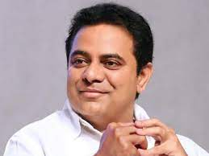
2. Prepare Phase
Source of Dataset :
The dataset is taken from Open Data Telangana. Thanks to Telangana Government and K.T. Rama Rao Garu for providing real-time datasets for public access which is a great learning asset.
K. T. Rama Rao
Minister of IT of Telangana

Slide 7
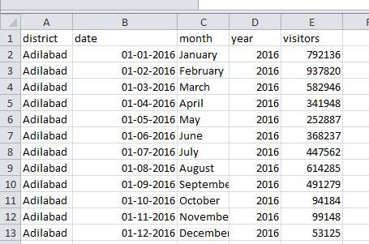
Let’s Talk About Data !!!
Before Knowing
What Data Is Talking about …
1. The data set provided by CODE BASICS contain .csv files of Domestic Visitors Data from 2016-2019 and foreign visitors data from 2016-2019.
2. Column Description for datasets :
district: The name of the district in Telangana.
date: The starting date of the month when the tourist data was collected for a district.
month: The month for which the tourist data is being reported.
year: The year is in YYYY format.
visitors: Number of Visitors.
3. To derive some of the insights, Population data for 33 districts in telangana in 2011 census was used and estimated 2019 data for all 33 districts as original data for 2019 is not yet available.
Rechecking to ensure data reliability : when the total visitors of 33 districts were added it matched with the original population count of Telangana state in 2019 i.e approx 3.8 crore.

Slide 8
3. Process Phase
Data Cleaning and Data Transforming Steps:
All the visitors information are available in single file so merged domestic and foreign visitors 2016-2019 data respectively using POWERBI and used for analysis.
There are many rows which do not contain visitors information, this might be considered as data issue. Replaced all such empty rows with zero values in PowerBI.
Checked Some spelling mistakes in data set using EXCEL. For example in district Narayanpet was spelled as Narayanpet and Narayanapet in different datasets. To get correct output data consistency is maintained.
Verified Unique Number of districts count in each file using EXCEL.
To calculate different values, created new measures and data tables in POWERBI.
To get combined results from different data sets, created relationships between different data tables in POWERBI.

Slide 9
4. Analyze Phase
AND
5. Share Phase
( Combined )

Slide 10
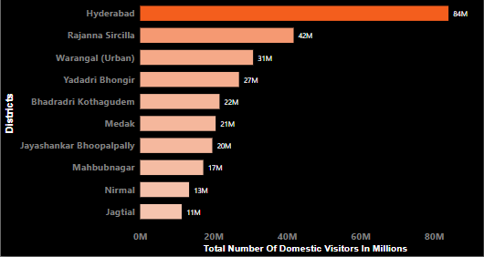
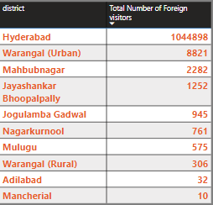
Q -1 : Top 10 Districts With Highest Number Of Domestic and Foreign Visitors In Telangana
Top 10 Districts With Highest Number Of
Domestic Visitors In Telangana
Top 10 Districts With Highest Number Of
Foreign Visitors In Telangana
Hyderabad is the first place in Telangana to receive 84 million domestic visitors and 1 million Foreign visitors.
Hyderabad got approx 23.55 % of total domestic visitors and 98.58 % of total foreign visitors.

Slide 11
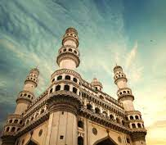
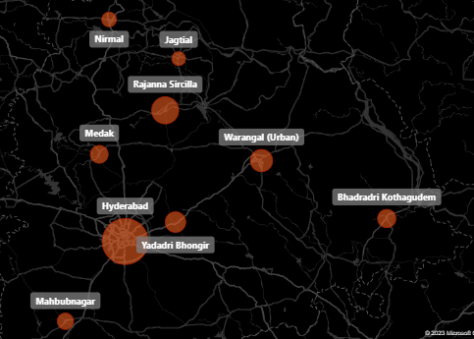
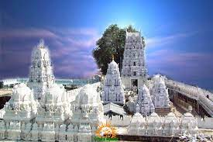
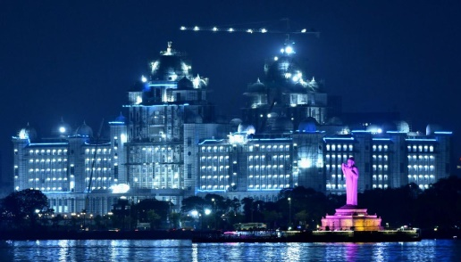
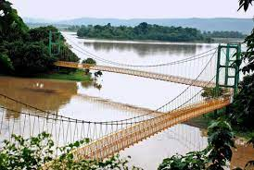
Insights Gained
Top 10 Districts With Highest Number Of Combined Foreign and Domestic Visitors In Telangana
Hyderabad District is a captivating mix of history, culture, and modernity. is a leading center of education and research, with prestigious universities, colleges, and research centers. From iconic landmarks like the Charminar and Golconda Fort, to its bustling bazaars and flavorful cuisine. Hyderabad offers a sensory treat for all kinds of visitors.
The district Rajanna Siricilla is home to several iconic landmarks, including the Sri Rajarajeswara Temple and the Vemulawada temple, which attract a large number of pilgrims and tourists. The district's numerous lakes and natural attractions also make it a popular destination for nature lovers and adventure enthusiasts.
Warangal is home to several iconic landmarks, including the Thousand Pillar Temple, the Warangal Fort, and the Bhadrakali Temple. With its ancient temples, beautiful lakes, and vibrant culture, Warangal is a must-visit destination for history and culture enthusiasts.

Slide 12
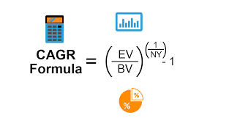
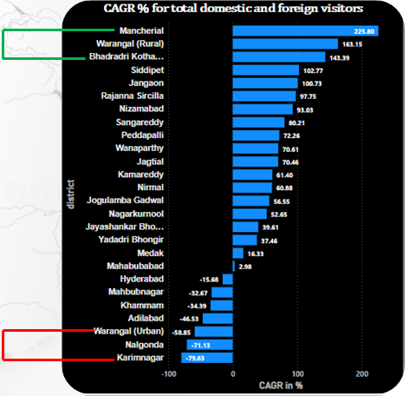
Q- 2,3 : Top 3 and Bottom 3 districts on CAGR %
CAGR is the best formula for evaluating how different visitors have visited over time.
Insights Gained
Mancherial, Warangal(Rural) and Bhadradri Kothagudem districts have experienced higher CAGR from 2016-2019 due to significant industrial and economic development, agricultural development, and government initiatives in the region. These factors have led to higher economic activity, job opportunities, and investment in these districts.
The reduction in CAGR for Warangal Urban(Hanmakonda) , Nalgonda, and Karimnagar districts from 2016-2019 could be due to insufficient infrastructure development.

Slide 13
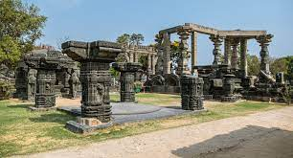
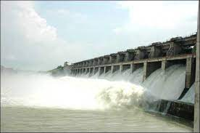
Recommendations :
Hanamkonda :
Warangal Fort, Bhadrakali Temple, Thousand Pillar temple
Nalgonda :
Nagarjuna Sagar Dam, Surendrapuri, Kunda Satyanarayana Kala Dhamam, Bhuvanangiri Fort
Warangal Fort
Karimnagar :
Lower Manair Dam, Elagandal Fort
For the above places Strategies such as
online promotion
improved infrastructure
cultural events
guided tours and collaborations with local businesses can be implemented.
Lower Manair Dam

Slide 14
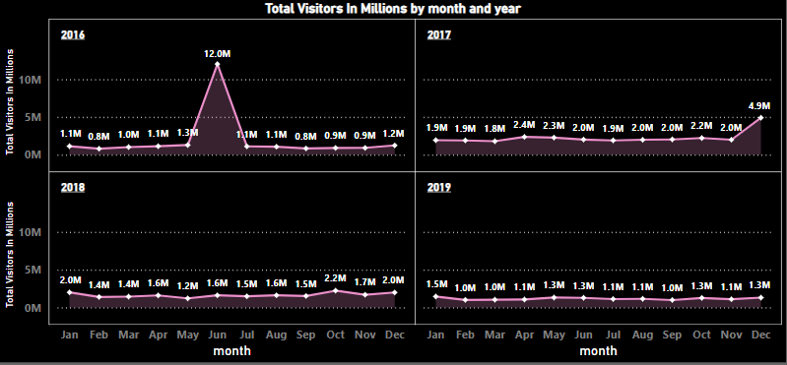
Q-4 : Hyderabad lowest and highest visitors months

Slide 15
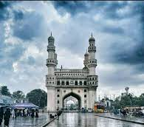
Insights
The count of visitors are high in June in Hyderabad possibly due to summer holidays for schools and colleges.
Telangana Formation day falls on June-2 and many events will held by Telangana Govt which promote more visitors.
Hyderabad is known for its hot and dry weather, and June falls during the monsoon season. The cooler temperatures and occasional rain showers could make it a more pleasant time to visit the city compared to the scorching heat of the summer months. and popular tourist attractions.
It is also in peak in December in 2017 month as mostly due to year end and holiday season, people tend to travel a lot.
In 2018, 2019 the visitors count almost stayed low and same this is possibly due to COVID and Lockdown.

Slide 16
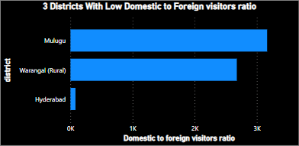
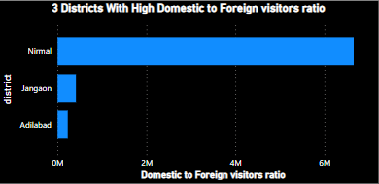
Q-5: Top and Bottom 3 districts on Domestic to Foreign visitors ratio
Increasing order of Foreign Visitors when compared to Domestic visitors
Decreasing order of ratios
Deccreasing order of Foreign Visitors when compared to Domestic visitors
Increasing order of ratios
6/2 =3
6/3=2

Slide 17
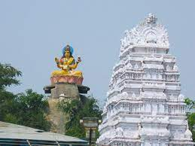
Insights
Lower Domestic to Foreign visitor ratio is a indicator to High Revenue as we get more income from foreign visitors.
Hyderabad, Warangal(Rural) and Mulugu are attracting more foreign when compared to domestic visitors as the tourism centric places here are more renowned like Charminar, 1000 pillars temple which etc.
Foreign visitors may be less in Adilabad, Jangaon, and Nirmal due to factors such as limited international connectivity, less promotion, language barriers, limited infrastructure, and safety concerns.
Recommendations:
Nirmal is famous for its handmade wooden toys, which are unique and have intricate designs. Government can work on this area and increase foreign revenue.
Adilabad has several tourist places that attract visitors, including Kala Ashram, Basar Saraswathi Temple, Kawal Wildlife Sanctuary, Pochera Waterfalls, Kinnerasani Wildlife Sanctuary. These places should be promoted more in order to attract more foreign tourism.
Basar Saraswathi Temple

Slide 18
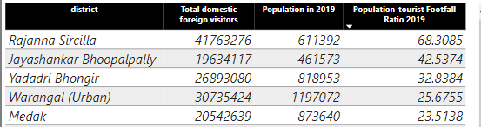
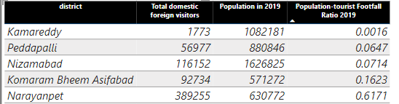
Q:6 :List top and bottom 5 districts based on population to tourists footfall ratio in 2019
Top 5 districts with high footfall ratio
( Total Visitors / Total Resident Population)
Bottom 5 districts with high footfall ratio

Slide 19
Insights
High ratio indicates that large number of tourists are visiting the place relative to the population of that place.
So government should take care of the planning of the infrastructure, facilities and increase more resources to avoid overcrowding and damage to natural environment.
Low ratio indicates that less number of tourists are visiting the place relative to the population of that place.
For the Places like Komaram Bheem Asifabad which is ranked as 2nd most backward district according to NITI Ayog 2018, Government should take care of poor infrastructure, limited tourist activities, security concerns, and lack of awareness for this place.

Slide 20
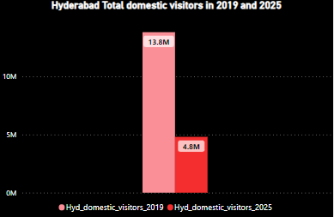
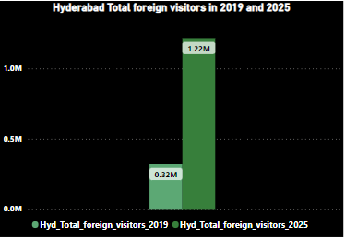
Q-7: Projected No. of foreign and domestic tourists in 2025 for Hyderabad
CAGR = [(Ending value / Beginning value)^(1 / Number of years)] – 1
Projected value = Beginning value x (1 + CAGR)^Number of years
Steps :
Calculated CAGR for Hyderabad visitors from 2016-2019
Estimated Visitors in 2025 = Visitors in 2019 * (1+ CAGR)^(6)

Slide 21
Insights & Recommendations
As the foreign revenue is estimated to grow by 2025 Telangana State government and according to a report by the World Travel and Tourism Council, the total contribution of travel and tourism to GDP in Telangana is projected to grow by 6.7% per annum by 2028, which may suggest an increase in the number of foreign visitors, so Government can take below necessary steps:
Develop and implement a tourism plan.
Invest in infrastructure.
Promote local culture and heritage.
Ensure environmental sustainability.
Support local businesses.
Ensure safety and security.
On the Contrary, As the Domestic Visitors might decrease by 2025, government can
The government can develop tourism infrastructure such as hotels, resorts, transportation, and other facilities to make it easier for tourists to visit and enjoy their stay in Telangana.
The government can launch various tourism campaigns to create awareness among domestic tourists about the various tourist destinations in Telangana and the activities they can participate in

Slide 22
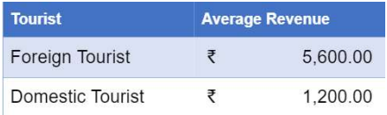
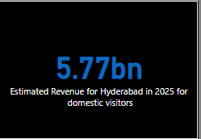
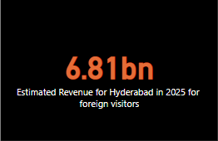
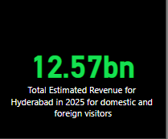
Q:8-Projected Revenue for Hyderabad in 2025
Expected Revenue in hyd 2025 for domestic visitors = [Hyd domestic visitors 2025]*1200
Expected Revenue in hyd 2025 for foreign visitors = [Hyd foreign visitors 2025]*5600
As it is given in the challenge that :

Slide 23
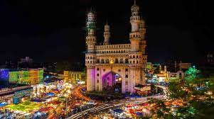
6. Act Phase
Q: 9 Districts with highest potential
Based on the data accumulated and the results obtained for CAGR, number of domestic and foreign tourist population yearly , the districts with highest potential for tourism industry and development are Hyderabad, Warangal and Rajanna Sircilla, Bhadradri kothagudem.
These districts has a varied cultural heritage with forest covers, pilgrimage sites and a metropolitan city.
Recommendations :
Using the present day social media trends, taking help from Influencers, Celebrities to promote the state tourist places to the world.
Maintaining state tourism online profile as efficient and updated as possible.
Helping in making amenities for putting modern day tourism sports(or)trends(or) like kayaking, paragliding, adventure parks, forest hiking etc...
Giving out offers and making recommended holiday trip plans to locations across the state to attract the tourists and especially during the footfall months for keeping the tourism ongoing throughout the year.
Promotion of Telangana famous foods like Biryani, Haleem, Appalu etc. will increase tourism and also provide occupation to rural people.

Slide 24
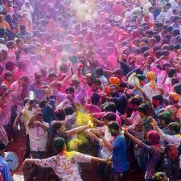
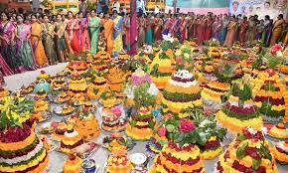
Cultural/ Corporate events and recommendations to boost up tourism
Recommendations to boost up tourism:
Boosting cultural events like Bonalu festivals in the month of June will boost up tourism and pave a way for the local and street vendors, small scale industries to flourish, helps in the tourism industry for financial growth.
Organizing few festivals as Big events in Community Halls like Holi in March and Bathukamma In october will make people to come together and participate in the celebrations.
Corporate events can be put up like International IT conferences, International science fairs, promoting stays for the foreign tourists. Giving our best hospitality.

Slide 25
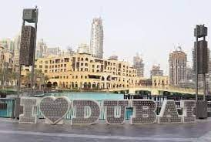
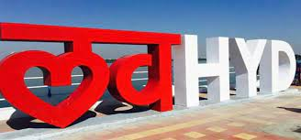
Taking Insights from Dubai Tourism Industry
Dubai is now one of the worlds leading places for tourism industry. Dubai situated in Middle-east has become leading tourist spots in the world. Any other country or city can get inspired from Dubai.
Hyderabad can take note of a few key points to focus from Dubai model like Construction industry.
Dubai is famous for its architectural constructions. Hyderabad also has constructions oriented forefront like the Cable bridge, THUB building etc. So, Telangana can also promote the hospitality and tourism industry and attract more foreign visitors.
Telangana can also provide world class hospitality, giving special offers during the months of Holiday seasons like June and December. So the foreign income on tourism will increase.

Slide 26
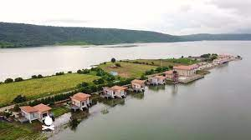
Recommendations for Telangana Tourism:
Telangana has a rich demographic area with waterfalls, forest cover, cities , towns and tribes.
Hyderabad has may lakes nearby. Hyderabad can get the tourist attraction at water resorviors like nearby Lower Manair dam, Cable bridge.
Places like Somasila which is considered to be Maldives of Telangana should be promoted with different marketing strategies.
Since there is a good increase in the domestic and foreign tourists in IT industry, Hyderabad tourism industry can provide for the maintenance of the city like better traffic management, Road maintenance, holiday stays, ease of communication with English as the main language for communication since its literacy rate also good.
Somasila

Slide 27

If Telangana can come up with the mixture of cultural heritage with its development and the popularity of the world wide front, Hyderabad and Telangana's Tourism industry can flourish successfully world wide.

