Slide 1
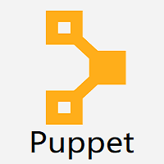
Puppet

Slide 2
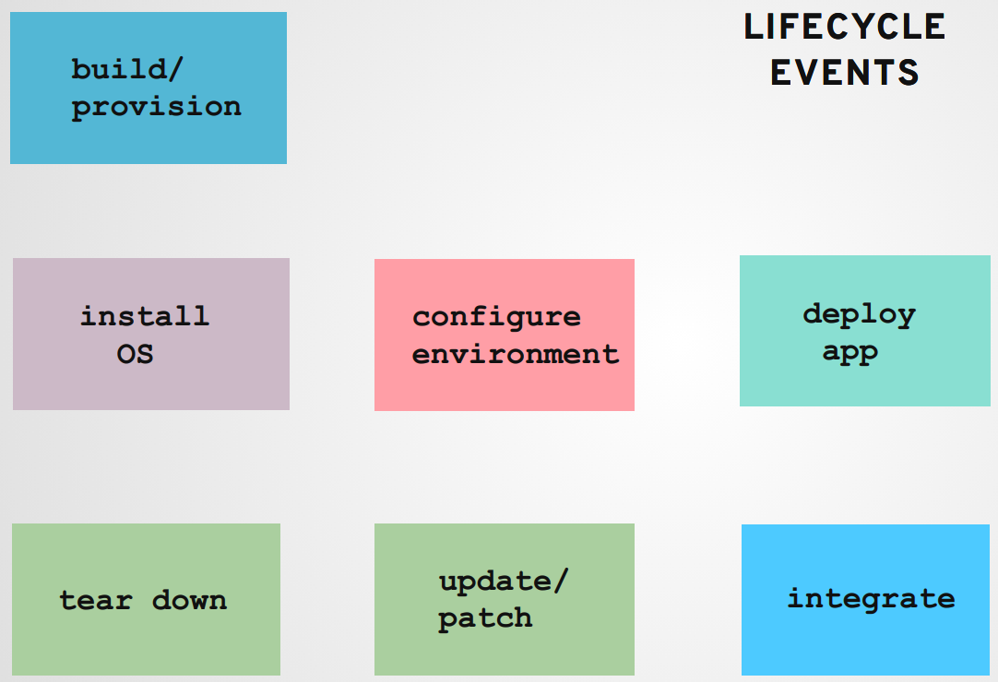

Slide 3
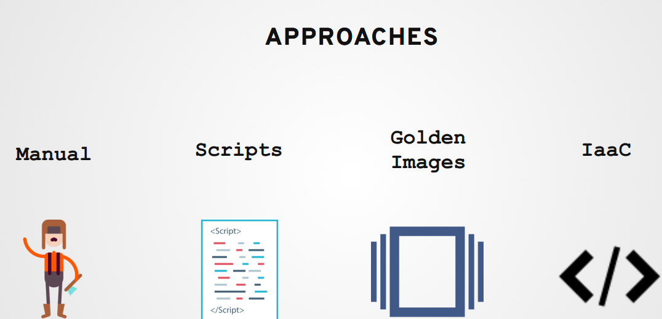

Slide 4
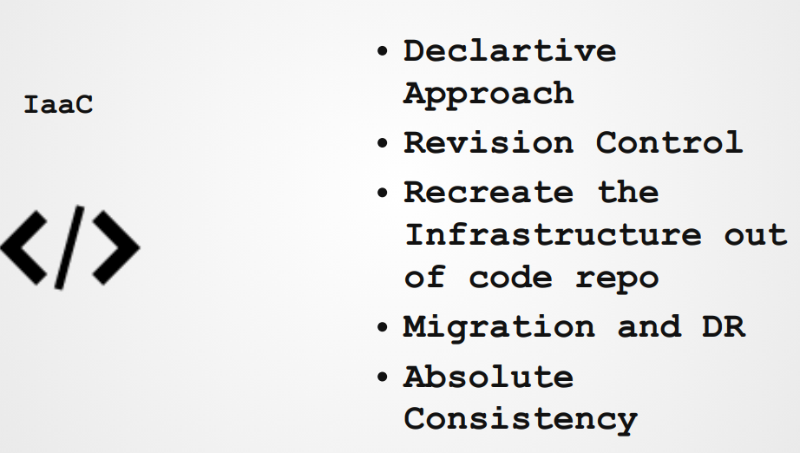

Slide 5
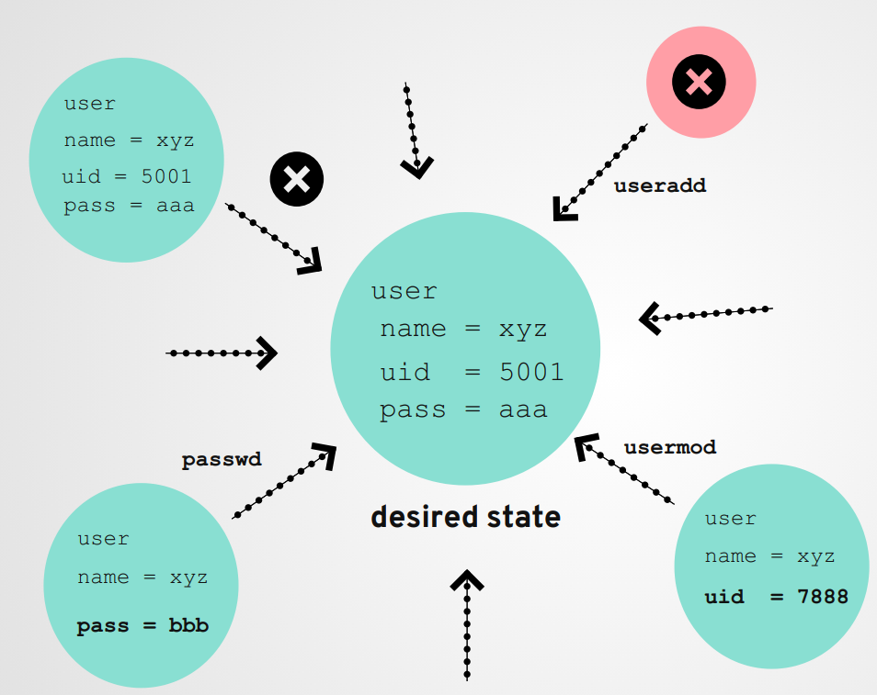

Slide 6
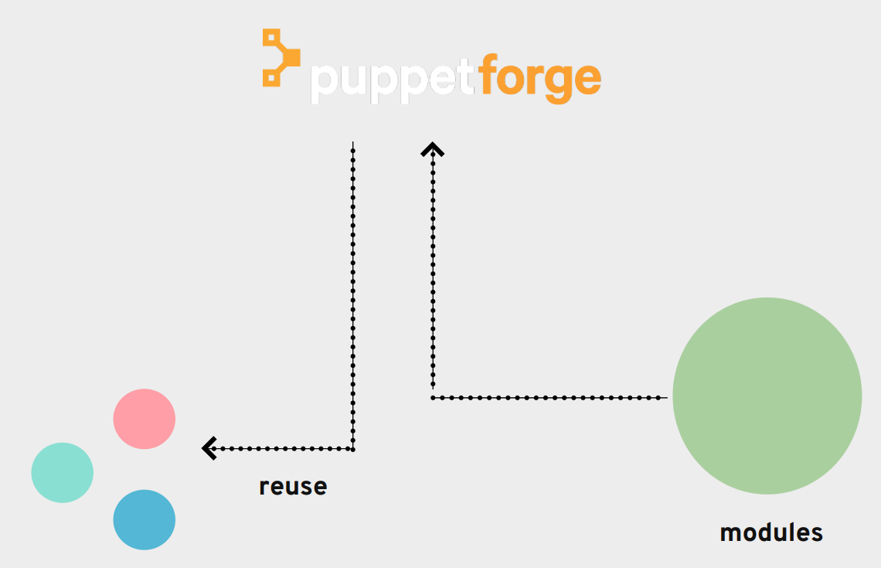

Slide 7
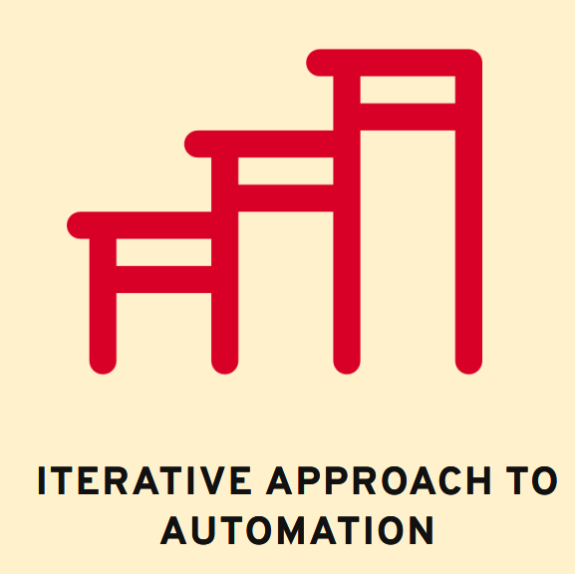

Slide 8
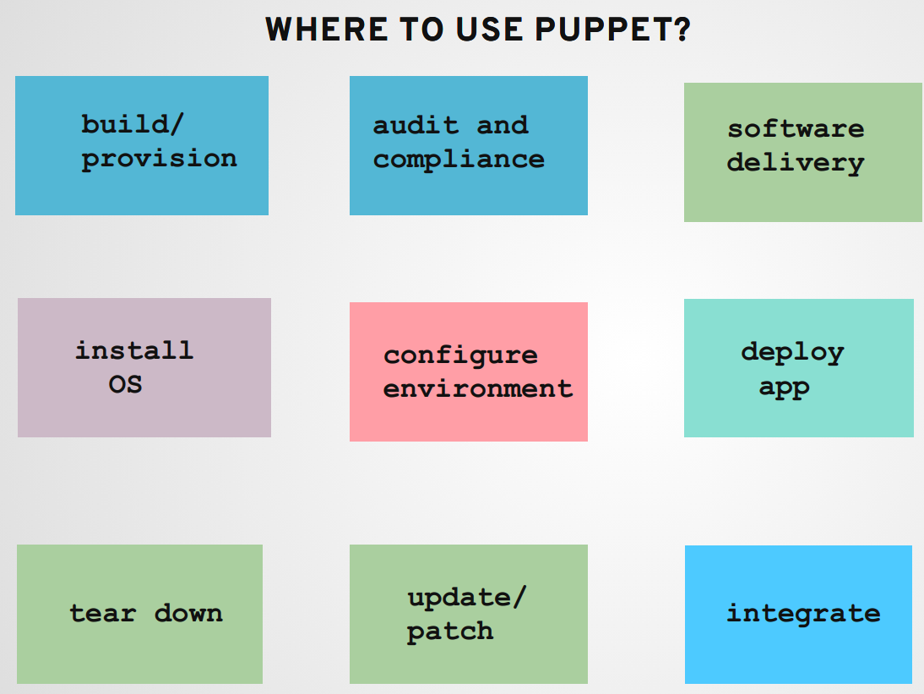

Slide 9
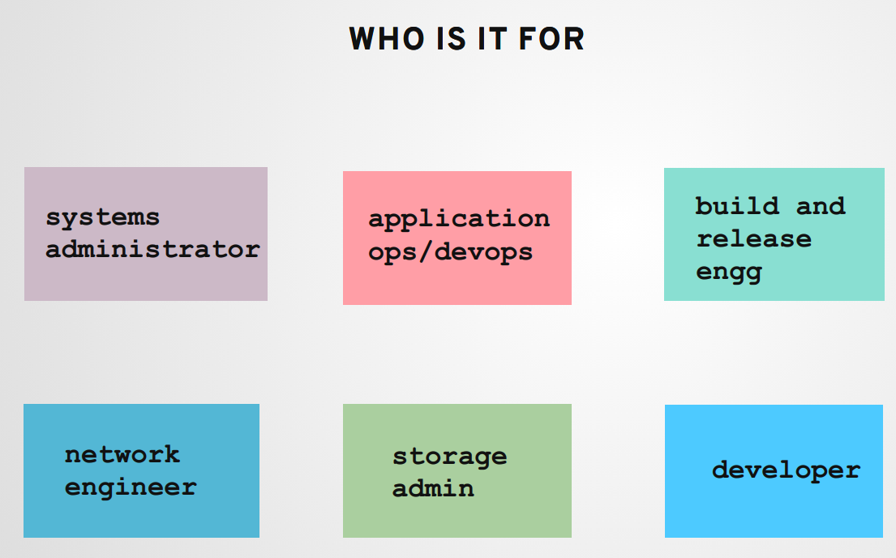

Slide 10
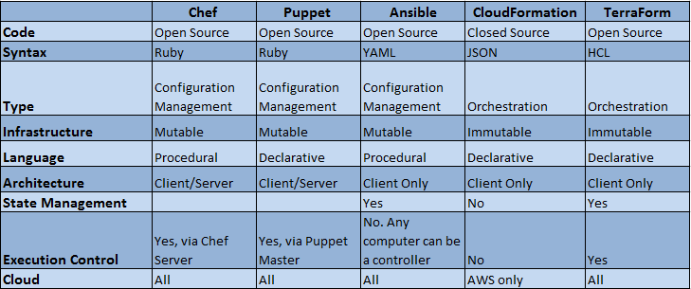
Puppet vs Chef vs Ansible vs Terraform

Slide 11
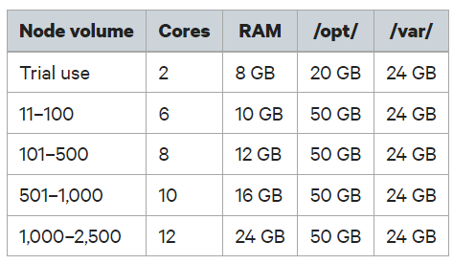
Puppet System Sizing for standard installations

Slide 12
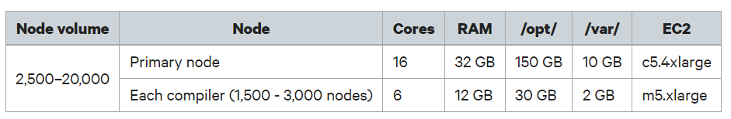
Puppet System Sizing for large installations

Slide 13
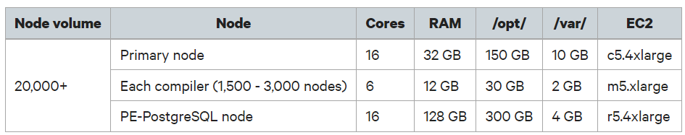
Puppet System Sizing for extra-large installations

Slide 14
Standard guidelines for Puppet Sizing
Puppet master scaling depends on a number of variables
The number of files pulled during a cycle
The frequency of Agent updates of catalog data
The complexity of the modules being applied

Slide 15
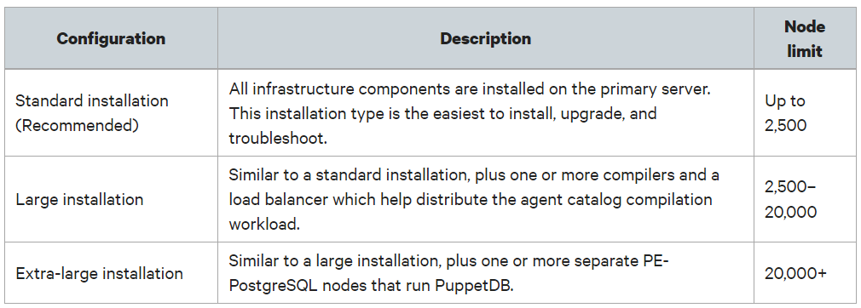
Supported architectures

Slide 16
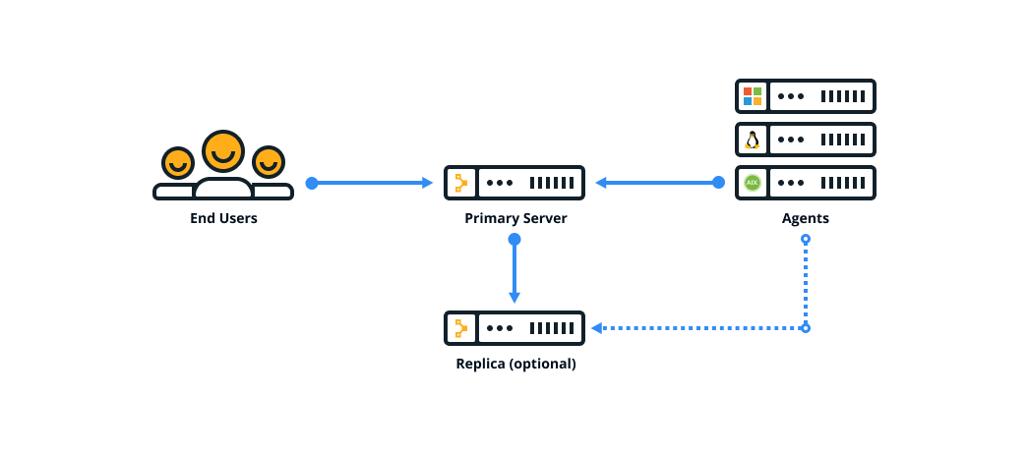
Standard installation

Slide 17
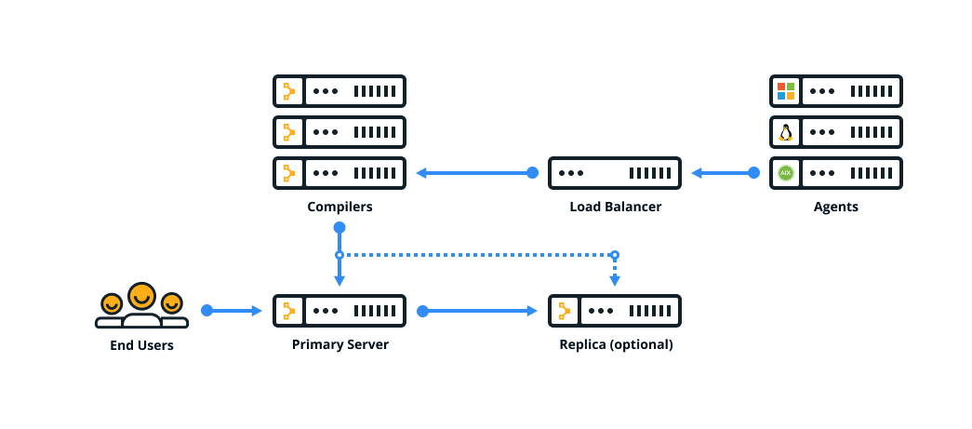
Large installation

Slide 18
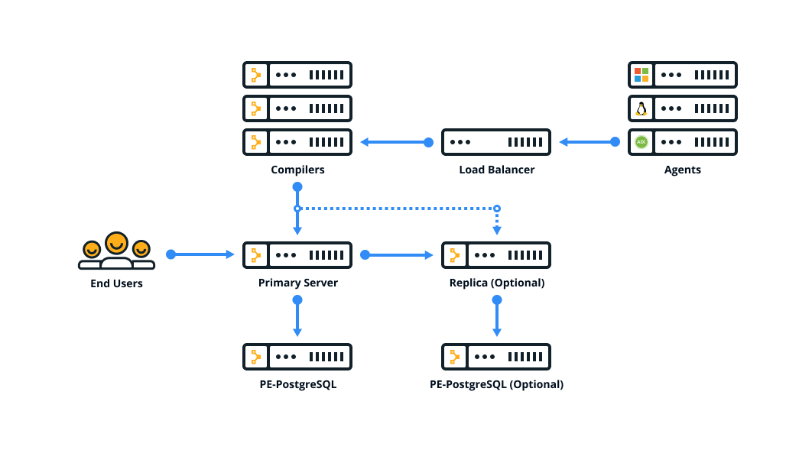
Extra-large installation

Slide 19
What is Puppet Compiler?
A single primary server can process requests and compile code for up to 4,000 nodes
Expand infrastructure by adding compilers to
Share the workload and
Compile catalogs faster

Slide 20
Puppet Enterprise vs Opensource
 | Puppet | Puppet Enterprise
Graphical Interface | Not available | Available
Orchestration –Task automation | Not available | Available
Role based access control | Not Provided | Provided
Support – option for 24 * 7 * 365 | No | Yes
Support – Defined SLA | No | Yes
Packaging | Need to install each separately | Includes over 40+ open source projects

Slide 21


