Slide 1
The Profit-Satisfaction Matrix
Strategic Analysis of Amazon Bestsellers (2009-2019)
Data-Driven Growth for Sustainable Business

Slide 2
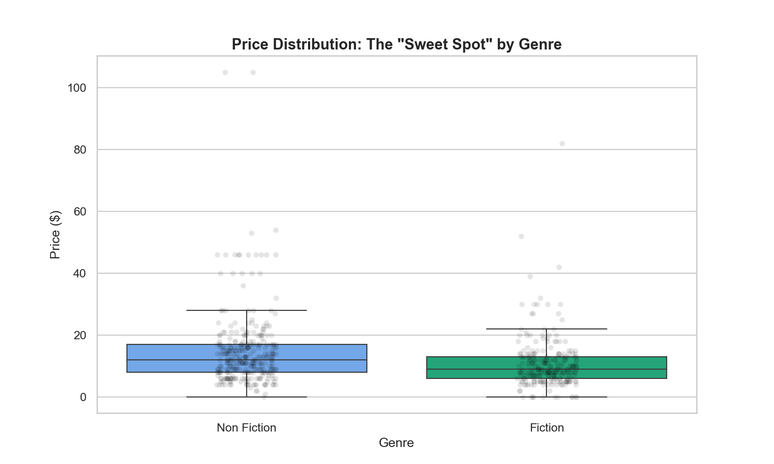
Genre Strategy: Volume vs. Margin
FICTION: The Engagement Engine
• Drives 73% more reviews than Non-Fiction.
NON-FICTION: The Profit Engine
• Maintains 37% higher pricing power with authority.
STRATEGIC ACTION:
• Use Fiction as a Lead-Magnet to cross-sell high-margin Non-Fiction portfolios.

Slide 3
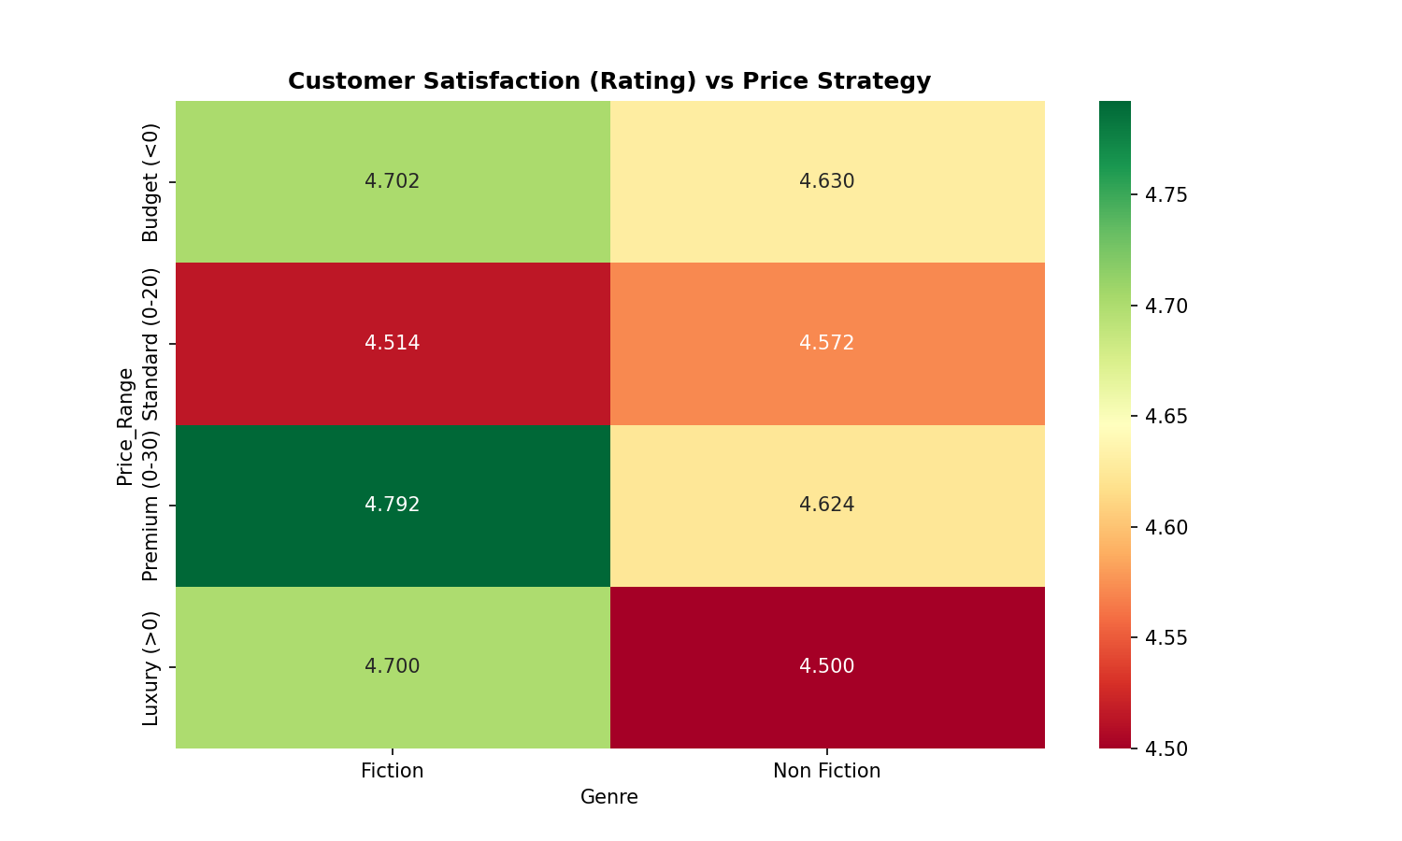
The Value Gap: Pricing vs. Rating
INSIGHT: The $10 - $20 Slump
• Fiction satisfaction drops to 4.51 in this tier.
PHASED PRICING MODEL:
• Phase 1 (Launch): $4.99 for Review Acquisition.
• Phase 2 (Maturity): $9.99+ for Profit Extraction.
RED LINE RULE:
• Only raise price after a 4.6+ rating is secured.

Slide 4
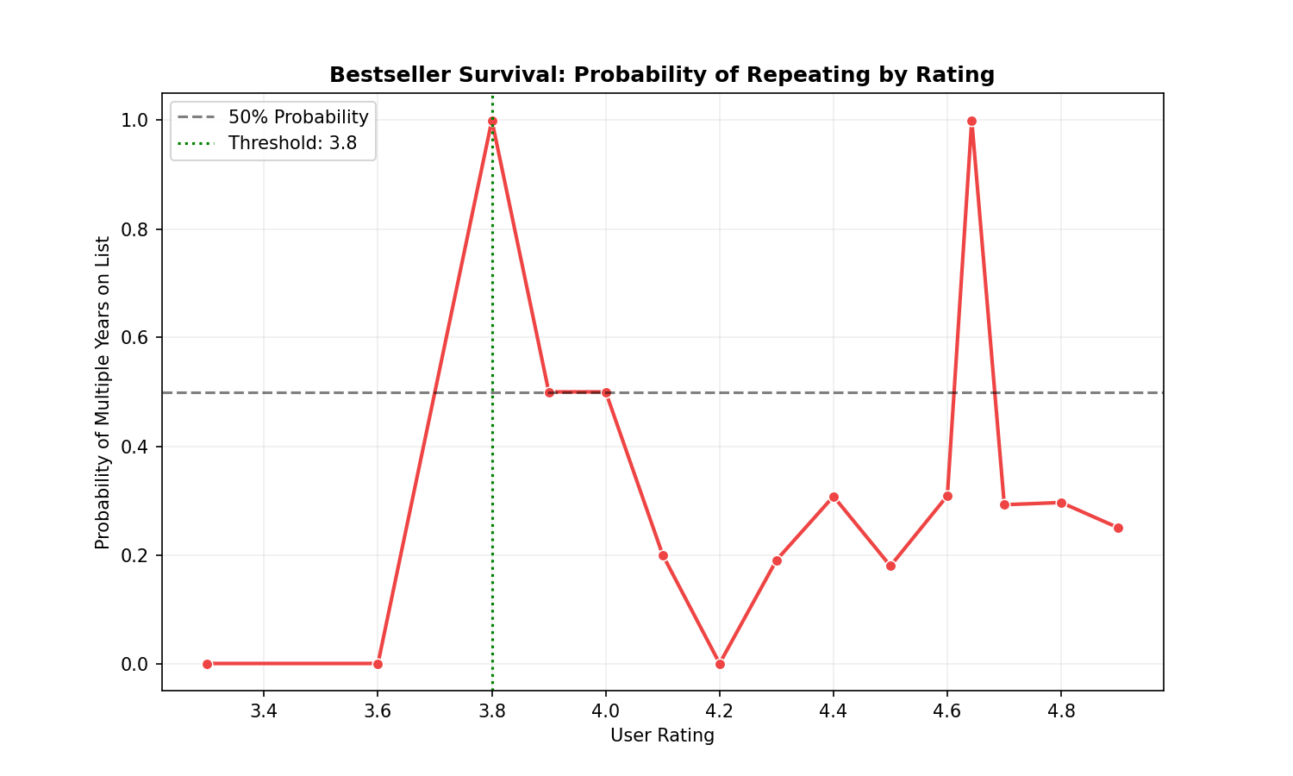
Survival: The Bestseller Paradox
INSIGHT: Perfect Ratings are Risky
• 4.9 rated books often fail to repeat in Year 2.
SURVIVAL THRESHOLD:
• The 3.8 - 4.2 range contains the most resilient titles.
STRATEGIC ACTION:
• Focus on long-term Utility and Evergreen relevance over short-term score spikes.

Slide 5
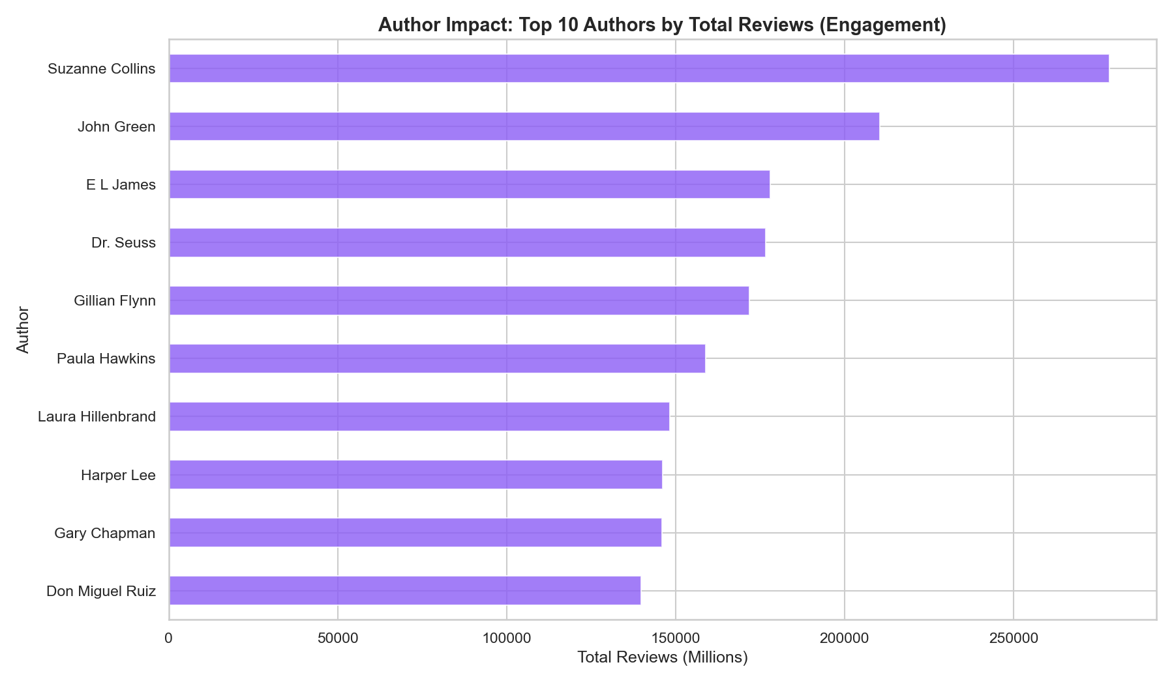
Sustainability: Risk vs. Reward
TACTICAL WIN: High Velocity
• Rapid review growth via $0.99 promotional pricing.
STRATEGIC RISK: Brand Devaluation
• Extended low pricing erodes long-term LTV.
THE PIVOT POINT:
• Raise price at 500 reviews or Day 60—No Exceptions.

