Slide 1
EOPS ET
Near real-time stock ticker

Slide 2
Objective
To bring out near real time stock data into our web application with present price, percentage change, red and green for decrease and increase of stock from the previous price.
Trying to bring of graphical representation for the stock changes

Slide 3
Approaches
Created a front end for the stock application which tried to hit the API of the stocks to retrieve data.
Used the real time data stream from pub nub to create real time dashboard in power bi which represents the graph and the cards of the price change.
Tried to navigate to the power bi from the web application in order to represent the graph.
Tried different methods to hit the API and retrieve data.

Slide 4
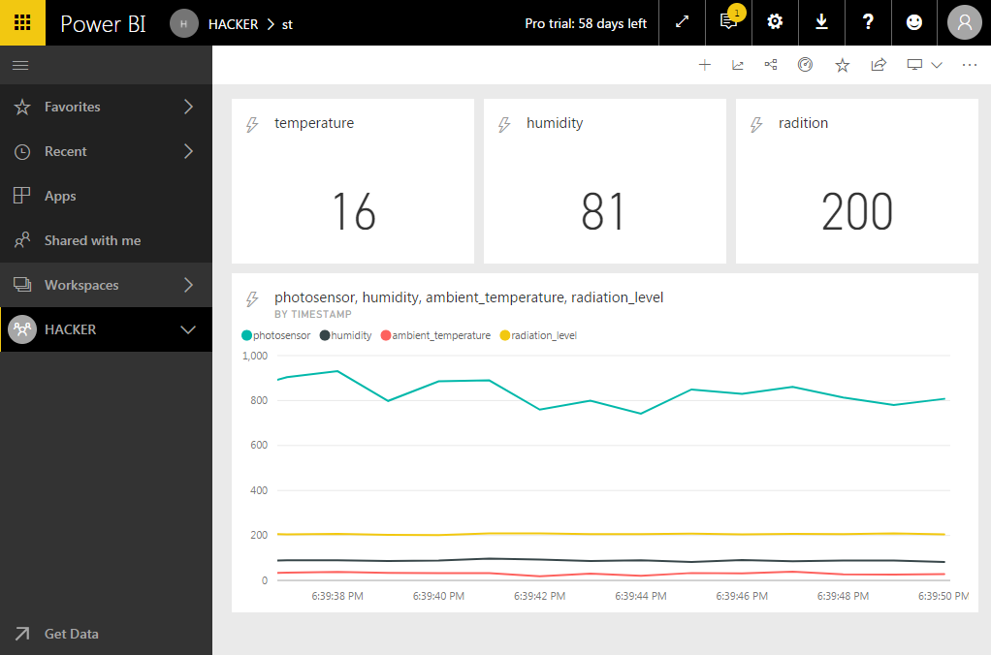
Power Bi implementation

Slide 5
Challenges
Various API was looked upon in order to take up the real time stock data.
Retrieving data to the web application was tried with different methods.
Finding live data streams for loading into power bi for graph creation.

Slide 6
Outcome
Designed the front end and collect data from API.
Based on the increase or decrease of the price green and red changes are made at the numerical rate.
Graphs and cards are generated from the real time data streams available at PubNub.

