Slide 1
TransArt: A Multimodal Application for Vernacular Language Translation and Image Synthesis

Slide 2
Problem Statement :
Develop a web-based application that:
Translates text from Tamil to English
Generates relevant images based on translated text
Demonstrates integration of language translation and creative AI

Slide 3
Objective:
Deploy a pre-trained or fine-tuned model using Hugging Face Spaces or AWS services
Create an accessible web application using Streamlit or Gradio

Slide 4
Key Skills:
Deep Learning
Transformers
Hugging Face models
Large Language Models (LLM)
Streamlit or Gradio
AWS or HF Code Spaces

Slide 5
Requirements :
Tamil to English translation model
Text-to-image generation model
Text generation model (e.g., GPT-3, GPT-Neo, or Google Gemini API)
Deployment platform (Hugging Face Spaces, AWS)

Slide 6
Technical Approach :
Model Selection: Hugging Face models for translation and image generation.
Frontend Development: React for user interface.
Backend Development: Flask or FastAPI for handling requests.
Integration and Testing: Ensure accuracy and smooth user experience.

Slide 7
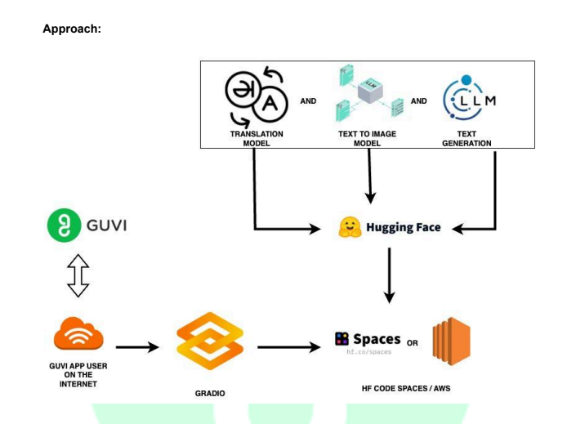

Slide 8
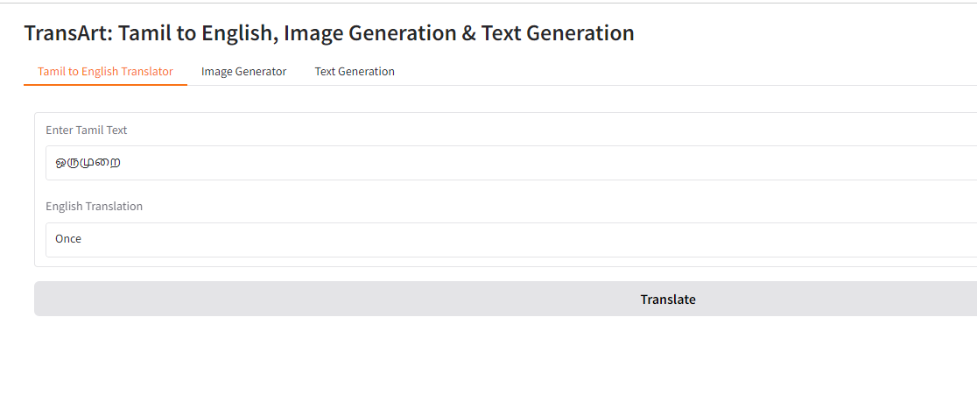

Slide 9
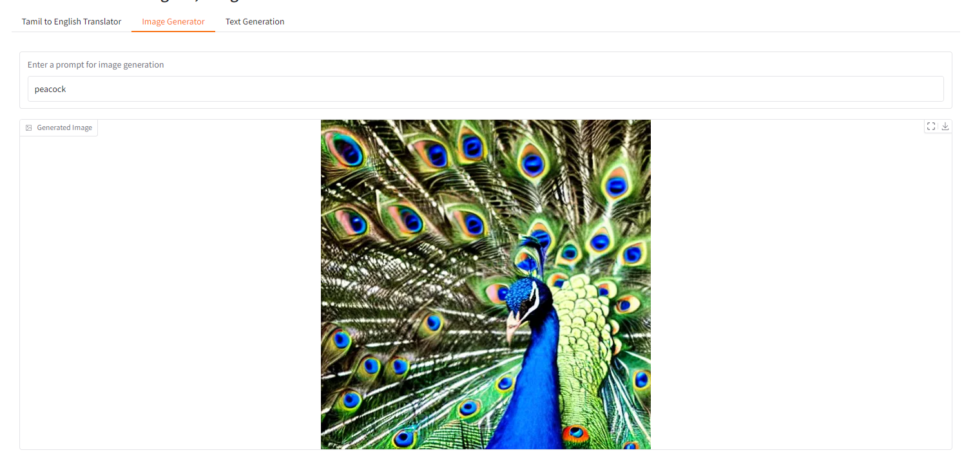

Slide 10
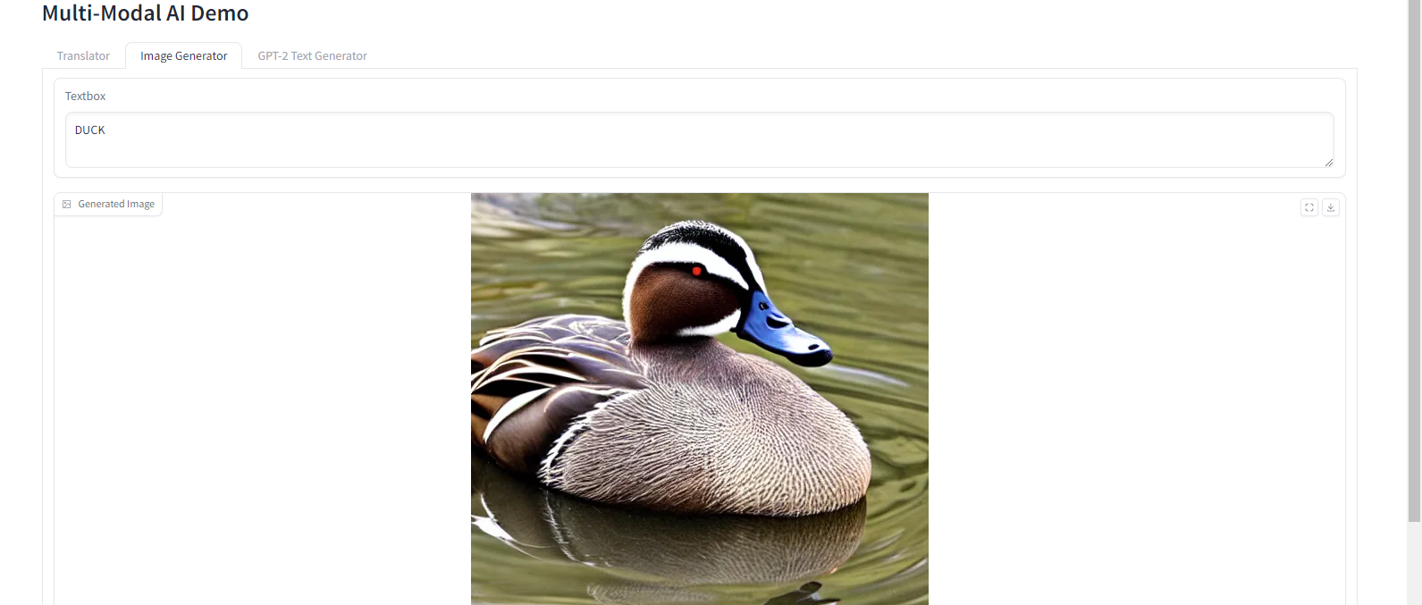

Slide 11
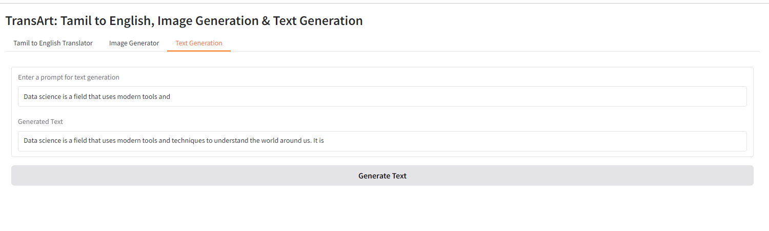

Slide 12
Purpose and Uses :
Educational Tools
Aid students and educators in understanding concepts
Enhance learning experiences with linguistic and visual elements
2. Creative Content Generation
Streamline visual content creation for digital marketing
Assist in developing presentations and educational materials

Slide 13
Application Features :
User-friendly web interface
Tamil to English text translation
Image generation based on translated text
Creative written content generation
Seamless integration of language processing and image synthesis

Slide 14
Future Enhancements :
Support for additional languages
Integration with more advanced AI models
User feedback loop for continuous improvement
Mobile application development

Slide 15
Conclusion :
A functional multimodal AI application combining language translation and image synthesis.
Scalability using Hugging Face.
Potential to enhance educational tools and creative content generation.

