Slide 1
Digital Twin-Assisted Intrusion Detection for
In-Vehicle CAN Networks
FINAL REVIEW • COMPLETE SYSTEM & FINAL RESULTS
Ramya Nakshathra 23BCE1611
Agilan 23BCE1790
School of Computer Science and Engineering,
Vellore Institute of Technology, Chennai, India
Faculty Guide
Anubha Pearline S*
Assistant Professor Grade,
School of Computer Science and Engineering,
Vellore Institute of Technology, Chennai, India
1

Slide 2
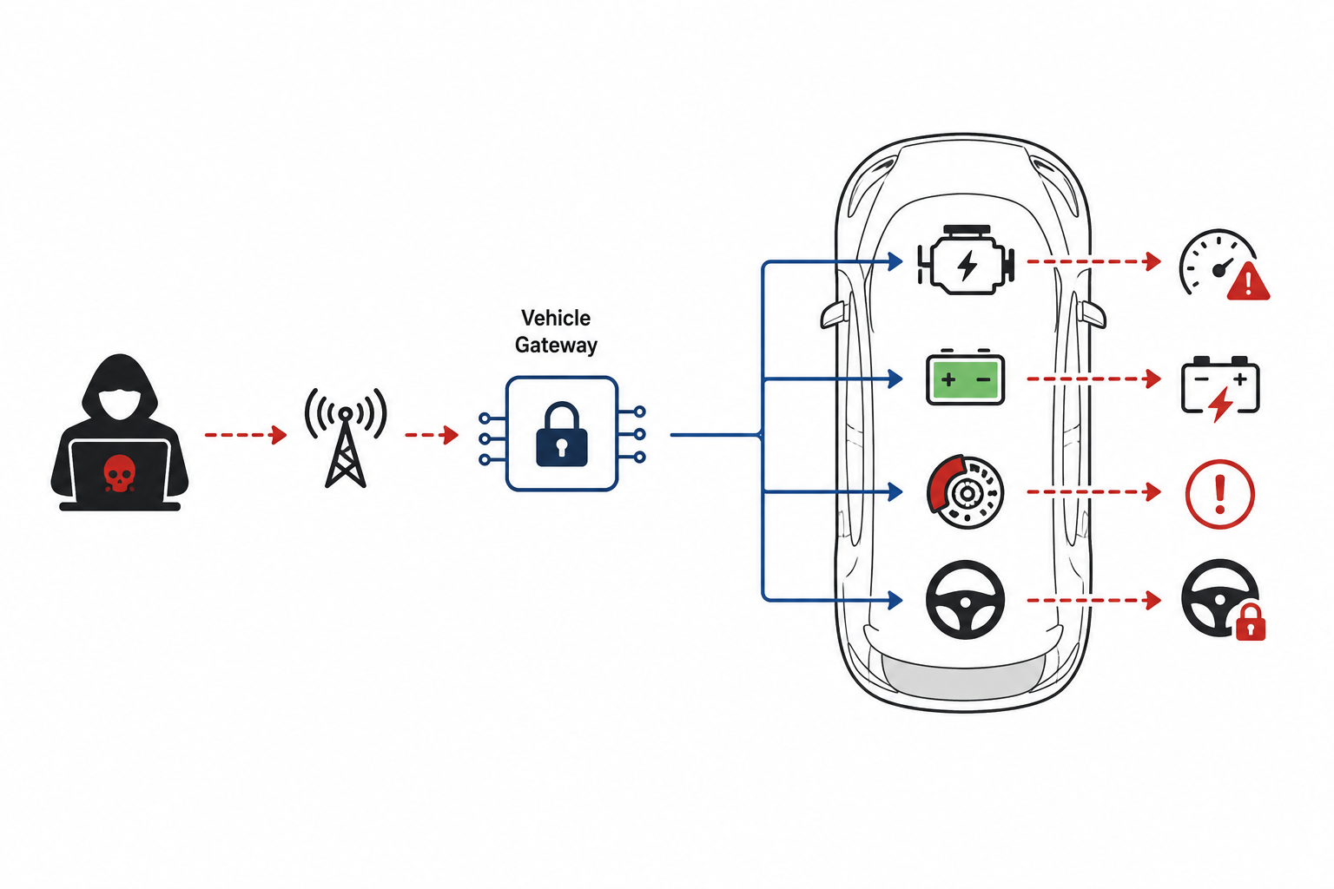
1. Introduction
What is cyber physical attacks?
Why we need to detect them?
Attacks that target the digital parts of a physical system.
In EVs, attackers can inject or modify CAN messages.
They can cause unsafe vehicle behaviour and system disruption
Protect vehicle safety by detecting malicious messages before they affect vehicle functions and prevent any disruptions.
TwinShield: A Digital Twin learns normal EV CAN behaviour, finds unusual changes, combines them, and uses AI to detect and explain attacks.
2

Slide 3
2. Literature Review
Paper
What was done
Relevance / limitation
1. Jeong et al. (2024), IEEE Transactions on Vehicular Technology
Developed an explainable CAN intrusion detection system using meaningful CAN signals instead of only raw bits.
Provides explainability, but does not use a Digital Twin to learn expected behaviour.
2. Ding et al. (2024), Information Sciences
Developed DeepSecDrive using deep learning to detect attacks in in-vehicle networks.
Supports real-time and explainable detection, but does not use behavioural residuals.
3. Le et al. (2024), Knowledge-Based Systems
Used a Transformer and Autoencoder to detect multiple types of CAN attacks from packet and sequence information.
Strong sequence learning, but does not use a Digital Twin.
4. Kang et al. (2024), Vehicular Communications
Developed CANival by combining CAN timing and signal information for attack detection.
Uses multiple types of CAN information, but does not use Digital Twin based residual fusion.
5. Khan et al. (2024), Computers and Security
Developed DivaCAN using multiple machine learning models combined as an ensemble for CAN attack detection.
Improves detection performance, but does not model expected vehicle behaviour.
3

Slide 4
2. Literature Review
Paper
What was done
Relevance / limitation
6. Bari et al. (2023), Sensors
Compared Support Vector Machine, Decision Tree and K Nearest Neighbor models using real vehicle CAN datasets.
Uses traditional machine learning and has limited behavioral modeling
7. Rai et al. (2025), Scientific Reports
Compared LSTM, GRU, BiLSTM and other deep learning models for CAN attack detection.
Shows strong deep learning performance, but does not use Digital Twin based residual information.
8. Xu et al. (2025), PeerJ Computer Science
Developed BEPCD using feature engineering and ensemble learning for CAN intrusion detection.
Handles multiple attacks, but does not use adaptive residual fusion.
9. Wang et al. (2026), IEEE Transactions on Vehicular Technology
Used data augmentation with Generative Adversarial Networks and prediction models using CNN and LSTM for CAN attack detection.
Improves attack detection and handles limited attack data, but does not use Digital Twin residual fusion.
10. Xu et al. (2026), Internet of Things
Developed a lightweight Mamba based model for long term CAN traffic patterns and fast attack detection.
Very strong performance and low latency, but does not use Digital Twin based behavioral residuals.
4

Slide 5
2. Literature Review and Research Gap
What is already established?
What is not directly covered?
Deep learning models such as CNN, LSTM, BiLSTM and Transformer are widely used for CAN attack detection.
Learning normal CAN behaviour using a Digital Twin for EV intrusion detection.
Detection of attacks such as DoS, spoofing, replay and data tampering is well studied.
Adaptive fusion of behaviour deviations from multiple CAN or ECU streams.
SHAP and attention mechanisms are established methods for explainability and feature importance.
A unified framework combining Digital Twin, residual fusion, CNN-BiLSTM, and SHAP for explainable EV CAN security.
Research gap statement
Existing EV CAN intrusion detection methods mainly focus on identifying known attack patterns. Digital Twin based behaviour deviations and adaptive multi-CAN residual fusion remain underexplored.
5

Slide 6
3. Objective
Research focus
Develop an explainable EV CAN intrusion detection system using Digital Twin based behaviour deviations and adaptive multi-CAN residual fusion.
Core idea
Experiment
CAN Traffic → Digital Twin → Residual Generation → Adaptive Multi-CAN Fusion → CNN-BiLSTM → Attack Detection + SHAP
3 Baselines + 2 Proposed Variants → Compare performance using the same test data.
Evaluate the contribution of Digital Twin, residuals, and adaptive fusion.
6

Slide 7
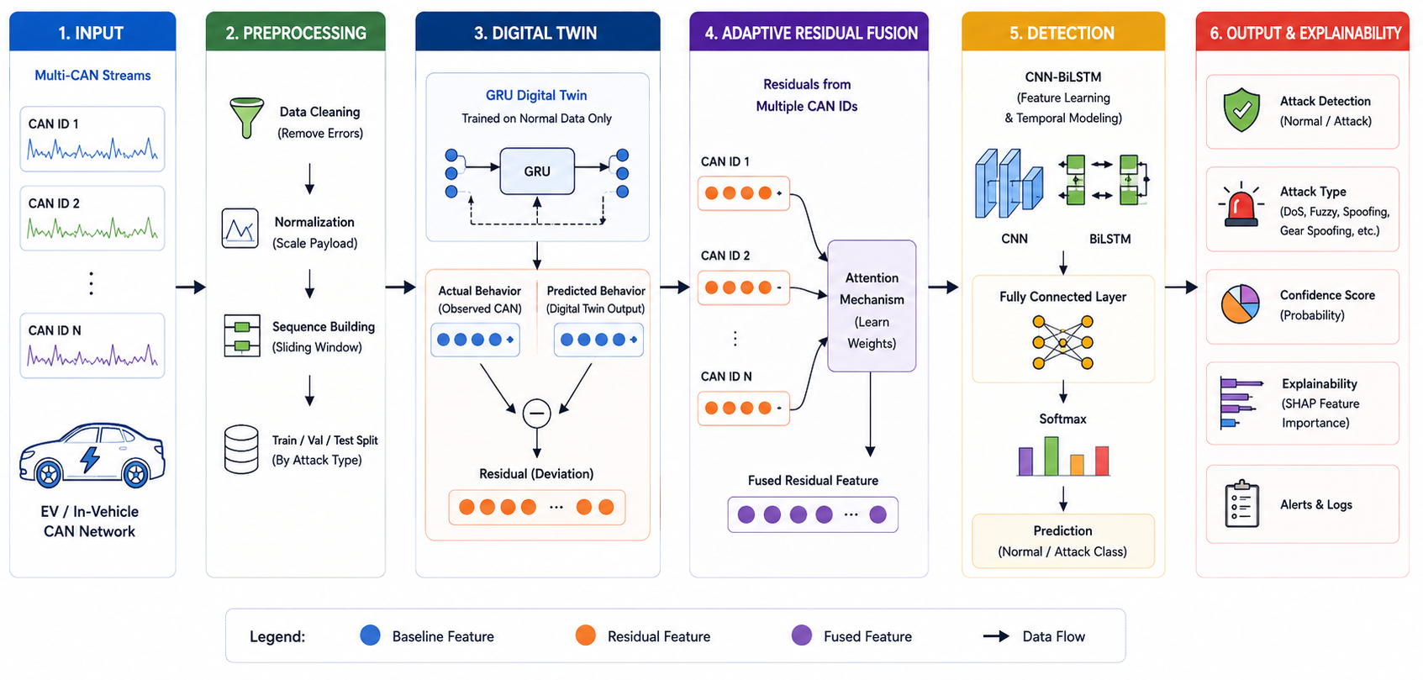
4. Proposed Methodology
7

Slide 8
5. Implementation Status
Completed modules
Completed since Review 3
Data pipeline: CAN parsing, windowing, splits.
Baselines trained: CNN, BiLSTM, CNN-BiLSTM.
GRU Digital Twin + residual generation working.
SHAP explainability producing attributions.
4-page Streamlit demo (all 4 pages working).
Adaptive multi-ECU residual fusion trained and evaluated.
Full ablation run, with and without the CAN ID.
Leave-one-attack-out protocol, four-stage quarantine.
Second dataset (SynCAN) converted and evaluated.
TwinShield: the pipeline runs end to end, every planned experiment has been run, and the report and the journal paper are complete.
8

Slide 9
6. Technical Approach and Best Practices
Input
Preprocess
Digital twin
Residual Fusion
Detection
Explainability
Real EV CAN Traffic
GEM-CAN
Select relevant CAN IDs and create time-based sequences
GRU: Learn normal CAN behaviour
CNN-BiLSTM Classifier
SHAP :Identify which CAN features contribute to the attack prediction
Generate residuals: Expected vs Actual behaviour
Best practices
Leakage-controlled split: contiguous 256-frame blocks assigned whole to train/val/test, no frame’s window crosses a split.
Class-weighted loss: compensates for the ~152:1 Normal-vs-tampering imbalance.
Controlled ablation: every model also re-run with CAN ID excluded, since ID alone can shortcut DoS.
Frame-level granularity: each frame classified individually, interleaved tampering would otherwise share one label.
Result: the same test split, class weights and evaluation code are shared by every model for a fair comparison.
9

Slide 10
7. Hyperparameters
Hyperparameter | Value
Sequence window | 32-frame context window; 256-frame blocks for the leakage-controlled split
Input features | CAN payload bytes; CAN ID included and excluded variants
Train / Val / Test split | 70 / 15 / 15 percent, block-based and stratified
GRU Digital Twin | 1 GRU layer, 96 hidden units, 16-dimensional CAN-ID embedding
Digital Twin objective | Mean squared error on the next CAN payload (MAE reported as the metric)
CNN block | 64 filters, kernels 5 then 3, ReLU activation
BiLSTM block | 96 hidden units, bidirectional
Dropout | 0.3
Classifier loss | Class-weighted cross entropy (about 152:1 imbalance)
Optimizer / Learning rate | Adam, 0.001
Batch size / Epochs | 512 / 6 epochs, best validation macro-F1 checkpoint
10

Slide 11
8. Results: Baseline vs. Proposed
Macro-F1 on the shared held-out test split, with and without the CAN ID. The four architectures span 0.0031 macro-F1: on this benchmark accuracy no longer separates them, because a lookup table on the CAN ID alone already reaches 98.9% accuracy.
Model | CAN ID included | CAN ID excluded
CNN | 0.9968 | 0.9914
BiLSTM | 0.9948 | 0.9895
CNN-BiLSTM | 0.9979 | 0.9914
GRU Digital Twin + CNN-BiLSTM | 0.9989 | 0.9979
TwinShield-Fusion | 0.9979 | 0.9979
11

Slide 12
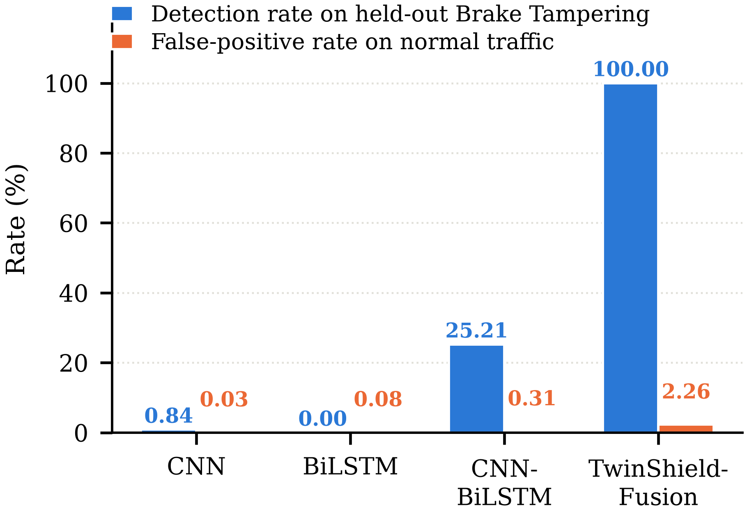
9. Results: Detection of an Unseen Attack
Brake tampering is quarantined from four places: the label space, every training context window, the Digital Twin's per-ECU history and the gate's calibration set. Detection is measured on its 119 held-out test frames, false alarms on 15,063 normal test frames.
Model | Detected | False alarms | Known macro-F1
CNN | 0.84% | 0.03% | 0.6667
BiLSTM | 0.00% | 0.08% | 0.7607
CNN-BiLSTM | 25.21% | 0.31% | 0.7787
TwinShield-Fusion | 100.00% | 2.26% | 0.7829
12

Slide 13
10. Results: Digital Twin and Residual Evidence
Digital Twin accuracy
MAE 10.52 bytes on the 0–255 scale (0.041 normalised) predicting the next CAN payload, on held-out normal frames. Fitted on normal traffic only, so it never sees an attack pattern.
Residual separation
SHAP explainability
Brake tampering lifts the residual on 18FF00F9 from 2.64 to 25.13 bytes, a factor of 9.5, and every frame is flagged. Steering tampering lowers it from 6.54 to 3.06, and the gate misses it.
Implemented and producing per-feature attributions for every predicted class.
Identifies which CAN ID and which payload byte contributed most to a detection.
13

Slide 14
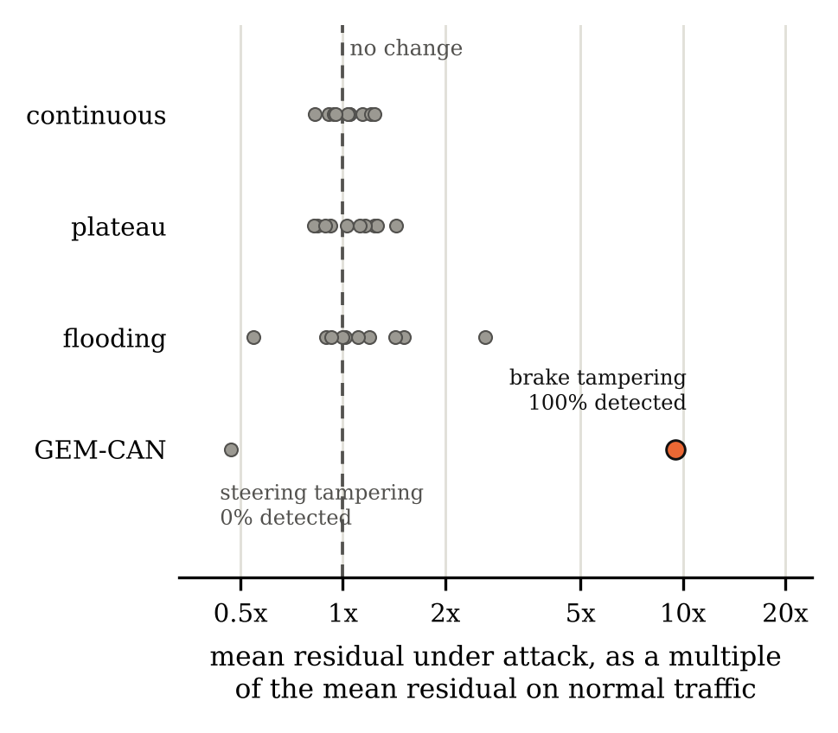
11. Results: Generalisation to a Second Dataset
The whole protocol re-run on SynCAN (ETAS), 250,000 frames converted to the GEM-CAN schema. Every SynCAN attack keeps its signals inside the normal operating range, so the twin's residual barely moves and the gate does not transfer. An 8-bit control rules out the conversion: it makes the twin five times more accurate and leaves detection unchanged.
Quarantined attack | Detected | False alarms
SynCAN flooding | 7.07% | 2.94%
SynCAN plateau | 1.56% | 1.47%
SynCAN continuous | 2.60% | 1.45%
GEM-CAN brake tampering | 100.00% | 2.26%
14

Slide 15
12. Challenges and Refinements
Challenge identified
How we addressed it
CAN ID alone reaches near-perfect accuracy on DoS, every DoS frame uses ID 00000000, no normal frame does.
Added a CAN-ID-excluded feature variant, so results aren’t inflated by the ID shortcut.
Normal vs. tampering classes are extremely imbalanced (≈152:1).
Applied class-weighted cross-entropy loss during training.
CAN traffic is highly repetitive, so a naive split risks train/test leakage.
Used block-based, stratified train/val/test splits so no frame’s window crosses a split.
Key takeaway
Accuracy alone is not a meaningful headline metric on this dataset. The residual gate earns its keep only on an attack no component was trained on, and it costs 2.26% false alarms against 0.03-0.31% for the baselines.
15

Slide 16
13. Conclusion and Contributions
TwinShield-Fusion is implemented end to end and evaluated on 143,444 real GEM-CAN traffic.
Closed-set accuracy separates the four architectures by only 0.0031 macro-F1; under a leave-one-attack-out quarantine they separate by 74 percentage points, and the whole of that detection comes from the Digital Twin residual gate, not from the supervised head.
The method has a measured boundary: it detects attacks that put implausible values on the bus and not attacks that put plausible ones, confirmed on a second dataset.
Deliverables: the Streamlit demo, the project report and an IEEE Access-format paper. Future work: more vehicles and drive cycles, and a timing or sequence model to cover the attacks the residual cannot see.
16

Slide 17
14. Progress Overview
Progress against the approved 6-phase plan, as of the final review
Phase 1: Done
Dataset verification
Verify GEM-CAN data, labels, CAN IDs, attack classes and data quality.
Phase 2: Done
Preprocessing pipeline
Clean, normalize and prepare CAN sequences for model training.
Phase 3: Done
Baseline implementation
Implement CNN, BiLSTM and CNN-BiLSTM baseline models.
Phase 4: Done
Digital Twin Development
Train the GRU Digital Twin and generate behavioural deviation features.
Phase 5: Done
Proposed Model
Adaptive multi-ECU residual fusion implemented, tuned and evaluated. TwinShield-Fusion.
Phase 6: Done
Final evaluation
Baseline vs. proposed comparison, ablation, SHAP, leave-one-attack-out and a second dataset all complete; report and paper written.
17

Slide 18
References
[1] Jeong, S., Lee, S., Lee, H., & Kim, H. K. (2024). X-CANIDS: Signal-Aware Explainable Intrusion Detection System for Controller Area Network-Based In-Vehicle Network. IEEE Transactions on Vehicular Technology, 73(3), 3230–3246.
[2] Ding, W., Alrashdi, I., Hawash, H., & Abdel-Basset, M. (2024). DeepSecDrive: An explainable deep learning framework for real-time detection of cyberattack in in-vehicle networks. Information Sciences, 658, 120057.
[3] Le, T. D., Truong, H. B. H., Pham, V. P., & Kim, D. (2024). Multi-classification in-vehicle intrusion detection system using packet- and sequence-level characteristics from time-embedded transformer with autoencoder. Knowledge-Based Systems, 299, 112091.
[4] Kang, H., Vo, T., Kim, H. K., & Hong, J. B. (2024). CANival: A multimodal approach to intrusion detection on the vehicle CAN bus. Vehicular Communications, 50, 100845.
[5] Bari, B. S., Yelamarthi, K., & Ghafoor, S. (2023). Intrusion Detection in Vehicle Controller Area Network (CAN) Bus Using Machine Learning: A Comparative Performance Study. Sensors, 23(7), 3610.
[6] Rai, R., Grover, J., Sharma, P., & Pareek, A. (2025). Securing the CAN bus using deep learning for intrusion detection in vehicles. Scientific Reports, 15, 13820.
[7] Xu, B., Cao, F., Li, X., Tian, S., Deng, W., & Yue, S. (2025). BEPCD: An ensemble learning-based intrusion detection framework for in-vehicle CAN bus. PeerJ Computer Science, 11, e3108.
[8] Wang, X., Zhao, J., Liu, P., Yao, N., & Xu, Z. (2026). CAN Bus Intrusion Detection Based on Deep Learning With Data Augmentation for Connected Autonomous Vehicles. IEEE Transactions on Vehicular Technology, 75(2), 2253–2266.
18

Slide 19
References
[9] Xu, B., Li, Q., Cao, F., & Gao, Y. (2026). A Mamba-based lightweight and dynamically adaptive intrusion detection framework for in-vehicle CAN bus. Internet of Things, 37, 101918.
[10] Devika, S., Narang, P., & Alladi, T. (2026). FedLiTeCAN: A federated lightweight transformer for fast and robust CAN bus intrusion detection. Ad Hoc Networks, 190, 104279.
[11] Tavasoli, M., Sarrafzadeh, A., Karimoddini, A., et al. (2026). GEM-CAN: A real-world dataset of CAN-bus attack scenarios on an autonomous vehicle for intrusion-detection research. Data in Brief, 66, 112805.
[12] Upstream Security. (2022). 2022 Global Automotive Cybersecurity Report. The report analyzed 900+ automotive cybersecurity incidents and reported that 84.5% of automotive attacks were carried out remotely.
19

