Slide 1
UNHACK ’25
Die Analyzer

Slide 2
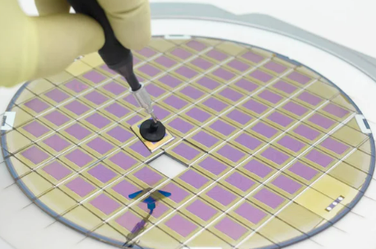
Chip from a wafer

Slide 3
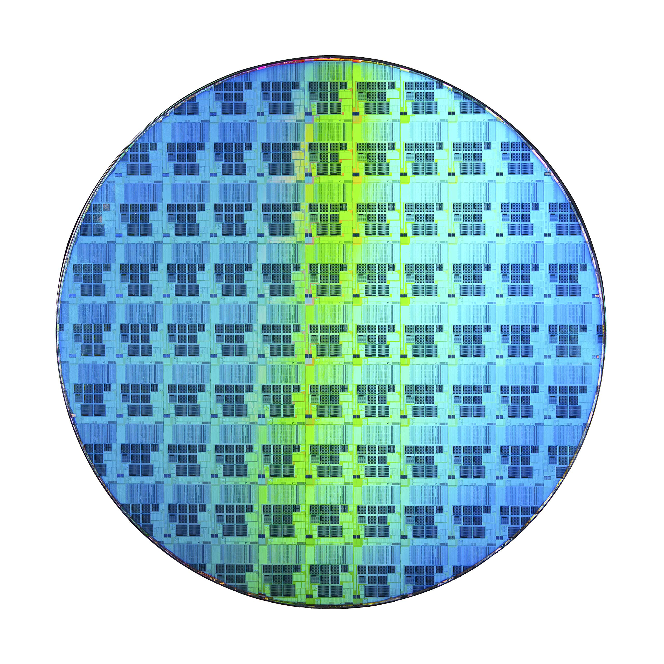
Wafer and Die
Wafer
Die

Slide 4
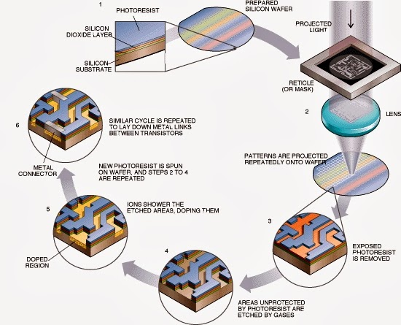
Wafer fabrication process

Slide 5
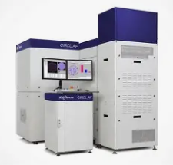
Inspection Overview
Good Die
Bad Die
Tool #1
Inking
file

Slide 6
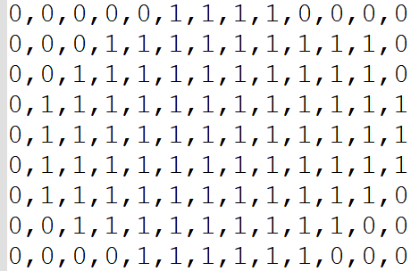
Wafer Map Representation – (Matrix.csv)
9x13
0 | 0 | 0 | 0 | 0 | 1 | 1 | 1 | 1 | 0 | 0 | 0 | 0
0 | 0 | 0 | 1 | 1 | 1 | 1 | 1 | 1 | 1 | 1 | 0 | 0
0 | 0 | 1 | 1 | 1 | 1 | 1 | 1 | 1 | 1 | 1 | 1 | 0
0 | 1 | 1 | 1 | 1 | 1 | 1 | 1 | 1 | 1 | 1 | 1 | 1
0 | 1 | 1 | 1 | 1 | 1 | 1 | 1 | 1 | 1 | 1 | 1 | 1
0 | 1 | 1 | 1 | 1 | 1 | 1 | 1 | 1 | 1 | 1 | 1 | 1
0 | 1 | 1 | 1 | 1 | 1 | 1 | 1 | 1 | 1 | 1 | 1 | 0
0 | 0 | 1 | 1 | 1 | 1 | 1 | 1 | 1 | 1 | 1 | 0 | 0
0 | 0 | 0 | 0 | 1 | 1 | 1 | 1 | 1 | 1 | 0 | 0 | 0
2D Matrix File
1 –> Valid dies 0 –> Invalid dies
Note: MATRIX.csv will always be in 0 orientation

Slide 7
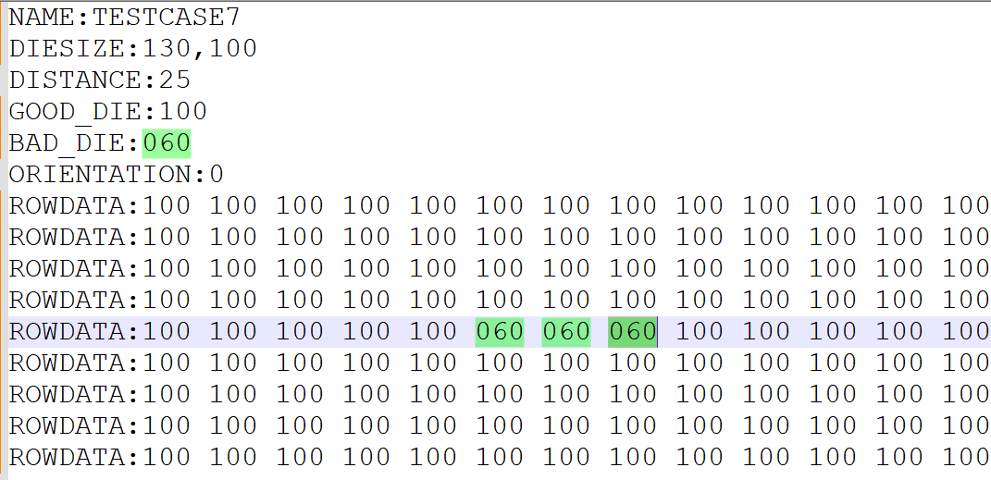
Ink file Overview
9x13
Bad dies
Good dies

Slide 8
Apply Ink file on Wafer map
9x13
9x13
0 | 0 | 0 | 0 | 0 | 1 | 1 | 1 | 1 | 0 | 0 | 0 | 0
0 | 0 | 0 | 1 | 1 | 1 | 1 | 1 | 1 | 1 | 1 | 0 | 0
0 | 0 | 1 | 1 | 1 | 1 | 1 | 1 | 1 | 1 | 1 | 1 | 0
0 | 1 | 1 | 1 | 1 | 1 | 1 | 1 | 1 | 1 | 1 | 1 | 1
0 | 1 | 1 | 1 | 1 | 1 | 1 | 1 | 1 | 1 | 1 | 1 | 1
0 | 1 | 1 | 1 | 1 | 1 | 1 | 1 | 1 | 1 | 1 | 1 | 1
0 | 1 | 1 | 1 | 1 | 1 | 1 | 1 | 1 | 1 | 1 | 1 | 0
0 | 0 | 1 | 1 | 1 | 1 | 1 | 1 | 1 | 1 | 1 | 0 | 0
0 | 0 | 0 | 0 | 1 | 1 | 1 | 1 | 1 | 1 | 0 | 0 | 0
0 | 0 | 0 | 0 | 0 | 1 | 1 | 1 | 1 | 0 | 0 | 0 | 0
0 | 0 | 0 | 1 | 1 | 1 | 1 | 1 | 1 | 1 | 1 | 0 | 0
0 | 0 | 1 | 1 | 1 | 1 | 1 | 1 | 1 | 1 | 1 | 1 | 0
0 | 1 | 1 | 1 | 1 | 1 | 1 | 1 | 1 | 1 | 1 | 1 | 1
0 | 1 | 1 | 1 | 1 | 1 | 1 | 1 | 1 | 1 | 1 | 1 | 1
0 | 1 | 1 | 1 | 1 | 1 | 1 | 1 | 1 | 1 | 1 | 1 | 1
0 | 1 | 1 | 1 | 1 | 1 | 1 | 1 | 1 | 1 | 1 | 1 | 0
0 | 0 | 1 | 1 | 1 | 1 | 1 | 1 | 1 | 1 | 1 | 0 | 0
0 | 0 | 0 | 0 | 1 | 1 | 1 | 1 | 1 | 1 | 0 | 0 | 0
Apply Ink file
1 –> Valid dies 0 –> Invalid dies
Bad dies
Good dies

Slide 9
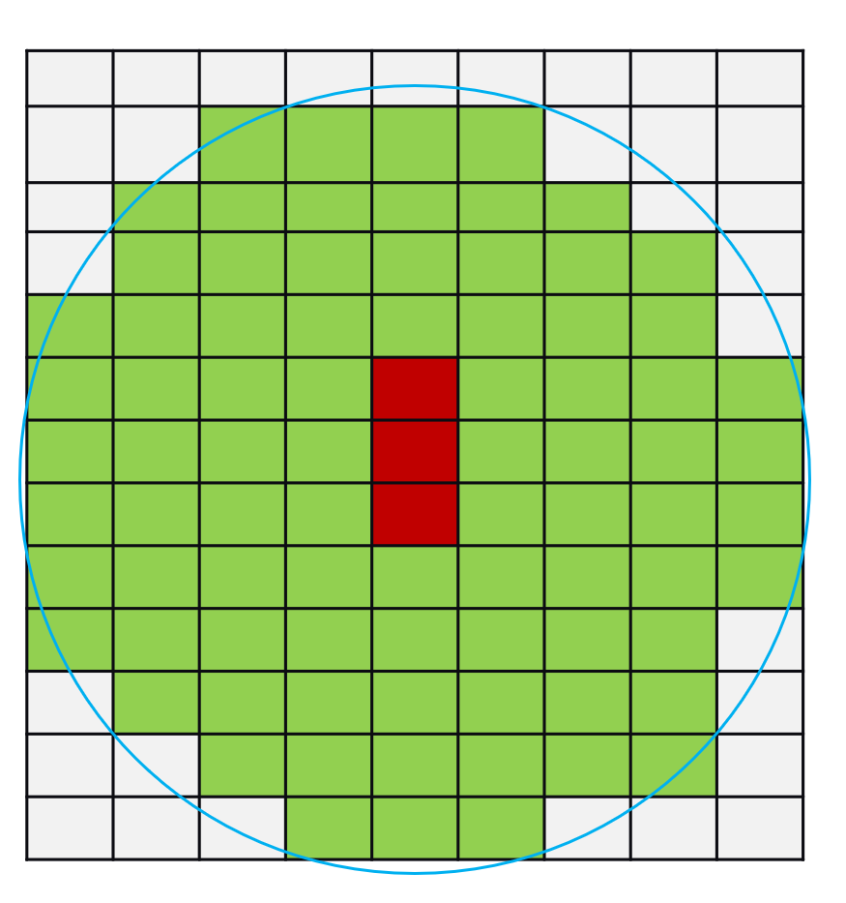
Interpreting Orientation
9x13
13x9
90
Clockwise
0 orientation
90 orientation
When ORIENTATION is 90 in input ink file, it is already rotated at 90 degree clockwise. The output ink file is always expected to be in zero orientation.

Slide 10
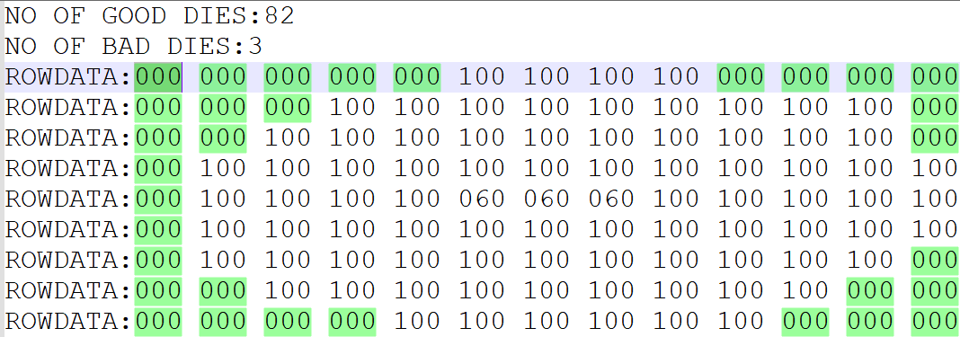
Milestone #1 – Rotate
Input:
  2D Matrix File
  Ink File
  Rotate the ink file based on the orientation and mark the invalid dies(000) on the ink file based on the matrix.
Output:
    Generate the output file with number of good dies and bad dies in the below format. The output filename should be M<MilestoneNumber>T<TestcaseNumber>.txt eg: M1T3.txt
Output file format
Notes:
Remove the space in # of good dies

Slide 11
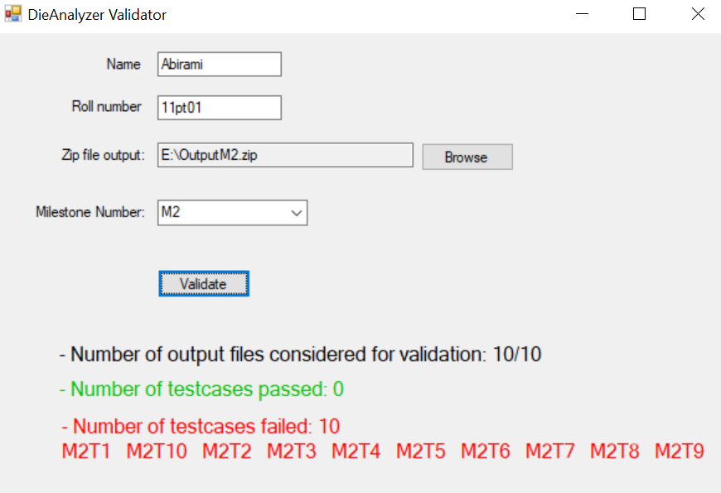
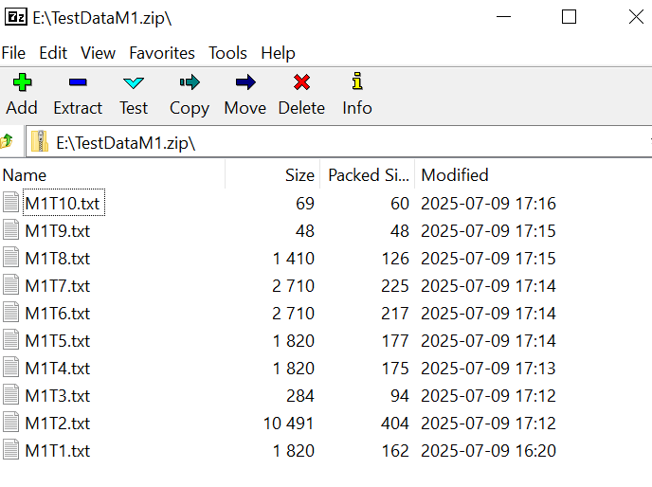
Validator Usage
Create
Create a zip of all the result files
Launch
Launch the DieAnalyzerValidator.exe
Choose
Choose the .zip file path
Select
Select milestone # in the drop down
Click
Click Validate

Slide 12
All the best!

