Slide 1

RETINA BASED BIOMETRIC RECOGNITION SYSTEM
Batch Number:A9
by,
3VC15CS053: Meghana K
3VC15CS050: Manjula G P
3VC15CS027: G Ramya
3VC14CS112: Veluru Eshwari
Under the guidance of,
Puneeth G J,
Assistant Professor,
Department of CSE,
RYMEC

Slide 2
Contents
Introduction
Area and Problem statement
Objective
Specific Requirements
System Architecture
Subsystem Architecture
Object-Oriented Analysis and Modeling (refer SRS)
References

Slide 3
Introduction
A biometric system is a pattern recognition system that checks the authenticity of a person using biometric measures.
There are two types of authentication: - verification (checking the validity of a given identity) and identification (checking if given pattern is associated with any of the enrolled identities stored in database).
The retina is an internal protected organ of the body. Human retina consists of blood vessels which form a unique pattern and the pattern does not change through the individual’s life. So it is impossible to forge that pattern.

Slide 4
Introduction
Retina based security system works by tacking an image of an individual's retinal blood vessel network and comparing it to a previously authenticated scan of the same individual.
The uniqueness and stability of retina guarantees a strong biometric authentication. Also it is less vulnerable to identity theft.

Slide 5
2. Area and Problem statement
Area: Image Processing
Problem statement: Biometric security has become more important because of the increasing activities of terrorism and hackers . Retina recognition technology is continuously growing over years, this technology can resolve the identification of a persons identity, the main purpose of this project is to develop an retina based biometric recognition system for authenticating individual’s

Slide 6
3. Objective
The main objective of this project is to identify a person/individual through their retina.
To track an image of an individual’s retinal blood vessel network.
To compare tracked retinal blood vessel network with previously authenticated scan of the same individual.

Slide 7
4.Specific Requirements
Functional requirements:
System to satisfy the business needs and be acceptable to the users. Based on this, the functional requirements that the system must require are as follows:
1. System Functional requirements are the functions or features that must be included in any must detect the individual on the basis of Iris.
2. System should process the input given by the user only if it is an image file.

Slide 8
4.Specific Requirements
Non-Functional requirements:
Non-functional Requirements is a description of features, characteristics and attribute of the system as well as any constraints that may limit the boundaries of the proposed system. The non-functional requirements are essentially based on the performance, information, economy, control and security efficiency and services. Based on these, non-functional requirements are as follows:
User friendly
System should provide better accuracy
To perform with efficient throughput and response time.

Slide 9
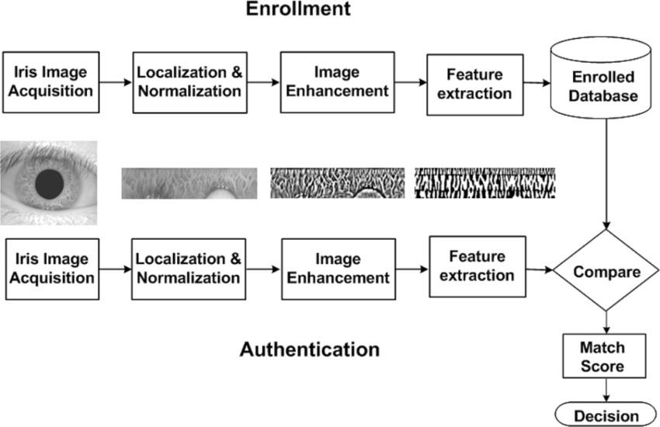
5.System Architecture

Slide 10
7.Object-Oriented Analysis and Modeling.
Use Case Diagram:
Retina Image
Preprocessing
Bifurcation
User
System
Result

Slide 11
7.Object-Oriented Analysis and Modeling.
System Sequence Diagram:
Retina Image
Preprocessing
Bifurcation
Feature matching
Result
Retina image as input
Preprocessing stage
Finding the bifurcation
Feature matching
Result

Slide 12
8. References
[1] J. Daugman, “How iris recognition works,” IEEE Trans. Circuits Syst.Video Technol., vol. 14, no. 1, pp. 21–30, Jan. 2004.
[2] J. Daugman, “Probing the uniqueness and randomness of IrisCodes:Results from 200 billion iris pair comparisons,” Proc. IEEE, vol. 94,no. 11, pp. 1927–1935, Nov. 2006.
[3] Unique Identification Authority of India. [Online]. Available:http://uidai.gov.in, accessed Nov. 1, 2015.
[4] K. R. Nobel, “The state of the art in algorithms, fast identificationsolutions and forensic applications,” MorphoTrust USA,Billerica, MA, USA, Tech. Rep., Jan. 2013. [Online]. Available:http://www.planetbiometrics.com/article-details/i/1446/.
[5] P. E. Peterson et al., “Latent prints: A perspective on the state of the science,” Forensic Sci. Commun., vol. 11, no. 4, pp. 1–9, 2009.
[6] C. Champod, “Edmond Locard—Numerical standards and ‘probable’ identifications,” J. Forensic Identificat., vol. 45, no. 2, pp. 136–163,1995.
[7] K. McGinn, S. Tarin, and K. W. Bowyer, “Identity verification usingiris images: Performance of human examiners,” in Proc. IEEE 6thInt. Conf. Biometrics, Theory, Appl., Syst. (BTAS), Sep./Oct. 2013,pp. 1–6.
[8] H. Proenca, “Iris recognition: On the segmentation of degraded imagesacquired in the visible wavelength,” IEEE Trans. Pattern Anal. Mach.Intell., vol. 32, no. 8, pp. 1502–1516, Aug. 2010.

Slide 13
8. References
[9] H. Proenca, S. Filipe, R. Santos, J. Oliveira, and L. A. Alexandre, “TheUBIRIS.v2: A database of visible wavelength iris images captured on the-move and at-a-distance,” IEEE Trans. Pattern Anal. Mach. Intell.,vol. 32, no. 8, pp. 1529–1535, Aug. 2010.
[10] Z. Sun, L. Wang, and T. Tan, “Ordinal feature selection for iris andpalmprint recognition,” IEEE Trans. Image Process., vol. 23, no. 9,pp. 3922–3934, Sep. 2014.
[11] M. S. Sunder and A. Ross, “Iris image retrieval based onmacro-features,” in Proc. 20th Int. Conf. Pattern Recognit., 2010,pp. 1318–1321.
[12] J. De Mira and J. Mayer, “Image feature extraction for applicationof biometric identification of iris—A morphological approach,”in Proc. Brazilian Symp. Comput.Graph. image Process., 2003,pp. 391–398.
[13] F. Shen, “A visually interpretable iris recognition system with crypt features,”Ph.D. dissertation, Dept. Comput. Sci. Eng., Univ. Notre Dame,Notre Dame, IN, USA, 2014.
[14] F. Shen and P. J. Flynn, “Using crypts as iris minutiae,” Proc. SPIE,vol. 8712, p. 87120B, May 2013.
[15] F. Shen and P. J. Flynn, “Iris matching by crypts and anti-crypts,” inProc. IEEE Conf. Technol. Homeland Secur., Nov. 2012, pp. 208–213.

Slide 14
8. References
[16] F. Shen and P. J. Flynn, “Are iris crypts useful in identity recognition?”in Proc. IEEE 6th Int. Conf. Biometrics, Theory, Appl., Syst.,Sep./Oct. 2013, pp. 1–6.
[17] F. Shen and P. J. Flynn, “Iris crypts: Multi-scale detection and shapebasedmatching,” in Proc. IEEE Winter Conf. Appl. Comput. Vis.,Mar. 2014, pp. 977–983.=
[18] J. Chen, C. W. Harvey, M. S. Alber, and D. Z. Chen, “A matchingmodel based on earth mover’s distance for tracking Myxococcusxanthus,”in Proc. Med. Image Comput. Comput.-Assist. Intervene., 2014,pp. 113–120.
[19] J. Chen, F. Shen, D. Z. Chen, and P. J. Flynn, “Iris recognition based onhuman-interpretable features,” in Proc. IEEE Int. Conf. Identity, Secur.Behavior Anal. (ISBA), Mar. 2015, pp. 1–6.
[20] P. J. Phillips, K. W. Bowyer, P. J. Flynn, X. Liu, and W. T. Scruggs, “Theiris challenge evaluation 2005,” in Proc. 2nd IEEE Int. Conf. Biometrics,Theory, Appl., Syst., Sep./Oct. 2008, pp. 1–8.
[21] CASIA Iris Image Database. [Online]. Available: http://biometrics.idealtest.org/, accessed Nov. 14, 2015.

Slide 15
Thank You…

