Slide 1
Customer Insights Dashboard – 2024

Slide 2
Key Customer Metrics
• Average Age: 55 years
• Average Spending per Customer: $598
• Total Customers: 1311

Slide 3
Key Business Insights
• Customers with higher education (PhD, Master) spend more on average.
• Store is the most preferred purchase channel.
• Income is positively correlated with total spending.
• Web visits are low compared to in-store activity, suggesting room for digital engagement growth.

Slide 4
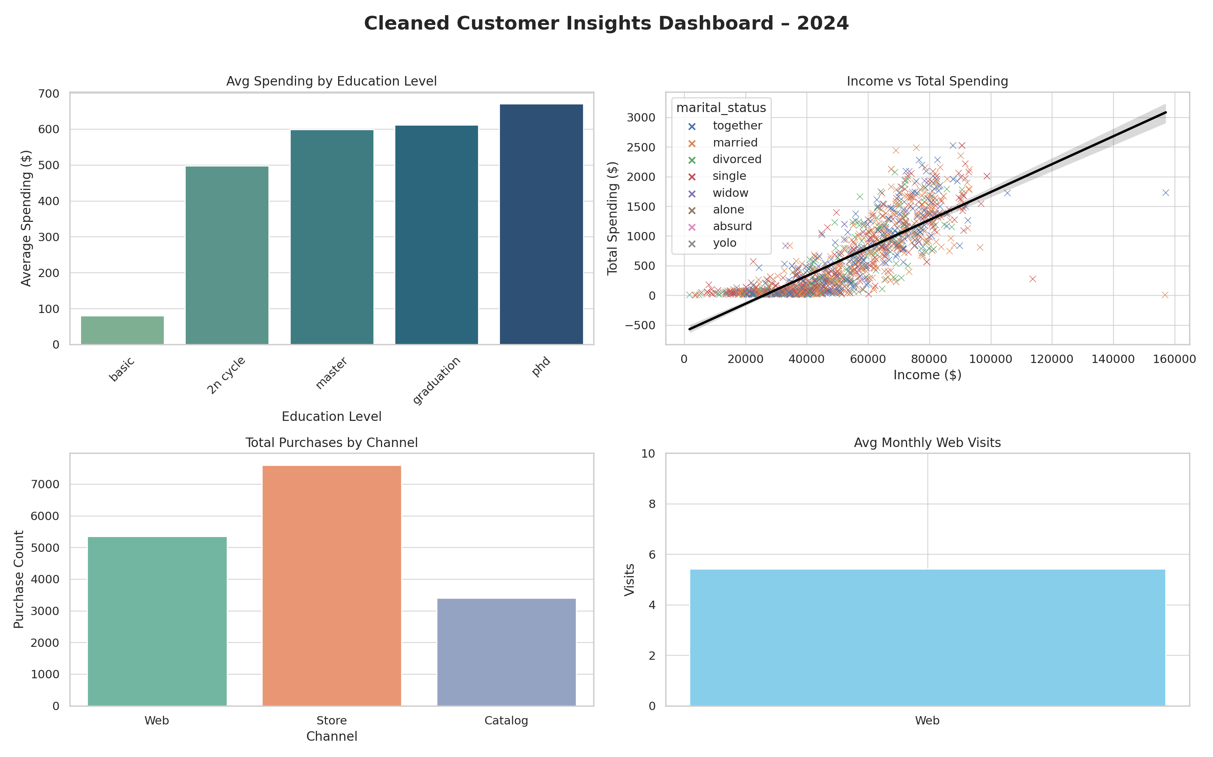
Visual Dashboard Summary

