Slide 1
Aura BI: Your AI-Powered Decision Partner
Vision - Empowering every decision-maker with instant, explainable insights to act with confidence, manage risks proactively, and unlock new value from data. AuraBI transforms information overload into actionable intelligence, making autonomous business decisions a reality.
-Ramya Balabhadrapathruni

Slide 2
Architecture Overview
Frontend
ReactUI
Backend
N8n webhook
LLM
Gemini API
Tools
Gemini
Supabase
Response

Slide 3

Agent Workflow
User sends query via React UI
N8n webhook receives the input
AI Agent
Calls Supabase for vector search using RAG
Calls LLM for reasoning / query passing
Integrates results and returns structured response
Webhook returns results in UI
Optional triggers: Email

Slide 4
Why This Architecture
Modular: Easily add new tools via n8n
1
Quick Prototyping: Helps build the PoC easily
2
Transparent: Logs all agent decisions.
3
Scalable: Extend to multiple LLMs or parallel queries.
4
Roadmap: Multi-agent, advanced analytics, more autonomous actions.
5

Slide 5
Challenges & Considerations
Data extraction and processing is challenging without having access to various in-built tools.
With Vibe coding the UI there are limitations to code control and editability which leads to more failures as the scenarios become more complex.
Handling agent hallucinations.
Agent Tests and sanity checks.

Slide 6
Agents Created
Conversational
Agent
Insights Agent
Email Agent

Slide 7
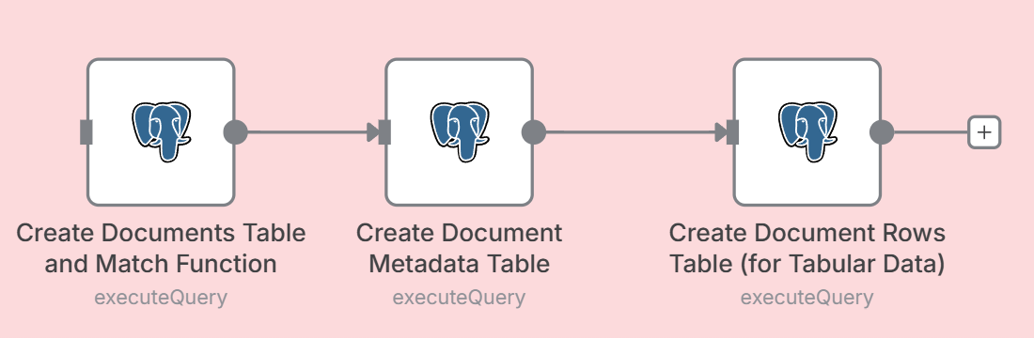
Supabase with Postgres used for RAG Setup
These Postgres sql queries are used to setup the database tables and the RPC function.

Slide 8
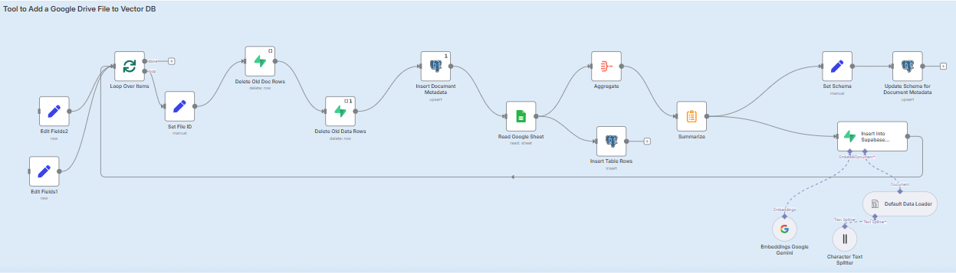
RAG Flow used to setup the Supabase data with vector embeddings

Slide 9
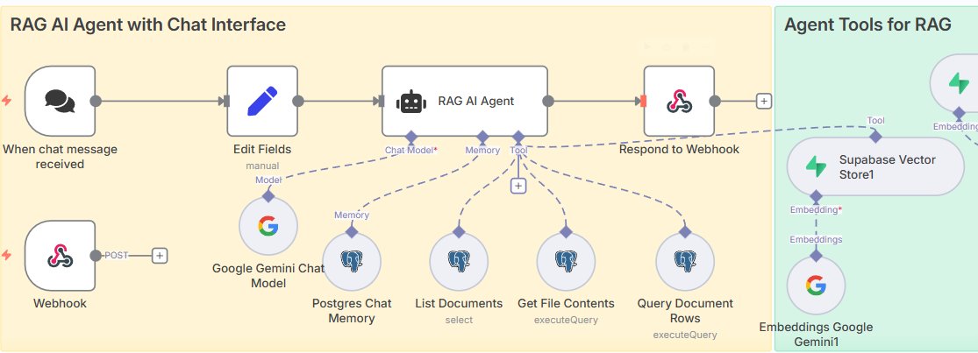
Conversational Agent for fetching specific user defined queries.

Slide 10
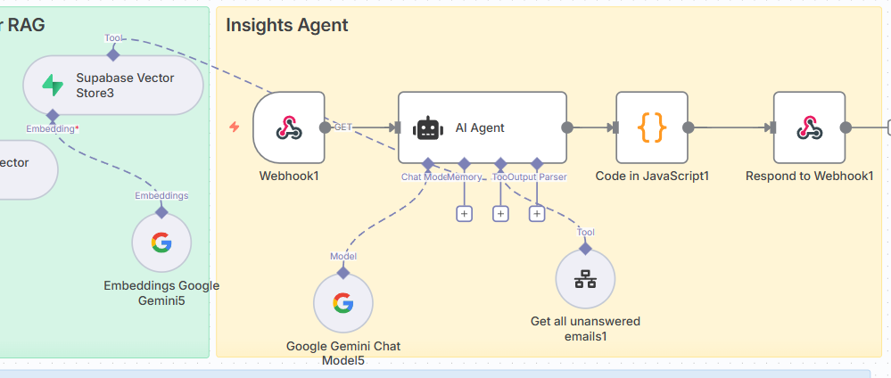
Insights Agent – Real-time insights generated on Database records and triggered through WebHook

Slide 11
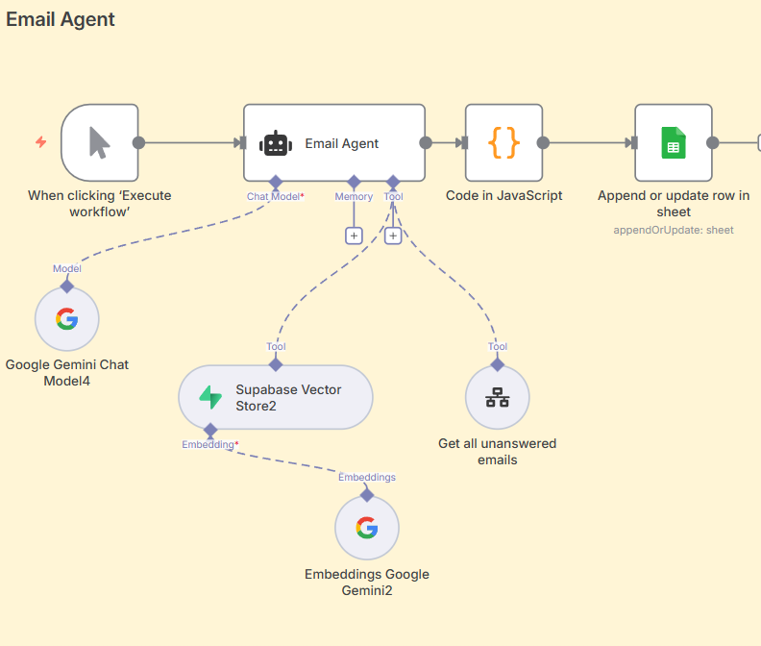
Email Agent – Reads new emails, categorizes them and auto generates responses for them.

Slide 12
Thank you

