Slide 1

Sentimental Analysis on Amazon Fine Food Reviews using Machine Learning
Bandaru Venkata Ramya
X22151699

Slide 2

Introduction
The Amazon Fine Food Reviews dataset stands as a prime example of this evolution. These evaluations bridge the gap between product quality and customer experience, influencing purchasing decisions and shaping brand reputations.
This study focuses on harnessing the power of sentiment analysis, a branch of machine learning, to interpret and categorize the vast amounts of feedback available in online platforms like Amazon.
The analysis provides a nuanced understanding of customer sentiments, offering a valuable tool for businesses to adapt to market needs and enhance customer engagement.

Slide 3
Research Question
How can sentiment analysis accuracy in the e-commerce industry, specifically for Amazon’s fine food product reviews, be optimized for logistic regression when applied with a range of featurization methods (Bag of Words, TF-IDF, Word2Vec, and TF-IDF-Word2Vec) and L1 regularization?

Slide 4
Data Summary
Dataset Summary
568,454 reviews, 74,258 products, 256,059 users (Oct 1999 - Oct 2012).
Inclusion of frequent reviewers for robustness.
Features of Dataset
10 attributes including ID, product and user details, review text.
Use for target categorization and feature extraction.
Library Imports
Python libraries for database, data management, visualization.
Gensim for NLP, sklearn.metrics for model evaluation.
Performance Metrics
Evaluation using precision, recall, accuracy, F1-score.
Application Context
Sentiment analysis using logistic regression for Amazon reviews.
Classification of text reviews as positive or negative.

Slide 5
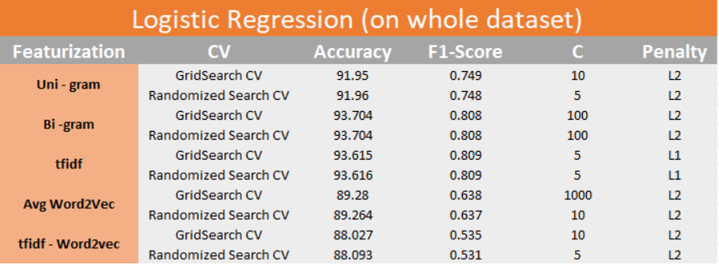
Result table

Slide 6
Conclusion
Features are multi-collinear i.e. they are co-related
Bigram Featurization performs best with accuracy of 93.704 and F1-Score of 0.808
Sparsity increases as we increase lambda or decrease C when L1 Regularizer is used
Algorithms like Logistic Regression performed best on this data

Slide 7

Thank you

