Slide 1


Time Series Analysis for the Stock Prediction.
Team - 13

Slide 2




Team Members
Krishnaveni Peesapati
Data Engineering
Ramya Boggala Ramesh Data Research & Analysis
Kavyasree Moktala
Data Visualization
Amer Sohail
Modelling and Deployment

Slide 3

Introduction
Time series analysis is a popular technique for predicting stock market movements. It involves analysing historical data to identify patterns, trends, and relationships that can be used to make predictions about future stock prices.
Some popular techniques used for stock market prediction:
Correlation Analysis
Random Forest
Principal Component Analysis (PCA)
Auto encoder

Slide 4
Proposed Solution
Start with a clear question
Determine predictability
Data preprocessing
Explore and visualize the data
Choose an appropriate forecasting model
Train and validate the model
Forecast future values
Evaluate and refine the results

Slide 5
Methodology:
Make data sequence by considering sequence length 15
Data collection
Data processing
Data splitting into train and test: 80:20
Train the models
Test the models
Calculate the model metrics

Slide 6

Data Sources
Google Dataset Search: One can search for specific topics or keywords and filter the results based on various criteria, such as last updates, download format, and license.
World Bank Open Data: The World Bank Open Data portal provides access to a comprehensive collection of development indicators from countries around the world. These indicators cover various sectors such as education, health, economy, and population, making it a valuable resource for time series analysis.
Other Data Sources
1.GitHub
2.Climate Data Online (CDO)
3.Kaggle

Slide 7
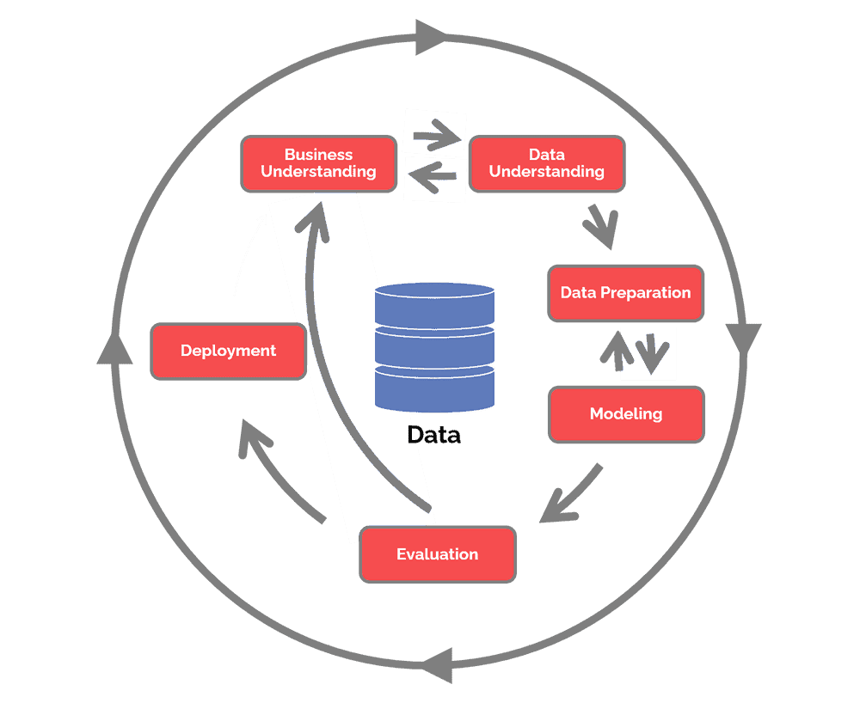
CRISP DM - METHODOLOGY
Business understanding – What does the business need?
Data understanding – What data do we have / need? Is it clean?
Data preparation – How do we organize the data for modeling?
Modeling – What modeling techniques should we apply?
Evaluation – Which model best meets the business objectives?
Deployment – How do stakeholders access the results?

Slide 8
Tools Used
Python Libraries:
Pandas
NumPy()
Stats models
Scikit-learn
Other Tools:
R Packages:
MATLAB
SAS

Slide 9
Why we are better?
User-Friendly Interface:
Analysts can easily navigate through the platform, import their data, and apply various analysis techniques without the need for extensive programming knowledge.
Advanced Forecasting Capabilities:
With our advanced forecasting models, analysts can predict future data based on historical trends. This enables businesses to make informed decisions and plan for the future with greater accuracy.
Scalability and Performance:
It can process and analyse massive datasets without compromising performance, ensuring that analysts can work with data of any size and complexity
Visualization Capabilities:
Our platform offers powerful visualization tools that allow analysts to create interactive and visually appealing charts, graphs, and dashboards

Slide 10
Estimated Project Timeline
Week 1 | Data Research
Week 2
Week 3 | Data Analysis
Week 4
Week 5 | Data Preparation
Week 6
Week 7 | Data Visualization
Week 8
Week 9 | Data Modeling
Week 10
Week 11 | Evaluation
Week 12 | Deployment

Slide 11

Thank you

