Slide 1

Uber Analysis Project
A Guided Power BI Project for Data Visualization and Insights
📒About the Project
Focused on analyzing Uber ride data
Identified peak hours, locations, and user trends
Built interactive dashboards with filters and visuals
🧰 Tools & Skills
Power BI (DAX, Power Query)
Data Cleaning & Transformation
Dashboard Design
Analytical Thinking
👤 Presented by: Ramya 📅 Date: April 2025 🔗 GitHub: github.com/RamyaD789/uber-analysis

Slide 2
Dashboard Structure:
Overview Analysis: Provides a summary of key metrics, payment/trip type distribution, vehicle analysis, and top locations.
Time Analysis: Focuses on daily and weekly booking patterns and peak times.
Details: Presents the raw, trip-by-trip data.
Key Metrics:
Total Bookings: Over 103.7 thousand trips were booked.
Total Revenue: These bookings generated approximately $1.6 million in revenue.
Average Trip Value: The average revenue per trip was $15.0.
Total Distance: Users traveled a combined distance of 349 thousand miles.
Average Trip Distance: The average trip distance was 3 miles.
Average Trip Time: The average duration of a trip was 16 minutes.

Slide 3
2.Booking Characteristics :
Payment Methods: The majority of bookings (nearly 68%) were paid via User Pay, with Cash accounting for a significant portion (over 32%). Amazon Pay and Google Pay were used much less frequently.
Trip Type: Day trips accounted for nearly two-thirds of all bookings (over 65%), while Night trips made up the remaining share.
3. Vehicle Performance and Preference (Overview Page):
Usage & Revenue: UberX and UberXL were the most frequently booked vehicle types and generated the highest total booking values. UberX had the most bookings (44.5K), while UberXL had the highest total booking value ($2.49 million). Uber Comfort and Uber Black also contributed significantly.
Average Value by Vehicle: Average booking values were relatively consistent across vehicle types (around
15−15−16), except for UberXL which had a higher average value ($49), likely due to larger group sizes or longer trips.
Most Popular: UberX is the most preferred vehicle type overall.

Slide 4
4.Location Insights:
Frequent Areas: Penn Station/Madison Sq West was the most frequent pickup location, and Upper East Side North was the most frequent dropoff location.
Longest Trip: The longest recorded trip within the period was 144.1 miles, from Lower East Side to Crown Heights North.
Top Booking Locations: Penn Station/Madison Sq West and Upper East Side appear as top locations for bookings.
5.Temporal Trends(Time Page):
Daily Pattern: Bookings peak in the evening, roughly between 5 PM and 7 PM, with a secondary peak during the morning commute (around 8 AM). Demand is lowest during the early morning hours (1 AM to 5 AM).
Weekly Pattern: Booking volume increases significantly towards the end of the week, with Friday, Saturday, and Sunday being the busiest days. Thursday shows the lowest volume.
Hourly/Day Heatmap: The heatmap confirms that late afternoons and evenings, particularly on weekends, are the periods with the highest booking intensity.

Slide 5
6. Detailed Data (Details Page):
The dashboard provides access to granular, trip-level data, including Trip ID, Pickup Date/Time, Vehicle, Payment Type, Passenger Count, Distance, Amount, and Location. This allows for detailed investigation of individual trips. The table lists over 146,000 rows, providing the raw data source for the aggregations.

Slide 6
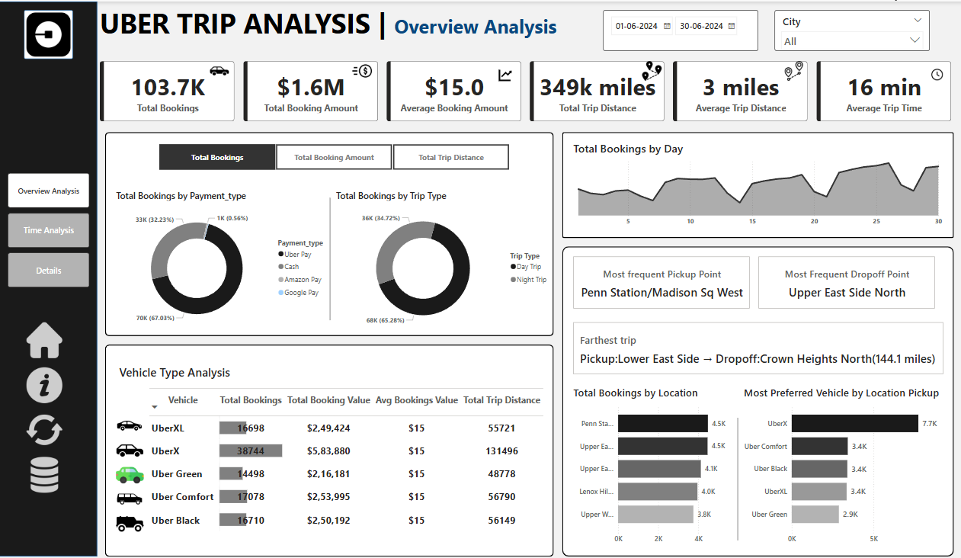

Slide 7
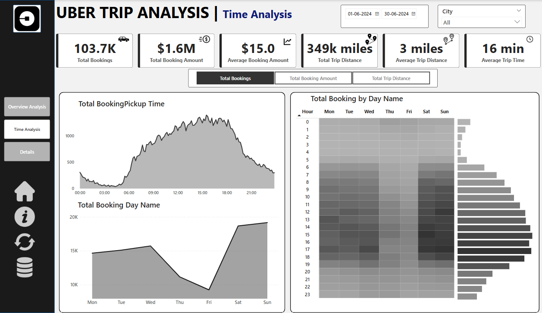

Slide 8
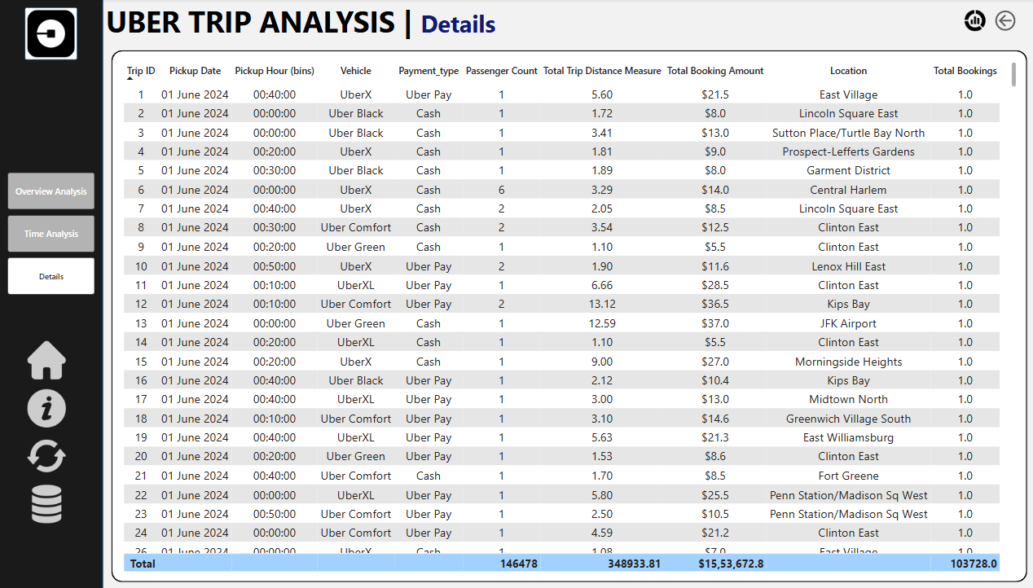

Slide 9



THANK YOU FOR YOUR ATTENTION

