Slide 1

DAS Page Replacement Algorithm
(Dynamic And Stable)
Ramya Danappa
Notes:
Hello Everyone and good evening all, Thank you for being part of my thesis defense,
I have done some research work on page replacement algorithm and built an new page replacement algorithm,
Under the guidance of my professor, dr.song jiang.
I want to thank to dr hao che and Dr. jia for being my committee member for this defense
Okay let start DAS algorthim

Slide 2
Page replacement algorithm
In an operating system that uses paging for memory management, a page replacement algorithm is needed to decide which page needs to be replaced when new page comes in.
Notes:
Over an 60 years , We are working on page replacement algorithm.
Why page replacement ago is imp When the page that was selected for replacement and paged out is referenced again it has to be paged in (read in from disk), and this involves waiting for I/O completion. We have one of the best replacement algorithm that is OPT

Slide 3
Optimal page replacement algorithm
This is theoretical concept
Impossible to implement online caching
Optimal is used as upper bound
Notes:
The page replacing problem is a typical online problem from the competitive analysis perspective in the sense that the optimal is offline algo

Slide 4


…yet another page replacement algorithm
LRU
2Q
LRU-K
ARC
LFU
LRFU
LIRS
LRU-2
NFU
DLIRS

Slide 5
Some ignorance we have been making for decades….

Slide 6
Problem
Recency (some algorithm recency based ignore frequency)
For Example LRU (Least Recently Used)
Problem in LRU algorithm sequential scans
Problem in LRU algorithm for loop access
Notes:
The LRU algorithm sequential scans can cause commonly referenced blocks in the cache to be replaced. In an ideal page replacement algorithm commonly referenced two blocks must not be replaced by blocks that haven't been used.
The LRU algorithm for loop access does not maintain a miss rate which is close to the buffer space shortage ratio hence this algorithm always removes the blocks that will be accessed the soonest as these blocks have not been accessed recently.

Slide 7
Problem
Frequency (some algorithm are frequency based and ignore recency)
For Example, LFU (Least frequently used)
LRU does not take into consideration the recency of the blocks.
Notes:
In LFU when a block having high frequency although not being accessed for a long time does not get evicted from the cache.
LFU does not take into consideration the recency of the blocks.

Slide 8
Why DAS ?
If algorithms better in some case and worst some cases. We need something stable performance and also sustain current result.

Slide 9
DAS Design Idea
DAS uses basic approach of replacement policies such as LRU and LFU
It is dynamic algorithm
Uses both frequency and recency
Notes:
Dyanmic has one tunable parameter
I executed with both freq and recency

Slide 10
Overview
DAS algorithm design
Adding blocks in empty cache
Hit in cache
Miss in the cache

Slide 11
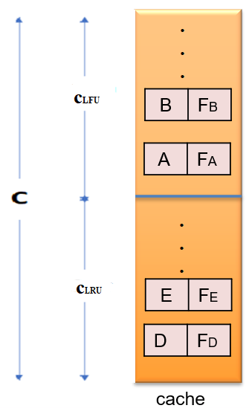
DAS design
Notes:
We devide the cache size c into two partition LRU and LFU portion.

Slide 12
Overview
DAS algorithm Structure
Adding blocks in empty cache
Hit in cache
Miss in the cache

Slide 13
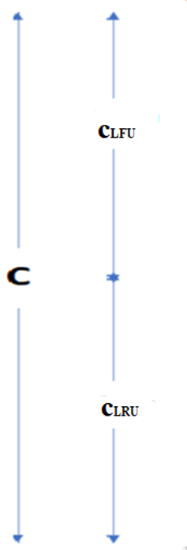
Filling empty cache …..F E D C B A
F | FF
E | FE
D | FD
C | FC
B | FB
A | FA
cache

Slide 14
Overview
DAS algorithm Structure
Adding blocks in empty cache
Hit in cache
Miss in the cache

Slide 15
Hit on LFU …..E F E D C B A
F | FF
E | FE
FE will increment by 1
D | FD
C | FC
B | FB
A | FA
cache

Slide 16
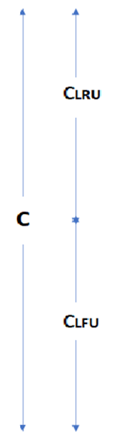
Hit on LRU portion: . . . B F E D C B A
Increase frequency of B now,
If FB > min(FP, FE,FD),
Then swap the location
P | FP
E | FE
D | FD
C | Fc
B | FB
A | FA
cache

Slide 17
Overview
DAS algorithm Structure
Adding blocks in empty cache
Hit in cache
Miss in the cache

Slide 18
Miss on cache …..G F E D C B A
F | FF
E | FE
D | FD
G | FG
C | CF
B | FB
A | FA
cache

Slide 19
Any Queries in DAS design

Slide 20
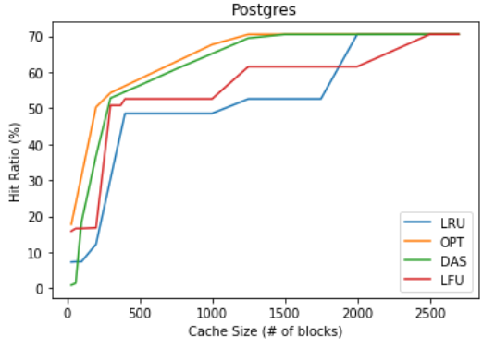
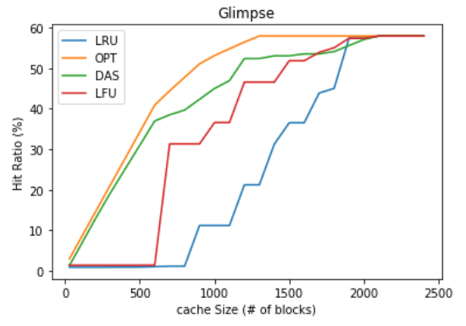
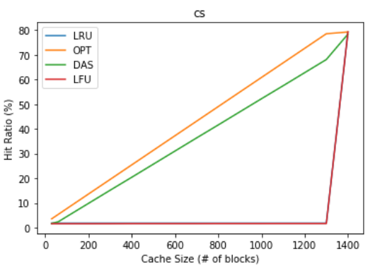
Performance for Looping Type Workloads
Notes:
Here we can observe LRU and LFU both performs lowest hit rates,
Cs is pure looping –each block accessed at almost the same freq
Glimpse- loop with intervals
Postgres –is loop pattern with different freq

Slide 21
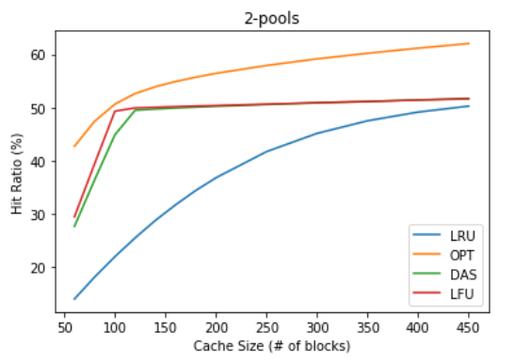
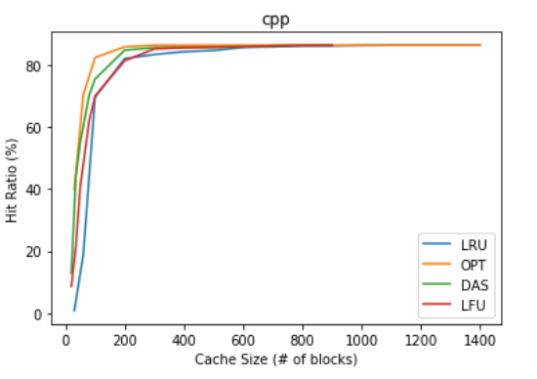
Performance for the probabilistic workloads
Notes:
2 ppols – where blocks are referred once and after long time it will be referred
Cpp-completely probabilistic workload

Slide 22
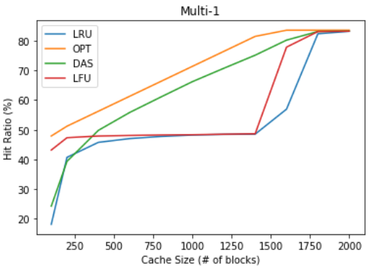
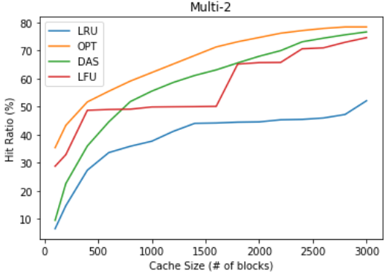
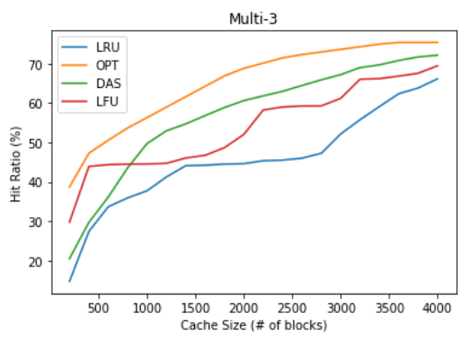
Performance for Mixed Type Workloads
Notes:
Multi1=have both seq and loop
Multi2 – interval loop and seq
Multi3.- probabilistic and interval loop and seq

Slide 23
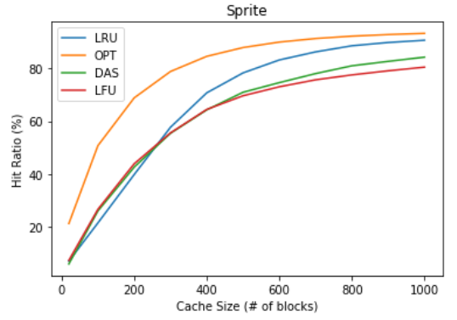
Performance for Temporally Clustered Type
Sprite is LRU friendly. DAS is still Stable

Slide 24
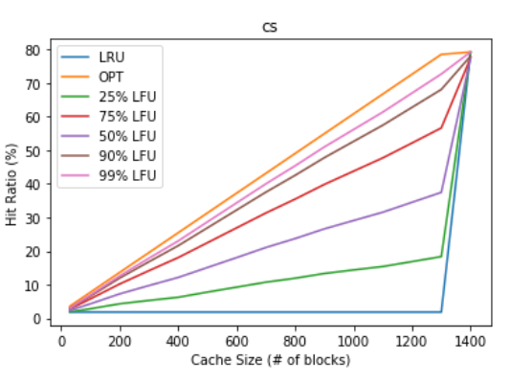
Sensitivity Analysis

Slide 25
Conclusion
Simple to implement and low space required to implement.
DAS is dynamic and also performs better than LRU and LFU performance
DAS is stable since implementation have both recency and frequency bases

Slide 26


Slide 27


