Slide 1
Revisiting Analytical Models of
Phonon-Point Defect Scattering
Ramya Gurunathan
Snyder Group @ Northwestern University
11/8/2018 DMREF Meeting
Notes:
Starting my second year at Northwestern
In a thin film photovoltaics group at Penn State for my undergrad (SnS)
MPhil in Scientific Computing at Cambridge → structure relaxation of metal nanoparticles. Machine learning to identify local structural domains

Slide 2
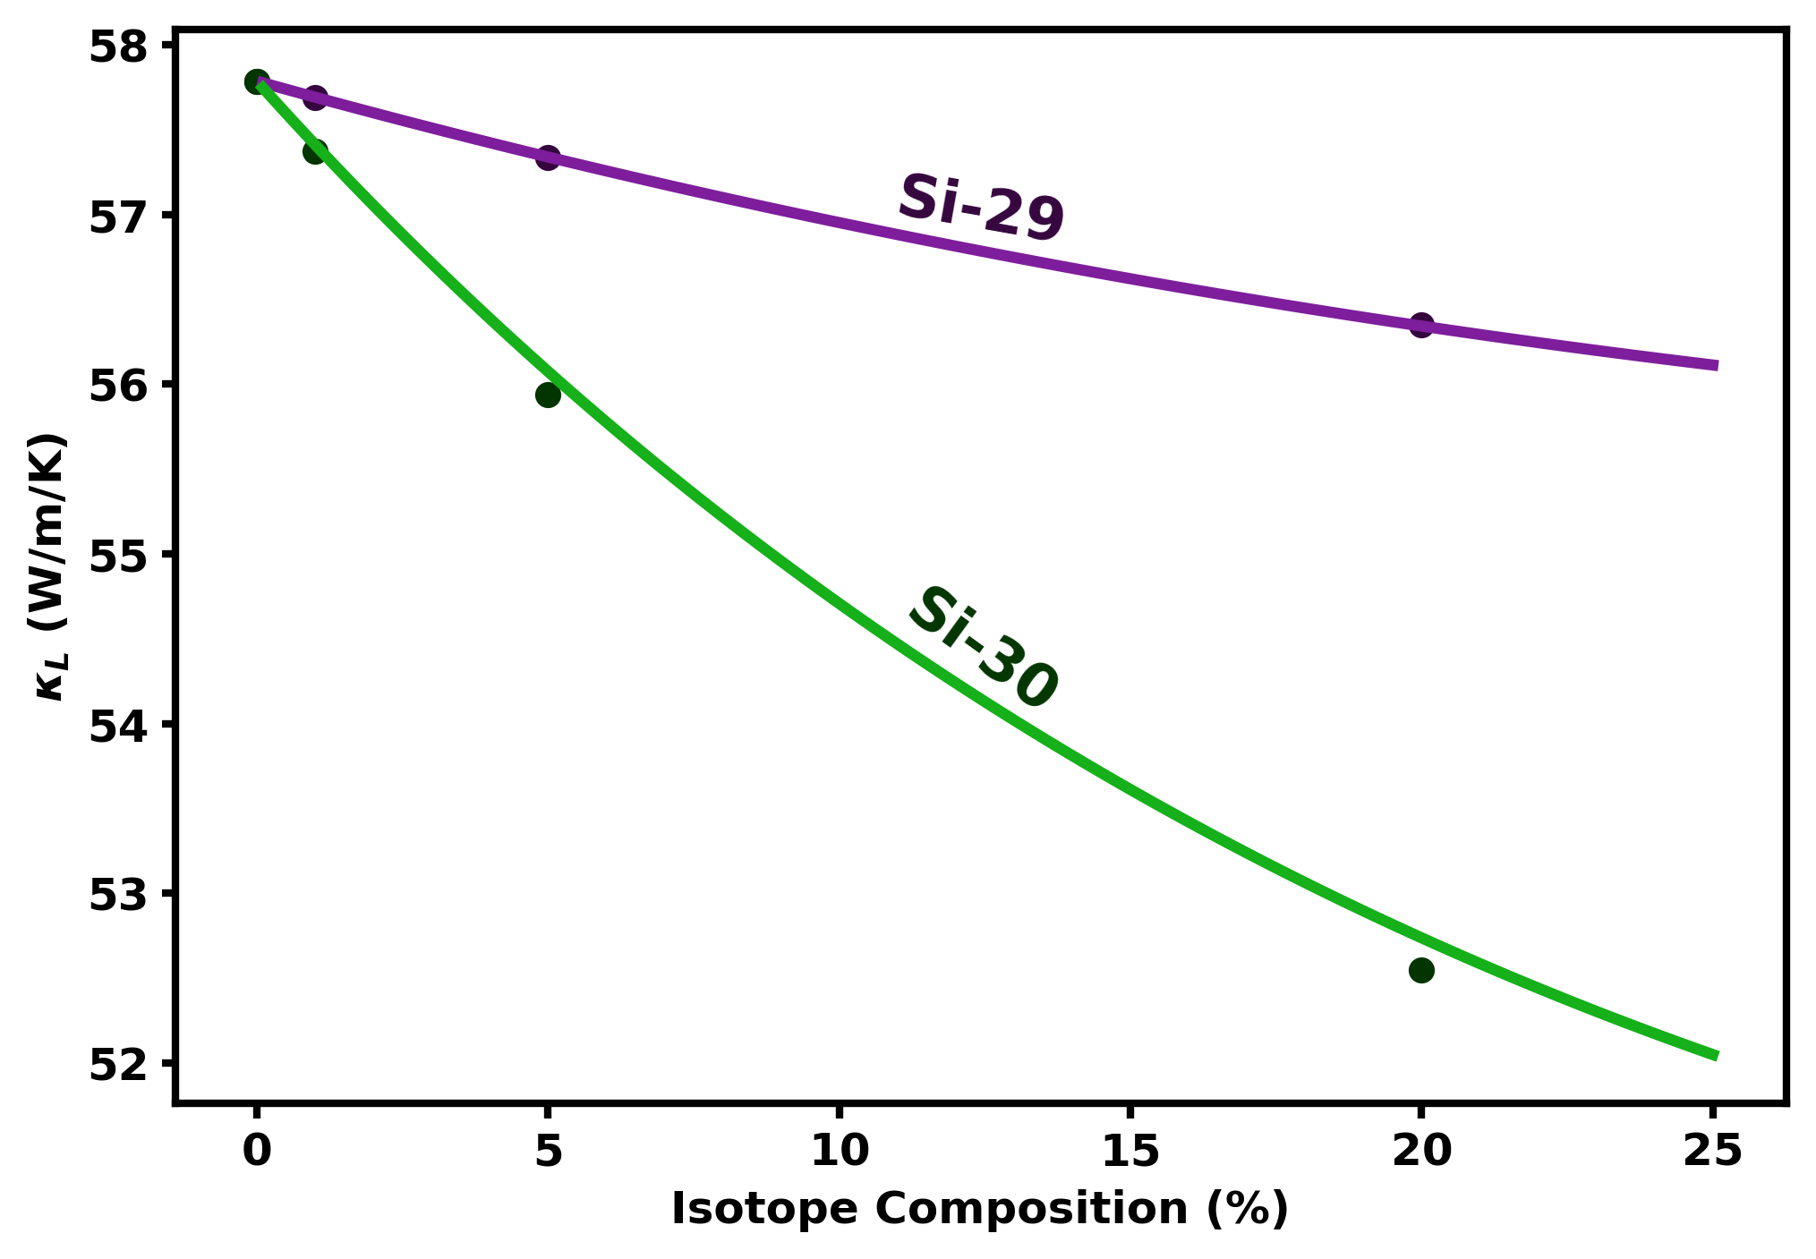
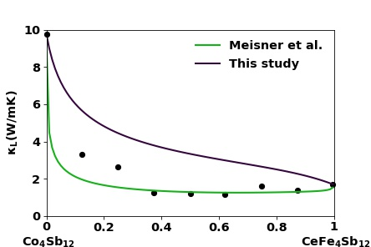
Closed Form Solutions for Point Defect Scattering are Surprisingly Predictive..
Discrepancies over model inputs can lead to incomplete conclusions over the dominant scattering mechanisms in a system
Points: Calculated using DFT supercell calculations, T-matrix scattering theory, full solution of the BTE
Lines: Calculated using Klemens/Callaway model
G. P. Meisner et al. Phys. Rev. Lett., 80, 3551–3554 (1998)

Slide 3
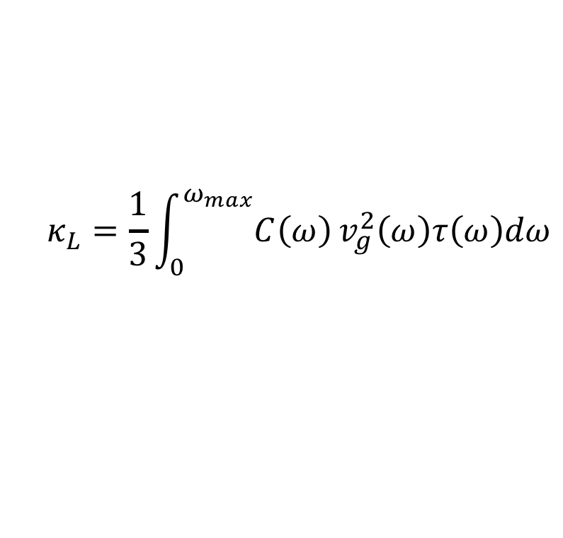

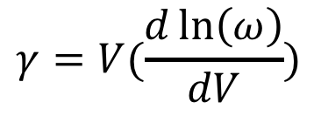
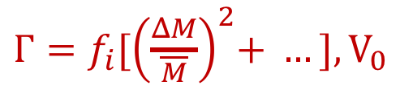

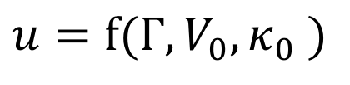

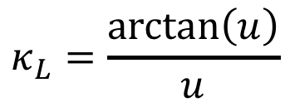
The Klemens/Callaway Model
$$τ^{−1}=τ_{PD}^{−1}+τ_{U}^{−1}$$
$$τ_{PD}^{−1}=Aω^{4}$$
$$τ_{U}^{−1}=B(T)ω^{2}$$
$Γ=f_{i}{[\left(\frac{ΔM}{\overline{M}}\right)}^{2}+ …], V_{0}$
$$γ=V(\frac{d\ln\left(ω\right)}{dV})$$
$$κ_{L}=\frac{1}{3}\int_{0}^{ω_{max}}{C\left(ω\right)}v_{g}^{2}\left(ω\right)τ\left(ω\right)dω$$
$$κ_{L}=\frac{\arctan\left(u\right)}{u}$$
$$u=f(Γ, V_{0}, κ_{0} )$$
k + k’ +k’’ = G
Notes:
Add diagram of Umklapp scattering → BZ
Phonon which produces a lattice distortion, an incident phonon which

Slide 4
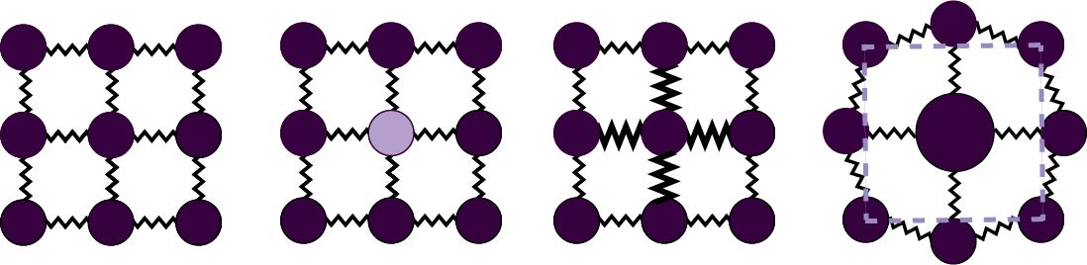
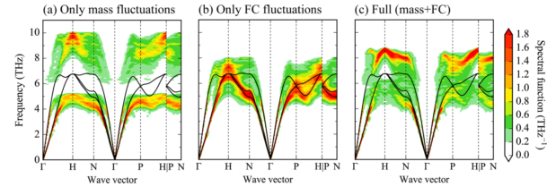
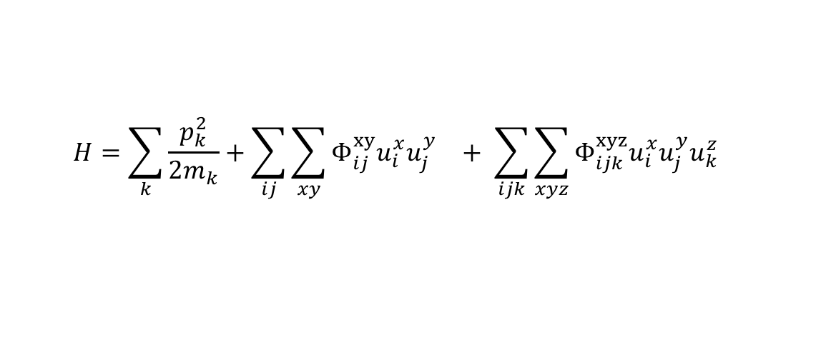



Point Defect Perturbation
$$ΔM$$
$$ΔK$$
$$ΔR$$
$$H=\sum_{k}{\frac{p_{k}^{2}}{2m_{k}}}+\sum_{ij}{{\sum_{xy}{Φ_{ij}^{xy}u_{i}^{x}u_{j}^{y}}}_{}^{}}+ \sum_{ijk}{{\sum_{xyz}{Φ_{ijk}^{xyz}u_{i}^{x}u_{j}^{y}u_{k}^{z}} }_{}^{}}$$
F. Körmann, Y. Ikeda, B. Grabowski, and M. H. F. Sluiter, npj Comput. Mater.,(3), 36, 2017.
Notes:
Mass contrast, force constant contrast (different chemical couplings), strain contrast (local distortion)
.. In reality. DFT papers won’t refer to strain contrast because both these effects are captured calculated force constants around a defected site.

Slide 5
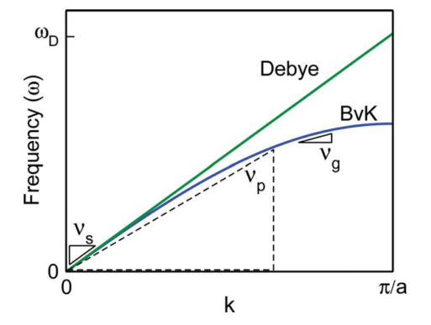

Stated Assumptions of the Model
Debye Model Dispersion
1 Atom Per U.C.
Monatomic Lattice Approximation (MLA):
Virtual Crystal Approximation (VCA):
$$v_{g}=v_{p}=v_{s}$$
E. S. Toberer, et al., J. Mater. Chem., 21, 15843–15852 (2011).
Notes:
Discuss the monatomic lattice approximation against the Debye approximation

Slide 6
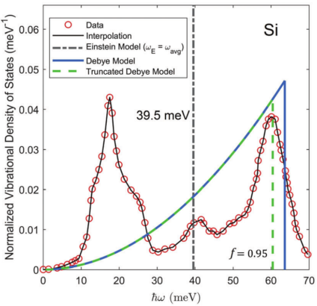
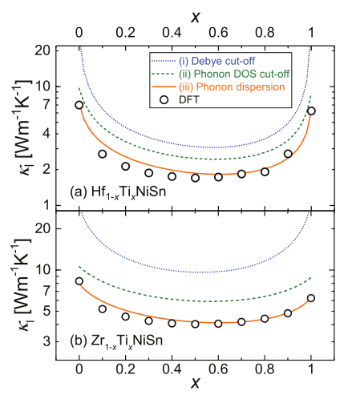
Dispersion Dependence
M. Schrade and T. G. Finstad, Phys. Status Solidi, 1800208, 1–6, 2018.
M. T. Agne, R. Hanus, and G. J. Snyder, Energy Environ. Sci., 11 (13) 609–616, 2018.
Notes:
Constant values for the kappaL/kappa0 → justifying that the shapes are the same

Slide 7
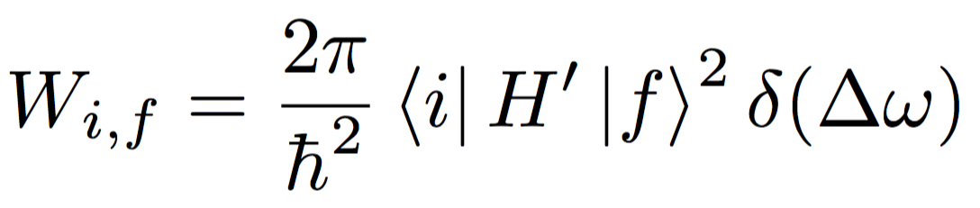
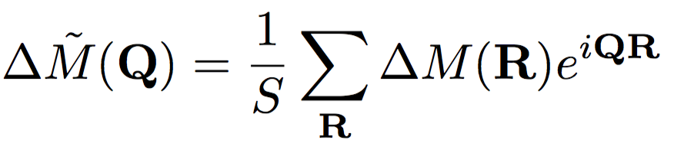
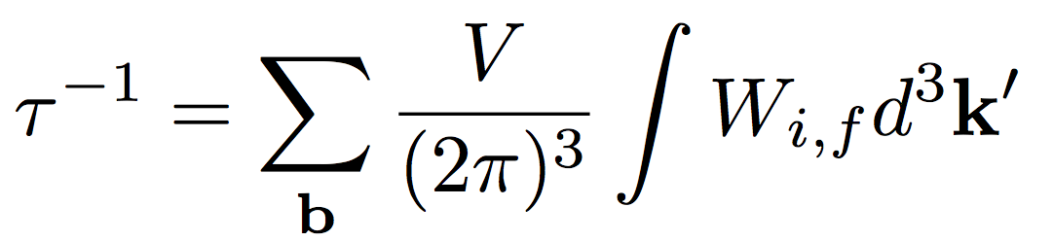
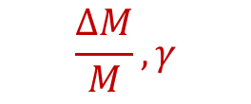
Dispersion Dependence
Fermi’s Golden Rule:
Form of the Perturbation:
$$\frac{ΔM}{M},γ$$
Express real space perturbations in Fourier components:
Integrate W over all possible final states:
Notes:
…keep?
The initial and final states are eigenstates of the original lattice Hamiltonian. So, without perturbation, if you started in the initial state, you would stay in the initial state. However, given the perturbation, this is related to the probability that you would end up in the final state if you started in the initial state
Initial and final states related by a change in the occupation of two phonon states (for a two-phonon process) or three phonon states for a three phonon process

Slide 8
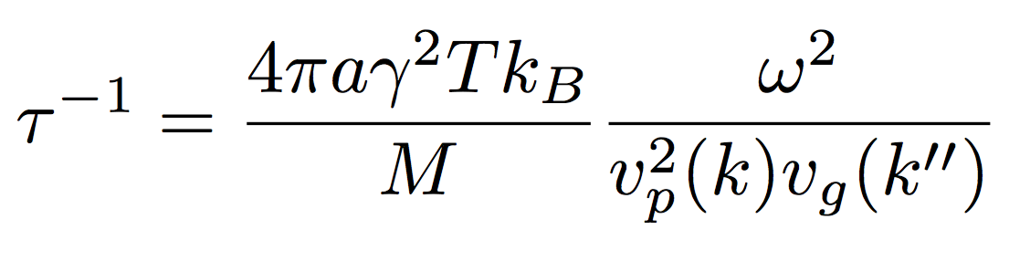
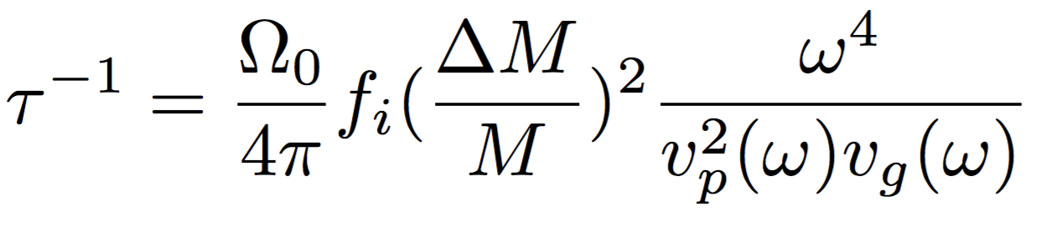
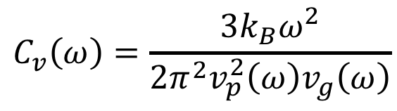
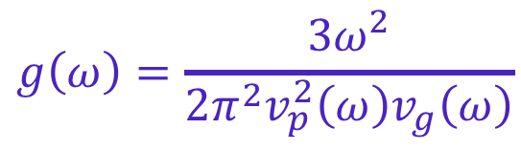
Dispersion Dependence
Umklapp:
$$g\left(ω\right)=\frac{3ω^{2}}{2π^{2}v_{p}^{2}\left(ω\right)v_{g}\left(ω\right)}$$
Point Defect:
$$C_{v}\left(ω\right)=\frac{3{k_{B}ω}^{2}}{2π^{2}v_{p}^{2}\left(ω\right)v_{g}\left(ω\right)}$$
Notes:
For the BvK dispersion, tried to strictly integrate this by parts in Wolfram Alpha and the functional form was really complicated
Also, the form would be dispersion-dependent
Is the averaged v_g more similar to the v_s
Density of states

Slide 9
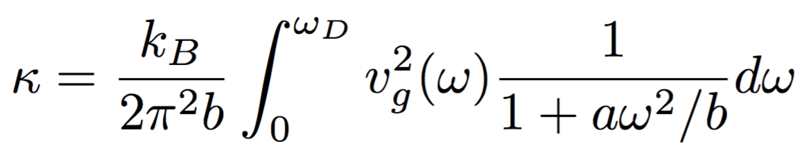
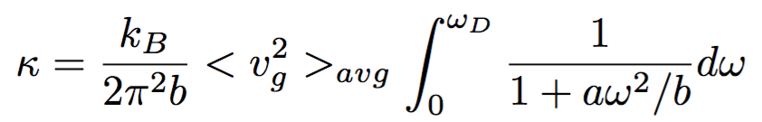
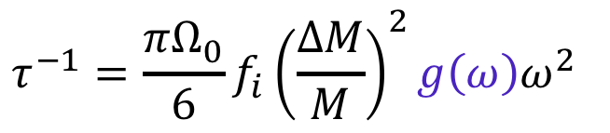


Dispersion Dependence
Umklapp:
?
$$g\left(ω\right)=\frac{3ω^{2}}{2π^{2}v_{p}^{2}\left(ω\right)v_{g}\left(ω\right)}$$
Point Defect:
$$τ^{−1}=\frac{πΩ_{0}}{6}f_{i}{\left(\frac{ΔM}{M}\right)}^{2}g\left(ω\right)ω^{2}$$
$$C_{v}\left(ω\right)=k_{B}g(ω)$$
Quantity of interest:
$$κ/κ_{0}$$
Notes:
For the BvK dispersion, tried to strictly integrate this by parts in Wolfram Alpha and the functional form was really complicated
Also, the form would be dispersion-dependent
Is the averaged v_g more similar to the v_s
Density of states

Slide 10
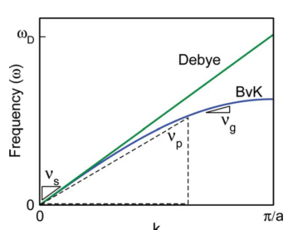
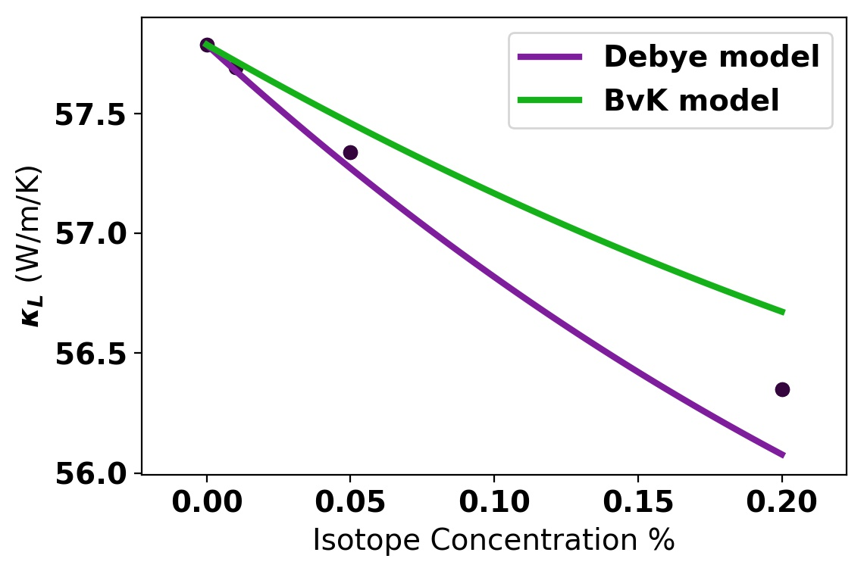
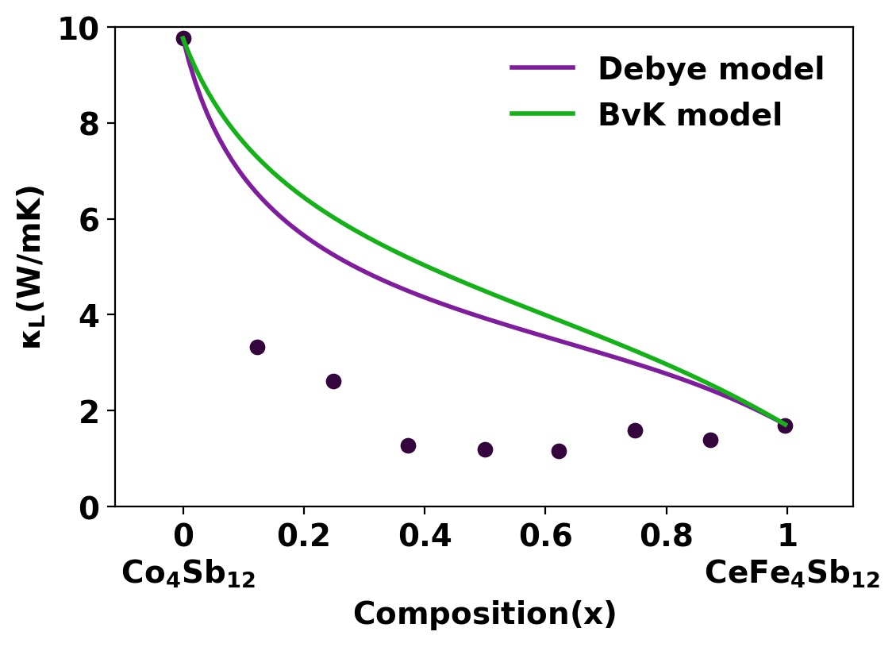
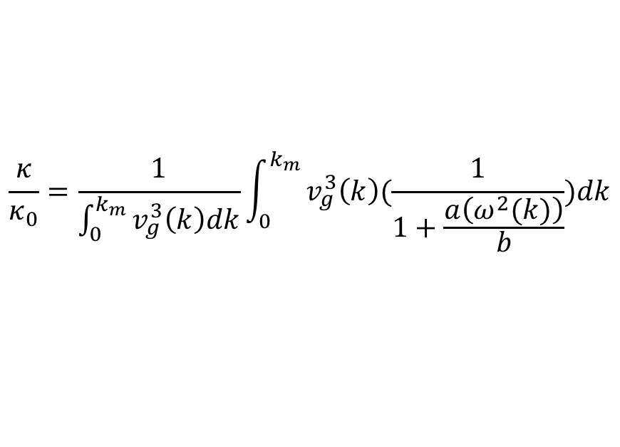
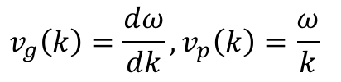
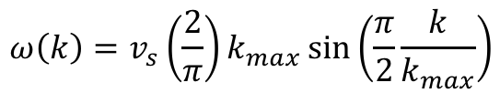
Dispersion Dependence
$$ω\left(k\right)=v_{s}\left(\frac{2}{π}\right)k_{max}\sin\left(\frac{π}{2}\frac{k}{k_{max}}\right)$$
$$v_{g}\left(k\right)=\frac{dω}{dk}, v_{p}\left(k\right)=\frac{ω}{k}$$
$$\frac{κ}{κ_{0}}=\frac{1}{\int_{0}^{k_{m}}{v_{g}^{3}\left(k\right)dk}}\int_{0}^{k_{m}}{v_{g}^{3}\left(k\right)(\frac{1}{1+\frac{a\left(ω^{2}(k)\right)}{b}})dk}$$
Notes:
Remove math?? Leave this in at all??
Plot frequency dependence of the vg^3 for BvK

Slide 11
Stated Assumptions of the Model
Debye Model Dispersion
1 Atom Per U.C.
Monatomic Lattice Approximation (MLA):
Virtual Crystal Approximation (VCA):
$$v_{g}=v_{p}=v_{s}$$
E. S. Toberer, et al., J. Mater. Chem., 21, 15843–15852 (2011).
Notes:
Discuss the monatomic lattice approximation against the Debye approximation

Slide 12
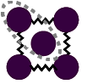
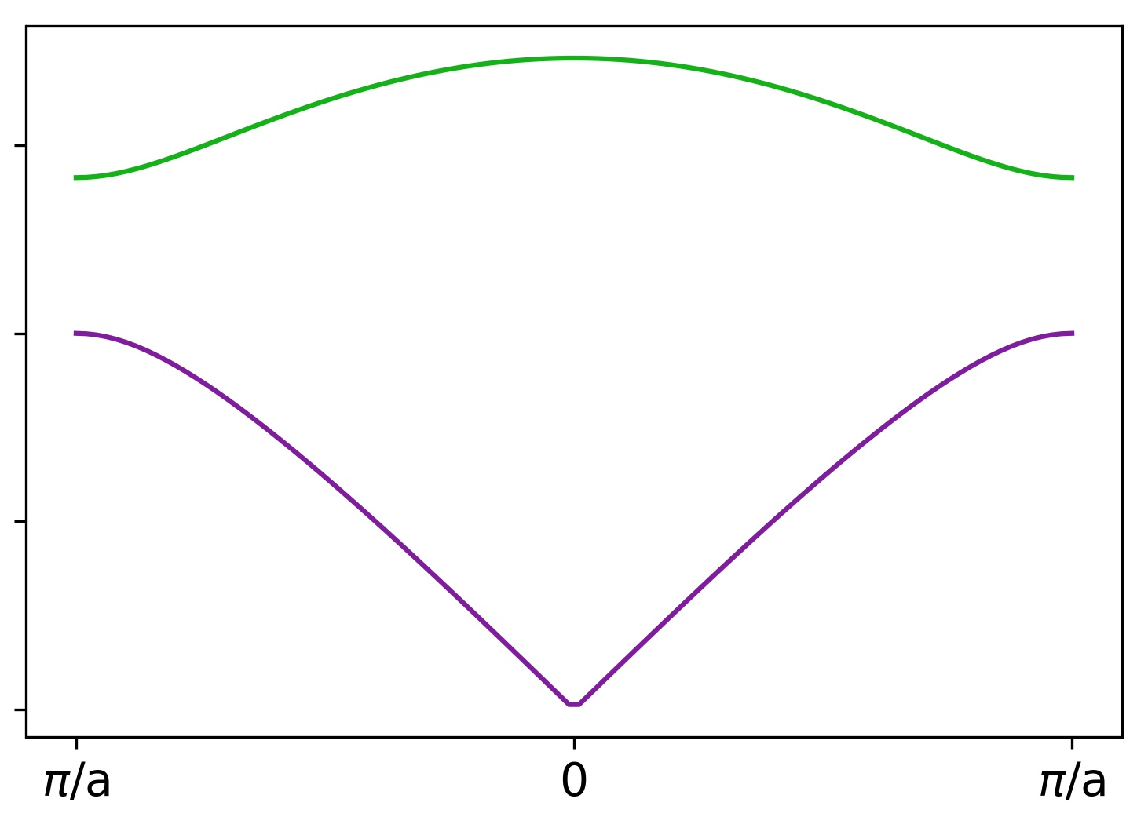
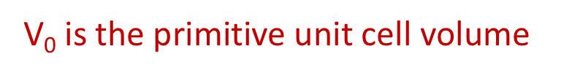
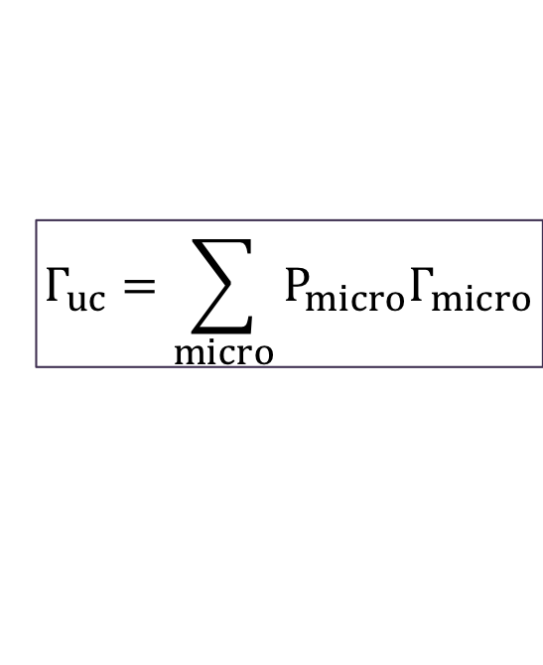
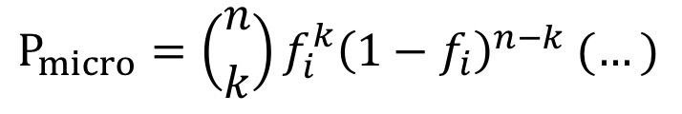
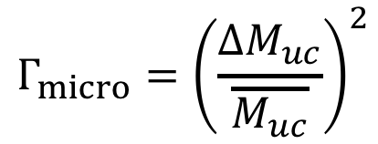
MLA: Per Primitive Unit Cell
The various primitive unit cells in the lattice are your “microstates”
$$Γ_{micro}={\left(\frac{ΔM_{uc}}{\overline{M_{uc}}}\right)}^{2}$$
$$P_{micro}=\left({n \atop k}\right)f_{i}^{k}{\left(1−f_{i}\right)}^{n−k} (…)$$
$$Γ_{uc}=\sum_{micro}{{P_{micro}Γ}_{micro}}$$
V₀ is the primitive unit cell volume
Notes:
Suggestion in the skutterudite paper
… look at Klemens stuff and figure out how to talk about defect clusters

Slide 13
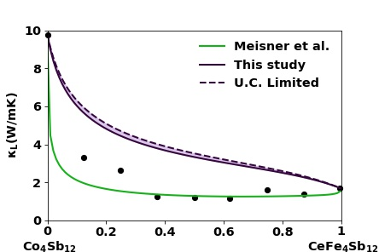
MLA: Per Primitive Unit Cell
The various primitive unit cells in the lattice are your “microstates”
$$Γ_{micro}={\left(\frac{ΔM_{uc}}{\overline{M_{uc}}}\right)}^{2}$$
$$P_{micro}=\left({n \atop k}\right)f_{i}^{k}{\left(1−f_{i}\right)}^{n−k} (…)$$
$$Γ_{uc}=\sum_{micro}{{P_{micro}Γ}_{micro}}$$
V₀ is the primitive unit cell volume
Notes:
Suggestion in the skutterudite paper
… look at Klemens stuff and figure out how to talk about defect clusters

Slide 14


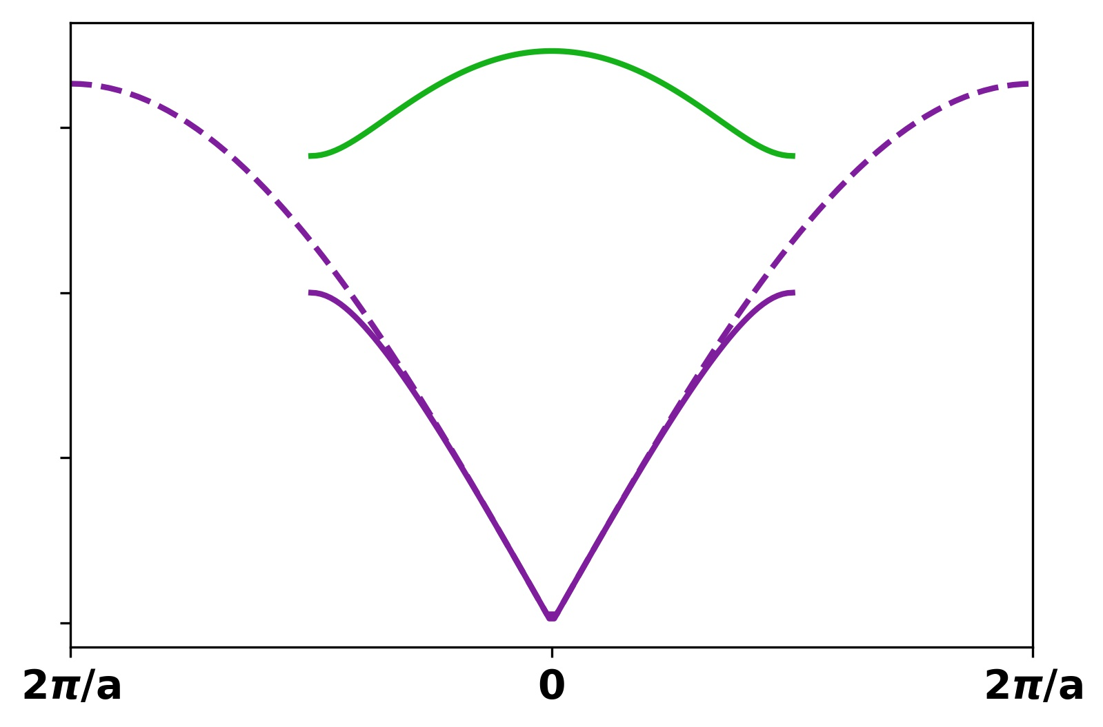
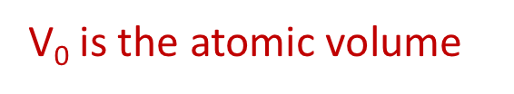
VCA: Per Atomic Site
Every atom has the averaged atomic volume and mass of the lattice
For the example compound: A_{x}B_{y}C_{z}
V₀ is the atomic volume
Notes:
Extended zone scheme representation

Slide 15
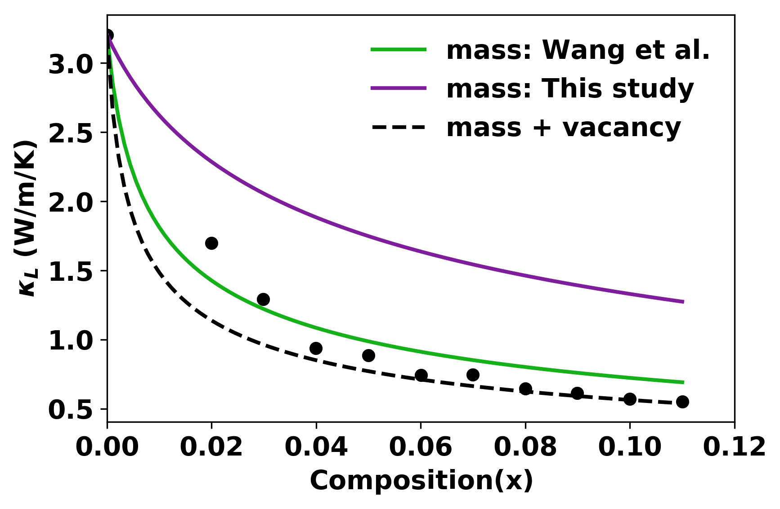
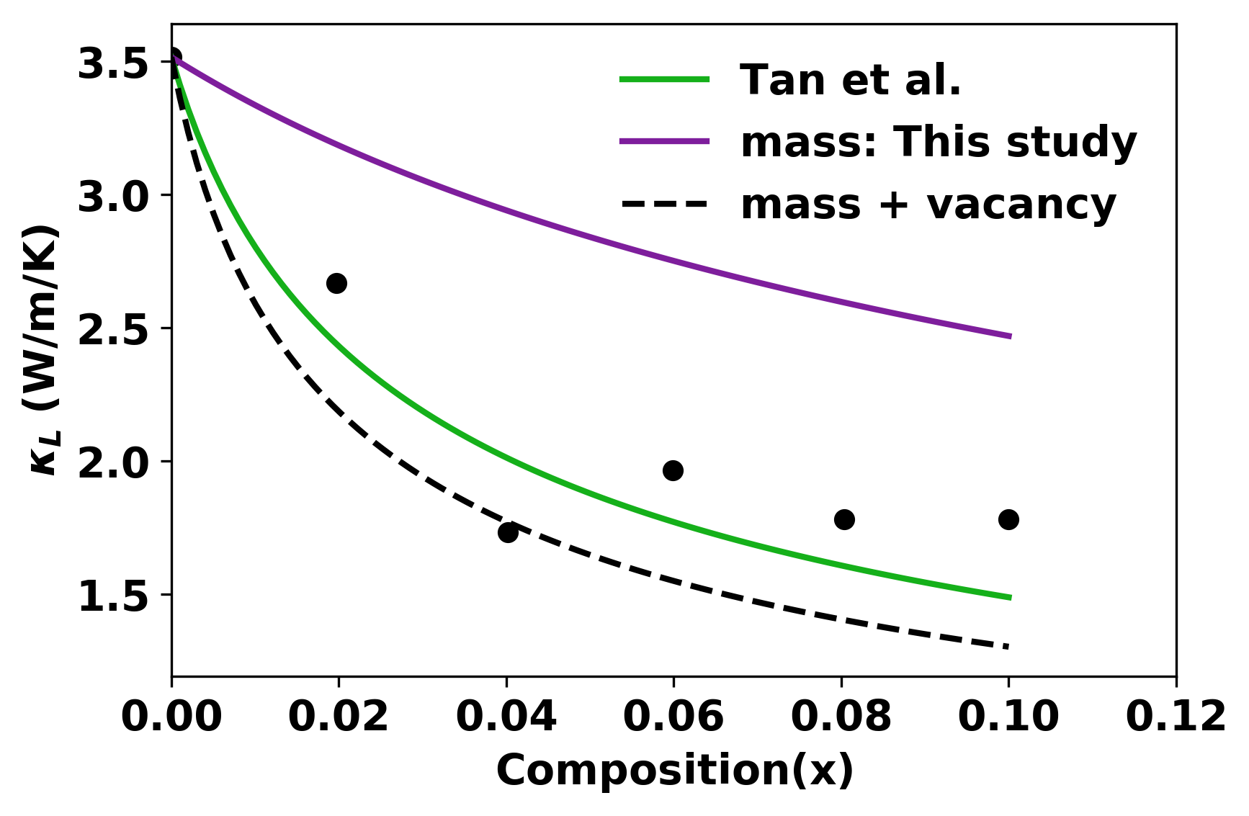
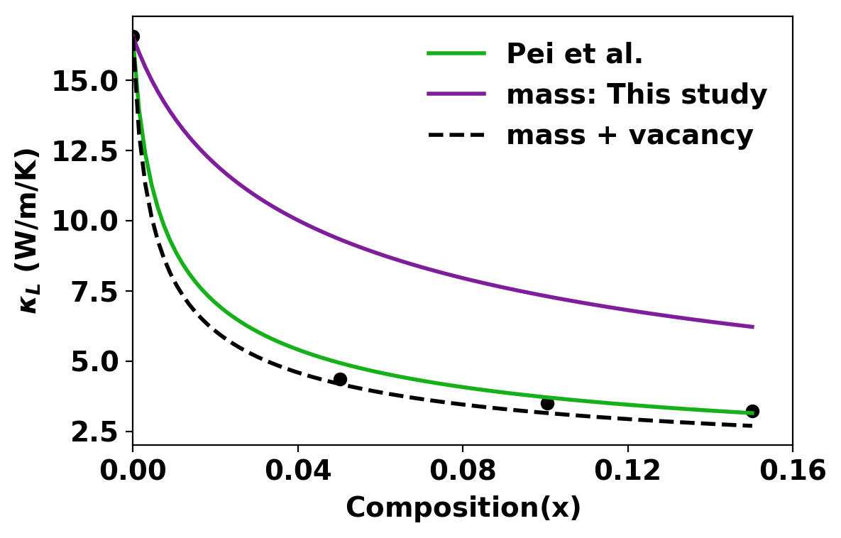
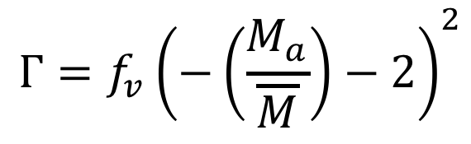
Simple and Effective Treatment of Vacancies
La_{1-x}Co_{x}O_{3-x}
$$Γ=f_{v}{\left(−\left(\frac{M_{a}}{\overline{M}}\right)−2\right)}^{2}$$
(SnTe)_{1-x} (In₂Te₃)_{x}
(InSb)_{1-x} (In₂Te₃)_{x}
Coming soon: Vacancy scattering in the
TiCoSb---Ti_{0.9}NiSb System
Notes:
Note: check how the vacancy concentrations were measured if they were…
Need to think about whether the vacancy picture makes sense for skutterudites
Does the filler atoms form transient bonds that should be treated as a potential energy perturbation?

Slide 16
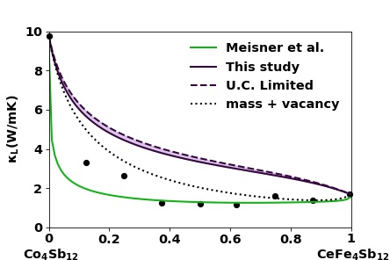
Simple and Effective Treatment of Vacancies
La_{1-x}Co_{x}O_{3-x}
$$Γ=f_{v}{\left(−\left(\frac{M_{a}}{\overline{M}}\right)−2\right)}^{2}$$
(SnTe)_{1-x} (In₂Te₃)_{x}
(InSb)_{1-x} (In₂Te₃)_{x}
Coming soon: Vacancy scattering in the
TiCoSb---Ti_{0.9}NiSb System
Notes:
Note: check how the vacancy concentrations were measured if they were…
Need to think about whether the vacancy picture makes sense for skutterudites
Does the filler atoms form transient bonds that should be treated as a potential energy perturbation?

Slide 17
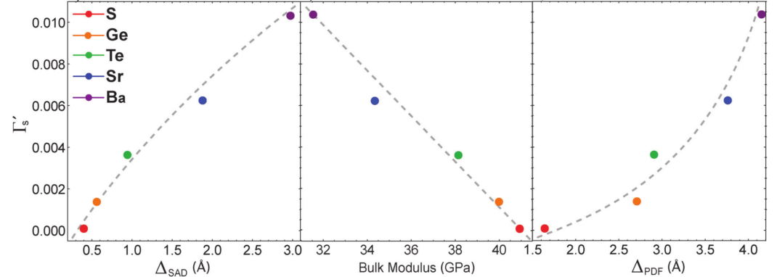
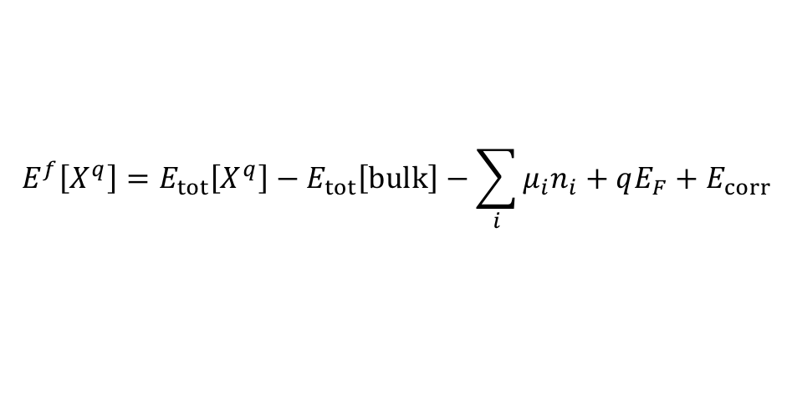
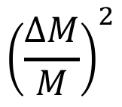
Features for Point Defect Scattering
$${\left(\frac{ΔM}{M}\right)}^{2}$$
Mass fluctuation:
Force constant fluctuation:
Check: Correlation between defect formation energy and defect scattering strength
$$E^{f}\left[X^{q}\right]=E_{tot}\left[X^{q}\right]−E_{tot}\left[bulk\right]−\sum_{i}{μ_{i}n_{i}+qE_{F}+E_{corr}}$$
B. R. Ortiz, et al. PCCP, 17, 19410–19423 (2015).
Notes:
Feature correlation? Avoid collinearity in prediction engines.
Tier one: Keep at least the mass scattering… see if perturbation in potential energy is buried in values already calculated
Tier two: extra calculation on Bulk modulus to get a proxy for the perturbation to elastic properties

Slide 18
Takeaways:
Important Points for the Klemens/Callaway Model:
Historical discrepancy over defining inputs on a “per atom” or “per unit cell” basis. Either is valid as long as the “accounting” is consistent.
In practice, in dispersion relation sensitivity of the model appears to be lifted.
A simple treatment of vacancy scattering with a “-2” term for broken bonds seems robust
Further Exploration:
Impact of “associated defects” and “defect clusters”
Potential Action Items for DMREF?
See if features describing “lattice perturbation” introduced by dopants are relevant to defects database.
Notes:
“featurizers” for alloy scattering

Slide 19
Extra Slides

Slide 20
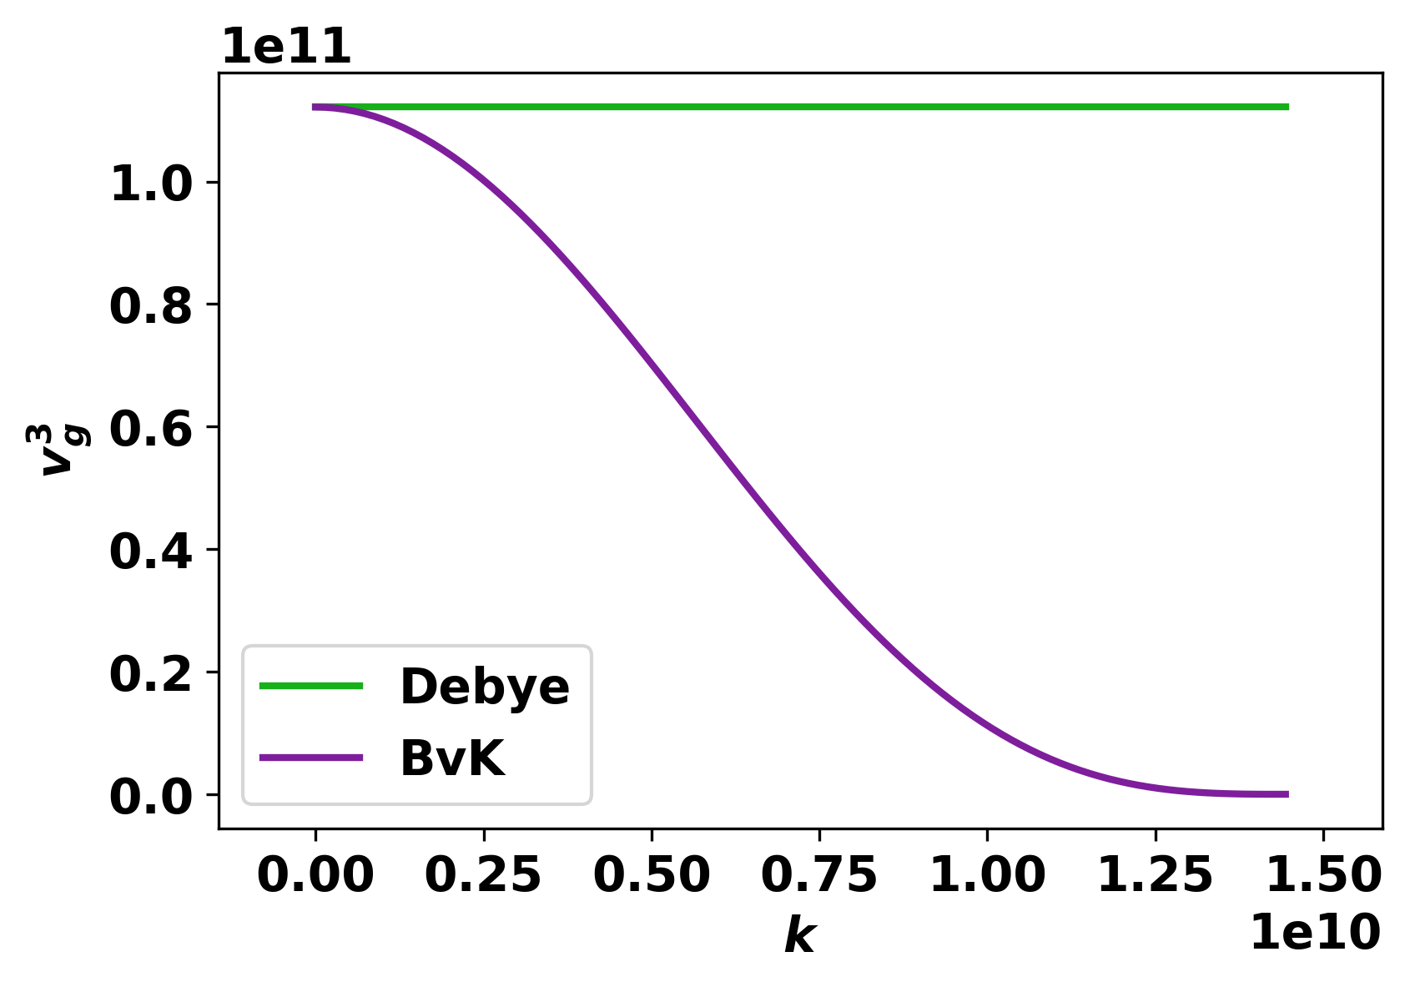
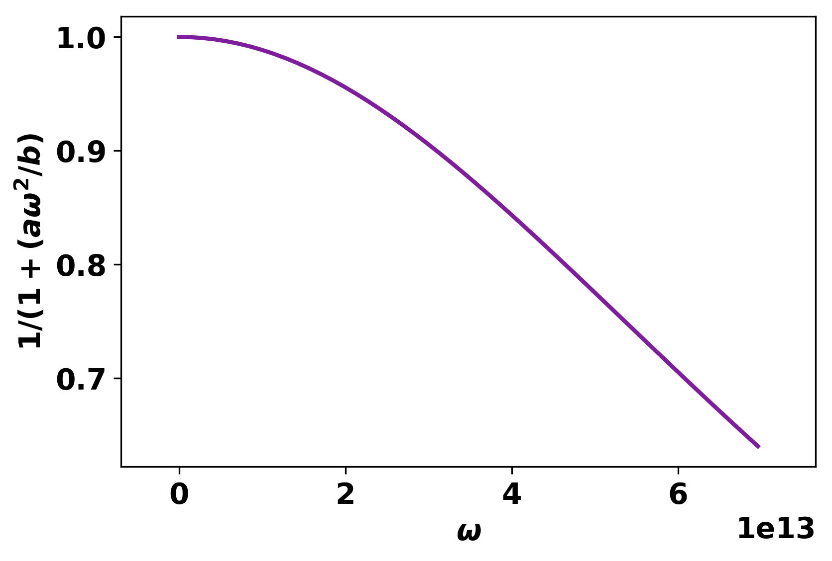
Unpacking the Dispersion Comparison

