Slide 1
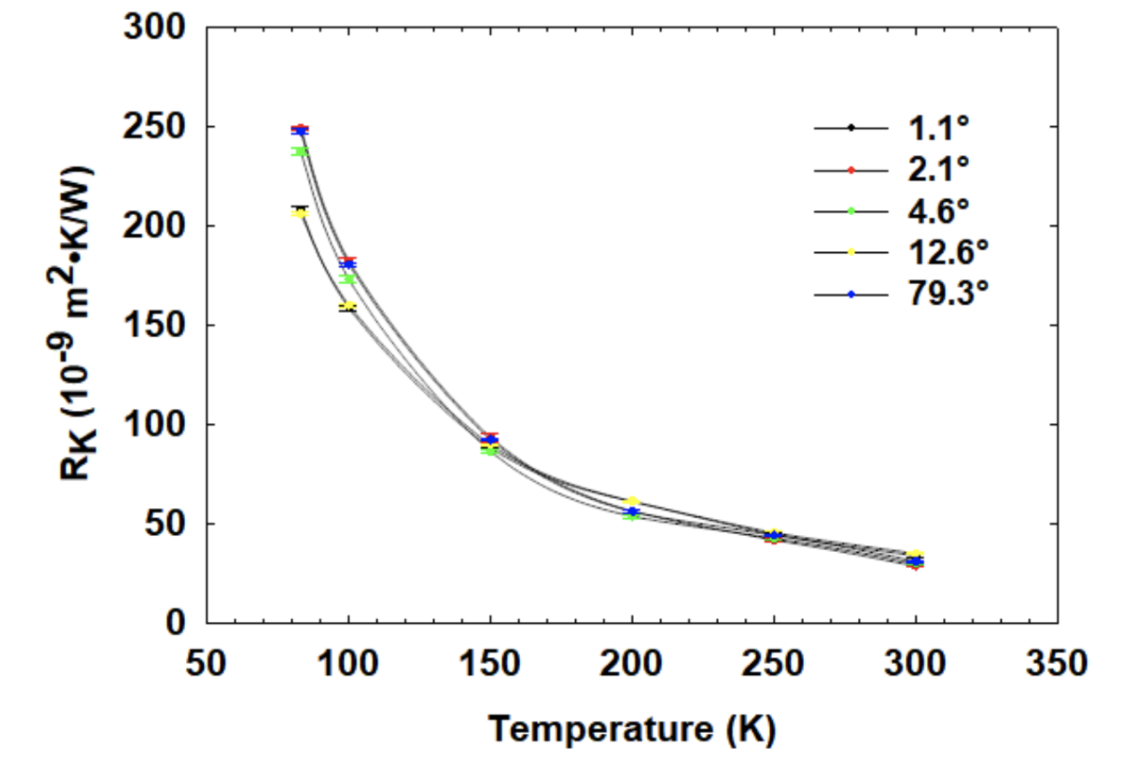
Qing Hao’s Thermal Boundary Resistance
Si-Ge interface at different twist angles (likely just an amorphous layer between substrates)

Slide 2

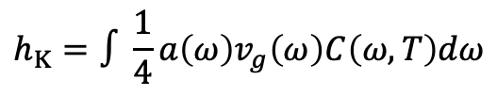
Tilt Boundary Properties
This is a tilt angle of 23 degrees. 1 nm dislocation spacing.
Thermal Boundary Resistance
Kapitza Length
$$h_{K}=∫\frac{1}{4}a\left(ω\right)v_{g}\left(ω\right)C\left(ω, T\right)dω$$
$$L_{Kap}=R_{K}κ_{L}$$

Slide 3
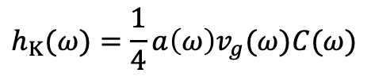
Tilt Boundary Properties: Spectral
Spectral thermal conductance
$$h_{K}(ω)=\frac{1}{4}a\left(ω\right)v_{g}(ω)C(ω)$$
(a is the transmissivity)

Slide 4
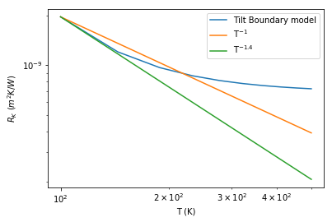
Log-Log Plots
Spectral thermal conductance
$$h_{K}(ω)=\frac{1}{4}a\left(ω\right)v_{g}(ω)C(ω)$$

