Slide 1


CAPSTONE PROJECT TRAVEL APP
SUBMITTED BY :
Name: K Ramya
Batch: WIP-SF-B1
LMS Id: MGSA_502
Date: 27/02/2023

Slide 2
Contents :
Introduction
Module 1
Module 2
Module 3

Slide 3
Introduction to travel app :
The Salesforce Travel Approval App is a web-based application that is designed for the travel approval process for the employees .
This app is built on the Salesforce platform , which provides a robust and customizable framework for managing travel requests .
This project involves several components .

Slide 4
Module – 1 :
This project module focuses on the non-coding approach to modifying the user interface , as you customize an app that tracks company travel .
Build a Lightning app, add tabs, and customize page layouts.
Create custom objects and fields for the app.
Define relationships between objects.
Import data and test the app.

Slide 5
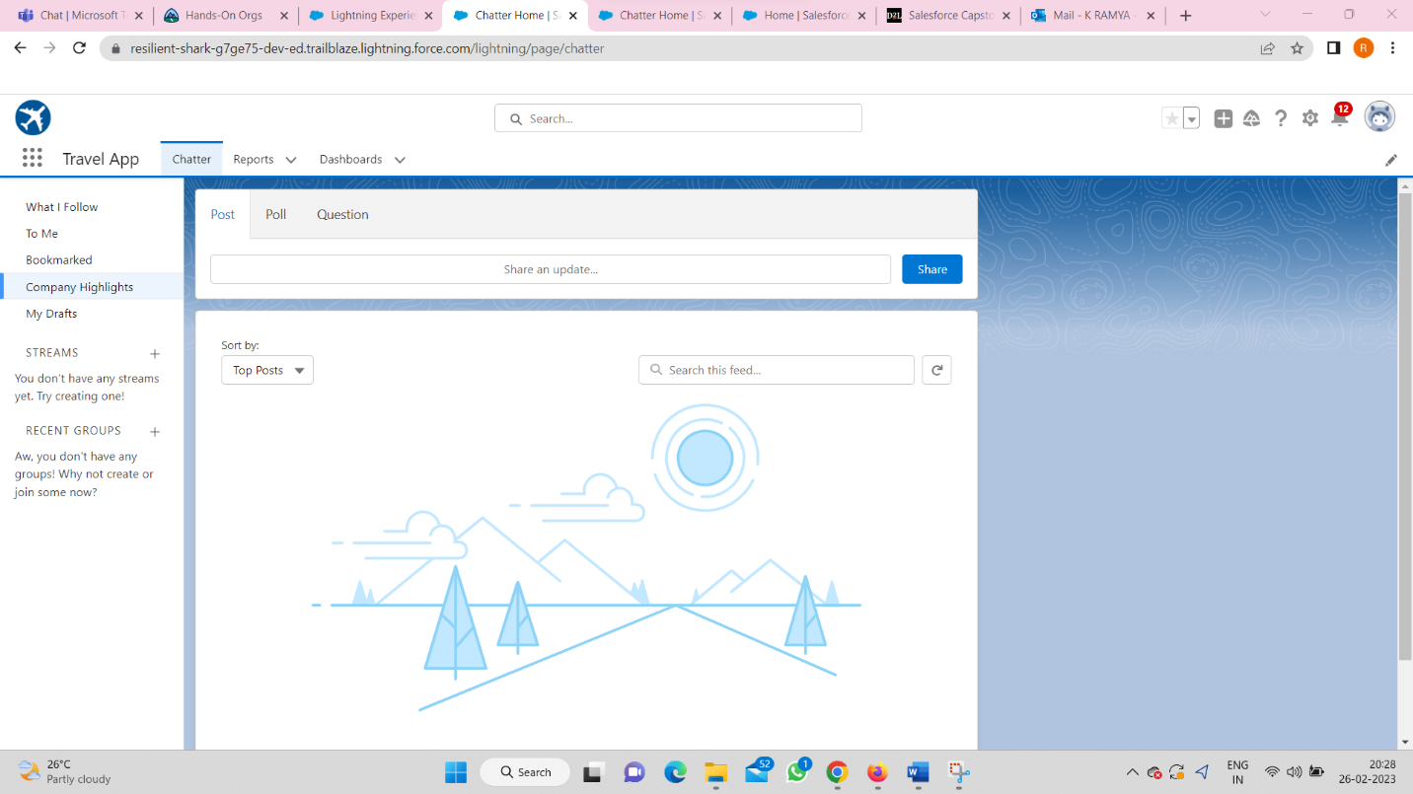
Module – 1 screenshots :

Slide 6
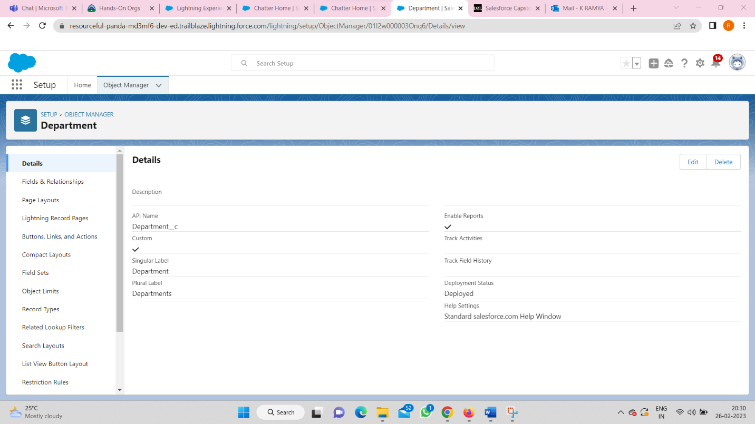
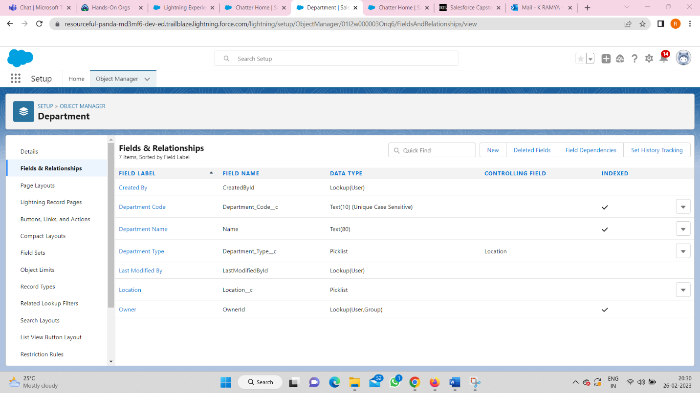
create custom objects and custom fields :

Slide 7
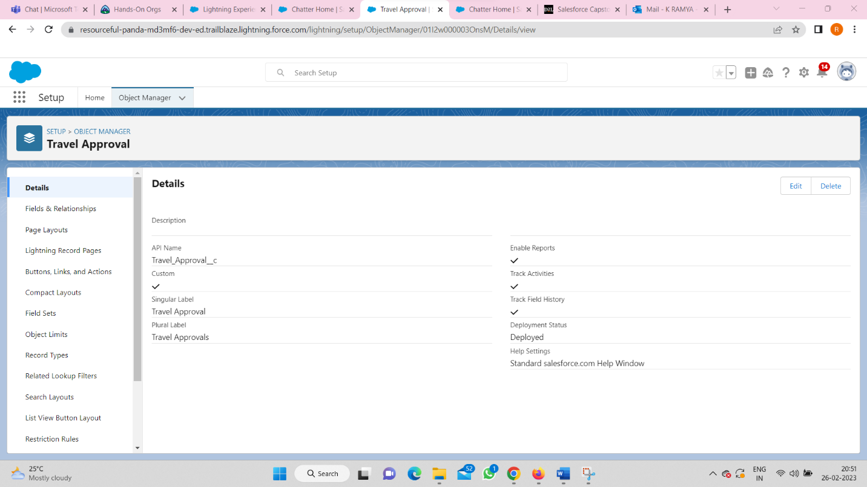
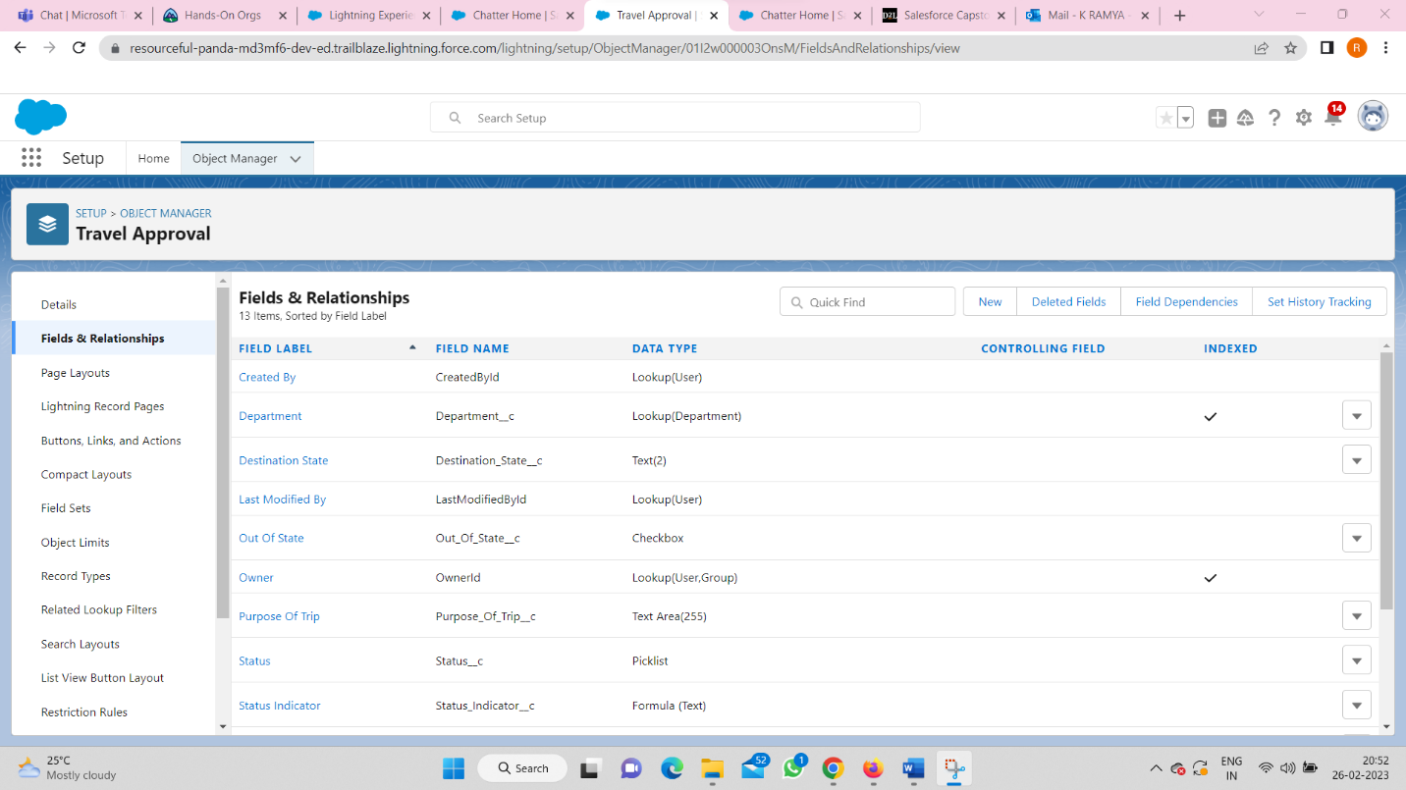
Custom objects and fields :

Slide 8
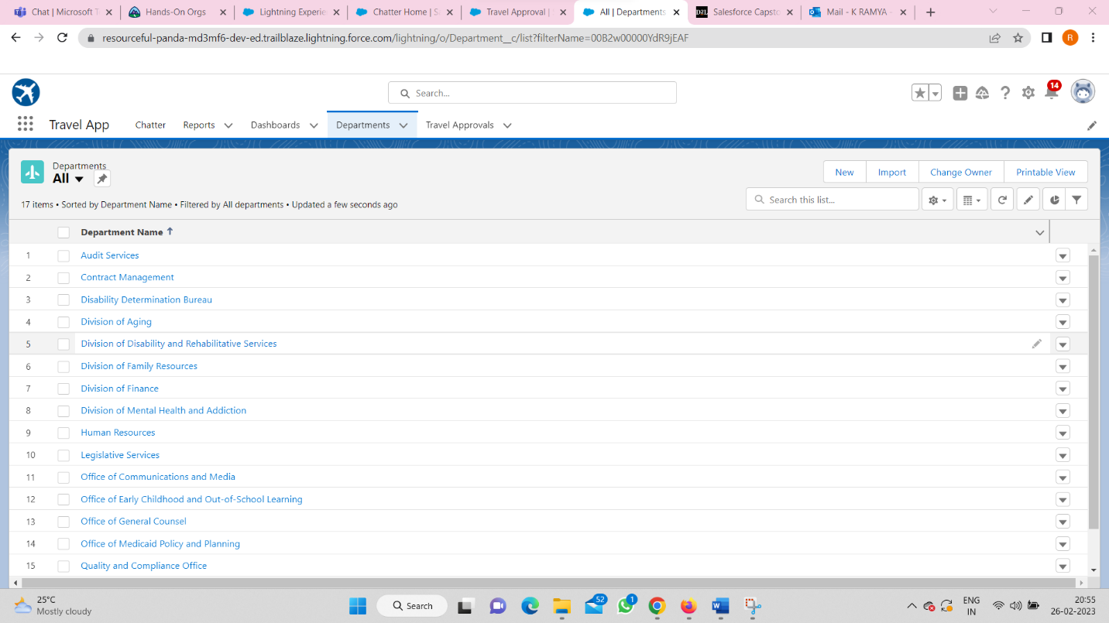
Importing the data of Departments from ‘Data Import Wizard’ :

Slide 9
Module – 2 :
This module focuses on the Automation and Analytics Tools to enhance your custom App development .
Enforce data integrity with validation rules
Automate business processes with flows
Define Approval Process for Travel Approval App
Create Reports to analyse Travel Approvals
Build Dashboards for Travel Approval Management

Slide 10
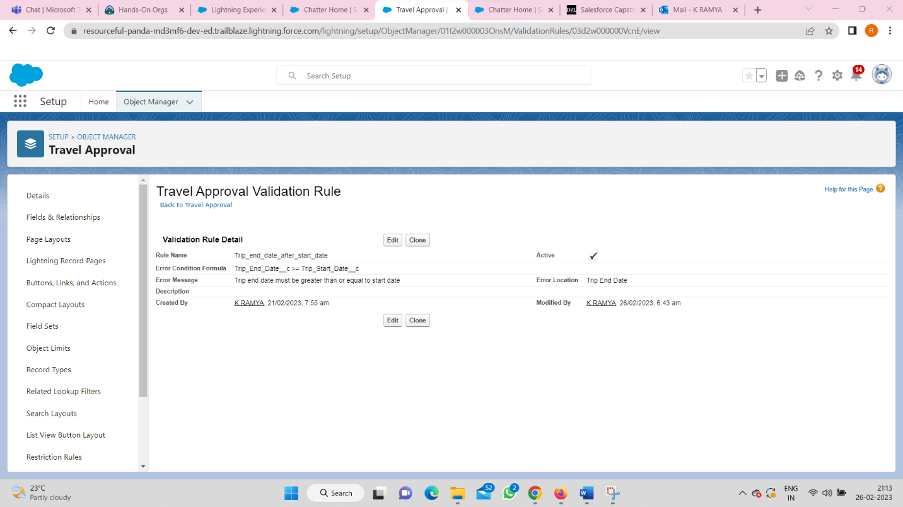
module- - 2 screenshots :
Validation Rule :

Slide 11
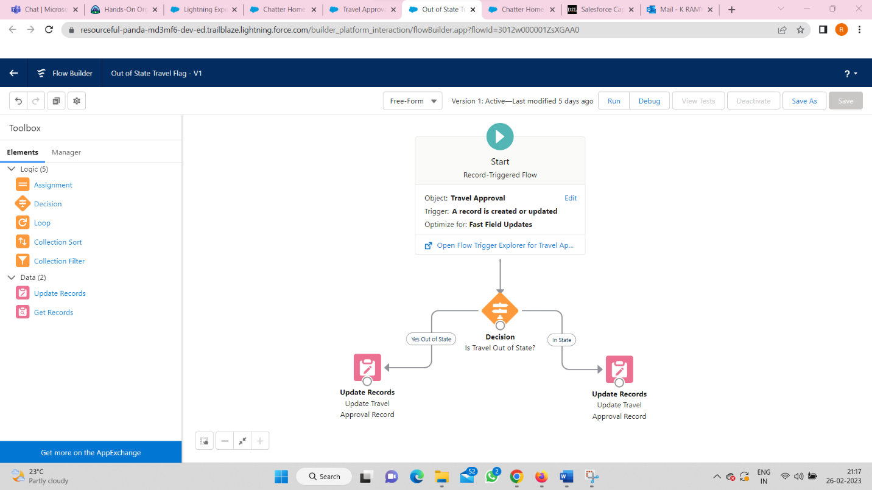
Created a flow :

Slide 12
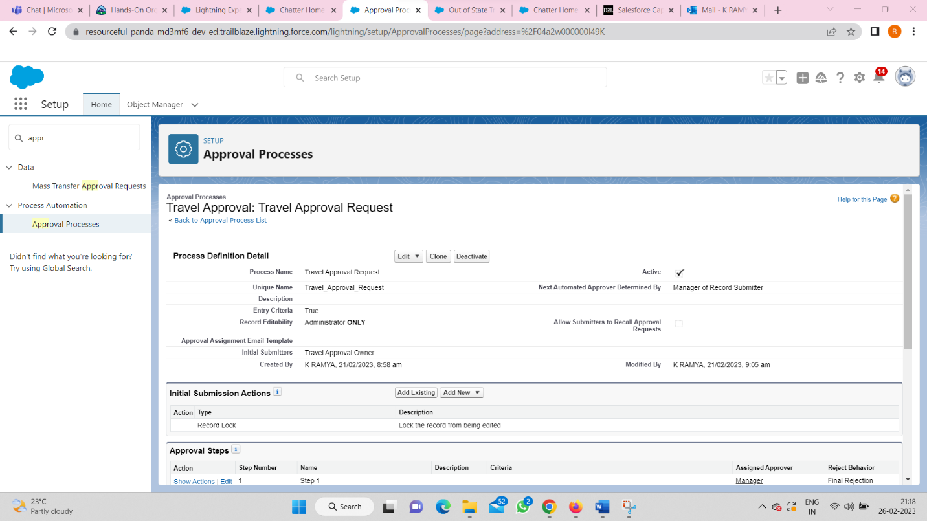
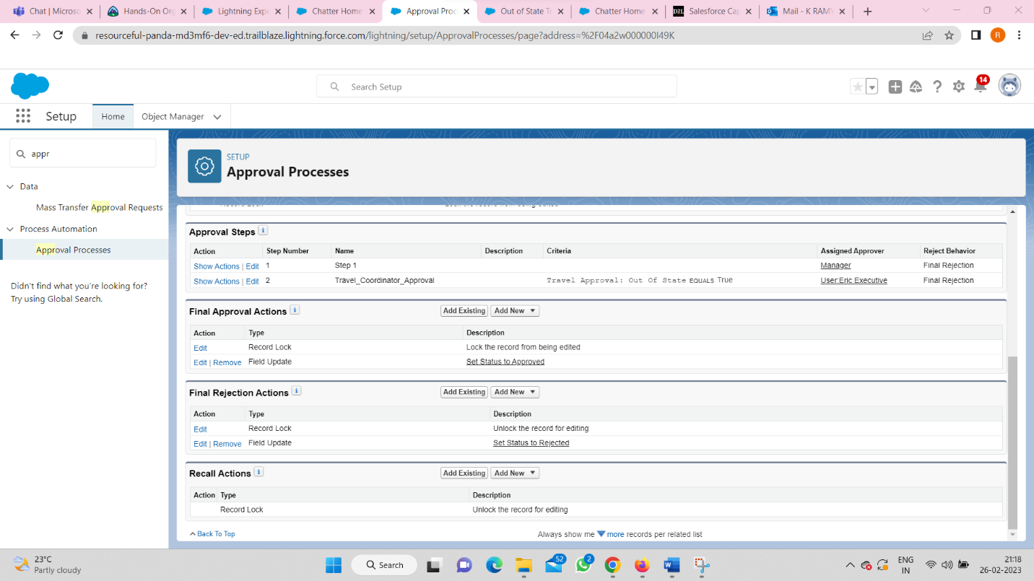
Approval Process :

Slide 13
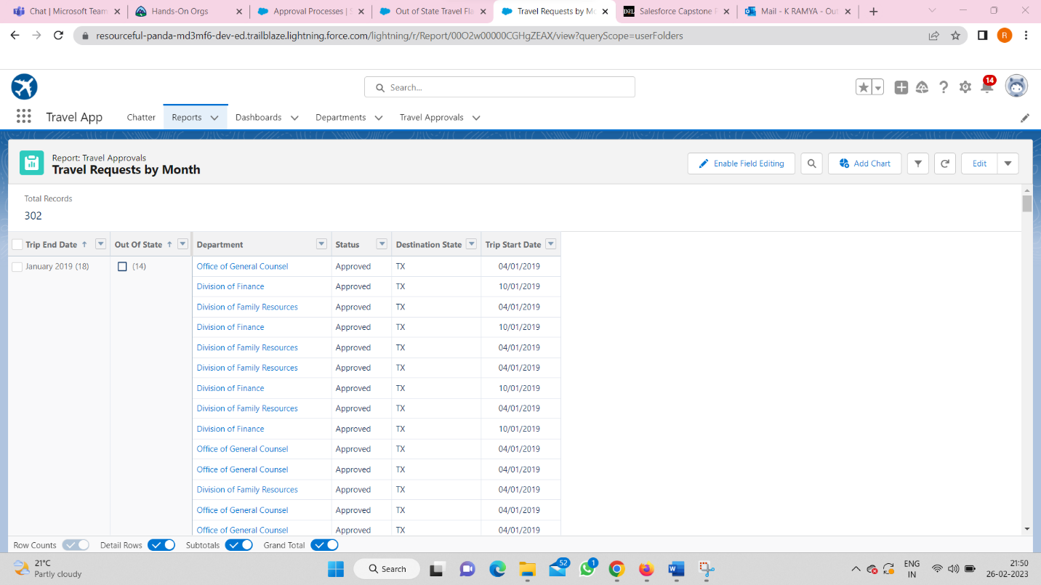
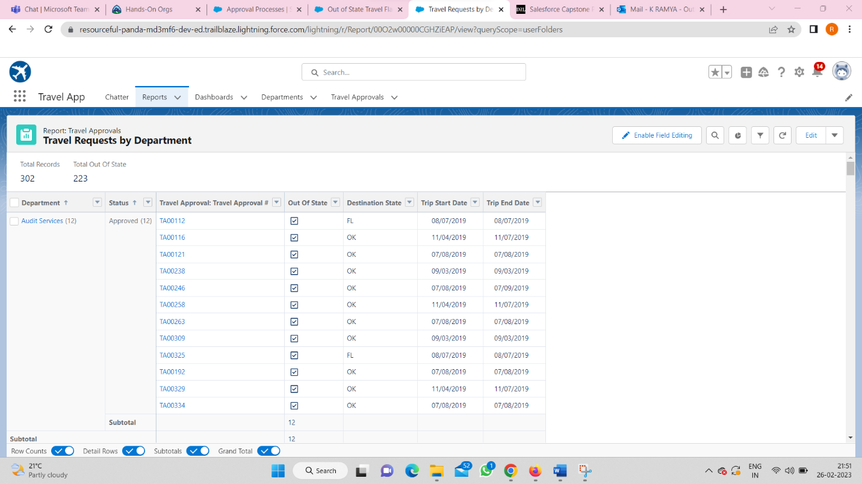
Reports :

Slide 14
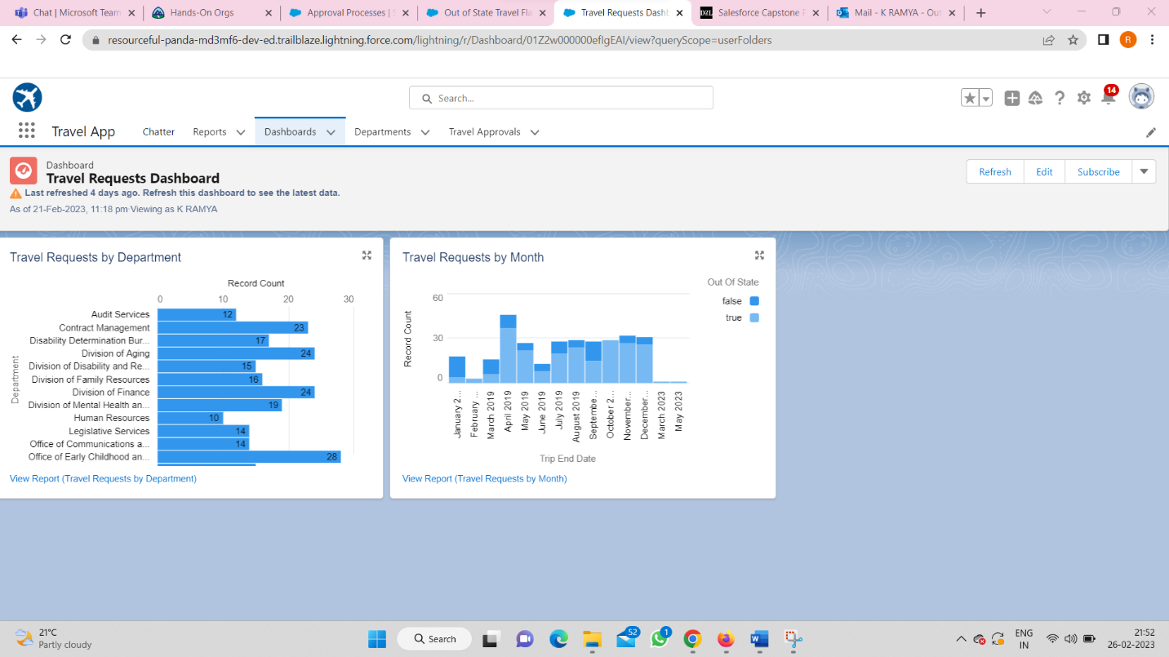
Dashboards :

Slide 15
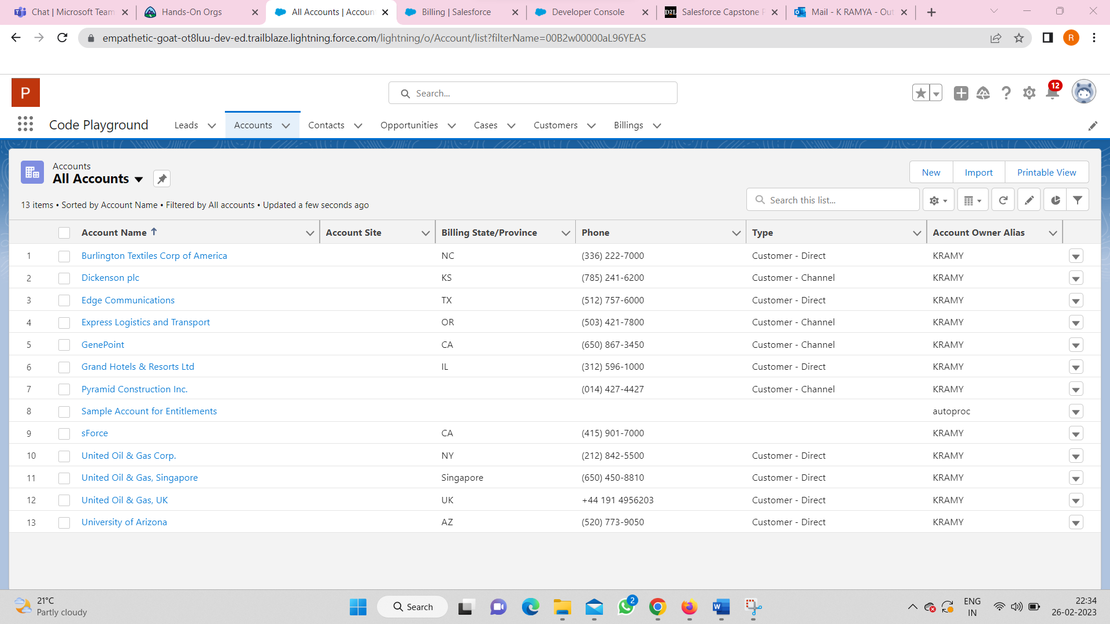
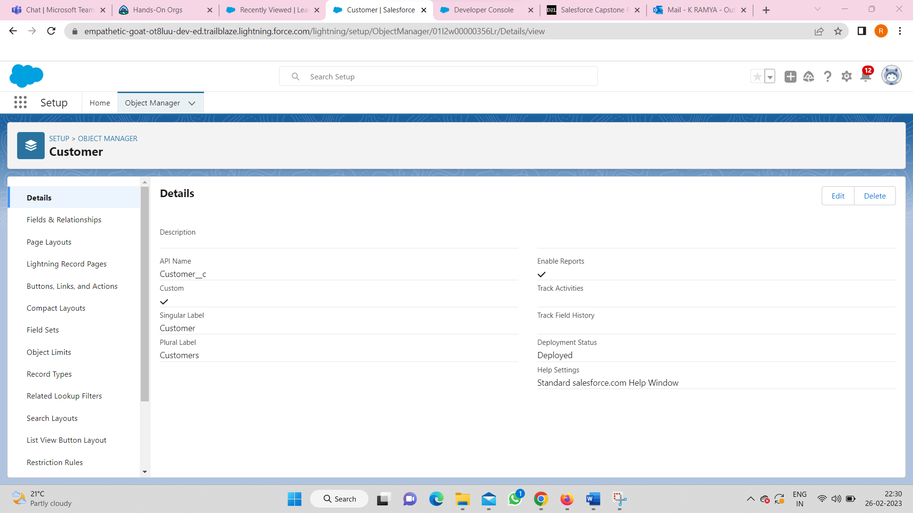
Module – 3 :

