Slide 1
Tracking in industrial environments using UWB
Reactive: Continuously tracking the object using a small tag offering an accuracy better than 30 cm in contrast to beacons (1-3 meters) or Wi-Fi (5-15 meters)) and responding to its movements.
Hard real time system: Failing to deliver the exact location of a person at the correct time can lead to extreme consequences.
Quasi-continuous: Latency time is very low (position request up to 100 times/second).
Dependability: It must work correctly when it is being used (High reliability) It must be available to work when needed. High availability). It must not endanger any human life (High safety).

Slide 2
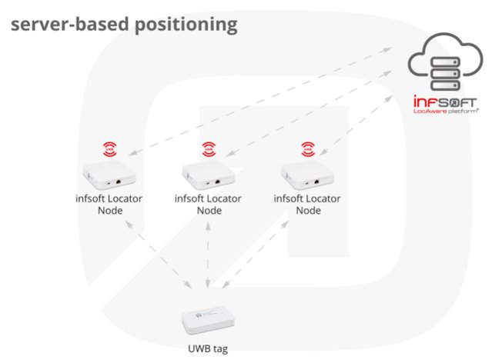
Distributed
The Tag measures the distance to several Nodes and sends the data back to them. The Node processes the data it receives and sends them to a Platform via Wi-Fi, Ethernet or UMTS. Here, the position is displayed for example on a map.

Slide 3
Distributed Systems
Heterogeneous System: Must be able to run in a variety of Operative Systems.
High Scalability: The system must remain efficient no matter the number of Nodes and Tags connected.
High Failure Handling: Corrective measures must be implemented to ensure the correct operation of the system.
High Concurrency: To ensure access to the location of tags from several sub-systems at the same time.

Slide 4



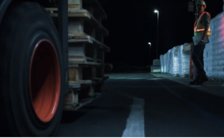

Slide 5

Airplane - Boeing 777

Slide 6
The characteristics
Reactive systems: Near-Earth Warning Systems (GPWS)
Real-time systems: Global Positioning System (GPS)
Continuous/discrete/hybrid systems: Continuous Climb and Descent Operations (CCOs and CDOs)
Dependable systems:
sealed modular component of an airplane
designed to be replaced quickly at an operation location for cost reduction
designed to a common specification
Distributed systems: Integrated avionics system

Slide 7
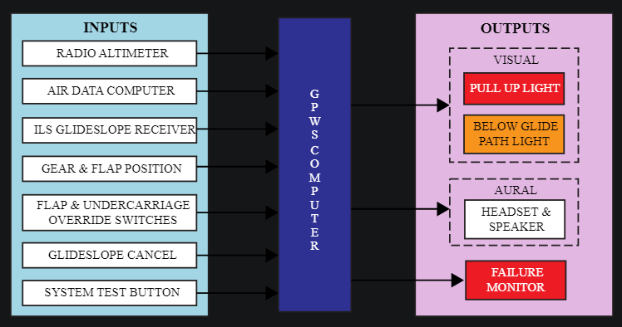
The architecture
Reactive Systems → GPWS
GPWS relied on the airplane’s radio altimeter, which determines the aircraft’s altitude by bouncing a radar signal off the ground and measuring the duration of the signal’s round trip.

Slide 8
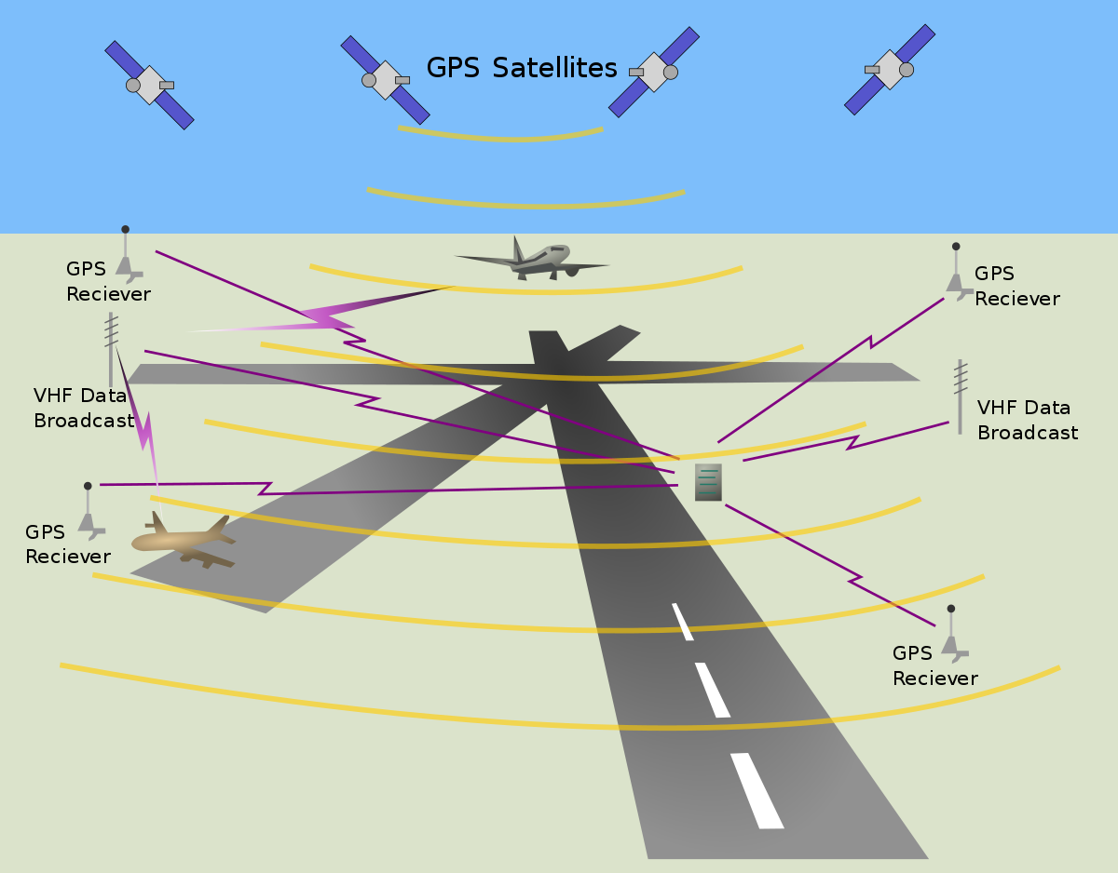
The architecture
Real-time systems → GPS
GPS satellites carry atomic clocks that provide extremely accurate time. The time information is placed in the codes broadcast by the satellite so that a receiver can continuously determine the time the signal was broadcast.

Slide 9
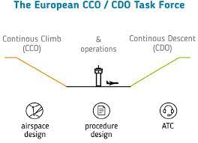
The architecture
Continuous systems → CCOs and CDOs
Aircraft applying CCO employ optimum climb engine thrust and climb speeds until reaching their cruising levels. With CDO, aircraft employ minimum engine thrust, ideally from top of descent and in a low drag configuration, prior to the final approach fix. Employment of these techniques reduces intermediate level-offs and results in time being spent at more fuel-efficient higher cruising levels, hence significantly reducing fuel burn and lowering emissions and fuel costs

Slide 10
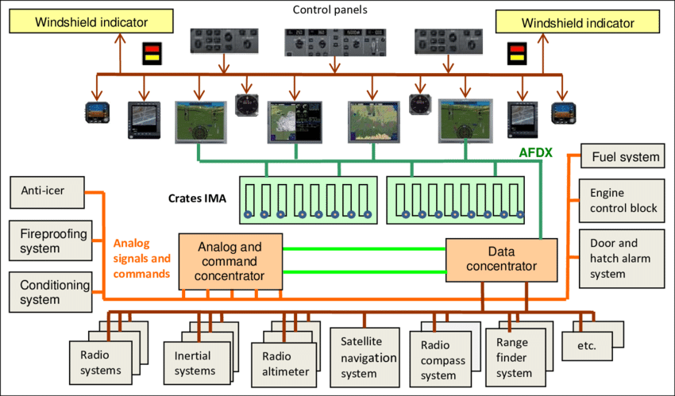
The architecture
Distributed systems -> Integrated avionics system
due to the use of distributed computer structure, standard aircraft internal data bus, fault tolerance technology and other more advanced technology, aviation integrated system flexible, adaptable and highly reliable, this system has gradually been used in some advanced fighter aircraft and high-performance civil aircraft.

Slide 11
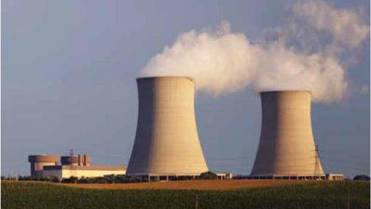
Industrial Automation in Nuclear Power Plants

Slide 12
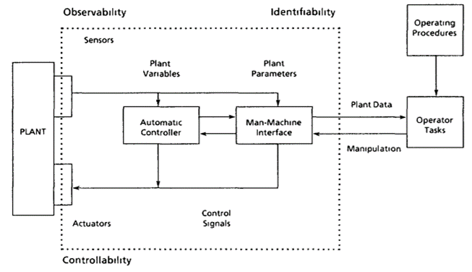
Industrial Automation
Automation is a technique of making an apparatus, process or a system to operate with self-acting or self-regulating mechanisms.
The industrial communication system helps monitor and operate entire production lines, manage power distribution, and control machines.
The most popular protocols for industrial communication are Fieldbus, PROFIBUS, EtherCAT, EtherNET

Slide 13
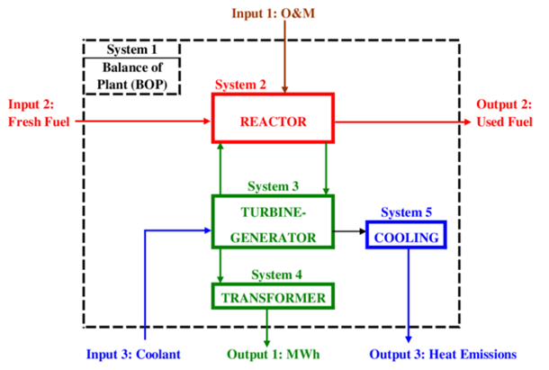
Characteristics
Reactive systems:
Nuclear power plants use closed loop control systems which to processes parameters such as temperature, pressure, flow etc.
Sensors are used to track these parameters and any change in these parameters, will be immediately notified to the technicians.
Real-time systems:
An automated equipment monitoring system helps observe the working condition of all the equipment in the manufacturing unit.
Sensors, cameras, and network can be used to observe the equipment from afar.
The monitoring system also helps diagnose any issues in the equipment and do the necessary repairs and services.

Slide 14
Characteristics
Dependable systems
Reliability: Industrial automation also helps increase and maintain consistent quality of the output. automated machines in the manufacturing industry have an error rate that is as low as 0.00001%.
Availability: Automation is employed to reduce scram (trip) frequency and hence improve plant availability by backup controls or limitation systems to prevent plant parameters reaching limits which would invoke protective action.
Safety: Using robots for loading and unloading materials or transferring huge machine parts reduce risks of accidents.
Industrial automation also keeps workers from going too close to the assembly lines, thereby improving safety.
Security: Using security automation, one can reduce the threat of hacking the access to the nuclear power plant or modifying the pre-set parameter data.

Slide 15
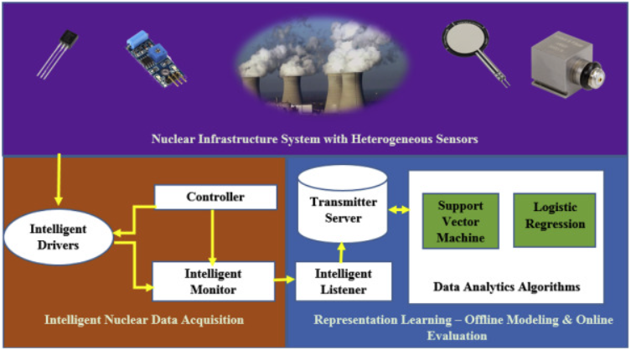
Characteristics
Distributed System
Data automation is based on accurate data integration and connectivity.
When accurate information is used in the production process, you can be assured of precise results.
AI and ML solutions help you get detailed data that can be analysed using data analytics tools to get accurate information. Also, they are scalable and self-learning.

Slide 16
References
https://www.sciencedirect.com/science/article/pii/S1738573319306783
https://www.researchgate.net/publication/334340498_Economics_of_Nuclear_Power
https://utthunga.com/blogs/top-10-advantages-of-industrial-automation/

Slide 17


Slide 18
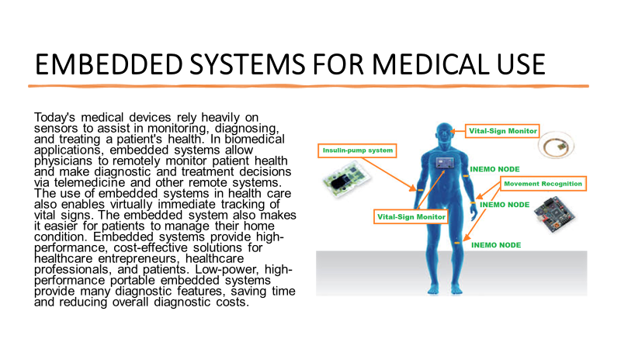

Slide 19
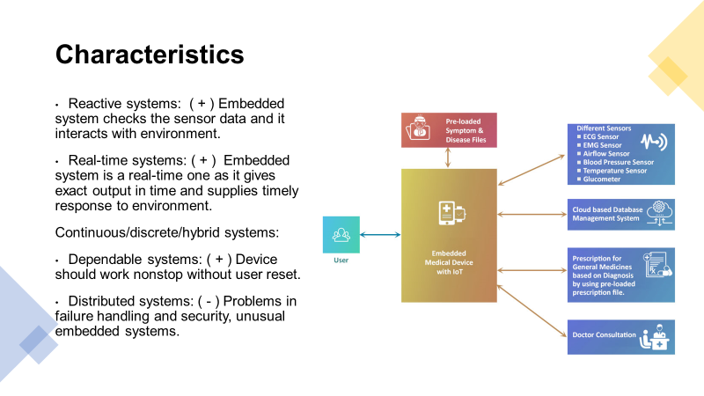

Slide 20
