Slide 1
Python Data Types

Slide 2
Session Agenda
Data Types
Numbers
Strings
Lists

Slide 3
DATA TYPES
Data types are fundamental in programming because they provide structured ways to handle and organize data.
They help in managing, organizing and processing various data elements efficiently .
Data types allow you to store multiple values in a single variable, making it easier to perform operations on groups of data.
DATA TYPES
NUMBERS
STRING
LISTS
SETS
DICTIONARY
TUPLES

Slide 4
DATA TYPES
Numbers:
Used to store numeric values
Example: a=10
Strings:
Used to store sequences of characters, enclosed in quotes (' ' or " ").
Example: str=‘a’ or str=‘apple’
Lists:
Store multiple values in a single variable.
Lists can contain duplicate elements.
Defined using square brackets ([ ]).
Example: my_list = [ 1 , ‘a’ , “123” , ‘a’ ]

Slide 5
DATA TYPES
Set:
Store multiple values in a single variable.
Do not allow duplicate elements.
Defined using curly braces { }.
Example: my_set = {1,2,3,5,7}
Tuple:
Similar to lists, but immutable once defined.
Allow duplicate elements .
Defined using parentheses ( ).
Example: my_set = (‘a’ , ‘b’ , ‘c’ , ‘d’ , ‘a’)
Dictionary:
Store data in key-value pairs.
Defined using curly braces { }
Keys and values separated by a colon : .
Example : dict = {'name': 'Alice', 'age': 25}

Slide 6
NUMBERS
Built-in data types in Python, used to store numeric values
Divided into three categories - Integer , float , complex
Immutable data type ( values cannot be changed once assigned)
Supports type casting
NUMBERS
Integers
Float
Complex
Example: a=10.0
Example: a=3+4j
Example: a=10

Slide 7
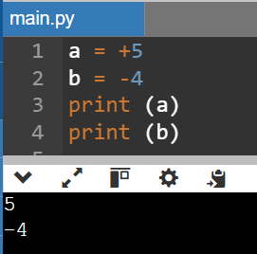
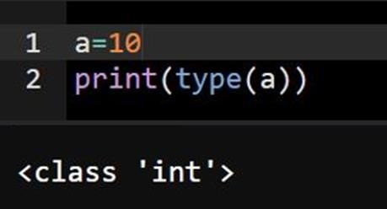
INTEGER
int data type is used to represent integer values.
Integers are whole numbers without a fractional component.
Can be a positive or negative value
DECLARATION AND INITIALIZATION
Variable a is declared with an positive integer value and b with negative integer value
type () is a built –in function used to determine the data type

Slide 8
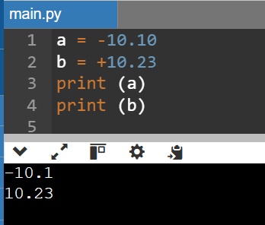
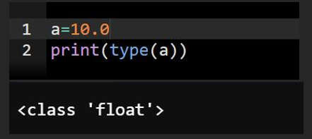
FLOAT
Float data type is used to represent floating-point numbers, which are numbers with a decimal point
Can be a positive or negative value
DECLARATION AND INITIALIZATION
Variable a is declared with an positive float value and b with negative float value

Slide 9
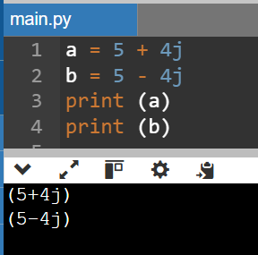
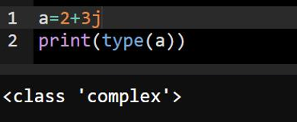
COMPLEX NUMBERS
The complex data type is used to represent complex numbers, which have a real part and an imaginary part.
Complex number contains a real part and an imaginary part. The imaginary part is denoted by a j or J.
DECLARATION AND INITIALIZATION
Variable a is declared with a positive complex number and variable b with a negative complex number

Slide 10
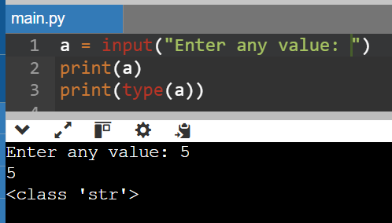
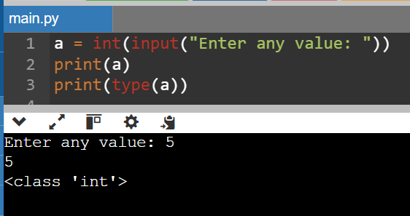
GETTING INPUT FROM USER
In Python , user can enter the input using the input() function.
By default, the input() returns a string.
To enter other data type we need to convert using its data type function.

Slide 11
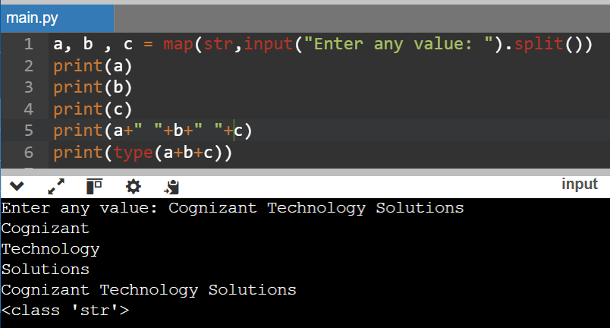
GETTING INPUT FROM USER
To get multiple value in one line we use map() and split().
map() function is used to apply a function to each value.
split() function is used to split the string based on a separator (by default it is whitespace).

Slide 12
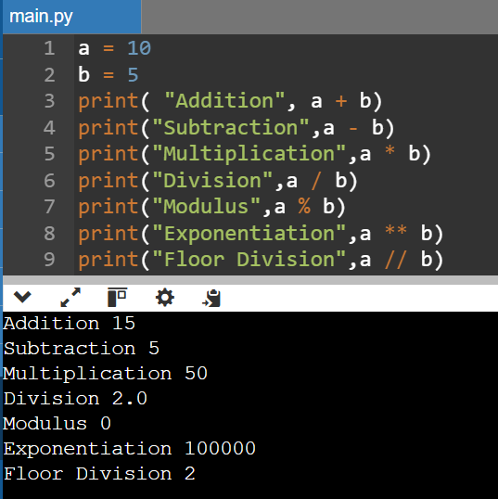
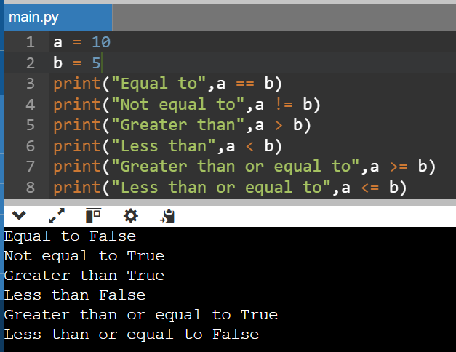
OPERATORS
Arithmetic Operators
These operators perform basic mathematical operations.
Comparison Operators
These operators compare two values and return a Boolean result.

Slide 13
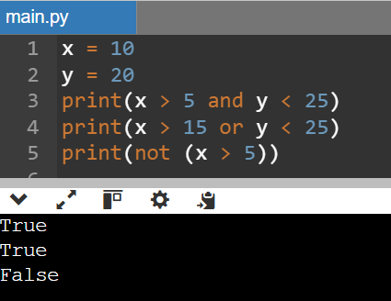
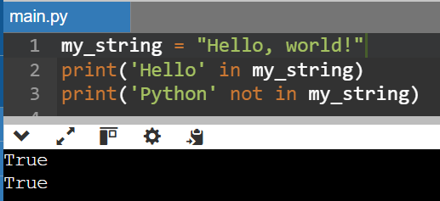
OPERATORS
Logical Operators
These operators are used to combine conditional statements.
Membership Operators
Test if a sequence contains a certain value using string
The and operator returns True if both conditions are true.
The or operator returns True if at least one of the conditions is true.
The not operator returns True if the condition is false, and False if the condition is true.

Slide 14
STRINGS
Sequence of characters enclosed in
Single quotes ‘ ’
Double quotes “ “
Used to represent textual data such as words, sentences
Immutable data type
Strings are sequence of characters and each characters can be accessed by its
index and its always starts with 0 eg: text = “Hello World”
TEXT | “H” | “e” | “l” | “l” | “o” | “ “ | “W” | “o” | “r” | “l” | “d”
INDEX | 0 | 1 | 2 | 3 | 4 | 5 | 6 | 7 | 8 | 9 | 10

Slide 15
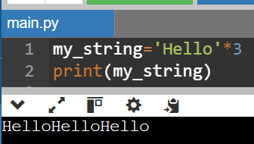
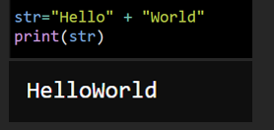
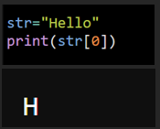
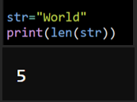
STRINGS OPERATIONS
Concatenation - The process of combining two or more strings into a single string using the + operator. Example :
Repetition - It allows you to repeat a string a specified number of times using the * operator. Example:
Indexing - Indexing is used to access individual characters of a string. Example :
Length - The len() function is used to get the length of a string — the number of characters it contains. Example :

Slide 16
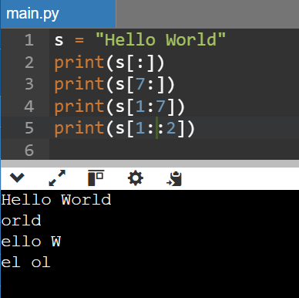
STRINGS OPERATIONS
String Slicing String slicing is used to get the specific parts of a string by using start, end and step values. Syntax of String Slicing in Python substring = string[start : end : step] EXAMPLE:
TEXT | “H” | “e” | “l” | “l” | “o” | “ “ | “W” | “o” | “r” | “l” | “d”
INDEX | 0 | 1 | 2 | 3 | 4 | 5 | 6 | 7 | 8 | 9 | 10
This prints the entire string "Hello World"
This prints the substring starting from index 7 to the end of the string
This prints the substring from index 1 to index 6
This prints every second character of the string starting from index 1

Slide 17
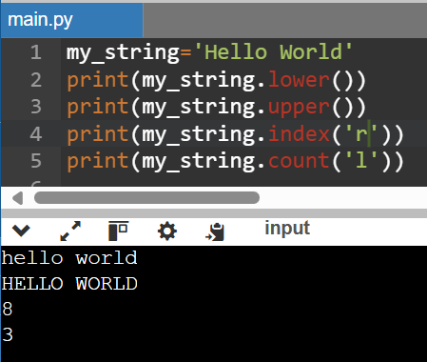
STRINGS METHODS
METHOD | DESCRIPTION | SYNTAX
lower() | Converts all characters to lowercase. | str.lower()
upper() | Converts all characters to uppercase. | str.upper()
index(sub) | Like find(), but raises an error if the substring is not found. | str.index(sub)
count(sub) | Counts the occurrences of a substring. | str.count(sub)
INPUT
OUTPUT

Slide 18
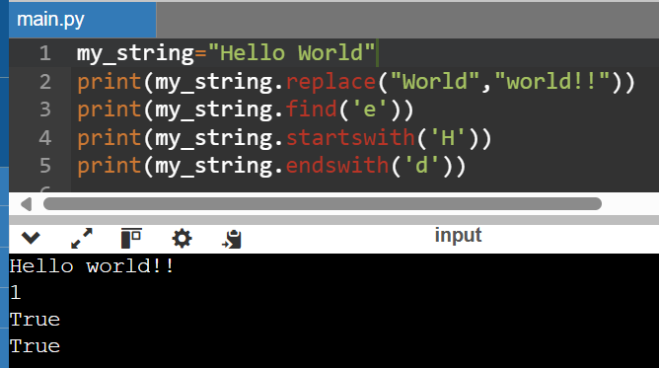
STRINGS METHODS
METHOD | DESCRIPTION | SYNTAX
replace(old, new) | Replaces a substring with another. | str.replace(old, new)
find(sub) | Returns the first index of the substring. Returns -1 if not found. | str.find(sub)
startswith(sub) | Checks if the string starts with a specific substring. | str.startswith(sub)
endswith(sub) | Checks if the string ends with a specific substring. | str.endswith(sub)
INPUT
OUTPUT

Slide 19
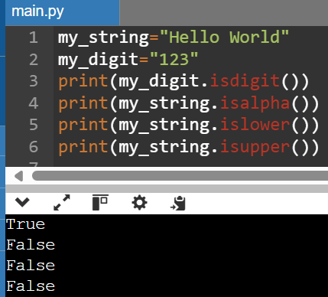
STRINGS METHODS
METHOD | DESCRIPTION | Syntax
isdigit() | Returns True if all characters are digits. | str.isdigit()
isalpha() | Returns True if all characters are alphabetic. | str.isalpha()
islower() | Checks if all characters are lowercase. | str.islower()
isupper() | Checks if all characters are uppercase. | str.isupper()
INPUT
OUTPUT

Slide 20
LIST
Ordered sequence of items.
A list can contain different data types ( integer, float, string)
Allows duplicate values
Created inside the square brackets [ ] , each value separated by commas
Mutable data type
The values in the list can be accessed using their indexing position
Also , a list can have another list inside it
Example : my_list = [ “abc” , 12 , ‘a’ , 10.2 , [ 5 , 4, ”abc” ] ]

Slide 21
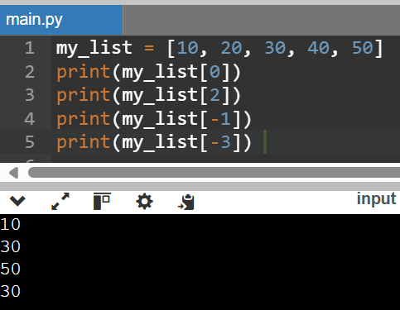
ACCESSING LIST ELEMENTS
List items can be access by their index position.
Python uses zero-based indexing, so the first element is at index 0.
Negative indexing
Negative indexing means start from end , -1 refers to the last item , -2 refers to the second last item etc.
Positive indexing | 0 | 1 | 2 | 3 | 4
my_list | 10 | 20 | 30 | 40 | 50
Negative indexing | -5 | -4 | -3 | -2 | -1

Slide 22
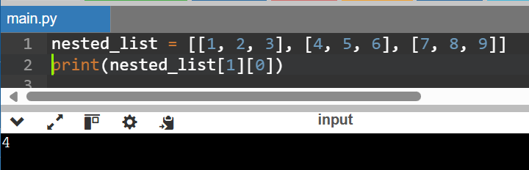
ACCESSING LIST ELEMENTS
Nested List
A list that contains another list as element.
To access a nested list, we can use multiple indices.
The first index select the sub-list from the main list.
The second index selects the specific elements from the sub-list
INDICES |  | Second index
 |  | 0 | 1 | 2
First index | 0 | 1 | 2 | 3
 | 1 | 4 | 5 | 6
 | 2 | 7 | 8 | 9

Slide 23
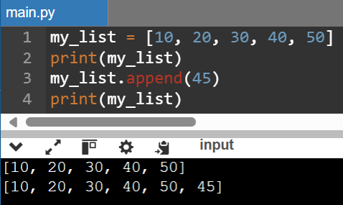
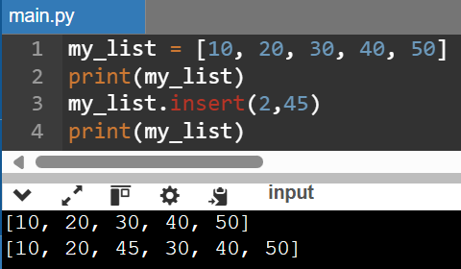
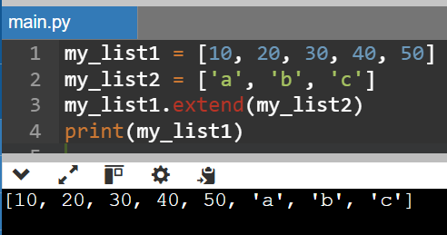
ADDING ELEMENTS IN THE LIST
Adding elements to a list can be done using methods like append(), insert(), or extend().
append() append() method is used to add a single item to the end of list. This method modifies the original list and does not return a new list.
insert()
insert() method inserts an item at a specific index in a list.
extend()
extend() method is used to add items from one list to the end of another list. It is efficient way to merge two lists or more list at once.

Slide 24
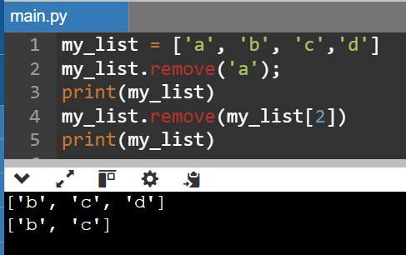
DELETING ELEMENTS IN THE LIST
remove()
The remove() method removes the first occurrence of a specified value from the list.
Original list
Index | 0 | 1 | 2 | 3
my_list | a | b | c | d
Remove ‘a’ from the list
Index | 0 | 1 | 2
my_list | b | c | d
Remove the element in the 2nd position from the list
Index | 0 | 1
my_list | b | c

Slide 25
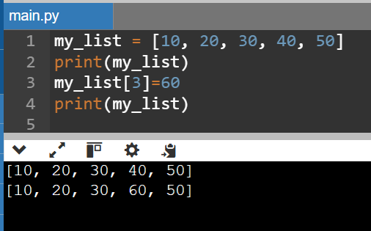
MODIFYING A LIST
Modifying the list involves accessing an element by its index and assigning a new value.
Original list
Index | 0 | 1 | 2 | 3 | 4
my_list | 10 | 20 | 30 | 40 | 50
Modified list
Index | 0 | 1 | 2 | 3 | 4
my_list | 10 | 20 | 30 | 60 | 50

Slide 26
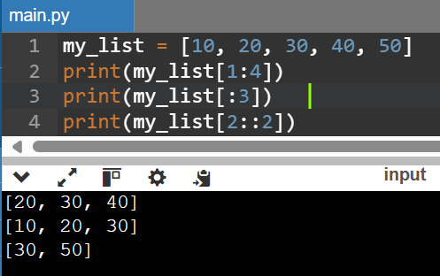
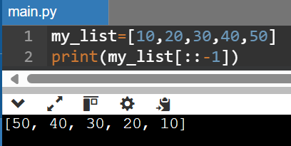
LIST METHOD
Slicing
Slicing is used to access a range of elements.
Slicing is also used to reverse a list [ : :-1]
Syntax : list= list[start : end : step]
Start is empty so by default it with start from 0 position
End is empty so it will take the whole list
Step is -1 to move backward through the list

Slide 27
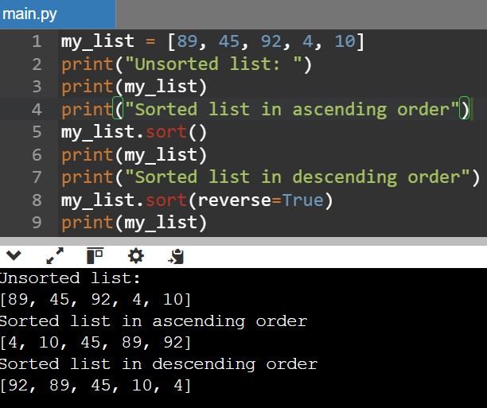
LIST METHODS
sort()
It is used to sort in python or the elements of a list in ascending order by default.
The sort() method modifies the original list in-place, meaning it rearranges the elements directly without creating a new list.
To sort() in descending order we need mention reverse = true.
INPUT
OUTPUT

Slide 28
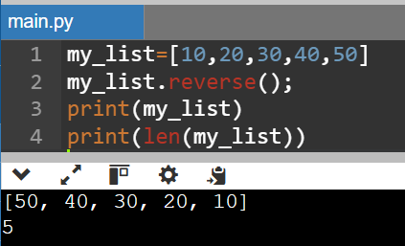
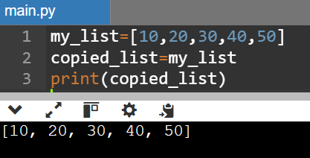
LIST METHODS
reverse()
It is used to reverse the order of the element in a list .
The reverse() method modifies the original list in-place, meaning it rearranges the elements directly without creating a new list.
len()
It is used to count the number of items in a list.
copy()
The copy() method will create a new list with the same elements as the original list
The new list and the original list is stored in different memory location

Slide 29
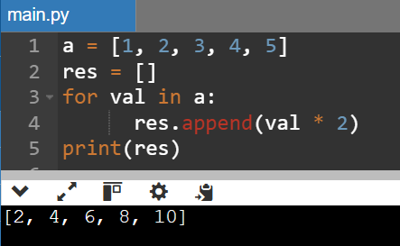
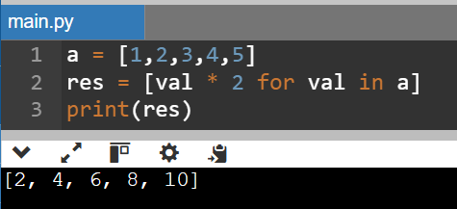
LIST COMPREHENSIONS
They offer a shorter syntax when you want to create a new list based on the values of an existing list.
List comprehensions helps you write looping statement with condition statement in single line.
Syntax:
newlist = [expression for item in iterable if condition] Here, for every item in list, execute the expression if the condition is True.
LIST COMPREHENSIONS
FOR LOOP

Slide 30
Thank you

