Slide 1
covid_Data_visualisation
File created on: 9/14/2021 9:22:22 PM

Slide 2
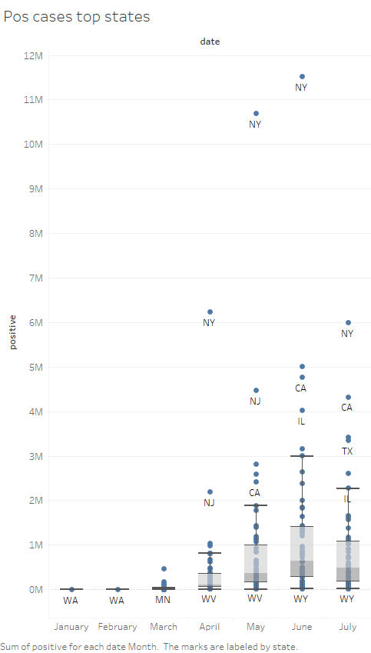

Slide 3
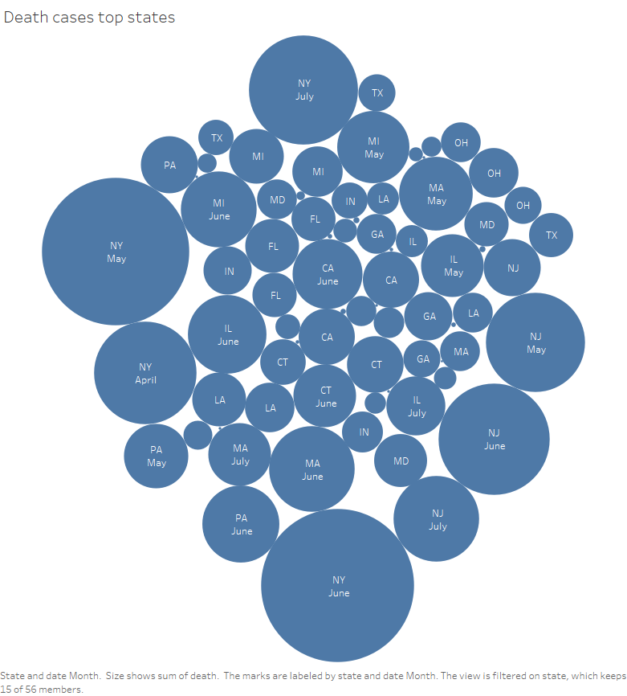

Slide 4
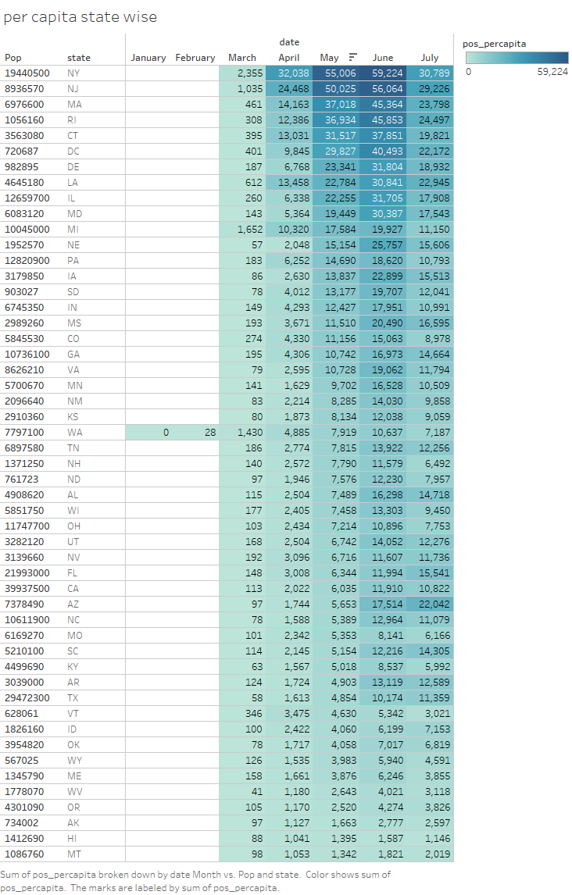

Slide 5


Slide 6
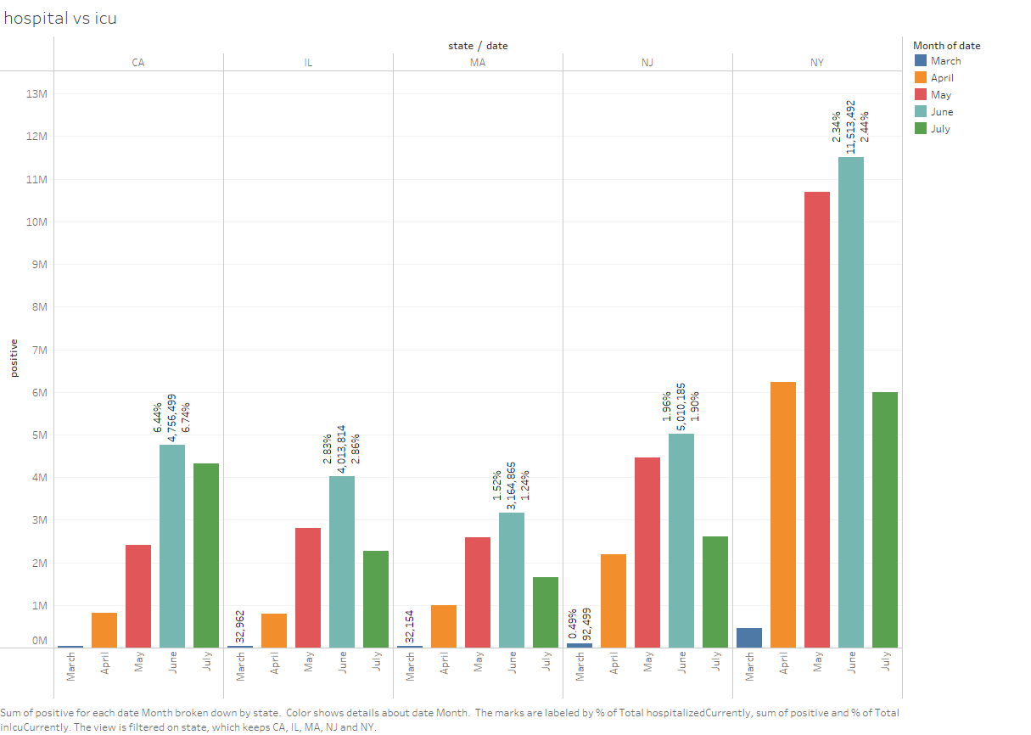

Slide 7
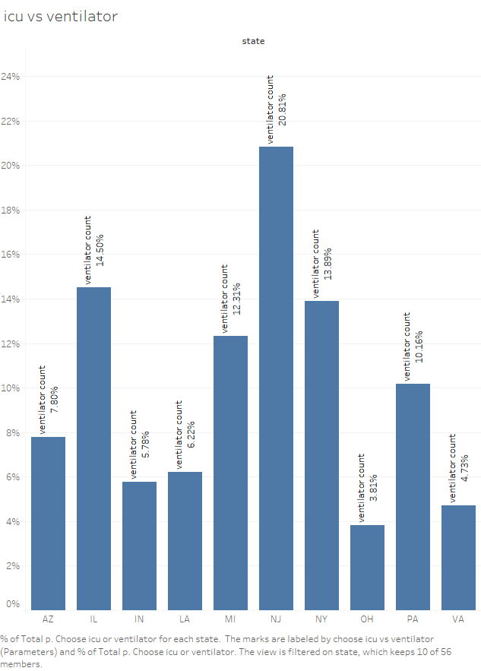

Slide 8
