Slide 1


Ethics in
Information Security
Sony-Data Breach
Ramya Perumalla
ID:11717649

Slide 2
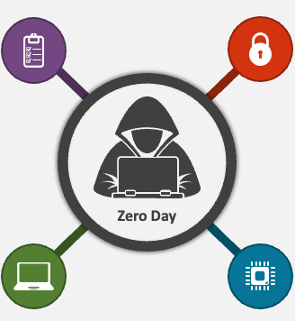
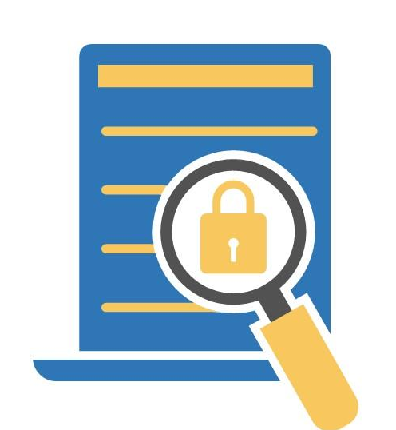

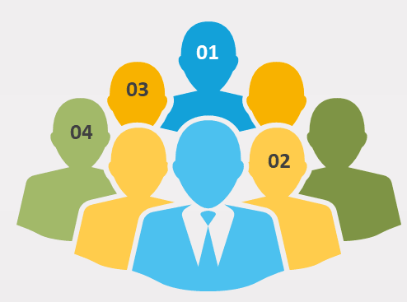
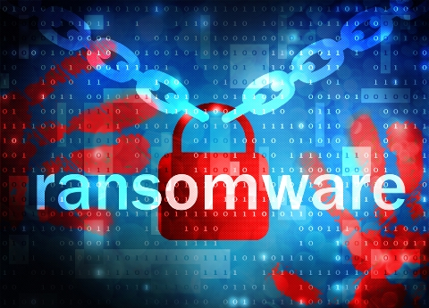
SONY DATA BREACH (2023)
COMPANY .
Sony Interactive Entertainment (SIE).
HOW THEY DID IT? ,
Zero-day vulnerability in file transfer platform.
WHAT HAPPENED?
Personal information of 6,791 employees was exposed.
HOW THEY GOT CAUGHT?
Discovered unauthorized downloads and took action.
MAIN PLAYERS .
Attackers, victims, Sony Interactive Entertainment.
FUN FACT .
Breach leveraged Clop ransomware flaw.
https://firewalltimes.com/sony-data-breach-timeline/

Slide 3
Legal & Ethical Responsibilities
Legally protect, ethically support personal data.
Promptly notify, ensure compliance, prevent breaches.
Transparently uphold moral duty, safeguard data.
Face legal liability, ensure due care.
Provide restitution, conduct thorough investigations.
Address vulnerabilities, ensure legal compliance.
https://www.theverge.com/2023/10/5/23905370/sony-interactive-entertainment-security-breach-confirmation

Slide 4
security laws/rules
CCPA, HIPAA, GDPR: Protect, safeguard, comply.
Notify promptly, implement security measures.
Face penalties for non-compliance.
Breach impacts EU protection, notify promptly.
Non-compliance incurs hefty fines, ensure security.
Maintain GDPR compliance, address scrutiny.
https://techwireasia.com/09/2023/is-my-account-compromised-what-sony-customers-should-know/

Slide 5
Ethics in Information Security
Student: Respect laws, avoid dishonesty, report.
Professional: Protect, adhere, report, update, act.
Unethical causes: Pressure, awareness, culture, greed, policies.
Snowden: Hero or traitor, ethical dilemma.
Ethical considerations: Public interest, confidentiality, transparency.
Debate: Whistleblower or criminal, perspectives vary.
https://www.theguardian.com/world/2013/jun/09/edward-snowden-nsa-whistleblower-surveillance

