Slide 1


Information Security
Essentials
Sony-Data Breach
Ramya Perumalla
ID:11717649

Slide 2




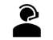

=
Information security Career
Qualification & Requirements
Bachelor's, advanced degrees, technical skills, certifications, trends, updates.
Certifications .
Foundational certification lead to specialization, career-aligned.
Occupational Outlook .
Growing demand, diverse roles, high pay.
Interviewing .
Research, prepare, highlight, emphasize, showcase, practice.
Role Type .
Start entry-level, learn, network, grow.
Sources of information .
Industry reports, networking, job platforms, updates, forums

Slide 3
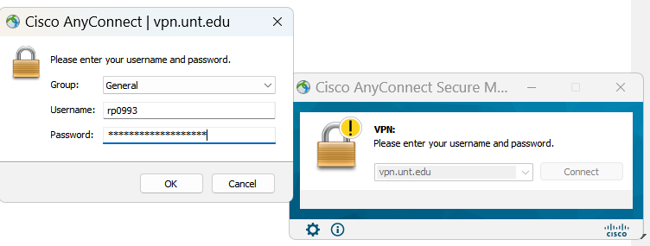
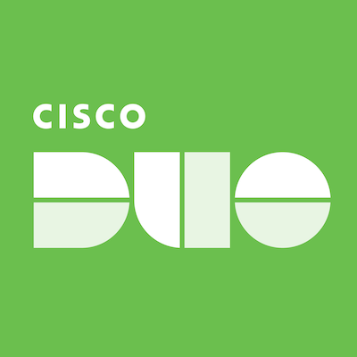
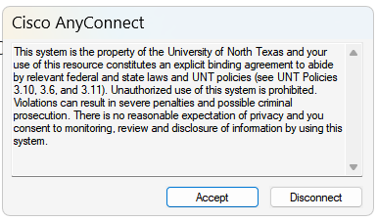
Access control & UNT VPN Login
Access control: Manage system entry, user permissions.
UNT VPN login: Involves 3 access controls.
Identification, authentication, authorization.
Identification
Authentication
Authorization

Slide 4
Single Bastion Hosts
External gateway with limited services.
Strong security measures enforced rigorously.
Thorough logging and monitoring implemented.
Possible honeypot features included.
Regular rotation enhances security protocol.
Reduced attack surface, simplified management.

Slide 5
Security Enhancements: Vital Tools
Firewall: Blocks unauthorized access attempts effectively.
Filters traffic, prevents malicious connections.
VPN: Encrypts connections, secures data transmission.
Provides secure remote access channels.
Access Control: Restricts unauthorized system access efficiently.
Limits access to authorized users only.
https://securityaffairs.com/151982/data-breach/sony-sent-data-breach-notifications-to-about-6800-individuals.html

