Slide 1


Information Security Management
Sony-Data Breach
Ramya Perumalla
ID:11717649

Slide 2
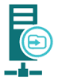
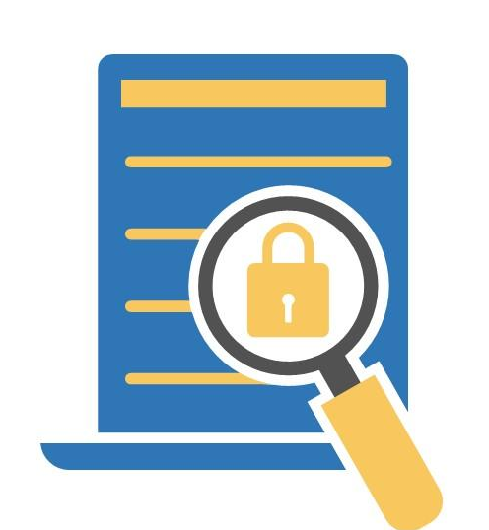


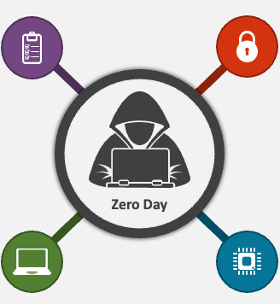

SONY DATA BREACH (2023)
WHAT HAPPENED? .
6,791 employees' personal data was compromised.
Software Involved .
MoveIt Transfer Platform.
When happened(Timelines).
Occured: May 28, 2023.
Detected: june 2nd 2023.
Who is responsible? .
Clop Ransomware group.
HOW THEY DID IT?
A file transfer platform's zero-day vulnerability.
Impact .
Employee families, reputation, legal liabilities

Slide 3
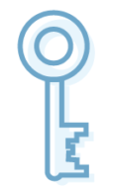
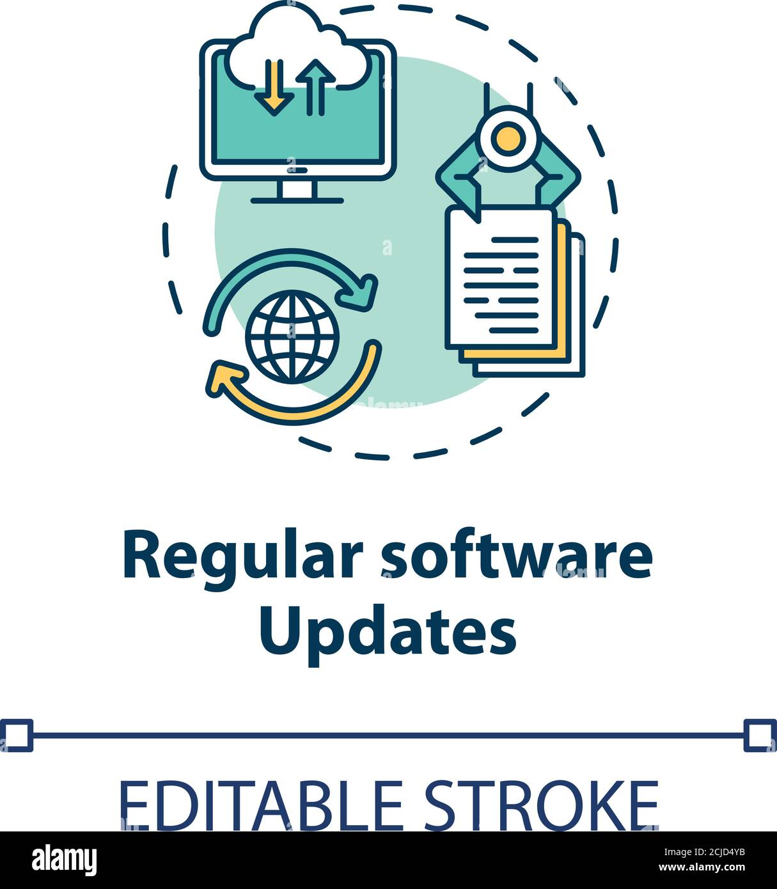
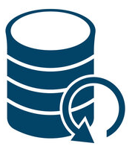
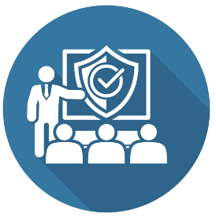


Preventive Measures
Software Updates .
Timely updates, automated monitoring, robust patching.
Access Controls .
Enforce least privilege, strong access controls.
Data Backup & Recovery .
Robust backup procedures, regular validation.
Employee training .
conducting Security awareness sessions, phishing protection.
Incident Response & Planning
Develop response plans,
real-time monitoring
Data Encryption .
Develop encryption policies, implement encryption protocols.

Slide 4
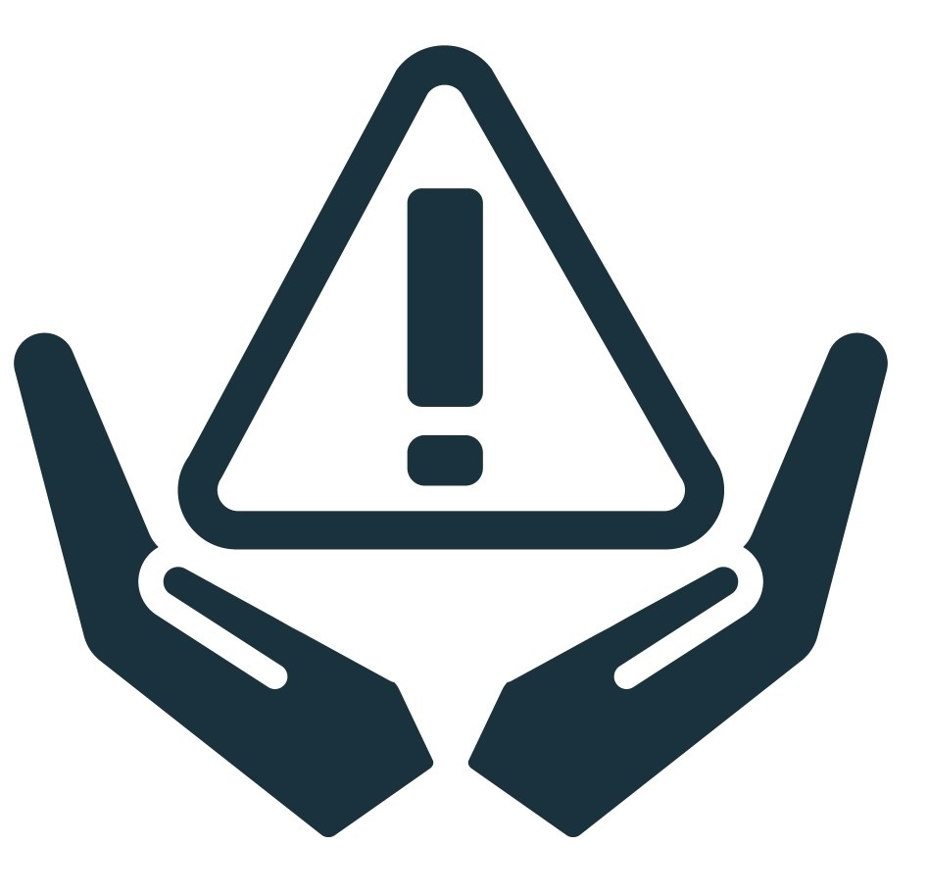


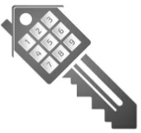


Learnings from ISM
C.I.A. Traid Principles .
Importance of Confidentiality, Integrity, Availability.
Risk Management .
Identify, Analysis, evaluate,Impact,treatment.
Data Responsibilities .
Data owners, data custodians, data trustee, data users.
Access Controls .
Identification,Authentication, Authorization, Accountability, VPNs, Firewalls.
Security Policies .
EISP , ISSP, SysSP, SETA.
Cryptography .
Encryption, decryption, algorithms, steganography.

Slide 5
References
https://variety.com/2023/digital/news/sony-data-breach-hack-6800-employees-family-members-1235747145/
https://www.theverge.com/2023/10/5/23905370/sony-interactive-entertainment-security-breach-confirmation
https://securityaffairs.com/151982/data-breach/sony-sent-data-breach-notifications-to-about-6800-individuals.html
https://firewalltimes.com/sony-data-breach-timeline/

