Slide 1
E-Money
Ramya Radhakrishnakumar
Sushant Sharma
Vinokkumar Uthayakumar

Slide 2
PROPOSAL
The main aim of this project is to reduce the use of credit cards and cash. Instead perform transactions with the help of QR code, be it sending money to a person or a payment to be done to a merchandiser. We have decided to use fingerprint reader in our project to fulfill security purpose. And the QR scanner is used while depositing money to the user’s/merchandisers account. This project is useful because one can send money or pay bills at ease.

Slide 3
Budget
Raspberry Pi – $112.99
QR Scanner – $78.99
Fingerprint Reader – $71.20
LCD Display – $54.99
USB to TTL converter – $24.99
Total money invested – $343.16

Slide 4
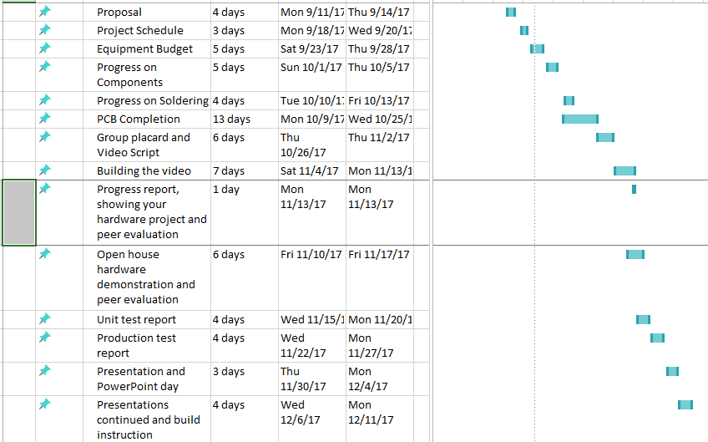
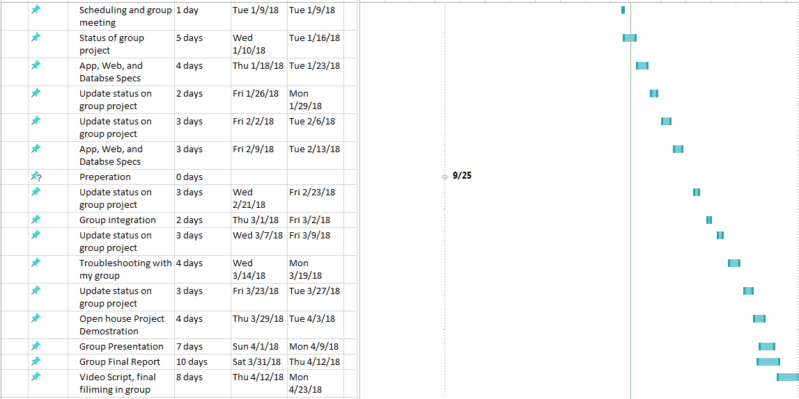
Schedule

Slide 5
Related Course from previous Semesters
CENG 153 Technical C
CENG 212 Programming Techniques in Java
CENG 216 Introduction to Software Engineering
CENG 254 Database with Java
CENG 256 Internet Programming
CENG 317 Hardware Production Technology
CENG 319 Software Project

Slide 6
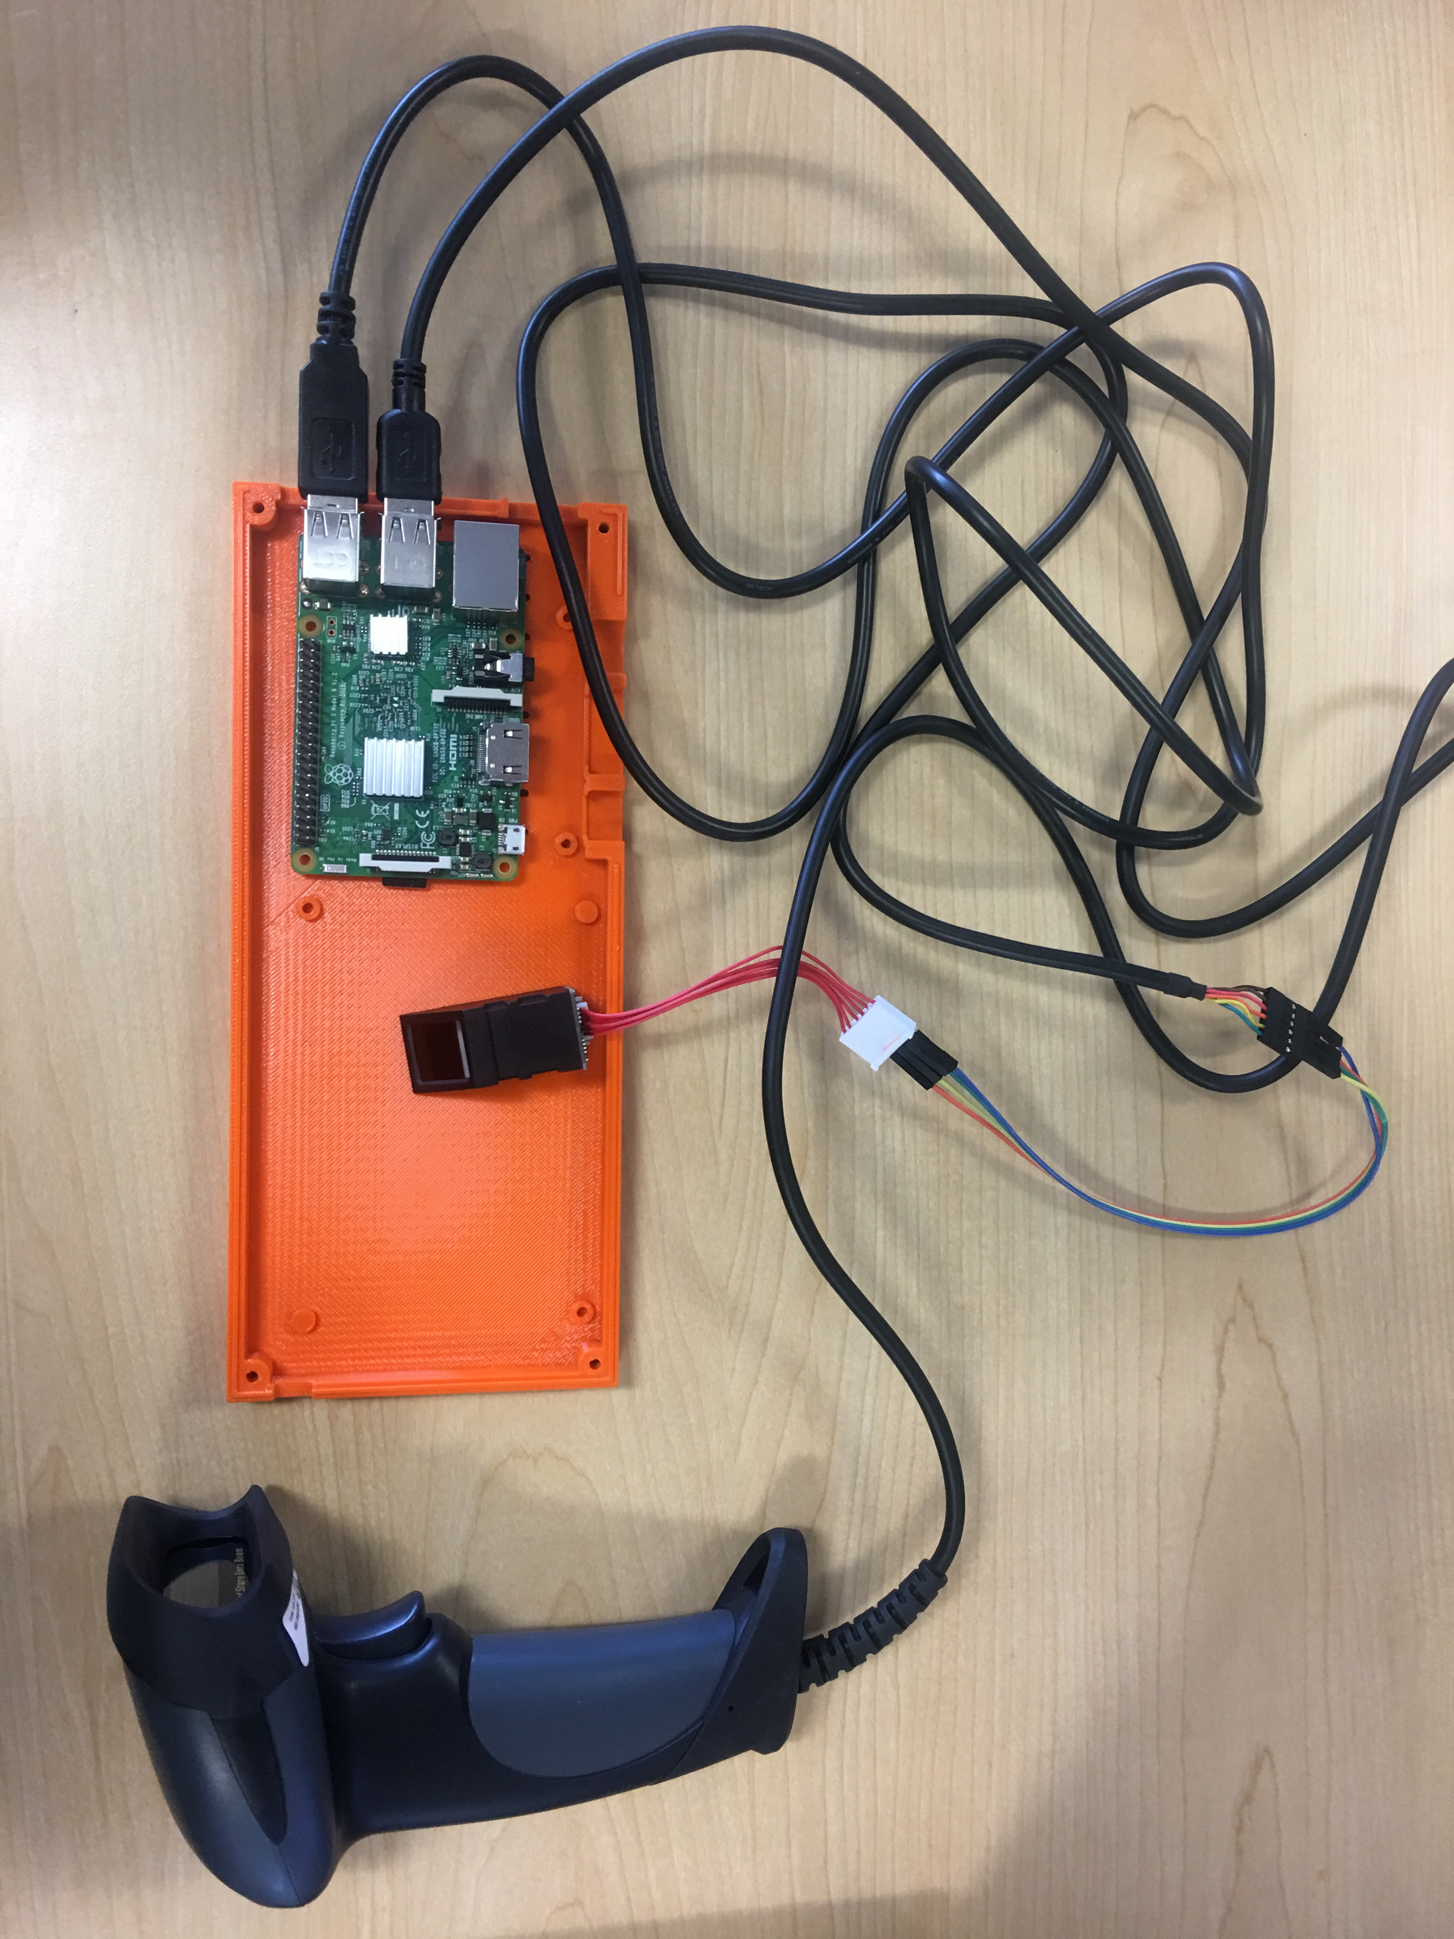
View of the hardware

Slide 7
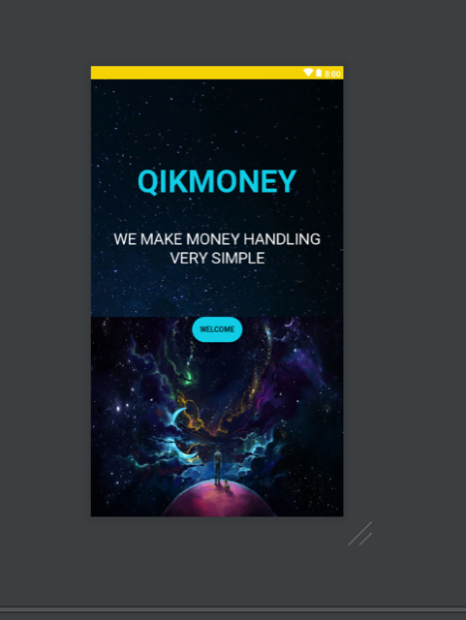
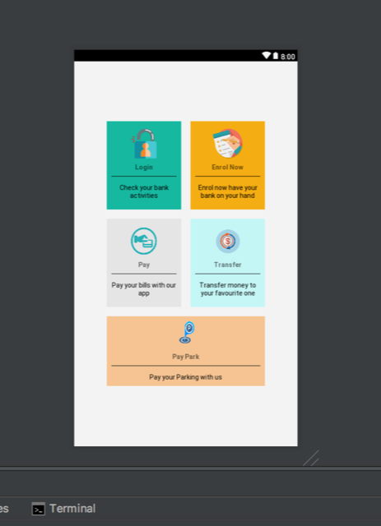
Software/Mobile application

Slide 8
Demonstration

Slide 9
Thank You for your time ☺
Ramya Radhakrishnakumar
Sushant Sharma
Vinokkumar Uthayakumar

