Slide 1
Telecom Churn Analysis
Ramya Raghavan
MB28
Final Project – I

Slide 2
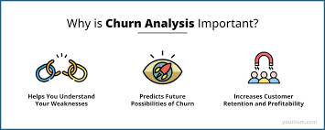
Project Details
Project Title | Analyzing Telecom Churn Data for Business Insights and Predictive Modeling
Skills | Data Cleaning, Data Visualization, Predictive Modelling, Business Insight Generation
Domain | Telecom
Industry Context:
Customer churn is a critical metric for telecom businesses impacting profitability.
High churn leads to increased acquisition costs, revenue loss, and reduced market share.
Project Focus:
Analyze a telecom churn dataset to derive actionable insights.
Understand factors driving customer attrition.
Methods Used:
Exploratory Data Analysis (EDA): Identify patterns, trends, and key drivers of churn.
Machine Learning: Develop a predictive model to identify customers likely to churn.
Objective:
Reduce churn rates by understanding customer behavior.
Enable proactive retention strategies by predicting at-risk customers.

Slide 3
Project Objective
Data Understanding
Analyse customer data, including demographic, behavioural, and service-related attributes (e.g., account length, international plan, usage metrics, customer service calls, etc.).
EDA in Python
Perform Exploratory Data Analysis using Python to uncover patterns, correlations, and trends in the dataset.
Feature Engineering
Identify and pre-process relevant features (e.g., service usage, customer support interaction) to improve model accuracy.
Predictive Modelling
Build and evaluate classification models (e.g., Logistic Regression, Random Forest, XGBoost) to predict customer churn based on provided attributes.
Business Insights
Generate actionable insights to minimize churn and improve customer retention strategies, focusing on high-risk customers identified by the model.
Tools/Packages
pandas, numpy, matplotlib, seaborn, scikit-learn, XGBoost.

Slide 4
Project Steps
Data Understanding & Preparation
Clean and organize data to remove inconsistencies.
Categorize customer features (e.g., services, usage).
Exploratory Insights
Identify usage patterns linked to churn.
Highlight key problem areas (e.g., frequent service calls).
Feature Prioritization
Pinpoint high-impact factors (e.g., international plans, service quality).
Eliminate noise to focus on what matters most.
Predictive Modeling
Build models to predict churn likelihood.
Test and validate accuracy to ensure reliability.
Business Insights
Segment customers by churn risk.
Recommend proactive retention actions (e.g., tailored plans, improved service).
Dataset Overview
Customer Information
  State, Account Length, Area Code
Service Plans
  International Plan, Voice Mail Plan
Usage Metrics:
  Day, Evening, Night, International Calls/Minutes/Charges
Customer Interaction:
  Customer Service Calls, Churn Indicator

Slide 5
Project Steps
Tools for Analysis
Data Analysis
Python with pandas and numpy
Visualization
Graphs and trends using matplotlib and seaborn
Predictive Models
Logistic Regression, Random Forest, XGBoost
Actionable Outcomes
Retention Strategies
Focus on high-risk customers with personalized offers.
Address service dissatisfaction to prevent churn.
Improved Decision-Making
Use insights to inform long-term business strategies.
Conclusion
By harnessing the power of data-driven insights, this analysis equips the business to proactively combat customer churn, strengthen loyalty, and maximize profitability.
The actionable recommendations derived from this project will enable smarter decision-making, empower retention strategies, and secure a competitive edge in the market.

Slide 6
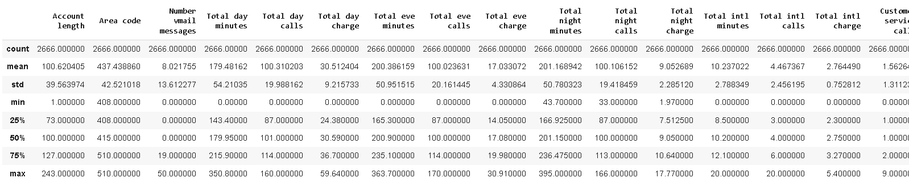
Univariate Analysis
describe() is used with pandas DataFrames to generate summary statistics of the data in a DataFrame. When we call tr_df.describe(), it provides an overview of the numerical columns (by default) in the DataFrame tr_df.
tr_df.describe()
Output of tr_df.describe() includes
count,mean,std,min,25% (1st quartile),50% (median or 2nd quartile),75% (3rd quartile),max

Slide 7
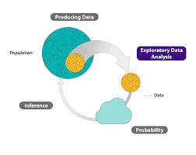
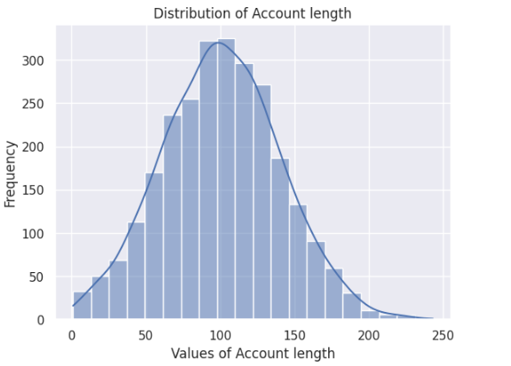
Univariate Analysis
Distribution of Customer tenure
Short Tenure:
Majority of customers have tenures under 50 months.
Long-Term Loyalty: A peak around 300 months indicates a segment of loyal, long-term customers.
Focus Areas:
Improve retention for new customers.
Nurture long-term relationships to sustain loyalty and maximize lifetime value.

Slide 8
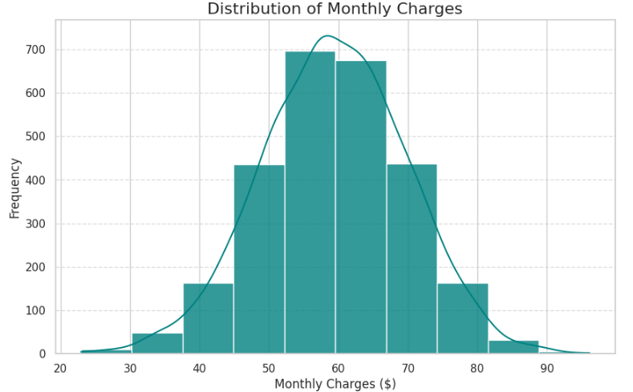
Univariate Analysis
Monthly charges distribution
Customer Behavior
High variability in variables like Total day charge or Monthly Charges could indicate different usage patterns.
Churn Prediction
Examining Customer service calls or International plan could reveal relationships with churn behavior in future analyses.
Targeted Marketing
Insights into categorical variables (e.g., most customers without an International plan) can guide campaigns.
Monthly charges starts in the range of $20-$30 and peaks at $60 + and finally winds up at 90$

Slide 9
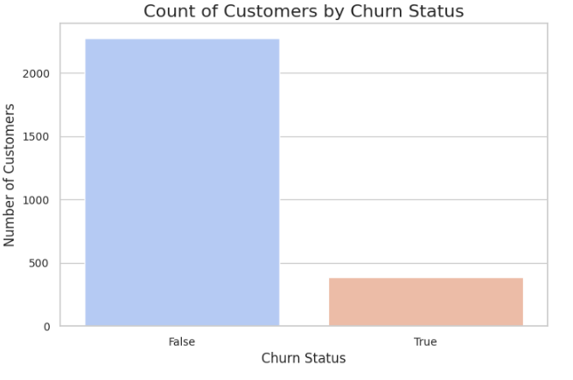
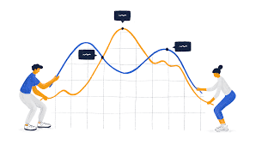

Univariate Analysis
Count of Customers by Churn status

Slide 10
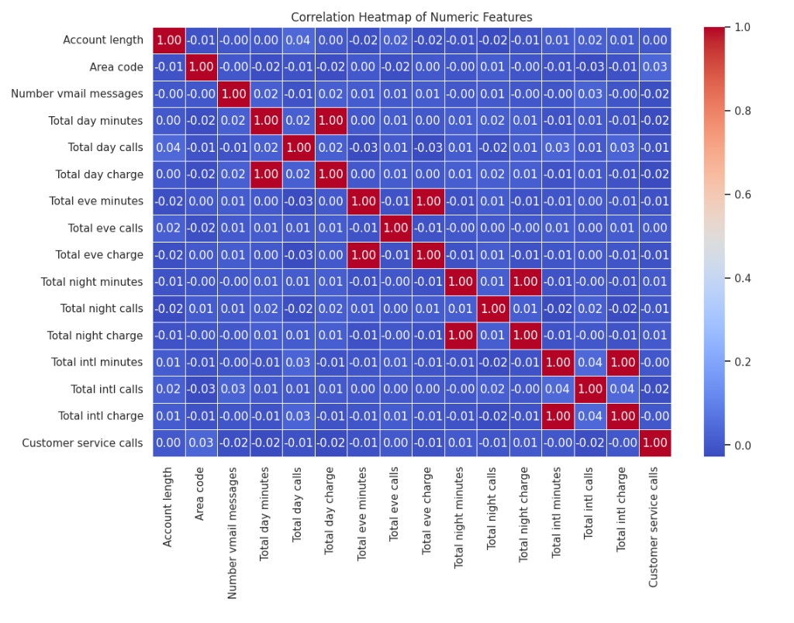

Bivariate Analysis

Slide 11
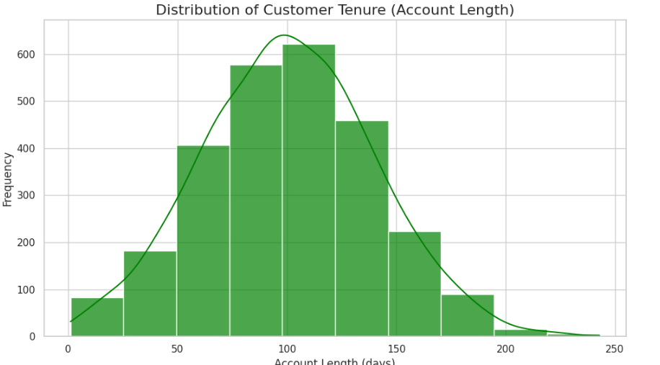
Distribution Analysis
Account length distribution
The histogram reveals that customer tenure (account length) is distributed across a broad range of values.
The distribution appears normal, with a peak around 100 days, suggesting that most customers tend to have a tenure of this duration.
A smaller percentage of customers have very short or very long tenures, as shown by the tails of the distribution.
The presence of a smooth Kernel Density Estimate (KDE) overlay highlights the trend and aids in identifying the underlying patterns more clearly.
The insights from this distribution can help identify customer retention strategies.
For example, customers with short tenures might require targeted interventions to increase retention rates.

Slide 12
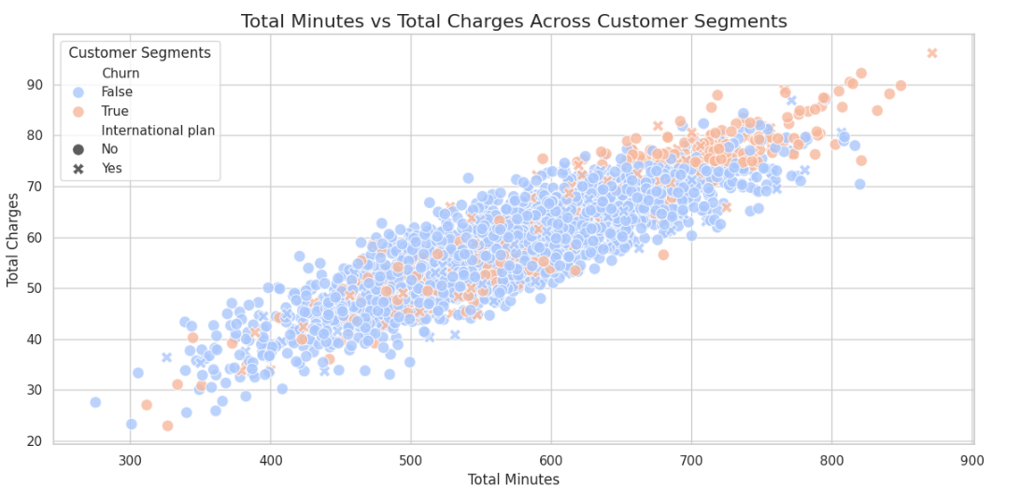
Distribution Analysis
Minutes and Charges distribution
Usage vs. Charges
Total minutes and charges show a strong positive correlation, with higher usage leading to higher charges.
Churn Behavior
Churned customers often have higher total minutes and charges, suggesting dissatisfaction with costs.
International Plan Impact
Customers with an international plan generally incur higher charges compared to those without it.
Outliers
A few customers exhibit unusually high usage or charges, indicating potential dissatisfaction or unique needs.
Actionable Insight
Retention strategies like discounts, loyalty rewards, or personalized plans could target high-usage churners to improve customer retention.

Slide 13
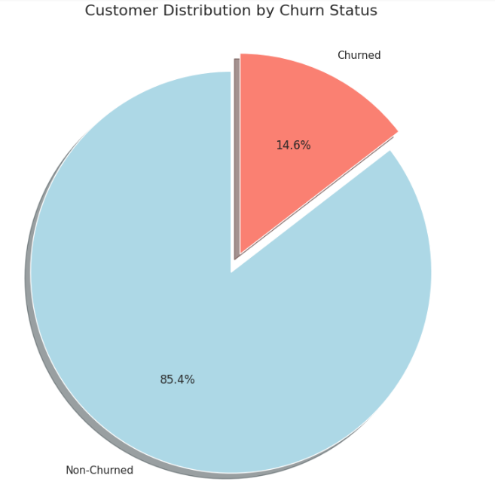
Distribution Analysis
Churn status Distribution
Churn Distribution
14.6% of customers are churned, while 85.4% are non-churned, indicating strong customer retention with a minor churn issue.
Business Implication
The churn rate suggests a need for targeted strategies to address dissatisfaction and retain at-risk customers.
Actionable Steps
Offer loyalty rewards and personalized plans to reduce churn.
Analyze churn drivers and replicate successful retention practices across the customer base.

Slide 14
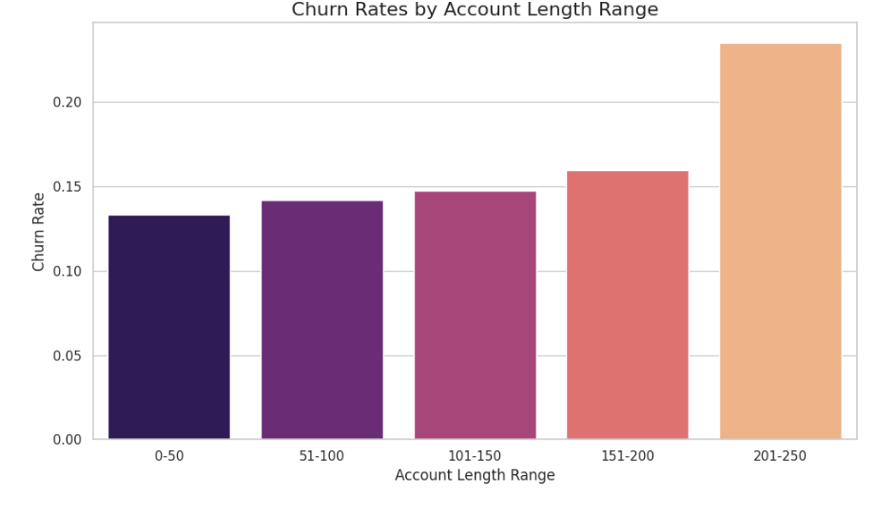
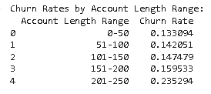
Business Insights
Churn Rate by Contract Type
Early Retention:
Focus on 51-150 range customers by improving engagement, addressing common pain points, and enhancing mid-term satisfaction.
Provide regular check-ins, service updates, and tailored offers to maintain interest.
Long-Term Loyalty:
For 151-250 range customers, implement loyalty programs, introduce value-added services, and address potential dissatisfaction proactively’
Regularly assess customer feedback to adapt services and ensure long-term retention.
This analysis highlights a gradual rise in churn with account length, emphasizing the need for lifecycle-based customer retention strategies.

Slide 15
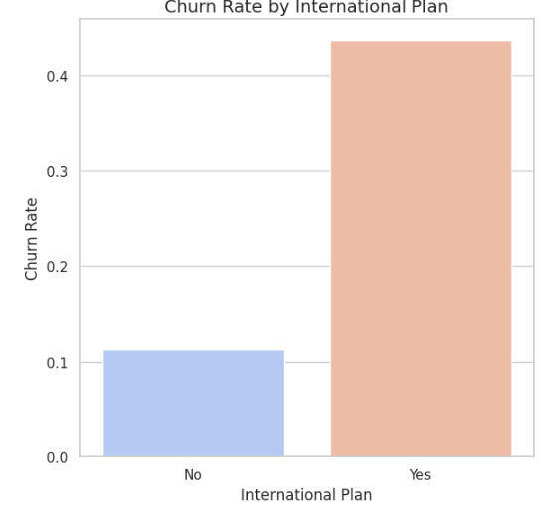

Business Insights
Churn rate by International Plan
International Plan and Churn
Customers with an International Plan tend to have a higher churn rate compared to those without it.
This indicates that offering or managing international plans might require additional focus to improve customer retention.
Actionable Recommendations
Analyze customer feedback for international plans to address potential dissatisfaction.

Slide 16
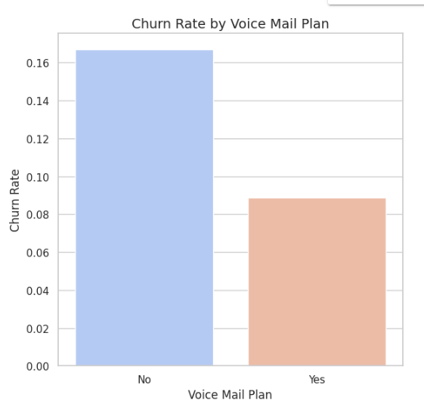

Business Insights
Churn rate by Voice Mail Plan
Voice Mail Plan and Churn
Customers with a Voice Mail Plan show a lower churn rate than those without it.
This suggests that voice mail plans may contribute positively to customer satisfaction and retention.
Actionable Recommendations
Highlight the benefits of voice mail plans to encourage adoption, as it seems to correlate with reduced churn.

Slide 17
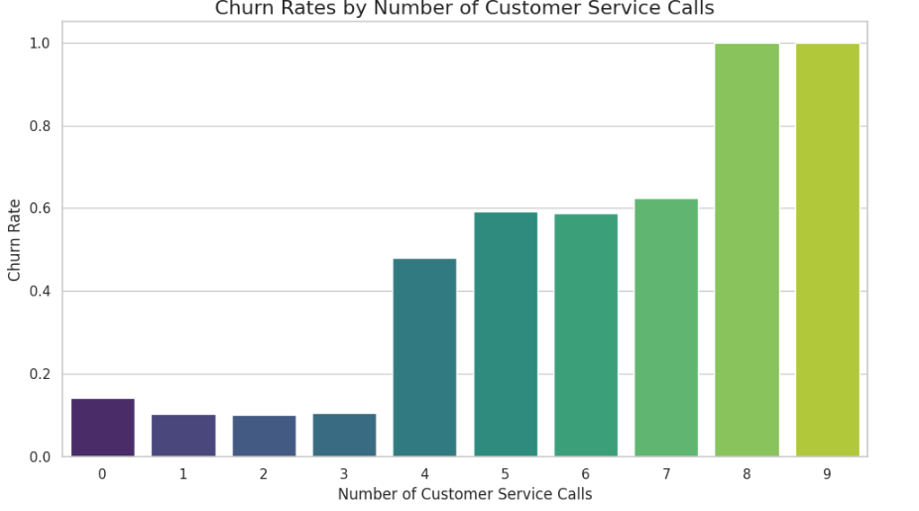
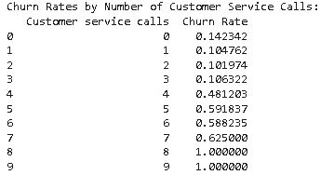
Business Insights
Customer Service Call Impact
Churn Increases with Customer Service Calls
Higher numbers of customer service calls are associated with increased churn rates. This suggests that frequent interactions with customer service may indicate unresolved issues or dissatisfaction, leading to customer churn.
Recommendation
Improve Customer Support Quality: Focus on resolving customer issues effectively and efficiently during initial interactions to enhance satisfaction and reduce churn.

Slide 18
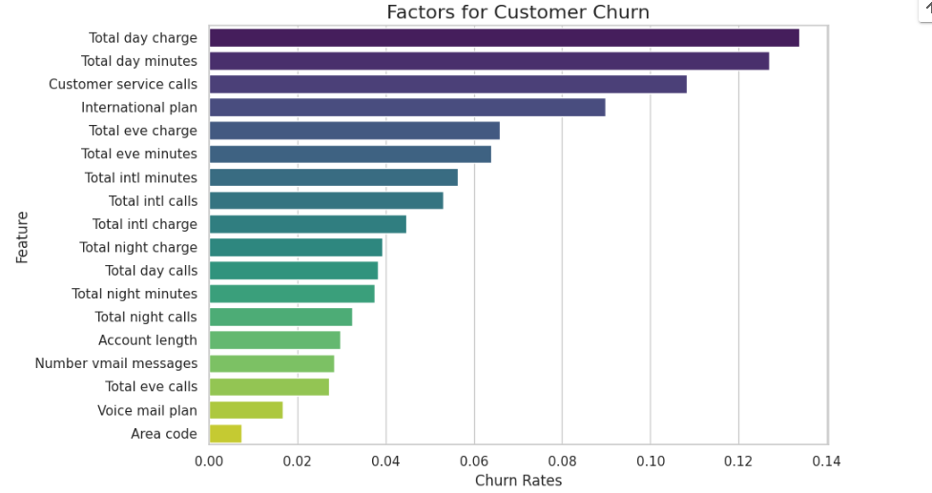
Classification Modeling
Feature Selection
The top features impacting churn are
Total Day Charge: Higher day charges are strongly correlated with churn, indicating potential dissatisfaction with pricing.
Total Day Minutes: Heavy daytime usage contributes significantly to churn, possibly due to higher costs or unmet expectations.
Customer Service Calls: Frequent calls to customer service suggest unresolved issues or dissatisfaction, which leads to higher churn rates.
Recommendation
Pricing Optimization: Review and adjust pricing structures for daytime usage to improve customer retention.
Proactive Engagement: Identify heavy daytime users and provide targeted plans or offers to address potential concerns.
Improve Support: Enhance customer service quality and resolve issues efficiently to lower churn among dissatisfied customers.

Slide 19
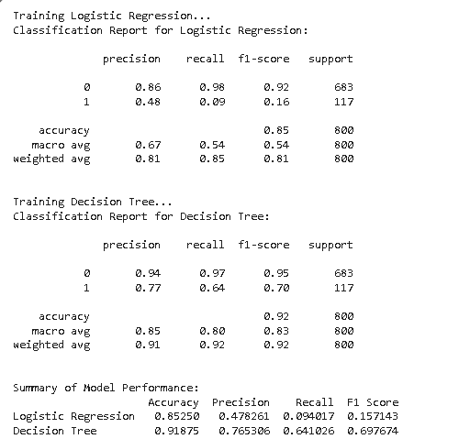
Classification Modeling
Model Development
Model Performance:
Decision Tree outperforms Logistic Regression with higher accuracy (92% vs. 85%) and better metrics across all classes.
Class 0 (Non-Churners):
Both models handle non-churners well, but Decision Tree achieves slightly better precision (94%) and recall (97%).
Class 1 (Churners):
Decision Tree identifies churners more effectively with higher precision (77%) and recall (64%) compared to Logistic Regression (48% precision, 9% recall).
Recommendation:
Use Decision Tree for churn prediction due to its superior handling of both churners and non-churners.
Improve churner recall with oversampling or advanced techniques for further refinement.

Slide 20
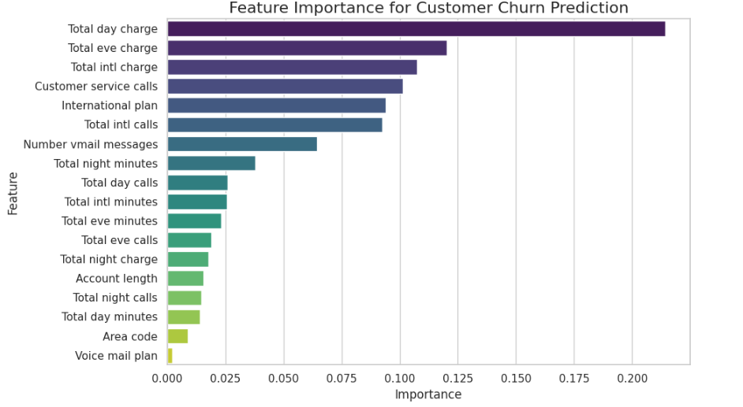
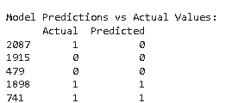
Classification Modeling
Model Interpretation
False Negative (Row 2087)
The model missed predicting a churner (actual 1, predicted 0). This is a false negative, indicating a missed opportunity for retention efforts.
True Positive (Row 1898)
The model correctly predicted a churner (actual and predicted 1), leading to a true positive.
True Negatives (Rows 1915 & 479)
Both non-churners were correctly predicted as non-churn (actual and predicted 0), representing true negatives.
Key Takeaways
The model performs well at predicting non-churners but struggles to predict churners accurately, as seen with the false negative.
Recommendation
Improve recall for churners by adjusting thresholds or using techniques like oversampling to better capture churners in the training process.

Slide 21
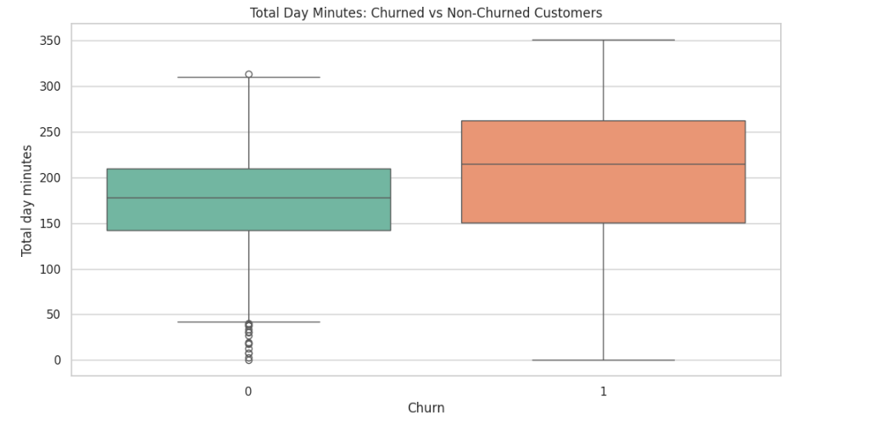
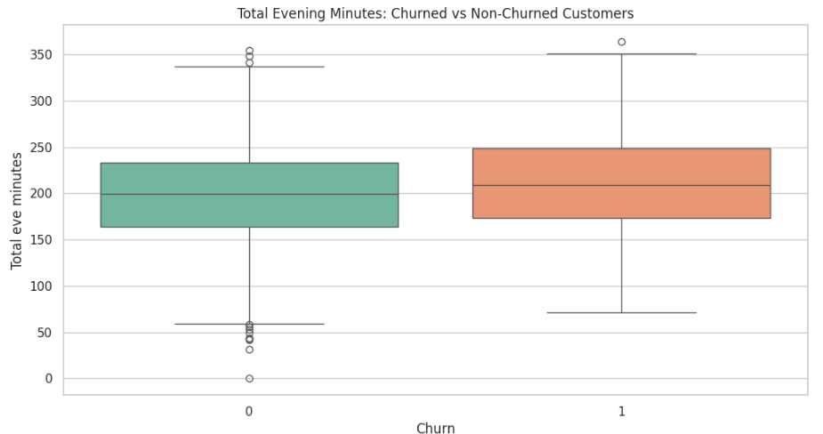
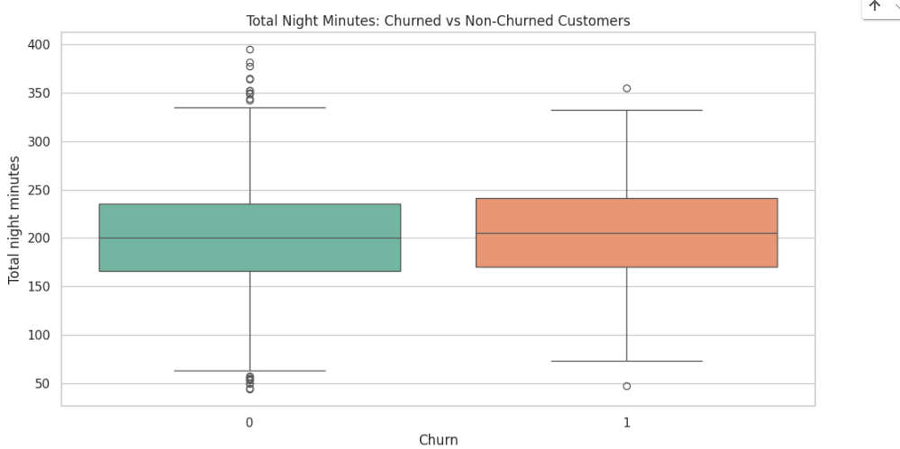
Usage Patterns
Usage pattern between churned and non churned customers
Day Usage: Churned customers tend to have significantly higher day usage, making it a strong predictor of churn.
Evening Usage: Churned customers also show slightly higher evening usage, but the effect is less distinct.
Night Usage: Usage during the night does not show a significant difference between the two groups.
Recommendations:
Investigate customer satisfaction for high-usage day and evening customers. These groups might experience dissatisfaction due to high costs or service issues.
Consider providing incentives or discounts for customers with high day and evening usage to reduce churn likelihood.
Use these insights as features in a predictive model to identify customers likely to churn based on their usage patterns.

Slide 22
Analysis Outcomes
Customer Tenure and Behavior
Short Tenure
Most customers have tenures under 50 months, requiring early engagement strategies.
Long-Term Loyalty
Peaks around 300 months show a loyal customer base requiring nurturing.
Tenure Distribution
A peak around 100 months suggests that most customers fall in this range, with fewer in very short or long tenures.
Usage Patterns
Usage vs. Charges
Strong positive correlation between total minutes and charges; higher usage leads to higher costs.
Churned Customers
Higher total minutes and charges, indicating dissatisfaction with pricing or service.
Churn Distribution
14.6% churned and 85.4% non-churned customers, showing strong retention but room for improvement.
Account Length
Churn rates gradually rise with account length, peaking for customers in the 151-250 range.
International Plan
Customers with an international plan show higher churn rates.
Voice Mail Plan
Customers with a voice mail plan have lower churn rates.
Customer Service Calls
Increased calls correlate with higher churn rates, indicating unresolved issues.

Slide 23

Analysis Outcomes
Feature Impact on Churn
Key Drivers
Total Day Charge
Higher charges lead to churn due to dissatisfaction.
Total Day Minutes
Heavy daytime usage is linked to churn, likely due to costs or unmet needs.
Customer Service Calls
Frequent calls signify dissatisfaction.
Model Performance
Decision Tree
Superior performance with 92% accuracy, excelling in predicting both churners and non-churners.
Logistic Regression
Lower performance (85% accuracy), particularly for predicting churners.
Error Analysis
False Negatives
Missed churners highlight areas for improvement.
True Positives/Negatives
Correctly predicted cases show reliability in identifying non-churners.

Slide 24
Recommendations
Retention Strategies
Short Tenure
Target new customers (0-50 months) with personalized engagement and incentives.
Mid-Tenure (51-150 months)
Improve engagement and address dissatisfaction with tailored offers.
Long-Term Loyalty
Implement loyalty programs and proactively address potential issues for 151-250 month customers.
Usage and Charges
Pricing Optimization: Adjust pricing structures for heavy daytime users to reduce churn.
Targeted Plans: Offer discounts or personalized plans for high-usage customers.
Churn Mitigation:
Customer Service
Enhance support quality to resolve issues efficiently, reducing dissatisfaction and churn.
International Plan
Analyze customer feedback and improve offerings to address concerns with international plans.
Voice Mail Plans
Promote voice mail plans as they correlate with reduced churn.

Slide 25
Recommendations
Model Improvement
Decision Tree Usage
Use Decision Tree for churn prediction due to its higher accuracy and recall for churners.
Enhance Recall
Address false negatives by adjusting thresholds, oversampling, or using advanced techniques.
Business Actions:
Early Retention:
Focus on retaining new customers with proactive support and tailored services.
Customer Segmentation
Use insights into usage patterns and tenure distribution to guide targeted marketing.
Feedback Analysis
Regularly analyze customer feedback to adapt offerings and address dissatisfaction
These insights and recommendations provide a clear roadmap for improving customer retention and refining churn prediction strategies.

Slide 26


